Slide 1

INTERNAL INFORMATION

Slide 2
HOW TO USE THE TRAINING MODULE
The Power Beauty HR training tool has been designed to be adapted to sessions taking place in training rooms or at point of sale.
Recommendations:
1 day format HR POWER BEAUTY, Since 1902 – complete module
½ day format The brand / The HR must have / Focus Skin care, Complexion, Mascara / HR Sales advice
2hr “Must Have” format The brand / The HR must have / HR Sales advice / Latest news
2hr Skin care format HR skin care / Sensorial discovery / HR Sales advice
2hr Make-up format HR make-up / Focus Complexion, Lash Queen, Wanted Rouge / HR Sales advice
“Must Have” coaching HR Must have / Sensorial discovery & key words / HR Sales advice
(at the point of sale)
Global objective: orient the training with sales advice as the priority following on with skin care and make-up sales
Notes:
Sequence 1: Power beauty since
Tool : slideshow

Slide 3
HOW TO CONDUCT THE TRAINING
Encourage maximum participation during the training day by using all the tools created to favor interactive learning , sales advice, sensorial discoveries…
In order to do this, we strongly advise you to use the activities contained in the module (shortening the detailed explanations of product technology if necessary – focus uniquely on the star active ingredients):
Table & set of 10 “key HR dates” cards
3 sensorial discovery workshops by combining product texture trial and key words (set of 27 cards)
Before & after Beauty Revelations
Hands-on make-up workshop (if possible) with focus on face / eyes / lips
Any extra initiatives are welcome!
Notes:
Sequence 1: Power beauty since
Tool : slideshow

Slide 4
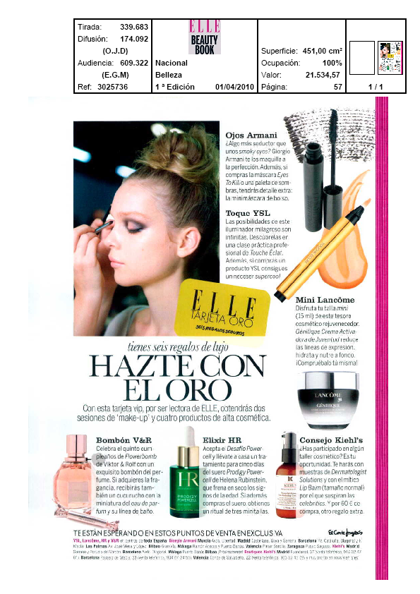
HOW TO USE HR’S LATEST NEWS
We have selected some of HR’s latest news, such as press launches, films and in women’s magazines.
We encourage you to regularly complete / up-date this section by inserting information on your own initiatives (roadshows, evenings, press meetings, coverage etc.) in order to share all of the brand’s latest news with your Beauty Advisors.
Notes:
Sequence 1: Power beauty since
Tool : slideshow

Slide 5
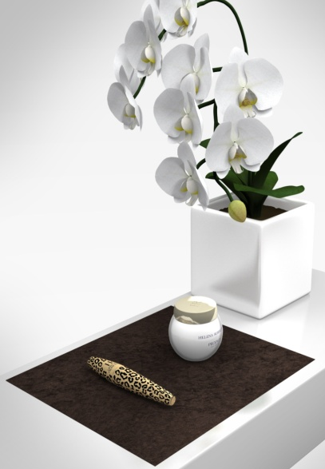
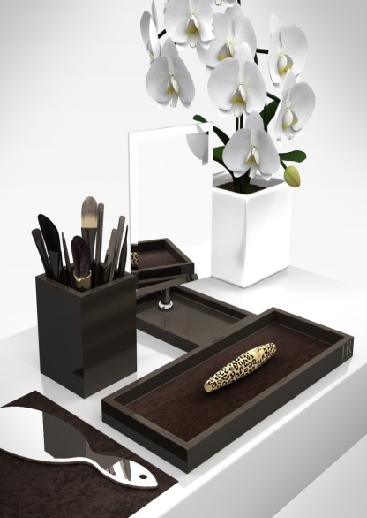
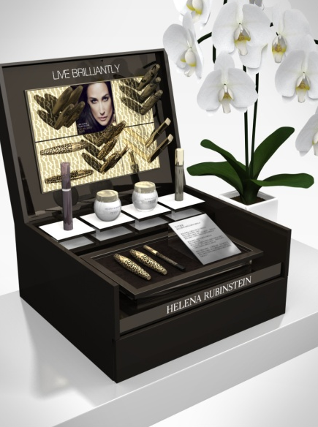
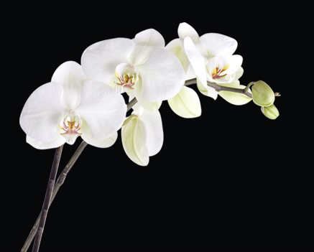
THE TRAINING ROOM
Respect color and material codes of the HR brand: taupe, white and gold.
Use HR Beauty Party accessories and merchandising elements to present products, the mirror, …
Add a touch of femininity with white orchids, the emblematic flower of the brand
Display star launch visuals: Prodigy Powercell / LQ Sexy Blacks,…
Do not overload the room with “Feline Blacks” decorative elements (leopard motif )
Notes:
Sequence 1: Power beauty since
Tool : slideshow

Slide 6
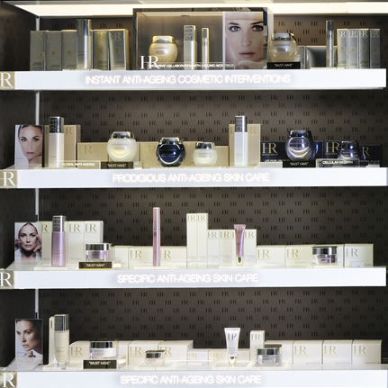




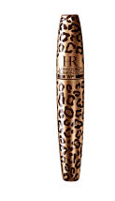

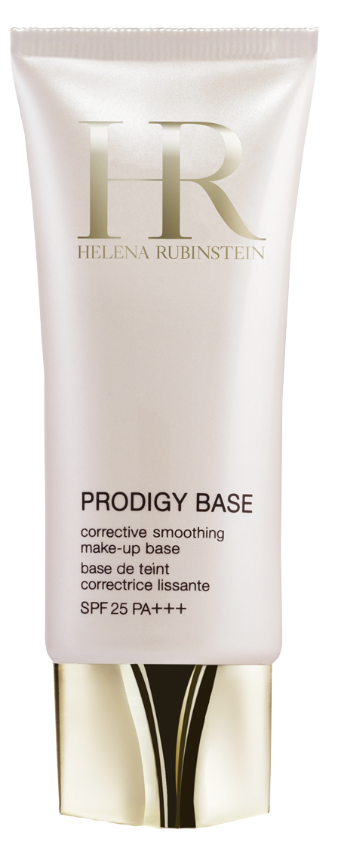

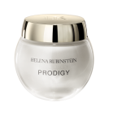



THE TRAINING ROOM
Plan generous merchandising with products by axe (following the HR merchandising charter)
Provide note pads, training booklets, sales bags, pedagogical tools according to the elements included in the Power Beauty training coffret
Play background music when welcoming participants and during breaks (music from the HR brand film, Wanted or lounge music)
BA gift at the end of the training: select products amongst our 3 star launches and “must have” products

Slide 7
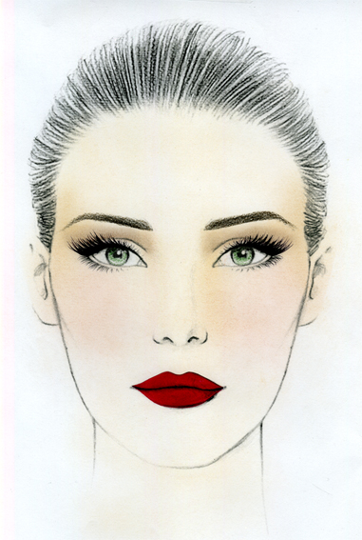
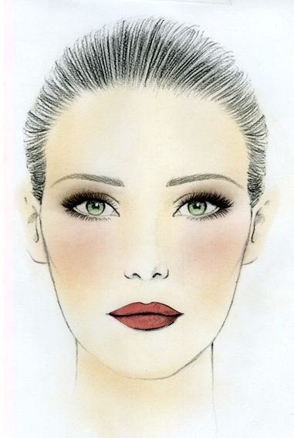
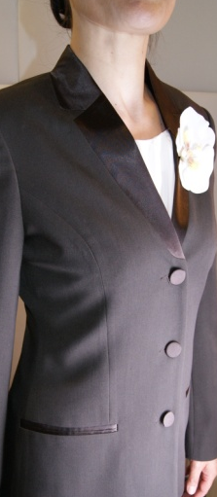
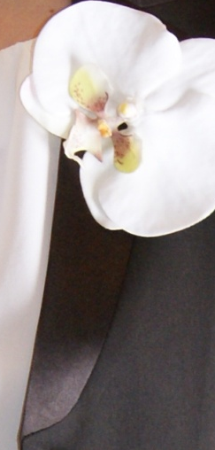
TRAINER GROOMING
Make-up:
We recommend these two types of make-up which will suit most women.
Hair should be simply, elegantly styled to highlight the face.
Clothing:
We recommend wearing either the HR uniform or an outfit with neutral and dark colors with an orchid brooch.
Wanted Rouge 101
Wanted Rouge 002
Eye make-up based on precise lines and neutral shades to highlight a stronger shade of lipstick.
Eye make-up based on gently shaded color, with no visible lines, to highlight “natural” lips.
Uniforms

