Slide 1

FROM AESTHETIC MEDICINE TO HR SKINCARE EXPERTISE KNOWLEDGE TEST
LAST NAME:………………………………..
FIRST NAME: ………………..……………..
TRAINING DATE: …./…./……..
SCORE: /20
/25
PART 1: SKIN BIOLOGY
1) The total surface area of the skin is:
1 m²
2 m²
4 m²
2) It weighs:
2 kg
4 kg
6 kg
3) What is the thickness of adult skin?
1.2 mm
3 mm
4 mm
7) Which cells are found in the dermis?
Melanocytes
Fibroblasts
Adipocytes
8) Where in the skin are wrinkles formed?
………………………………………………………….
………………………………………………………….
/1
/1
/1
/1
9) What do fibroblasts synthesize? (several right answers)
Keratinocytes
Collagen
Elastin
Melanocytes
/1
/2
4) The skin is composed of:
2 layers
3 layers
4 layers
5) How many layers are there in the epidermis?
3 layers
4 layers
5 layers
6) What makes up the majority of the epidermis?
Adipocytes
Water at 80%
Keratinocytes
/1
10) What is the name of the cell that synthesises melanin?
Keratinocyte
Melanocyte
Fibroblast
/1
/1
11) What role do the adipocytes play in the hypodermis?
Accumulate and store fat
Ensure that skin is renewed
Synthesise keratin
/1
/1
1

Slide 2
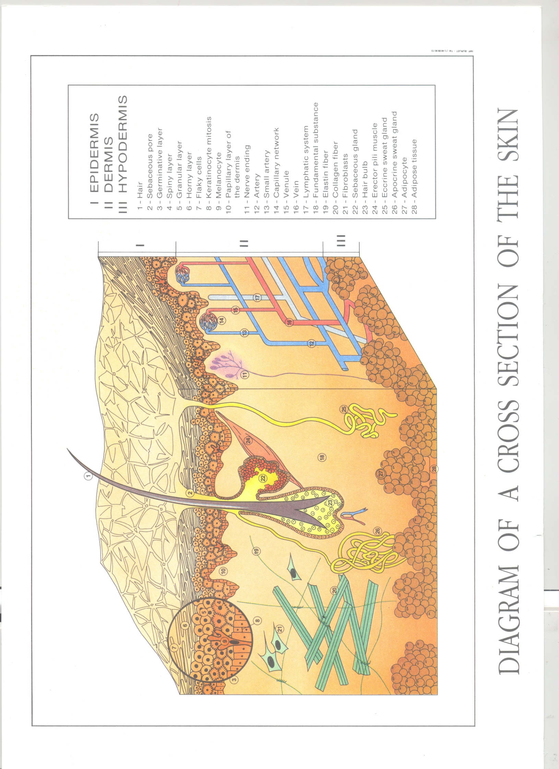
FROM AESTHETIC MEDICINE TO HR SKINCARE EXPERTISE KNOWLEDGE TEST
12) Fill in the diagram of the cross-section of skin below:
I
4
2
1
II
3
7
8
5
6
9
III
10
SKIN LAYERS:
I: …………………………………………………………………
II: ………………………………………………………………..
III: ……………………………………………………………….
/3
/10
COMPONENTS OF THE SKIN:
1: ………………………………………………………………..
2: ………………………………………………………………..
3: ………………………………………………………………..
4: ………………………………………………………………..
5: ………………………………………………………………..
6: ………………………………………………………………..
7: ………………………………………………………………..
8: ………………………………………………………………..
9: ………………………………………………………………..
10: ………………………………………………………………..
2

Slide 3

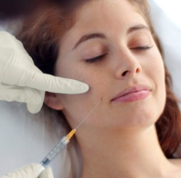


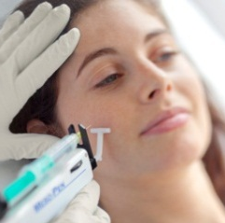

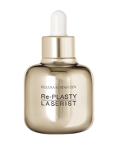
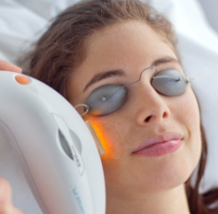
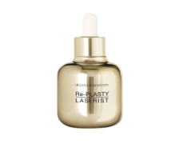

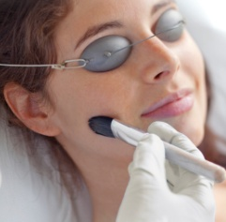
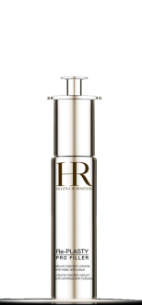
FROM AESTHETIC MEDICINE TO HR SKINCARE EXPERTISE KNOWLEDGE TEST
PART 2: AESTHETIC MEDICINE PROCEDURES AND HR SOLUTIONS
/115
13) Please give a basic definition of aesthetic medicine.
………………………………………………………………………………………………………………………………………………………………………………………………………………………………………………………………………………………………………………………………………………………………………………………………………………
14) What is the difference between aesthetic medicine and aesthetic surgery?
……………………………………………………………………………..………………………………………………………………………………
……………………………………………………………………………….
……………………………………………………………………………….
15) Which aesthetic medicine procedure inspired Re-PLASTY Mesolift?
……………………………………………………………………………….
Give the definition of the procedure:
…………………………………………………………………………….…………………………………………………………………………..……………………………………………………………………………….
16) Which aesthetic medicine procedure inspired Re-PLASTY Mesolift?
……………………………………………………………………………….
Give the definition of the procedure:
…………………………………………………………………………….…………………………………………………………………………………………………………………………………………………………….
17) Which aesthetic medicine procedure inspired Re-PLASTY Pro Filler?
……………………………………………………………………………….
Give the definition of the procedure:
…………………………………………………………………………….…………………………………………………………………………….……………………………………………………………………………….
18) Which aesthetic medicine procedure inspired Re-PLASTY HD Peel?
……………………………………………………………………………….
Give the definition of the procedure:
…………………………………………………………………………….…………………………………………………………………………….……………………………………………………………………………….
19) Match the aesthetic medicine procedures to the products:
/2
/2
/4
/2
/2
/2
/2
3

Slide 4
FROM AESTHETIC MEDICINE TO HR SKINCARE EXPERTISE KNOWLEDGE TEST
/2
20) Give the key actions performed by Re-PLASTY Mesolift, and at least 2 active ingredients, as well as the results the products has on the skin:
………………………………………………………………………………………………………………………………………………………………………………………………………………………………………………………………………………………………………………………………………………………………………………………………………………
……………………………………………………………………………………………………………………………………
21) Give the key actions performed by Re-PLASTY Laserist, and at least 2 active ingredients as well as the results the products has on the skin:
…………………………………………………………………………………………………………………………………………………………………………………………………………………………………………………………………………
……………………………………………………………………………………………………………………………………
……………………………………………………………………………………………………………………………………
22) Give the key actions performed by Re-PLASTY HD Peel, and at least 2 active ingredients as well as the results the products has on the skin:
…………………………………………………………………………………………………………………………………………………………………………………………………………………………………………………………………………
……………………………………………………………………………………………………………………………………
……………………………………………………………………………………………………………………………………
23) Give the key actions performed by Re-PLASTY Pro Filler, and at least 2 active ingredients as well as the results the products has on the skin:
…………………………………………………………………………………………………………………………………………………………………………………………………………………………………………………………………………
……………………………………………………………………………………………………………………………………
……………………………………………………………………………………………………………………………………
24) What is the name of Doctor Pfulg's secret?
……………………………………………………………………………………………………………………………………
What are the actions, active ingredients and results of this product?
……………………………………………………………………………………………………………………………………
……………………………………………………………………………………………………………………………………
/2
/2
/2
/3
4

Slide 5

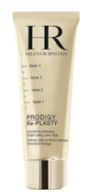

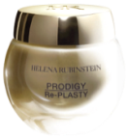

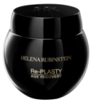
FROM AESTHETIC MEDICINE TO HR SKINCARE EXPERTISE KNOWLEDGE TEST
/5
25) Which Re-PLASTY routine would you recommend to a customer with dark spots, redness and imperfections? (check the boxes below)
Mesolift
HD Peel
MORN.
……X / week
EVE.
/5
26) Which Re-PLASTY routine would you recommend to a customer with wrinkles and a loss of volume and elasticity? (check the boxes below)
Mesolift
HD Peel
+
MORN.
……X / week
EVE.
/5
27) Which Re-PLASTY routine would you recommend for a customer with a dull complexion and a sagging face? (check the boxes below)
Mesolift
HD Peel
+
MORN.
……X / week
EVE.
5

Slide 6
FROM AESTHETIC MEDICINE TO HR SKINCARE EXPERTISE KNOWLEDGE TEST
/5
28) Which Re-PLASTY routine would you recommend to a customer with irregular skin texture and fine lines? (tick the boxes below)
Mesolift
HD Peel
MORN.
……X / week
EVE.
/10
29) Match the concerns below with the corresponding products:
DARK SPOTS
LOSS OF VOLUME
WRINKLES
IRREGULAR SKIN TEXTURE
DULL COMPLEXION
REDNESS
IMPERFECTIONS
FINE LINES
LOSS OF ELASTICITY
SAGGING FACE
6

Slide 7


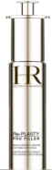
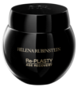
FROM AESTHETIC MEDICINE TO HR SKINCARE EXPERTISE KNOWLEDGE TEST
30) What is the general hook for the Re-PLASTY range?
………………………………………………………………………………………………………………………………………………………………………………………………………………………………………………………………………………………………………………
………………………………………………………………………………………………………………………………………………………………………………………………………………………………………………………………………………………………………………
31) What is the hook for Re-PLASTY Mesolift?
……………………………………………………………………………………………………………………………………………………………………………………………………………………………………………………………………………………………………………..
………………………………………………………………………………………………………………………………………………………………………………………………………………………………………………………………………………………………………………
32) What is the hook for Re-PLASTY HD Peel?
………………………………………………………………………………………………………………………………………………………………………………………………………………………………………………………………………………………………………………………………………………………………………………………………………………………………………………………………………………………………………………………………………………………………………………………………………………………………
33) What is the hook for Re-PLASTY Laserist?
………………………………………………………………………………………………………………………………………………………………………………………………………………………………………………………………………………………………………………………………………………………………………………………………………………………………………………………………………………………………………………………………………………………………………………………………………………………………
34) What is the hook for Re-PLASTY Pro Filler?
…………………………………………………………………………………………………………………………………………………………………………………………………………………………………………………………………………………………………………….. ………………………………………………………………………………………………………………………………………………………………………………………………………………………………………………………………………………………………………………
35) Give the hook for Re-PLASTY Age Recovery.
………………………………………………………………………………………………………………………………………………………………………………………………………………………………………………………………………………………………………………………………………………………………………………………………………………………………………………………………………………………………………………………………………………………………………………………………………………………………
/3
/3
/3
/3
/3
/3
7

Slide 8
FROM AESTHETIC MEDICINE TO HR SKINCARE EXPERTISE KNOWLEDGE TEST
36) Give at least 3 reasons to use Re-PLASTY MESOLIFT (link with aesthetic medicine).
1:………………………………………………………………………………………………………………………………………………….
……………………………………………………………………………………………………………………………………………………………………………………………………………………………………………………………………………………………………………………………………………………………………………………………………………………………………………………………………………………………………………………………………………………………………………………………………………………
2:………………………………………………………………………………………………………………………………………………….
…………………………………………………………………………………………………………………………………………………………………………………………………………………………………………………………………………………………………………………………………………………………………………………………………………………………………………………………………………………………………………………………………………………………………………………………………………………….
3:………………………………………………………………………………………………………………………………………………….
……………………………………………………………………………………………………………………………………………………………………………………………………………………………………………………………………………………………………………………………………………………………………………………………………………………………………………………………………………………………………………………………………………………………………………………………………………………
37) Give at least 3 reasons to use Re-PLASTY HD PEEL (link with aesthetic medicine).
1:………………………………………………………………………………………………………………………………………………….
……………………………………………………………………………………………………………………………………………………………………………………………………………………………………………………………………………………………………………………………………………………………………………………………………………………………………………………………………………………………………………………………………………………………………………………………………………………
2:………………………………………………………………………………………………………………………………………………….
……………………………………………………………………………………………………………………………………………………………………………………………………………………………………………………………………………………………………………………………………………………………………………………………………………………………………………………………………………………………………………………………………………………………………………………………………………………
3:………………………………………………………………………………………………………………………………………………….
……………………………………………………………………………………………………………………………………………………………………………………………………………………………………………………………………………………………………………………………………………………………………………………………………………………………………………………………………………………………………………………………………………………………………………………………………………………
/3
/3
8

Slide 9
FROM AESTHETIC MEDICINE TO HR SKINCARE EXPERTISE KNOWLEDGE TEST
38) Give at least 3 reasons to use Re-PLASTY LASERIST (link with aesthetic medicine).
1:………………………………………………………………………………………………………………………………………………….
……………………………………………………………………………………………………………………………………………………………………………………………………………………………………………………………………………………………………………………………………………………………………………………………………………………………………………………………………………………………………………………………………………………………………………………………………………………
2:………………………………………………………………………………………………………………………………………………….
……………………………………………………………………………………………………………………………………………………………………………………………………………………………………………………………………………………………………………………………………………………………………………………………………………………………………………………………………………………………………………………………………………………………………………………………………………………
3:………………………………………………………………………………………………………………………………………………….
…………………………………………………………………………………………………………………………………………………………………………………………………………………………………………………………………………………………………………………………………………………………………………………………………………………………………………………………………………………………………………………………………………………………………………………………………………………….
39) Give at least 3 reasons to use Re-PLASTY PRO FILLER (link with aesthetic medicine).
1:………………………………………………………………………………………………………………………………………………….
……………………………………………………………………………………………………………………………………………………………………………………………………………………………………………………………………………………………………………………………………………………………………………………………………………………………………………………………………………………………………………………………………………………………………………………………………………………
2:………………………………………………………………………………………………………………………………………………….
……………………………………………………………………………………………………………………………………………………………………………………………………………………………………………………………………………………………………………………………………………………………………………………………………………………………………………………………………………………………………………………………………………………………………………………………………………………
3:………………………………………………………………………………………………………………………………………………….
……………………………………………………………………………………………………………………………………………………………………………………………………………………………………………………………………………………………………………………………………………………………………………………………………………………………………………………………………………………………………………………………………………………………………………………………………………………
/3
/3
9

Slide 10
FROM AESTHETIC MEDICINE TO HR SKINCARE EXPERTISE KNOWLEDGE TEST
40) Give at least 3 reasons to use Re-PLASTY AGE RECOVERY (link with aesthetic medicine).
1:………………………………………………………………………………………………………………………………………………….
…………………………………………………………………………………………………………………………………………………………………………………………………………………………………………………………………………………………………………………………………………………………………………………………………………………………………………………………………………………………………………………………………………………………………………………………………………………………….
2:………………………………………………………………………………………………………………………………………………….
…………………………………………………………………………………………………………………………………………………………………………………………………………………………………………………………………………………………………………………………………………………………………………………………………………………………………………………………………………………………………………………………………………………………………………………………………………………………….
3:………………………………………………………………………………………………………………………………………………….
…………………………………………………………………………………………………………………………………………………………………………………………………………………………………………………………………………………………………………………………………………………………………………………………………………………………………………………………………………………………………………………………………………………………………………………………………………………….
/3
41) Write out the all the selling points in full for Re-PLASTY Age Recovery:
..………………………………………………………………………………………………………………………………………………….
…………………………………………………………………………………………………………………………………………………………………………………………………………………………………………………………………………………………………………………………………………………………………………………………………………………………………………………………………………………………………………………………………………………………………………………………………………………….
..………………………………………………………………………………………………………………………………………………….
…………………………………………………………………………………………………………………………………………………………………………………………………………………………………………………………………………………………………………………………………………………………………………………………………………………………………………………………………………………………………………………………………………………………………………………………………………………….
..………………………………………………………………………………………………………………………………………………….
……………………………………………………………………………………………………………………………………………………………………………………………………………………………………………………………………………………………………………………………………………………………………………………………………………………………………………………………………………………………………………………………………………………………………………………………………………………
/5
10

Slide 11
FROM AESTHETIC MEDICINE TO HR SKINCARE EXPERTISE KNOWLEDGE TEST
42) Write out all the selling points in full for Re-PLASTY Mesolift:
..………………………………………………………………………………………………………………………………………………….
……………………………………………………………………………………………………………………………………………………………………………………………………………………………………………………………………………………………………………………………………………………………………………………………………………………………………………………………………………………………………………………………………………………………………………………………………………………
..………………………………………………………………………………………………………………………………………………….
……………………………………………………………………………………………………………………………………………………………………………………………………………………………………………………………………………………………………………………………………………………………………………………………………………………………………………………………………………………………………………………………………………………………………………………………………………………
..………………………………………………………………………………………………………………………………………………….
……………………………………………………………………………………………………………………………………………………………………………………………………………………………………………………………………………………………………………………………………………………………………………………………………………………………………………………………………………………………………………………………………………………………………………………………………………………
43) Write out all the selling points in full for Re-PLASTY HD Peel:
..………………………………………………………………………………………………………………………………………………….
……………………………………………………………………………………………………………………………………………………………………………………………………………………………………………………………………………………………………………………………………………………………………………………………………………………………………………………………………………………………………………………………………………………………………………………………………………………
..………………………………………………………………………………………………………………………………………………….
……………………………………………………………………………………………………………………………………………………………………………………………………………………………………………………………………………………………………………………………………………………………………………………………………………………………………………………………………………………………………………………………………………………………………………………………………………………
..………………………………………………………………………………………………………………………………………………….
……………………………………………………………………………………………………………………………………………………………………………………………………………………………………………………………………………………………………………………………………………………………………………………………………………………………………………………………………………………………………………………………………………………………………………………………………………………
/5
/5
11

Slide 12
FROM AESTHETIC MEDICINE TO HR SKINCARE EXPERTISE KNOWLEDGE TEST
44) Write out all the selling points in full for Re-PLASTY Laserist:
..………………………………………………………………………………………………………………………………………………….
……………………………………………………………………………………………………………………………………………………………………………………………………………………………………………………………………………………………………………………………………………………………………………………………………………………………………………………………………………………………………………………………………………………………………………………………………………………
..………………………………………………………………………………………………………………………………………………….
……………………………………………………………………………………………………………………………………………………………………………………………………………………………………………………………………………………………………………………………………………………………………………………………………………………………………………………………………………………………………………………………………………………………………………………………………………………
..………………………………………………………………………………………………………………………………………………….
……………………………………………………………………………………………………………………………………………………………………………………………………………………………………………………………………………………………………………………………………………………………………………………………………………………………………………………………………………………………………………………………………………………………………………………………………………………
45) Write out all the selling points in full for Re-PLASTY Pro Filler:
..………………………………………………………………………………………………………………………………………………….
……………………………………………………………………………………………………………………………………………………………………………………………………………………………………………………………………………………………………………………………………………………………………………………………………………………………………………………………………………………………………………………………………………………………………………………………………………………
..………………………………………………………………………………………………………………………………………………….
……………………………………………………………………………………………………………………………………………………………………………………………………………………………………………………………………………………………………………………………………………………………………………………………………………………………………………………………………………………………………………………………………………………………………………………………………………………
..………………………………………………………………………………………………………………………………………………….
……………………………………………………………………………………………………………………………………………………………………………………………………………………………………………………………………………………………………………………………………………………………………………………………………………………………………………………………………………………………………………………………………………………………………………………………………………………
/5
/5
12

Slide 13
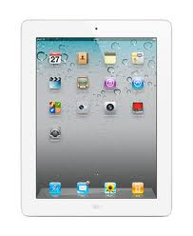
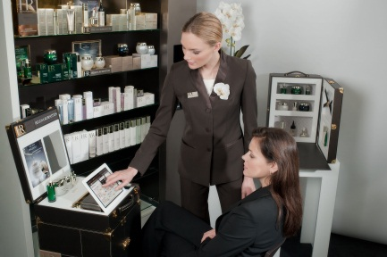
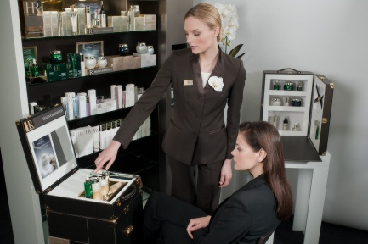
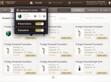
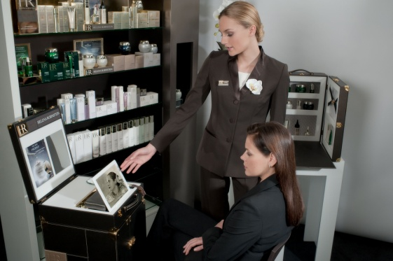
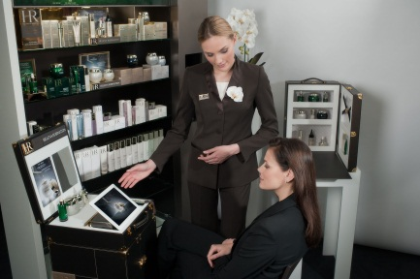
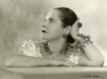

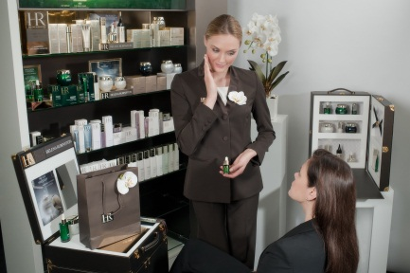
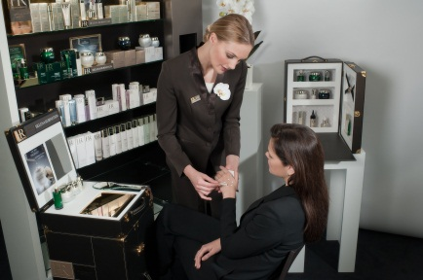
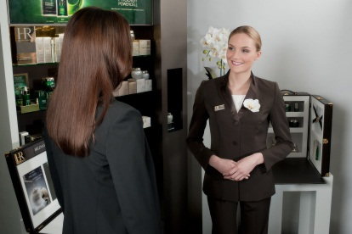
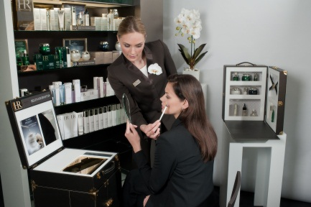
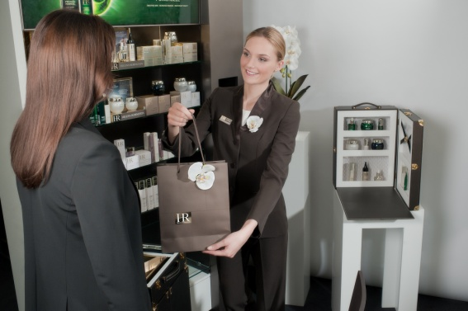
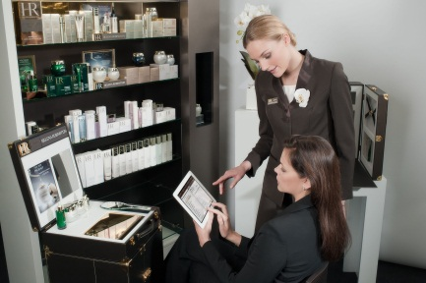
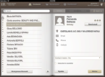
FROM AESTHETIC MEDICINE TO HR SKINCARE EXPERTISE KNOWLEDGE TEST
/20
PART 3: CUSTOMER PATH
37) Number the stages in the customer path in chronological order
13

