Slide 1
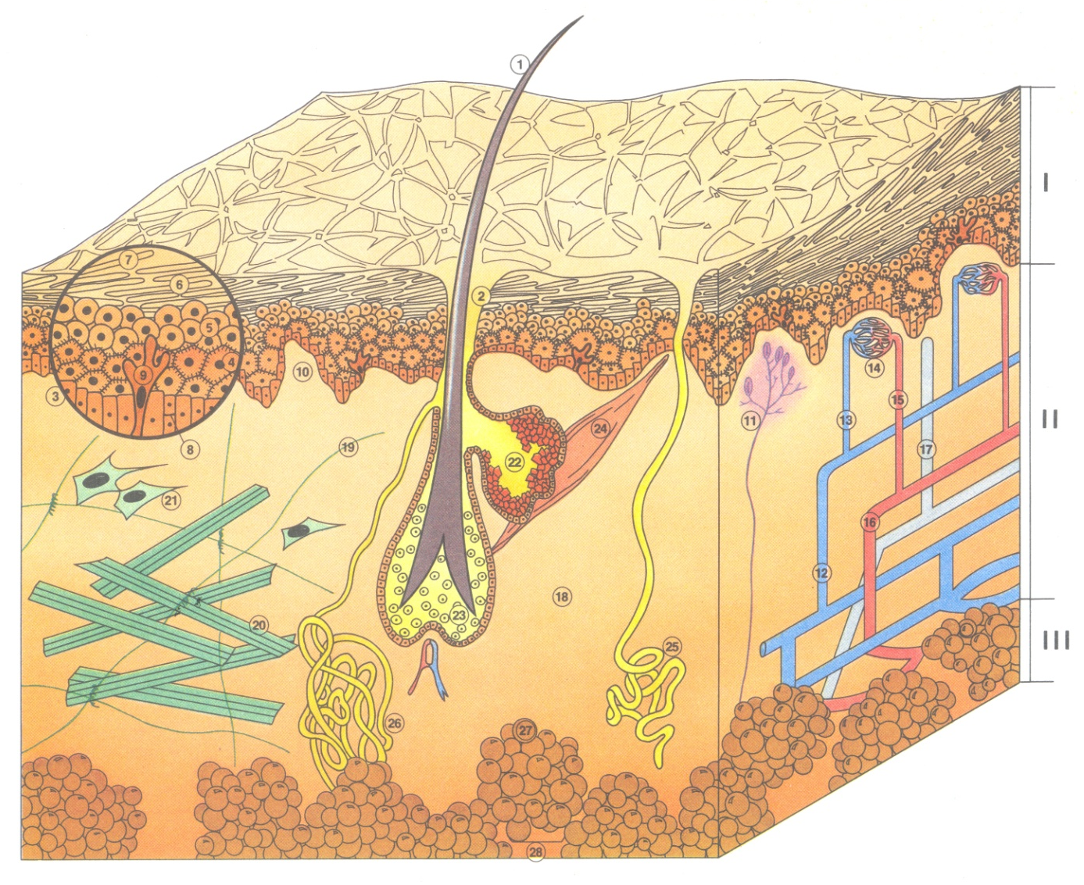
HR SKIN MODULE
LEVEL1
EPIDERMIS
DERMIS
HYPODERMIS
Hair
Sebaceous pore
Germinative or basal layer
Prickly or Malpighian layer
Granulosum layer
Horny layer
Desquamating cells
Keratinocytes
Melanocytes
Dermal papillae
Nerve endings
Arteries
Arterioles
Capillaries
Veinlets
Veins
Lymphatic system
Intercellular substance
Elastin fibers
Collagen fibers
Fibroblasts
Sebaceous glands
Hair bulb
Erector pili muscle
Eccrine sweat gland
Apocrine sweat gland
Adipocytes
Adipose lobule
PHOTO – INTERNAL USE ONLY
Notes:
Sequence: 0 INTRODUCTION
Objective: Become acquainted and present the program
Length: 10 min
Greet participants and introduce yourself
Suggest a round-table
Ask each participant to assess what they know about skin biology (on a scale of 1 to 5) and to express what they expect from this training session
Outline the training session
9:00

