Slide 1
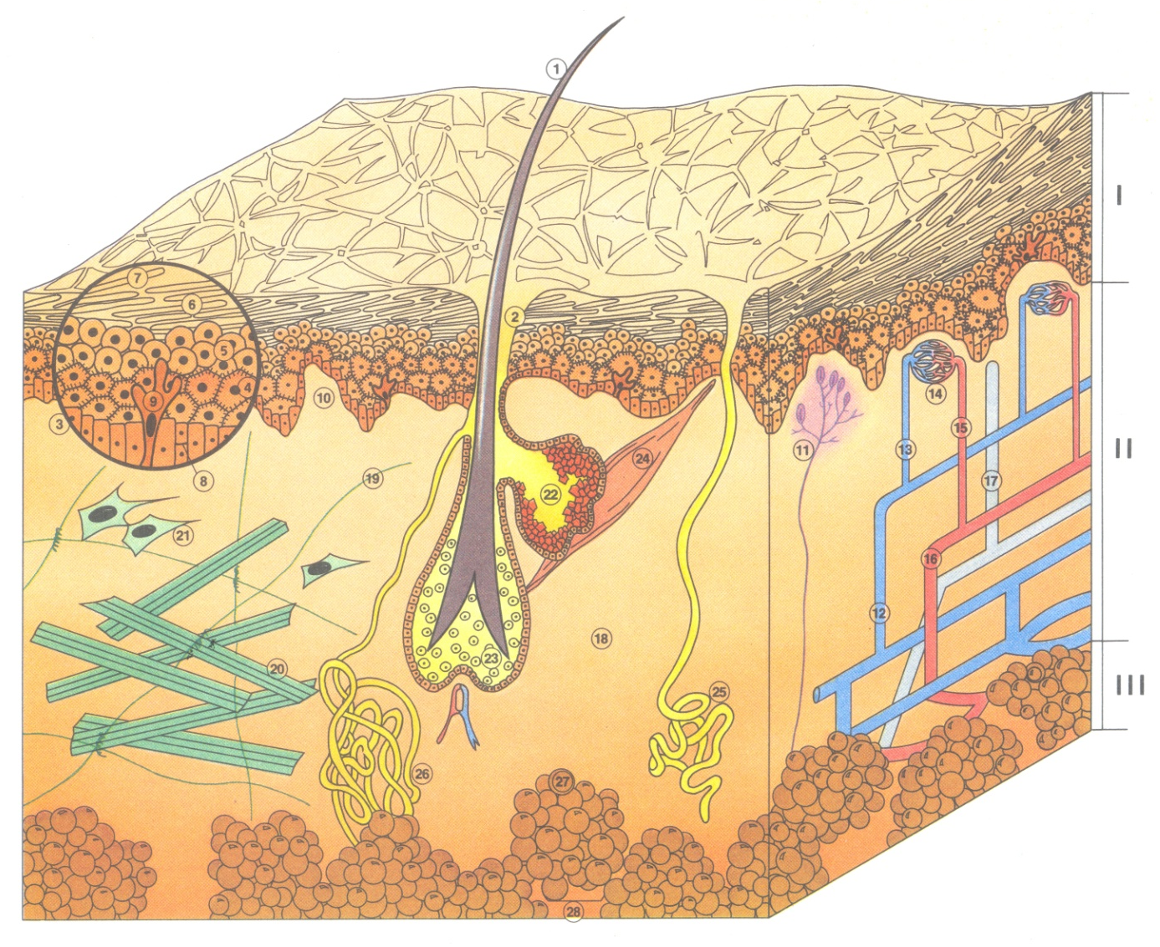
SKINCARE MODULE LEVEL 1 - MEMO
PHOTO – INTERNAL USE ONLY
Notes:
Séquence : 0 INTRODUCTION
Objectif : Faire connaissance et présenter le programme
Durée : 10 mn
Accueillir les participants et se présenter
Proposer un tour de table
Demander à chacun des participants d’évaluer leurs connaissances de la biologie de la peau (sur une échelle de 1 à 5) et d’exprimer leurs attentes de cette formation
Dérouler le programme de la session
9h00

Slide 2
THE SKIN
DEFINITION AND ROLE
WHAT’S SKIN?
A living organ made up of about 300 million cells.
A protective organ that protects us against our environment (impacts, pollution, germs, sun (UV rays), able to defend and repair itself after accidents from daily life (healing process).
An exchange organ – thermoregulation
  The skin participates in regulating our body temperature with an insulating power.
        Our organism eliminates and purifies toxins through the skin (via perspiration and sebum) and the skin maintains the necessary amount of water in the body.
        It also enables us to perceive our environment (sensations of hot/cold).
A sensory organ – indicator of our emotions and state of health.
      It sometimes reveals our emotions and tells about our state of health (sweat, redness, paleness).
      An age indicator : the skin is marked by passing time (appearance of wrinkles).
IT IS AN ACTIVE BARRIER
THE BIOLOGICAL CHARASTERISTICS OF THE SKIN
The skin is the heaviest organ (weigh 4.5 kg) with the largest area in the human body (area of 2 m²) for an adult weighing 80 kg.
The skin is approximately 1.2 mm thick and it varies according to location:
We speak of thin skin on the eyelids 0.05 mm and of thick skin on the soles of the feet (1.2 mm).
The skin is composed of 3 layers:
The epidermis: acts as a barrier, protective role and location for cellular regeneration.
The dermis: water storage, network of elastin and collagen that forms a matrix, support tissue.
The hypodermis: energy storage, protects against impacts and provides thermal insulation.
The dermal-epidermal junction separates the dermis from the epidermis.
Notes:
Séquence : 0 INTRODUCTION
Objectif : Faire connaissance et présenter le programme
Durée : 10 mn
Accueillir les participants et se présenter
Proposer un tour de table
Demander à chacun des participants d’évaluer leurs connaissances de la biologie de la peau (sur une échelle de 1 à 5) et d’exprimer leurs attentes de cette formation
Dérouler le programme de la session
9h00

Slide 3
THE SKIN
SKIN TYPES
SKIN TYPES
The skin is classified according to 3 types. Madame RUBISNTEIN was the first to classify skin types in 1910.
DRY SKIN
Dry Skin is skin that lacks moisture, lipids or both. It reacts more strongly to aggressions. It becomes wrinkled earlier than other skin types.
People who have dry skin feel a sensation of tautness and discomfort (more or less intense itchiness). They look for lasting daily comfort: non-greasy products that penetrate immediately and that can be used under makeup.
OILY SKIN
Oily skin is related to the abundance and nature of sebum on the skin’s surface. Excess sebum makes the forehead, sides of the nose and chin look shiny: the "T" zone.
Oily skin is thick and covered with a protective oily film.
People who have oily skin look for light, non-greasy textures that are instantly absorbed by the skin. They like aqueous emulsions.
COMBINATION SKIN
Combination skin is soft to touch, even and without any visible blemishes.
The "T" zone is oily and shiny (forehead, nose, chin) and there are some dehydrated areas on the rest of the face.
Sebum production is not excessive.
Notes:
Séquence : 0 INTRODUCTION
Objectif : Faire connaissance et présenter le programme
Durée : 10 mn
Accueillir les participants et se présenter
Proposer un tour de table
Demander à chacun des participants d’évaluer leurs connaissances de la biologie de la peau (sur une échelle de 1 à 5) et d’exprimer leurs attentes de cette formation
Dérouler le programme de la session
9h00

Slide 4
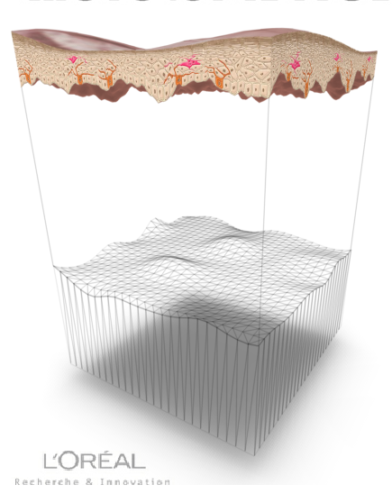
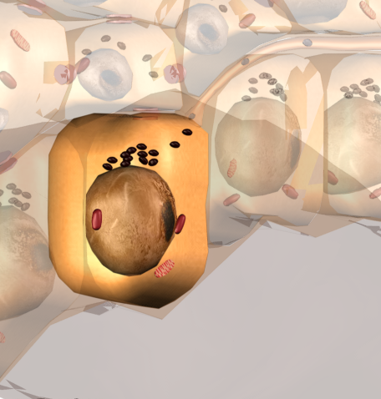
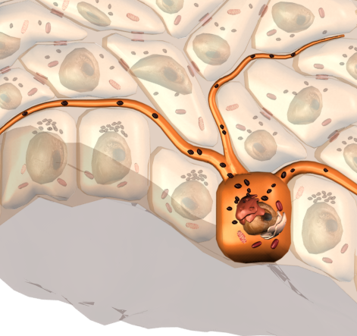
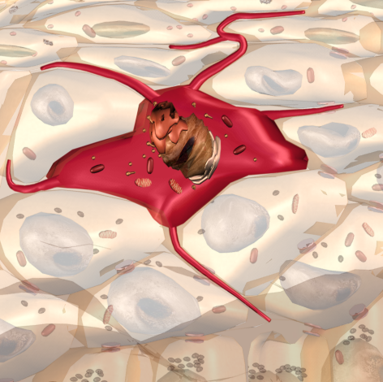
THE EPIDERMIS
DEFINITION AND ROLE
The epidermis is the outermost and therefore, the most superficial layer of the skin.
Made up of 5 layers of cells: the basal layer, the Malpighian layer, the granulosuem layer, the horny layer (disjointed and compact).
It is truly a coating that protects and isolates the organism from the external environment.
3 main characteristics: suppleness, impermeability and resistance.
The epidermis is made up of several cells:
KERATINOCYTES
That’s the majority of the cells: they account 95 % of cells in the epidermis.
They synthetize keratin and maintain moisture in the skin.
They play an important role during the cellular regeneration process.
MELANOCYTES
The melanocytes are cells located in the deepest part of the epidermis at the basal layer level on the DEJ.
They produce melanin either spontaneously, as do deeper shaded skins, or after being stimulated by the sun’s ray, as for fair skins.
Langerhans Cells
They capture foreign substances, transmit messages to the immune system and participate in eliminating the "aggressor".
Merkel Cells
These cells are always in contact with a nerve ending. They play a role as sensory receptors (tactile sensitivity): the sense of touch.
The cells of the epidermis regenerate continuously (28 days) from a very small number of cells called stem cells.
keratinocytes
melanocytes
Langerhans cells
Notes:
Séquence : 0 INTRODUCTION
Objectif : Faire connaissance et présenter le programme
Durée : 10 mn
Accueillir les participants et se présenter
Proposer un tour de table
Demander à chacun des participants d’évaluer leurs connaissances de la biologie de la peau (sur une échelle de 1 à 5) et d’exprimer leurs attentes de cette formation
Dérouler le programme de la session
9h00

Slide 5
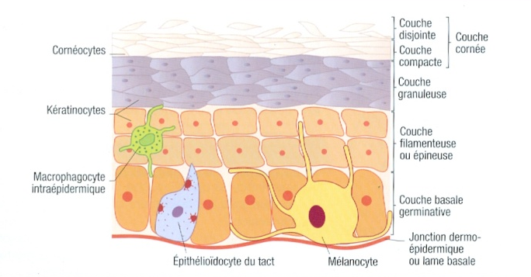
THE EPIDERMIS
THE DIFFERENT LAYERS
THE 5 LAYERS OF THE EPIDERMIS
CELLS TO REMEMBER: KERATINOCYTES & MELANOCYTES
Keratine:
Fibrous protein that
ensures the skin’s
impermeability and
protection against the
external environment
Melanine:
Pigment that collects around the keratinocytes’ vital organs and absorbs Ultraviolet (UV) rays in order to protect the epidermis, giving the epidermis color.

Slide 6
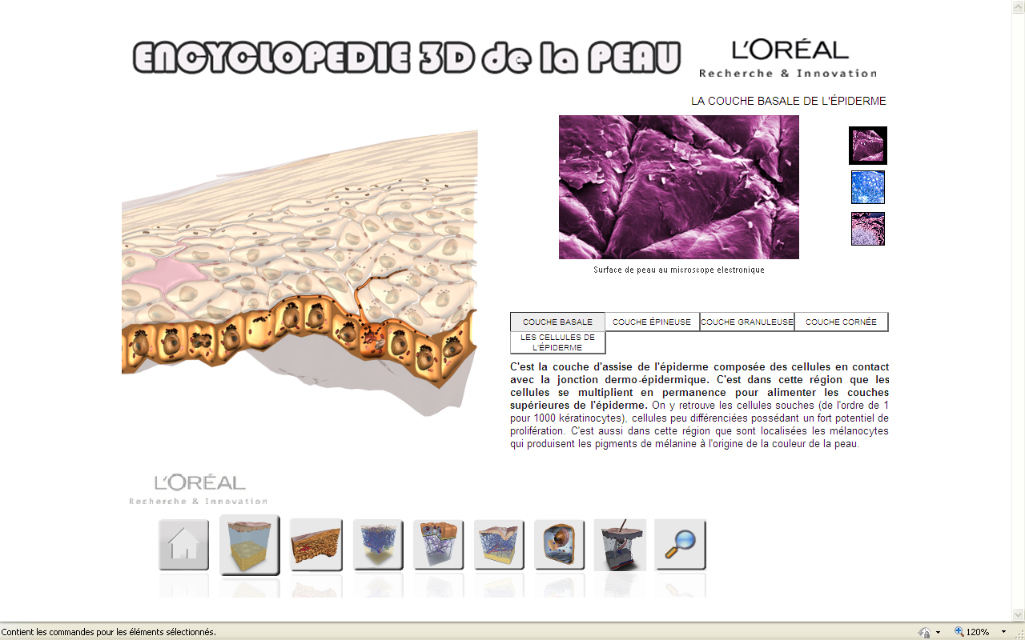
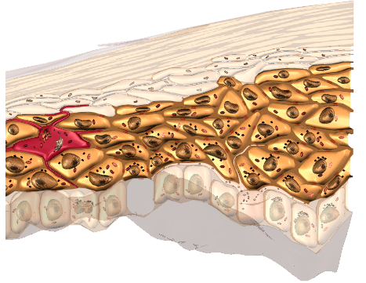
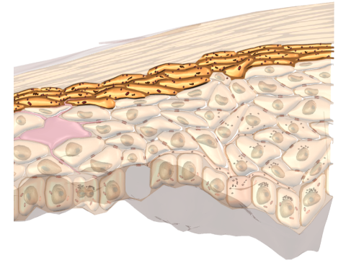
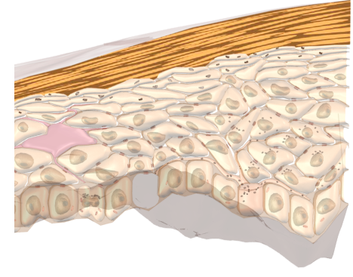
THE EPIDERMIS
THE DIFFERENT LAYERS
THE EPIDERMIS IS MADE UP OF 5 LAYERS OF CELLS:
The basal layer or the germinative layer.
It is the deepest layer in the epidermis.
It is located at the dermal-epidermal junction level.
It is the area where keratinocytes multiply. The cells constantly multiply in this area to feed the upper layers of the epidermis.
The Malpighian layer or prickly layer
It is located above the basal layer.
The Langerhans cells, or "alarm signal" cells, are found in this layer.
The Granulosum layer
It is located above the Malpighian layer and is made up of 2 to 3 layers of keratinocytes.
The Horny layer or corneum layer
It is the last layer of the epidermis that is in contact with the external environment.
Its role is to ensure final protection for the skin: barrier effect between the outside and inside of the body.
It has 2 parts: the compact corneum and the desquamative, disjointed corneum.
The horny layer is coaed of 2 important elements:
Hydrolipid film: natural emulsion on the skin’s surface made of sebum, perspiration and desquamated cells. It protects the skin, ensures its suppleness. It is an essential indicator that defines skin type. (dry – oily – combination).
Natural microbial bacterial flora
Plays a protective role on the skin’s surface. It is essential against external aggressions.
Notes:
Séquence : 0 INTRODUCTION
Objectif : Faire connaissance et présenter le programme
Durée : 10 mn
Accueillir les participants et se présenter
Proposer un tour de table
Demander à chacun des participants d’évaluer leurs connaissances de la biologie de la peau (sur une échelle de 1 à 5) et d’exprimer leurs attentes de cette formation
Dérouler le programme de la session
9h00

Slide 7
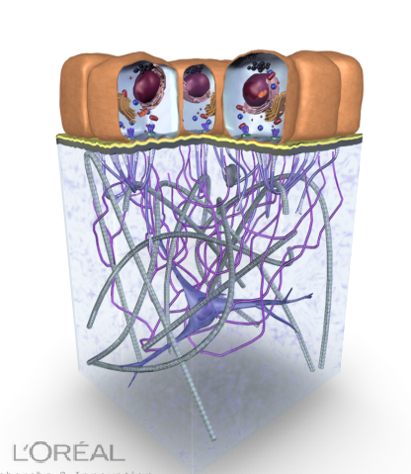
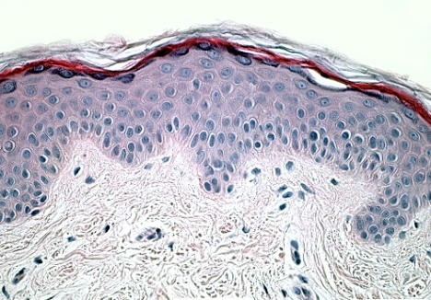
THE EPIDERMIS
THE DERMAL-EPIDERMAL JUNCTION
WHAT IS THE DERMAL-EPIDERMAL JUNCTION?
The dermal-epidermal junction is an area that is located on the boundary between the dermis and the epidermis with a thickness of 75 nm. This is not a layer of cells.
It plays a mechanical support role, a selective barrier role and a biological role in providing nutrition.
DJE
DJE
Area where wrinkles
are formed !
Notes:
Séquence : 0 INTRODUCTION
Objectif : Faire connaissance et présenter le programme
Durée : 10 mn
Accueillir les participants et se présenter
Proposer un tour de table
Demander à chacun des participants d’évaluer leurs connaissances de la biologie de la peau (sur une échelle de 1 à 5) et d’exprimer leurs attentes de cette formation
Dérouler le programme de la session
9h00

Slide 8
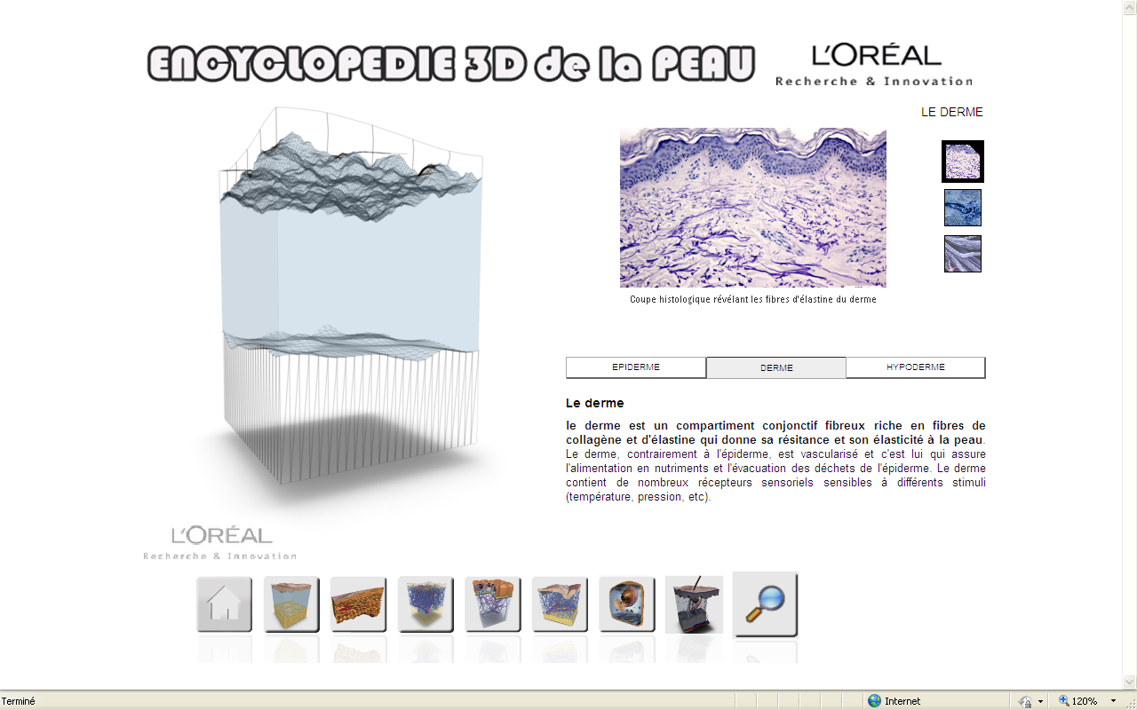
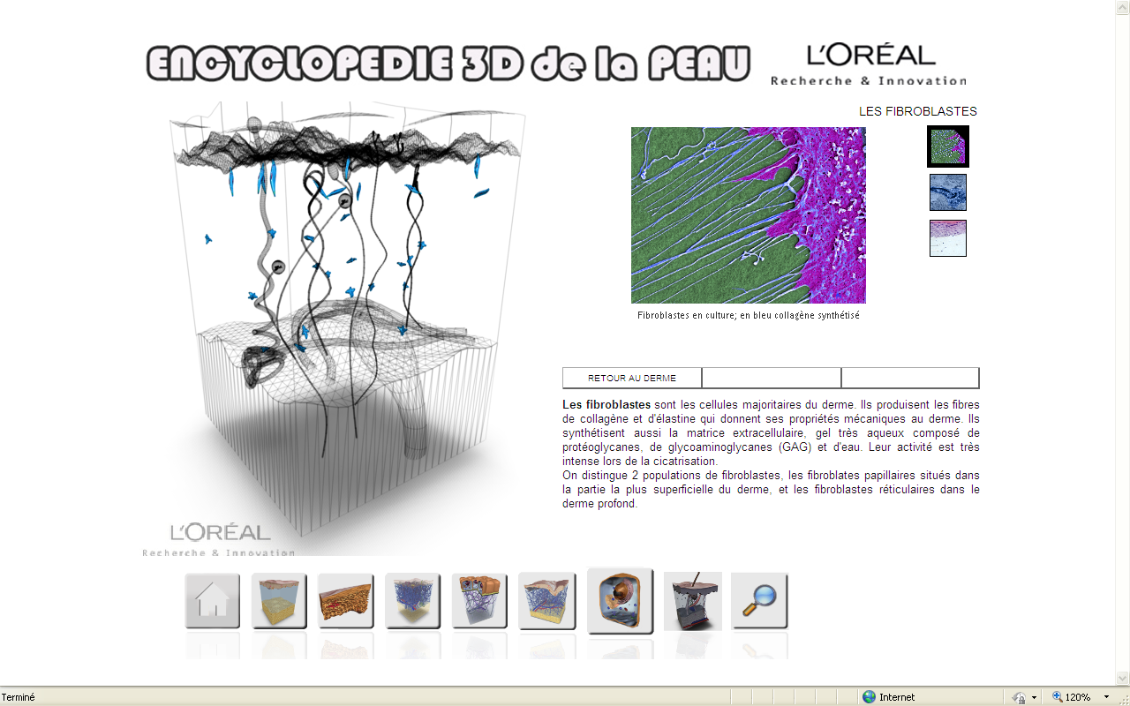
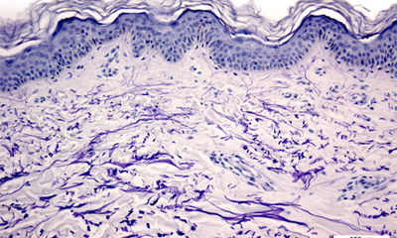
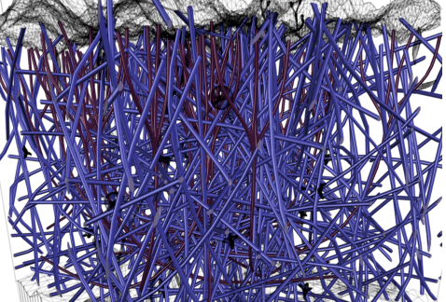
THE DERMIS
DEFINITION AND ROLE
The dermis is the support tissue for the skin:
It is located below the epidermis and is separated from the epidermis by the dermal-epidermal junction.
It is usually thicker than the epidermis and its thickness varies according to the part of the body where it is located.
It is made up of 2 parts: the dermal papillae and the reticular dermis.
It serves as water storage and a matrix for the skin which provides firmness and suppleness.
The dermis contains:
FIBROBLASTS: cells in majority in the dermis that produce:
An intercellular substance (an aqueous gel made of large molecules: the proteoglycanes the glycoaminoglycanes (GAGS) and hyaluronic acid. The GAGS capture water and transform the dermis into a natural water reservoir for the skin (made of 80 % water).
ELASTIN FIBERS ensure the skin’s elasticity. Just under the epidermis, elastin forms a discontinuous network that is thicker on the face.
COLLAGEN FIBERS ensure the skin’s firmness.
Blood vessels bring nutriments and oxygen to surrounding cells,
Nerves: sensory receptors sensitive to different stimuli (temperature, pressure, ...).
The lymphatic system is a circulatory system. Lymph collects waste products from cells and eliminates toxins. It participates in the organism’s immune system.
Auxiliary elements of the skin: hair, sudoriferous glands that produce perspiration and sebaceous glands that produce sebum.
fibroblasts
Elastine fibers
In the dermis
Collagen fibers
Notes:
Séquence : 0 INTRODUCTION
Objectif : Faire connaissance et présenter le programme
Durée : 10 mn
Accueillir les participants et se présenter
Proposer un tour de table
Demander à chacun des participants d’évaluer leurs connaissances de la biologie de la peau (sur une échelle de 1 à 5) et d’exprimer leurs attentes de cette formation
Dérouler le programme de la session
9h00

Slide 9
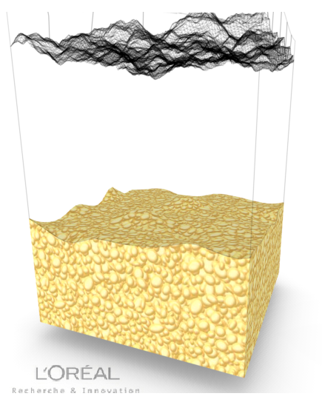
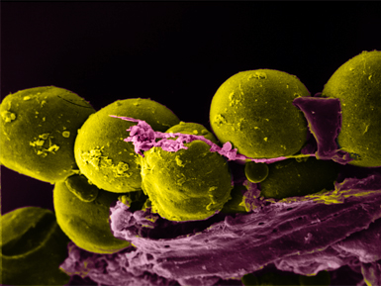
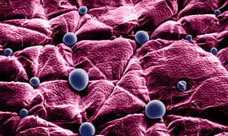
THE HYPODERMIS
DEFINITION AND ROLE
The hypodermis (or subcutaneous tissue) is the deepest and thickest compartment of the skin. It is not separate from the dermis.
It is a supple and supportive tissue that will hold its shape and whose role is to serve as an interface between the skin and the organs that it covers (muscles, bones).
The hypodermis is present all over the body except for the ears, the eyelids and the male genital organs.
It is especially thick on the parts of the body that are exposed to high pressure, such as the heels or buttocks.
The hypodermis plays a role in energy storage and protection against impacts.
The hypodermis participates in thermoregulation, the fat plays a passive role in insulation, reducing temperature exchanges with the external environment.
It is made up of:
ADIPOCYTES: cells that are specialized in accumulating and storing fat and are located in adipose tissue (triglycerides). They are grouped into lobes that are separated by conjunctive tissue.
SUDORIFEROUS GLANDS that secrete sweat.
It is responsible for the body’s silhouette.
The location of cellulite in women.
Although the hypodermis covers the entire body, it tends to accumulate above the belt on the stomach and shoulders in men and below the belt on the thighs, hips and buttocks in women.
0
Adipocytes
Sudoriferous glands
Notes:
Séquence : 0 INTRODUCTION
Objectif : Faire connaissance et présenter le programme
Durée : 10 mn
Accueillir les participants et se présenter
Proposer un tour de table
Demander à chacun des participants d’évaluer leurs connaissances de la biologie de la peau (sur une échelle de 1 à 5) et d’exprimer leurs attentes de cette formation
Dérouler le programme de la session
9h00

Slide 10
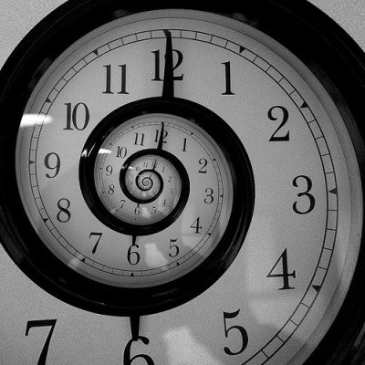

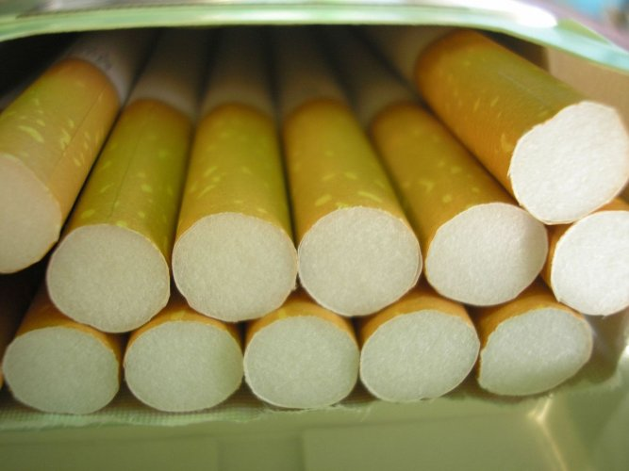
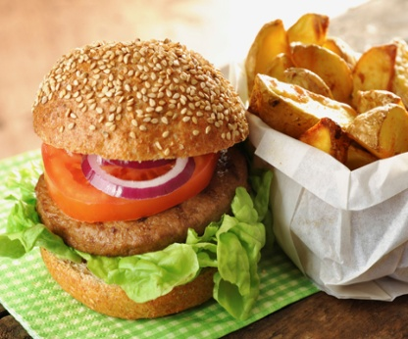
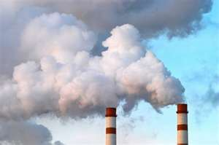
SKIN AGEING
It exists
2 types
of ageing
Ageing due to passing time
genetical or chronological ageing
Intrinsic aging
Ageing due to external ageing
related to our environment
and our lifetsyle
extrinsic ageing
Oxydative stress,
Pollution, tabacco,
Poor eating habits,
Poor lifetsyle habits,
Exposure to sun (Ultra-Violets rays) :
80 % of ageing is due to action from external factors also called free-radicals.
  Day after day, they destroy cells,
  They quietly and painlessly damage the skin,
  They are the cause of wrinkles, dark spots, loss of firmness, thus our ageing.
  20% of the remaining types of ageing are of genetic origin.
  75 % of ageing concerns the face.

Slide 11
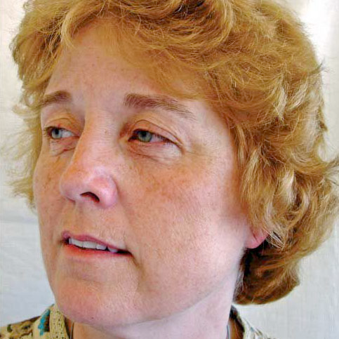
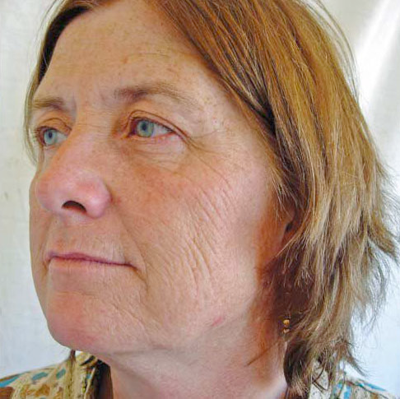
THE SKIN AGEING
The 1st signs of ageing show on the skin
Expressions lines
These come from grimaces, twitches, squinting eyes, pursing lips.
Expression lines are related to repetitive movement and facial muscle tension that pull the deep part of the dermis which hollows and forms deep wrinkles over time.
Wrinkles/fine lines
They are caused by sun exposure. It is an accelerated form of ageing that dermatologists call photoageing, you will also hear them speak about solar radiation.
Dull complexion
The skin lacks radiance.
Pigmentation
Appearance of pigment spots (dark spots).
Sagging:
Loss of density.

Slide 12
SKIN AGEING
HOW SKIN AGEING APPEARS?
EPIDERMIS | Slowdown of cell division: decrease of keratinocytes Decrease in melanocytes (10 to 20% per decade from 30 years), Appearance of age spots, Decrease in Langerhans cells Slowdown of vitamin D production, Decrease in skin hydration (from 13% to 7% for ageing skins).
DERMAL EPIDERMAL JUNCTION | Decrease in keratinocytes adhesion to the matrix, Reduced anchoring fibers: dermal fibroblasts being less numerous, fiber anchors no longer play their role junction between the dermis and epidermis, Flattening of the DEJ.
DERMIS | Decrease in the size and the number of fibroblasts, The dermis becomes less flexible, Alteration of elastic fibers in the dermis: loss of flexibility, firmness, Deep dehydration: the stock of hyaluronic acid decreases by a third each day. Slowdown of blood microcirculation: vascular lesions, disruption of thermoregulation.
HYPODERMIS | Adipocytes lose volume, the hypodermis is thinning in some areas.

Slide 13
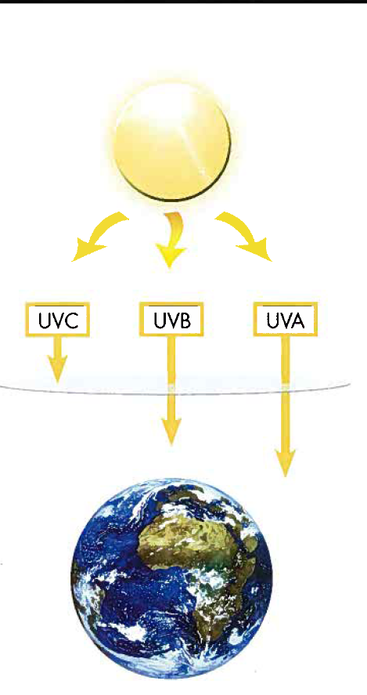
SKINAGEING
PHOTO AGEING
WE DISTINGUISH 3 TYPES OF ULTRA VIOLETS RAYS
    UV-A
    They account for 95% of UV reaching the surface of the earth and they go through windows.
    70% reach the epidermis and the dermis.
    They cause accelerated ageing (photo-induced) of the skin, free-radicals and skin cancer because they penetrate deeper.
    They decrease the immune system.
    Mnemonic tip UVA: A like Age.
    UV-B
    They account for the remaining 5% and they are stopped by windows. 80% are stopped by the stratum corneum but 20% penetrate the epidermis and 10% the dermis.
    They cause redness, burns (sunburn, solar erythema).
    They alter the cellular membranes and DNA.
    They decrease the immune system and cause skin cancer.
    Mnemonic tip UVB: B like Burn.
    UV-C
    They are the most aggressive and they are stopped by the atmosphere (the ozone layer). They do not reach the epidermis or the dermis.

