Slide 1

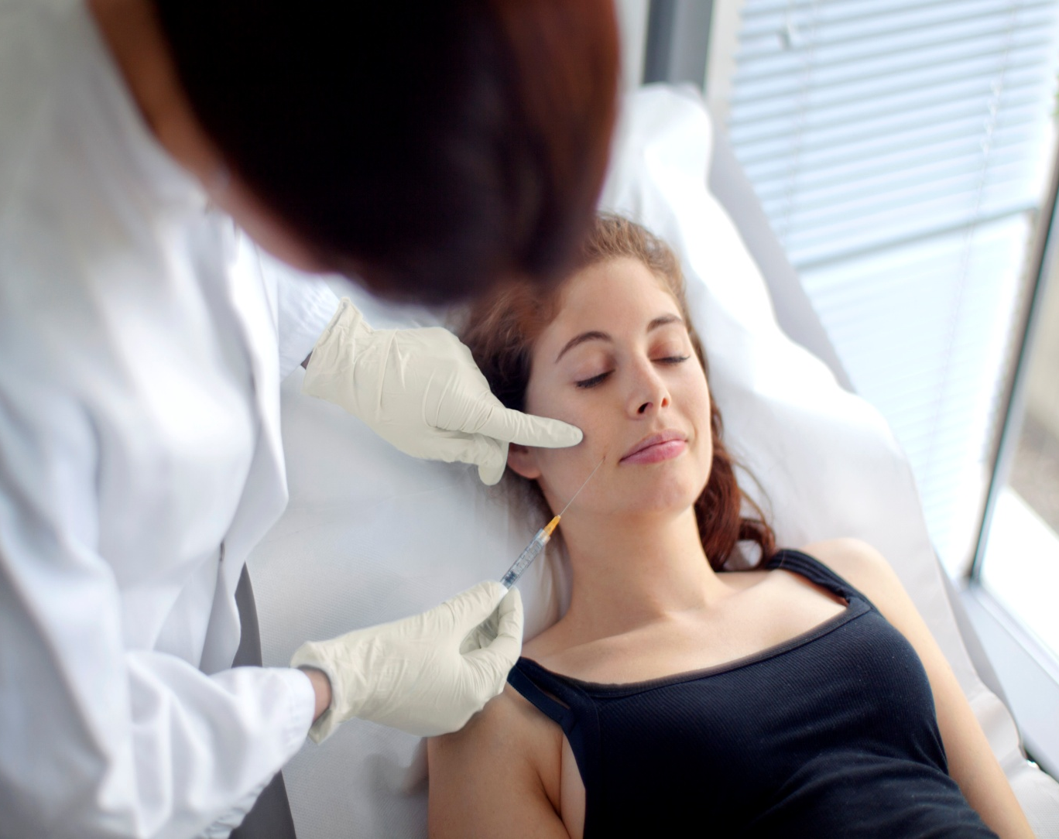


FROM AESTHETIC MEDICINE TO HR SKINCARE EXPERTISE TRAINING MODULE
Notes:
1
1
1
1
The Re-PLASTY range is the brand's strategic line and we have therefore decided to develop the "FROM AESTHETIC MEDICINE TO HR SKINCARE EXPERTISE".
This week-long* module will allow your BAs to acquire knowledge about skin biology, aesthetic medicine, advanced knowledge on each product in the Re-PLASTY range (aesthetic medicine procedure that inspired the product, results, technology, texture, hook, price selling points, etc.) and finally a reminder of the HR customer circle with training on Re-PLASTY sales scenarios.
Lastly, 1 day will be dedicated to training BAs (non beauticians) in Re-PLASTY 15’ et 30’ protocols.
2 days are also set aside to train beauticians in Re-PLASTY treatment cabin protocols (1hr and 2hrs).
In order to validate the knowledge that your BAs acquire during this training day, a written evaluation on all the information in the module has been developed. After this evaluation, the trainer will assess and grade each BA using a points scale.
Following the written evaluation, BAs will also be assessed during a role play.
Only BAs with score of 15/20 or over on the knowledge test, role play and those who are able to master the 15’/30’ protocols (for non aesthetician BAs) and 1 hr/2 hrs (for aesthetician BAs) will be awarded the “Instant Cosmetic Interventions- Re-PLASTY” Diploma signed by the Vice-President & General Manager L’Oréal Luxe and by the Training Manager Helena Rubinstein and approved by LACLINIC-MONTREUX.
Names on the diploma has to be adapted to your country.
This training module is for professional and internal use only.
As such, you are not permitted to reveal, use or reproduce the information, photographs or any other content included in this PPT document for other purposes than training.
* 3 days for non beauticians BAs and 5 days for beauticians BAs.

Slide 2
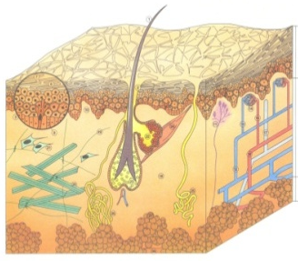
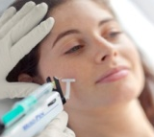
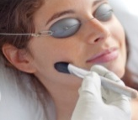
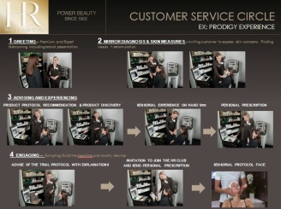

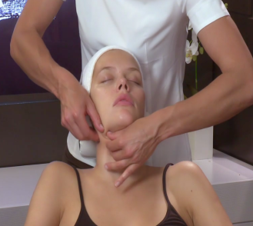
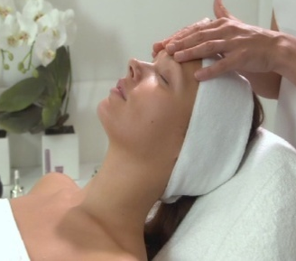
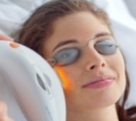

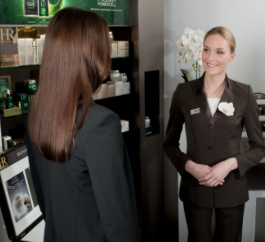




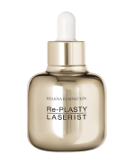
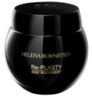
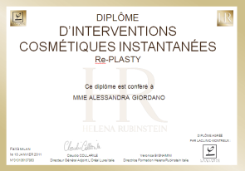
FROM AESTHETIC MEDICINE TO HR SKINCARE EXPERTISE TRAINING MODULE
AESTHETIC MEDICINE EXPERTISE
PROTOCOL EXPERTISE
DAY 1
DAY 2
DAY 3
DAYS 4 & 5
PART 1:
SKIN
BIOLOGY
PART 2:
AESTHETIC
MEDICINE
PROCEDURES
AND HR
SOLUTIONS
PART 3:
REMINDER OF
CUSTOMER
CIRCLE
+ SALES
SCENARIO
PART 4:
EVALUATION TEST:
Knowledge
Sales
scenario
PART 5:
Re-PLASTY 15’/ 30’
PROTOCOL
TRAINING
PART 6:
Re-PLASTY 1 & 2hr
PROTOCOL
TRAINING
2hrs 30 mins
4hrs
4hrs
4hrs
8hrs
at least 16hrs
Mandatory:
Local aestheticians must be trained by international aesthetician, Emmanuelle Foucaud
AWARDING OF
INSTANT COSMETIC INTERVENTIONS - Re-PLASTY DIPLOMAS APPROVED BY LACLINIC-MONTREUX
Notes:
2
2
2
2
Present the program for the training week to participants.

Slide 3
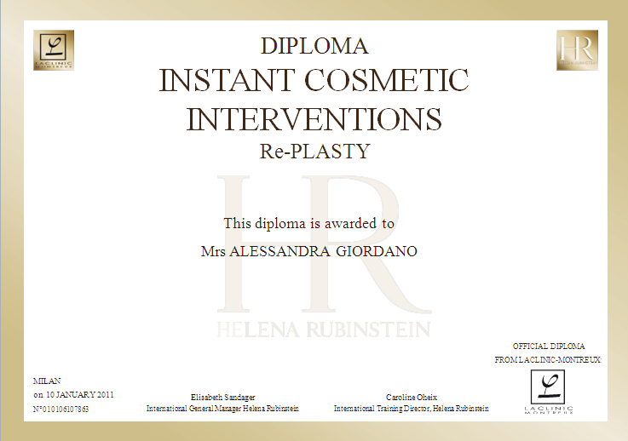
FROM AESTHETIC MEDICINE TO HR SKINCARE EXPERTISE ”INSTANT AESTHETIC PROCEDURES - Re-PLASTY” DIPLOMA
Notes:
Diploma and conditions for success:
After this training week, the “Instant Cosmetic Interventions– Re-PLASTY" Diploma signed by the Vice-President & General Manager L’Oréal Luxe and by the Training Manager Helena Rubinstein, and approved by LACLINIC-MONTREUX, will be awarded only to the Personal Beauty Experts who achieve an overall average grade in the knowledge tests and sales scenario role plays of 15/20 or over, and who master the 15’/30’ protocols for non beauticians as well as the 60’ protocols for beauticians.
NB: The mastery of the 15’/30’ protocols will be evaluated by the protocol trainer herself.
The mastery of treatment cabin protocols will be evaluated by Emmanuelle Foucaud, the expert aesthetician, who is responsible for training the Personal Beauty Experts.

Slide 4

PART 1:
SKIN BIOLOGY

Slide 5

SKIN BIOLOGY DIAGRAM OF THE SKIN
EPIDERMIS
DERMIS
HYPODERMIS
Hair
Sebaceous pore
Stratum germinativum or basal layer
Stratum spinosum or Malpighi layer
Stratum granulosum
Stratum corneum
Squamous cells
Keratinocytes
Melanocytes
Papillary dermis
Nerve ending
Artery
Arteriole
Capillary network
Venule
Vein
Lymphatic system
Ground substance
Elastin fibers
Collagen fibers
Fibroblasts
Sebaceous glands
Hair bulb
Arrector pili muscle
Eccrine sudoriferous gland
Apocrine sudoriferous gland
Adipocytes
Adipose tissue
PHOTO – INTERNAL USE ONLY
Notes:
Greet participants and introduce yourself
Suggest a round-table
Ask each participant to assess what they know about skin biology (on a scale of 1 to 5) and to express what they expect from this training session
Outline the training session

Slide 6

SKIN BIOLOGY CONTENTS
The skin
- Definition and role
- The cell
- Skin types
- Biological characteristics of the skin
Epidermis
- Definition and role
- Keratinocytes & melanocytes
- The layers in the epidermis
- The cellular regeneration process
The dermal-epidermal junction
- Definition and role
The dermis
- Definition and role
The hypodermis
  - Definition and role
  Skin ageing
      Definition and role
      The ageing process by stages
      Photo-ageing
PHOTO – INTERNAL USE ONLY
Notes:
Comment on the contents
State the objectives for the training session:
Improve understanding about the skin’s biological characteristics, the way skin works and the skin’s role
Be able to answer expert customer questions about the ageing process in order to recommend the product that is best suited to the customer’s concerns.
Transition :
“Before we start studying the different elements of THE SKIN, I would like you to tell me what the word "SKIN" means to you.”

Slide 7
THE SKIN
PHOTO - INTERNAL USE ONLY
Notes:
Have participants react to the word SKIN
Write their answers on a flipchart
Conclusion for brainstorming
"As we have just seen, THE SKIN is a complex organ that is perceived differently by each person according to personal knowledge and experience."
Transition
"However, we decided to ask the skin biology experts at the L'OREAL Research Laboratories for a more scientific answer."

Slide 8
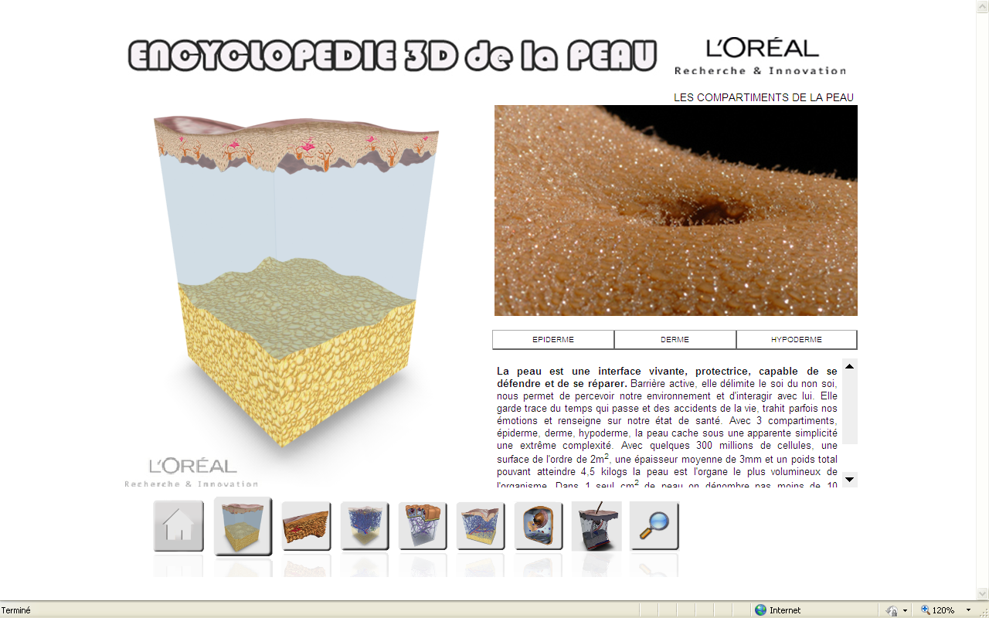
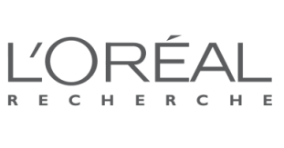
THE SKIN
DEFINITION & ROLE
Living organ made up of 300 million cells
Protective organ
Organ of exchange & thermoregulation
Sensory organ: reveals our emotions and state of health
An age indicator
IT IS AN ACTIVE BARRIER
Notes:
According to the skin biology experts at L’OREAL Research Laboratories, skin is:
A living organ
It is made up of about 300 million cells.
A protective organ
It protects us against our environment (aggression, pollution, germs, sun, i.e. UV rays) and it is able to defend and repair itself after undergoing daily wear and tear and accidents (healing process).
An exchange organ – thermoregulation
The skin helps to regulate our body temperature with its powers of insulation.
Perspiration as well as the dilation and contraction of blood vessels depending on the external temperature help maintain a constant body temperature at 37° C (98.6° F).
Our organism eliminates and purifies toxins through the skin (via perspiration and sebum) and the skin maintains the necessary amount of water in the body.
It also enables us to perceive our environment (sensations of hot/cold)
A sensory organ – indicator of our emotions and state of health
It sometimes reveals our emotions and tells about our state of health (sweat, redness, paleness):
- Fright will make us perspire, an embarrassing situation or anger will make us blush and a latent illness will make the complexion pale.
- Stress or painful events can also cause eczema, rashes …
An age indicator
The skin is marked by passing time (appearance of wrinkles)
"In conclusion, the skin is an active barrier that enables us to perceive our environment and it reacts when confronted with external and internal aggressions. IT IS OUR BODY’S BODYGUARD."
Transition
"Before we look at the skin’s biological characteristics, I would like to linger a few moments on the word CELL. As we saw in the introduction, our skin is made up of about 300 million cells but we will only focus on the essential cells …"

Slide 9
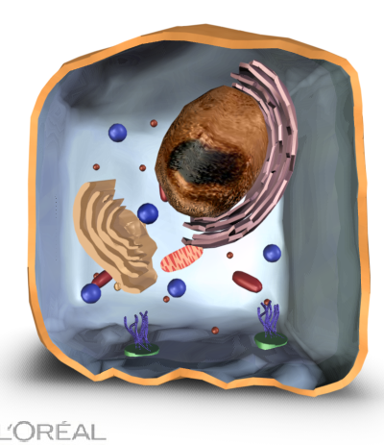
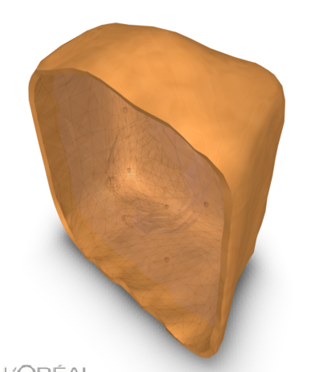
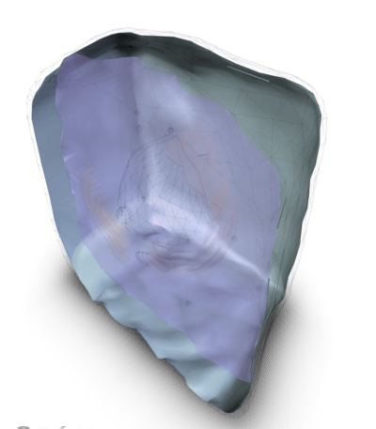
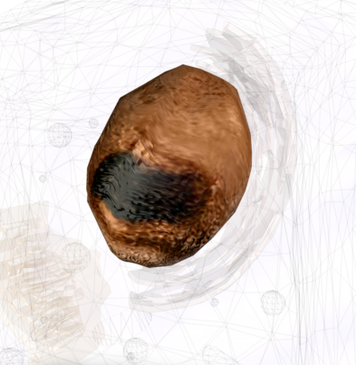
THE SKIN
THE CELL
CELL
The cell is the smallest element in a living being, whether human, vegetal or animal
All cells, no matter what their nature, have the same basic characteristics:
cytoplasm, aqueous gel that fills the cell
plasma membrane that defines cellular shape
a nucleus that contains the cell’s genetic heritage
Plasma
membrane
Cytoplasm
Nucleus
Notes:
What does the word "cell" mean to you?
Here is a colorful diagram of a cell provided by L’OREAL Research Laboratories.
No matter what the type of cell found in an organism, whether it is human, vegetal or animal, all cells have the same basic characteristics, which are:
The plasma membrane, a supple, fluid envelope that is rich in lipids and defines the shape of the cell. It selects the molecules that may enter and leave the cell. It acts like a protective barrier.
The cytoplasm, an aqueous gel composed of 85% water and rich in proteins, carbohydrates and mineral salts.
The nucleus is essential to the cell’s life because it stores DNA. During cellular division, or mitosis, the DNA in the nucleus condenses to form chromosomes.
It plays an essential role in producing living matter, cellular division and heredity.
If we compare a cell to a human being,
- The membrane: the skin
- The cytoplasm: water
- The nucleus: the brain
- Mitochondria: lungs (Module level 2)
Transition
"In conclusion, it is essential for you to understand that cells are living elements with multiple and varied functions and that our body contains several billion cells.
Let’s leave cells for now and look at the biological characteristics of the skin."

Slide 10
THE SKIN
BIOLOGICAL CHARACTERISTICS
The skin in a few figures:
Surface: 2 m²
Weight: 4.5 kg
Thickness: 1.2 mm
It is a tissue composed of 3 layers:
The epidermis: protective barrier
The dermis: support tissue
The hypodermis: adipose cushion and energy storage
Classified according to 3 types
Dry skin – Oily skin – Combination skin
epidermis
dermis
hypodermis
Notes:
Figures are valid for adult skin.
The skin is the heaviest organ with the largest surface area in the human body.
Area of 2 m² for an adult weighing 80 kg.
It is twice as heavy as the brain that only weighs 2 kg
The skin is approximately 1.2 mm thick
It varies according to location:
- Thin skin is located on the eyelids 0.05 mm, the auricle or nipple
- Thick skin is located on the back, the palms of the hands or on the soles of the feet (1.2 mm)
- Men’s skin is thicker than women’s skin.
- Skin thickness decreases with age
The skin is composed of 3 layers:
The epidermis: acts as a barrier, it plays a protective role and is the where cellular regeneration occurs
The dermis: water storage, network of elastin and collagen that forms a matrix, support tissue
The hypodermis: energy storage, protects against impacts and provides thermal insulation
The dermal-epidermal junction separates the dermis from the epidermis
The skin is classified according to 3 types.
Transition
"Perhaps you already know that Madame Rubinstein was the first to classify skin types in 1910 (oily, dry, combination) and the first to require strict scientific testing for all of her products, which had never been done before.
In your opinion, what are the main characteristics of these 3 skin types?"

Slide 11
THE SKIN
SKIN TYPES
SKIN TYPES | VISUAL EXAMINATION | TACTILE EXAMINATION
DRY SKIN | Dominant characteristic: lack of sebum, moisture and lipids - the skin is "taut"
 | Numerous fine lines Tight pores, fine skin texture Redness, dry patches Desquamation Dull complexion Makeup stays on longer | Thin, rough skin Loss of suppleness and elasticity Skin is easily dehydrated
OILY SKIN | Dominant characteristic: excess sebum, lipids – the skin "shines"
 | Enlarged pores, irregular skin texture Shiny look, highest at midday The skin shines Presence of blackheads, acne Makeup “changes color, runs" | Thick oily skin
COMBINATION SKIN | Dominant characteristic: "T" zone is oily, the rest of the face is dry
 | Combination to Oily Skin – very oily "T" zone Combination to Dry Skin – slightly oily "T" zone The "U" zone (cheeks – chin) is uncomfortable, dry and dehydrated
Notes:
Pair-up participants: Make a face to face skin diagnosis, to be validated by trainer
Objective: think about characteristics for each skin type (visual and tactile examination).
Normal skin does not exist in adults. Only babies and children before puberty have normal skin.
However, a woman who states that she has normal skin means that she has no major skin problems.
DRY SKIN
Dry Skin is skin that lacks moisture, lipids or both.
Reduced concentration in the stratum corneum is due to an alteration of the hydrolipid film and disorganization of the intercellular cement.
When skin is dry due to a lack of sebum, there are fewer protective lipids and it reacts more strongly to aggression. It becomes wrinkled earlier than other skin types.
It is frequent among older people who have a loss of elasticity and visible signs of ageing caused by slower cellular regeneration in the epidermis.
Major internal causes: heredity, age, menopause, certain medications and low-lipid nourishment. When under hormonal influence, sebaceous glands produce little sebum.
Major external causes: weather (wind, cold, sun, UV rays) air conditioning, poorly adapted cosmetics and makeup, hard water, soap and certain dermatological treatments.
People who have dry skin feel a sensation of tautness and discomfort (more or less intense itchiness). They look for lasting daily comfort : non-greasy products that penetrate immediately and that can be used under makeup.
OILY SKIN
Oily skin is related to the abundance and nature of sebum on the skin’s surface
It is frequent among teens and young adults.
Excess sebum makes the forehead, sides of the nose and chin look shiny: the "T" zone.
In extreme cases, various forms of acne can develop.
Oily skin is thick and covered with a protective oily film.
Major internal causes: heredity, medication (antibiotics, anticoagulants) hormones. When under hormonal influence, sebaceous glands produce too much sebum beginning at puberty
Major external causes: weather (heat, humidity), pollution , poorly adapted cosmetics, bad hygiene habits.
People who have oily skin look for light, non-greasy textures that are instantly absorbed by the skin. They like aqueous emulsions.
However, no cosmetic product can treat acne because it is an inflammatory condition of the pilo-sebaceous follicles. The only solution: dermatologist
COMBINATION SKIN
Combination skin is soft to touch, it is even and has no visible blemishes.
The "T" zone is oily and shiny (forehead, nose, chin) and there are some dehydrated areas on the rest of the face. Sebum production is not excessive.
Sometimes people speak incorrectly of sensitive or dehydrated skin, but these are really conditions or states of the skin and not skin types. The details for states of the skin are in the Level 2 module.
Transition
"Before continuing on to the precise functions for each of these skin layers, let’s do a QUIZ."

Slide 12
THE SKIN
QUIZ
The skin is a ------------------------------ organ
that ------------------- against external aggression, ------------------ body temperature
and ---------------- our emotions.
The skin is an active ---------------------.
The skin is thinnest on the ---------------------
and thickest on the ------------------------------.
The skin contains millions of ------------------- and is made up of ------ layers:---------------, ------------ and ---------------------.
?
cells – barrier – dermis – living – hypodermis – soles of the feet – protects – eyelids – regulates – reveals – three – epidermis
Notes:
Ask participants to complete this text orally.
Answers
living – protects – regulates – reveals
barrier
eyelids
soles of the feet
cells
three
epidermis – dermis – hypodermis
Transition
Summarize the 3 layers of the skin and announce the study of the first layer: the epidermis.

Slide 13
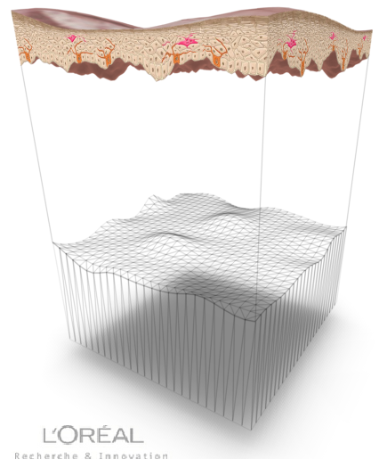
THE EPIDERMIS
http://www.skin-science.fr/_int/_fr/SKIN3D/EN/index_droit.htm

Slide 14
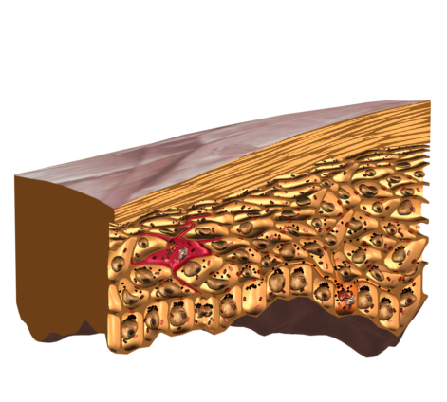
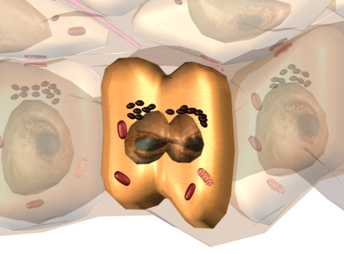
THE EPIDERMIS
DEFINITION & ROLE
Epidermis: the outermost layer
Barrier between the internal and external environment,
Location of cellular regeneration
Made up of numerous cells:
95% keratinocytes: keratin synthesis
3% melanocytes: melanin production
1% Langerhans cells: immune system
1% Merkel cells: sense of touch
melanocytes
keratinocytes
cells
Notes:
What we commonly call skin is actually the visible part that is called the "Epidermis" or the scientific name: stratified epithelium
- From the Greek "epi": above / "derma": skin => above the skin
- Stratified because it is made up of several layers of cells, a total of 5: the basal layer – stratum spinosum – stratum granulosum – stratum corneum (disjointed and compact), layers that we will study more in detail later.
The epidermis is the outermost and therefore, the most superficial layer of the skin. When describing the epidermis, we combine 3 main characteristics: suppleness, impermeability and resistance.
It is truly a coating that protects and isolates the organism from the external environment.
It is a layer that constantly regenerates itself especially during the night (process of continuous regeneration) thanks to numerous cells.
The epidermis is made up of numerous cells:
Keratinocytes & Melanocytes that we are going to look at in detail on the next slide. ESSENTIAL CELLS TO REMEMBER
Langerhans cells:
They act like guards for the skin’s immune system. They were discovered by Paul Langerhans, a German biologist, in the 19th century.
They capture foreign substances, transmit messages to the immune system and participate in eliminating the "aggressor".
They are located in the spinosum layer of the epidermis and they intercept foreign substances that penetrate the skin.
Merkel cells: these cells are always in contact with a nerve ending. They play a role as sensory receptors (tactile sensitivity): the sense of touch.
Transition
"Let’s take a closer look at 2 essential cells to remember about the epidermis: keratinocytes and melanocytes."

Slide 15
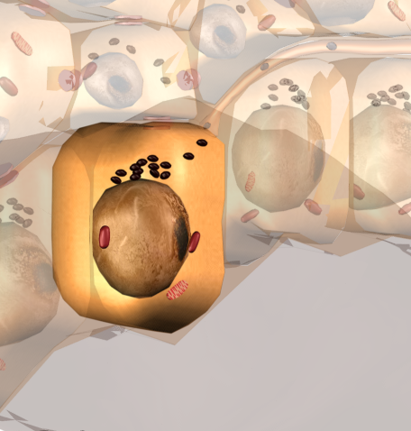
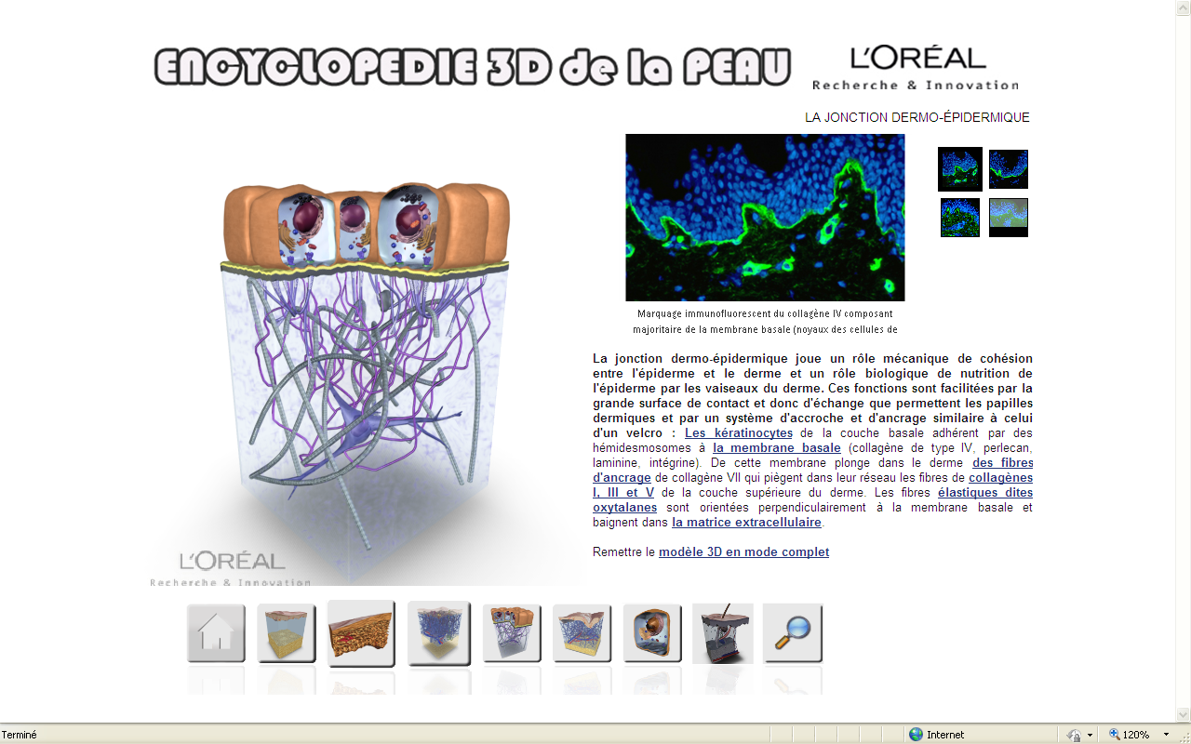
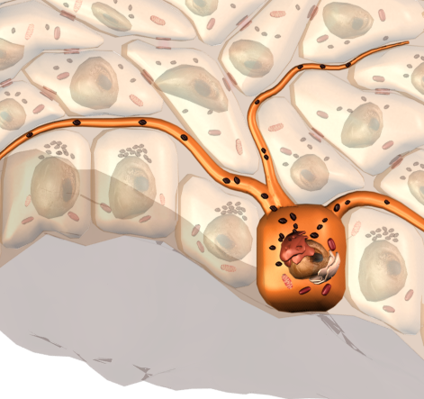
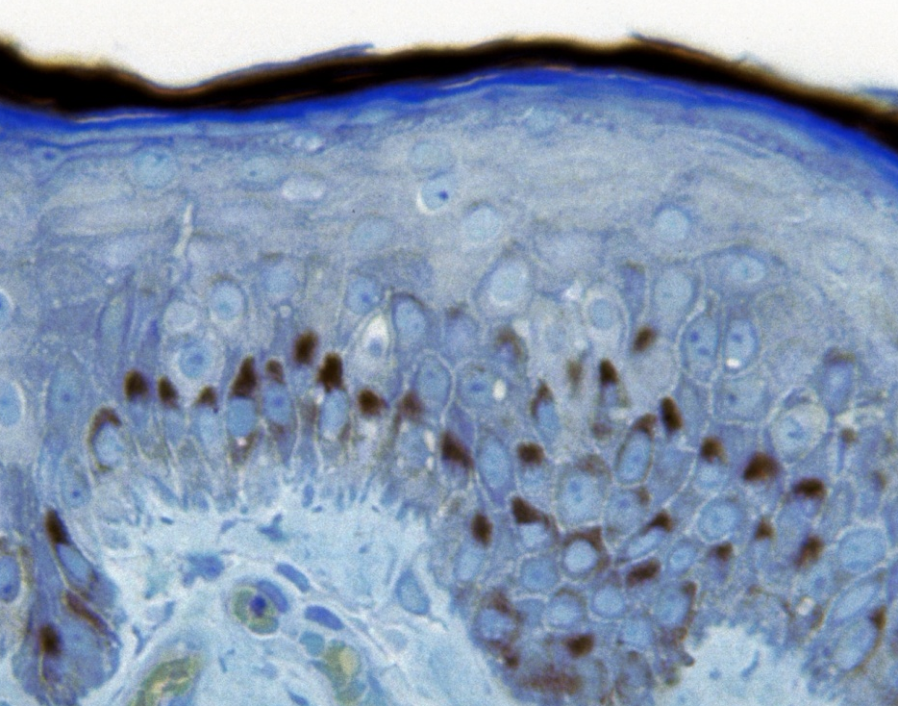
THE EPIDERMIS
KERATINOCYTES & MELANOCYTES
KERATINOCYTES
ensure mechanical protection of the skin
synthesize keratin
Keratin: fibrous protein that ensures the skin’s impermeability and protection against the external environment
keratinocytes
keratin fibers
MELANOCYTES
ensure sun protection for the epidermis
produce melanin
Melanin: Pigment that collects around the keratinocytes’ vital organs and absorbs Ultraviolet (UV) rays in order to protect the epidermis, giving the epidermis color.
melanocytes
melanin
Notes:
KERATINOCYTES
The majority of cells are keratinocytes: they account for 95% of cells in the epidermis.
"keratino": keratin and "cytes": cells.
They synthesize keratin and maintain moisture in the skin.
They are located in the basal layer and have cubic shapes.
They play an important role during the cellular regeneration process in the stratum corneum: they multiply in the basal layer and migrate toward the surface while undergoing stages of differentiation to become corneocytes.
Corneocytes are flat, dead cells reduced to the state of lamella without a nucleus and filled with keratin.
MELANOCYTES
Melanocytes are cells located in the deepest part of the epidermis at the basal layer level on the DEJ.
“melano”: melanin and “cytes”: cells.
They have long ramifications that are in contact with keratinocytes in the stratum spinosum.
They are star-shaped cells that synthesize melanin and transfer it to the keratinocytes.
They produce melanin either spontaneously, as do deeper shaded skins, or after being stimulated by the sun’s rays, as for fair skins.
The higher the melanin content in the keratinocytes, the darker the skin.
If melanocytes malfunction: pigmentation spots appear.
The melanogenesis process (melanin cell) will be seen in detail in Module level 2
Transition
"Now let’s look more in detail at the 5 layers that make up the epidermis."

Slide 16
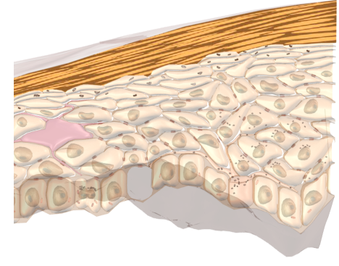
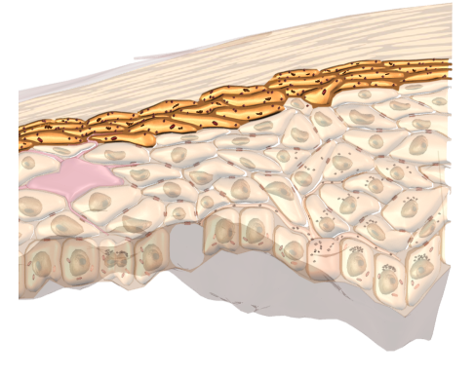
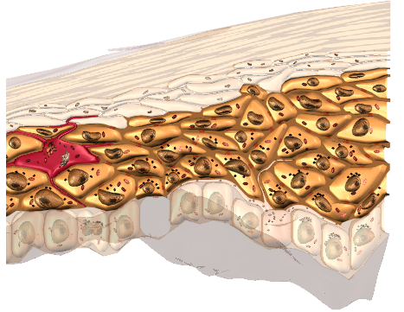
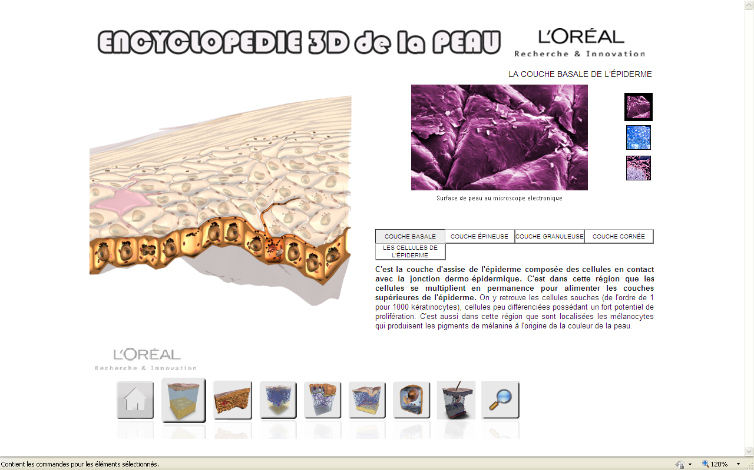
THE EPIDERMIS
THE DIFFERENT LAYERS
Surface of the Skin
Disjointed corneum
Stratum corneum
Compact corneum
Stratum granulosum
EPIDERMIS
Stratum spinosum or Malpighi layer
Basal layer
DEJ
DERMIS
Notes:
Under the microscope, we can see 5 layers in the epidermis
THE 2 ESSENTIAL LAYERS TO REMEMBER: BASAL LAYER AND STRATUM CORNEUM
The basal layer or stratum germinativum.
- It is the deepest layer in the epidermis.
- It is located at the dermal-epidermal junction level.
- This layer of living cells is made up of alternating 36 keratinocytes and 1 melanocyte.
- It is the area where keratinocytes multiply. The cells constantly multiply in this area to feed the upper layers of the epidermis.
The Malpighi layer or stratum spinosum (intermediary layer)
It is located above the basal layer.
It is made up of 5 to 6 layers of large volume cells that begin to flatten and widen.
The Langerhans cells, or "alarm signal" cells, are found in this layer.
The keratinocytes in the stratum spinosum, more differentiated than basal cells, and already have their functioning nucleus and cellular organelles.
These cells are more mature than basal cells and they migrate toward the third layer thanks to developing underlying cells.
The stratum granulosum (intermediary layer)
It is located above the stratum spinosum and is made up of 2 to 3 layers of keratinocytes.
It is the level where cells will lose their nucleus and their cellular organelles to become corneocytes that make up the stratum corneum.
The keratinocytes in this layer contain many lamellar bodies and keratohyalin granules, thus the name stratum granulosum.
The stratum corneum.
It is the last layer of the epidermis that is in contact with the external environment.
Its role is to ensure final protection for the skin: barrier effect between the outside and inside of the body.
It is made up of 15 to 20 layers of flat dead cells that have lost their nuclei, called corneocytes.
It has 2 parts: the compact corneum and the desquamative, disjointed corneum.
The stratum corneum is coated with 2 important elements:
Hydrolipid film: natural emulsion on the skin’s surface made of sebum, perspiration and desquamated cells. It protects the skin, ensures its suppleness. It is an essential indicator that defines skin type. (dry – oily – combination).
Natural microbial bacterial flora
Plays a protective role on the skin’s surface. It is essential against external aggression.
Excerpt from Module 2- It ensures a barrier function using a "brick and mortar" type of organization.
The bricks are corneocytes, dead cells filled with keratins connected together with corneodesmosomes. On the surface, the deterioration of corneodesmosomes causes desquamation. Corneocytes are continuously eliminated via this natural phenomenon or due to external aggressions such as rubbing, washing or detergents.
Transition
"Now that we know the characteristics of the epidermis, let’s see how the epidermis regenerates itself."

Slide 17
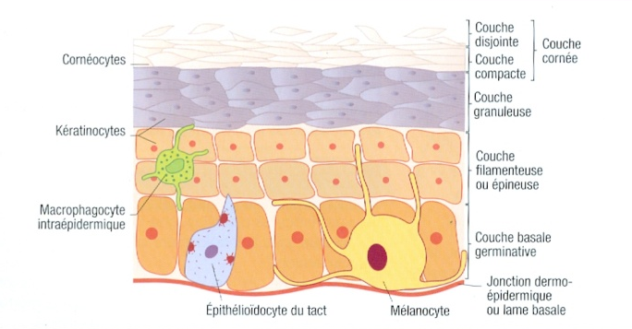
THE EPIDERMIS
THE DIFFERENT LAYERS
Notes:
TRANSLATION:
Cornéocytes = Corneocytes
Kératinocytes = Keratinocytes
Macrophagocyte intraépidermique = Intra-epidermal macrophagocyte
Epithélioïdocyte du tact = Tactile epithelial cell
Mélanocyte = Melanocyte
Couche disjointe = Disjointed layer
Couche compacte = Compact layer
Couche cornée = Stratum corneum
Couche granuleuse = Stratum granulosum
Couche filamenteuse ou épineuse = Dendritic layer or stratum spinosum
Couche basale germinative = basal layer or stratum germinativum
Jonction dermo-épidermique ou lame basale = Dermal-epidermal junction or basal lamina
Mélanocyte = Melanocyte
Here is another view of the layers of the epidermis, often used in beauty manuals, which enables us to visualize the 5 layers of the epidermis.

Slide 18

THE EPIDERMIS
THE CELLULAR REGENERATION PROCESS
Dead cell
Surface of the skin
Keratinocyte that loses its nucleus = corneocytes
Approximately 28 days
Daughter cells
Daughter cell that will migrate toward the surface of the skin
Nucleus
Daughter cell that remains to multiply again
Keratinocyte
Divides into
two daughter cells
Etc.
Notes:
CELLULAR REGENERATION: KERATINIZATION PROCESS
Cellular regeneration is the process of eliminating dead cells in the form of invisible scales.
The life cycle for each cell in the epidermis, the keratinocytes, lasts about 21 to 28 days depending on the individual: at the end of the cycle, the dead keratinocytes detach from the skin’s surface.
- The cells in the epidermis are constantly renewed starting with a very small number of cells called stem cells.
The stem cells in the epidermis are located in the basal layer where they are dormant for most of the time. They account for 0.01 – 0.1% of keratinocytes.
- The cells change as they move from deep in the epidermis toward the surface of the skin, that is from the basal layer to the stratum corneum.
- When the cells divide, they produce 2 daughter cells, one will remain as a stem cell, the other will become a keratinocyte that will multiply to regenerate the epidermis.
Explanation of the diagram
Keratinocytes are formed in the DEJ (at the basal layer level) to produce keratin and will die at the stratum corneum level.
Cellular division (mitosis) takes place in the DEJ for each keratinocyte: a mother cell divides in half to form 2 daughter cells. One of the cells undergoes the keratinization process while the other remains in the basal layer to divide and become 2 daughter cells, etc…

Slide 19
THE DERMAL-EPIDERMAL JUNCTION
http://www.skin-science.fr/_int/_fr/SKIN3D/EN/index_droit.htm

Slide 20
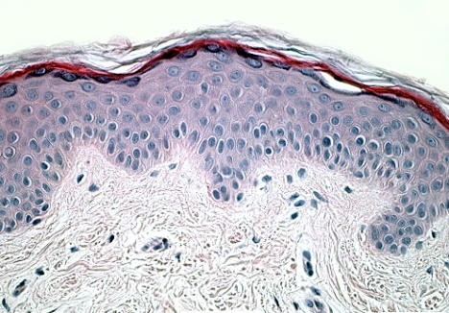
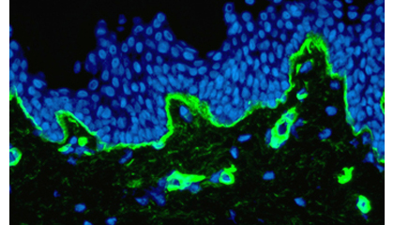
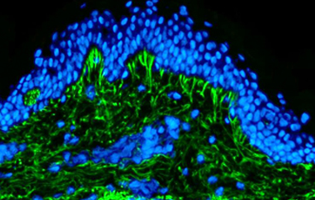
THE EPIDERMIS
THE DERMAL-EPIDERMAL JUNCTION
Dermal-epidermal junction (DEJ): boundary area between the dermis and the epidermis
Mechanical support for adherence between the epidermis and the dermis
Selective barrier that helps control molecular and cellular exchanges between the two compartments
Biological role in providing nutrition to the epidermis via vessels in the dermis
DEJ
DEJ
Area where wrinkles are formed!
Notes:
The dermal-epidermal junction is an area that is located on the boundary between the dermis and the epidermis with a thickness of 75 nm.
It plays
a mechanical support role
a selective barrier role
a biological role in providing nutrition
a fundamental role in regenerating the epidermis for skin healing
This structure enables the keratinocytes in the epidermis to be rooted in the dermal papillae.
On the dermis side, the anchoring fibers interact with the basal membrane to create a network which traps collagen fibers from the upper part of the dermis.
In case of malfunctions: the flattening of the Dermal-Epidermal Junction causes wrinkles to appear.

Slide 21
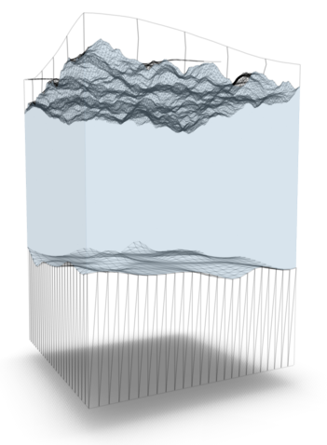
THE DERMIS
http://www.skin-science.fr/_int/_fr/SKIN3D/EN/index_droit.htm

Slide 22
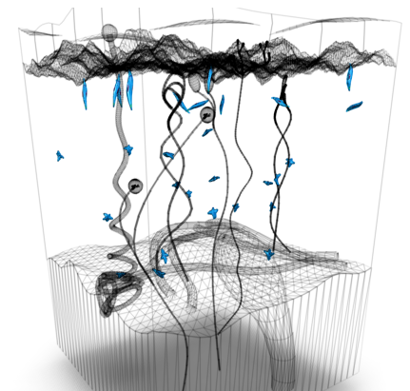
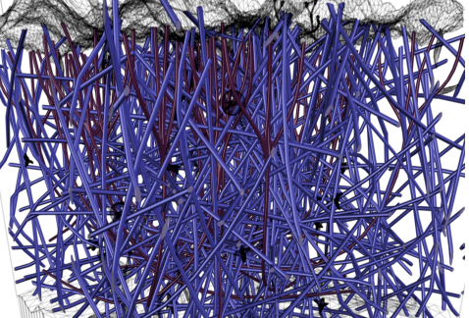
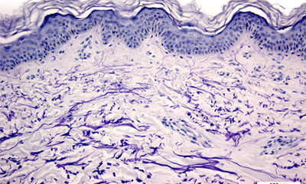
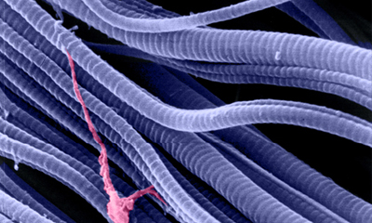
THE DERMIS
DEFINITION & ROLE
FIBROBLASTS
Dermis: support tissue for the skin
Made up of 2 parts
The superficial layer of the dermis is called the dermal papillae
The deep layer of the dermis is called the reticular dermis
Made up of:
Fibroblasts that produce a network made of collagen and elastin fibers that ensure anchorage between the dermis and the epidermis
They also synthesize GAGS
80% water - Glycoaminoglycanes (GAGS)
Blood vessels: nutrient exchange
Nerves: skin sensitivity
Lymphatic system: defense for the organism
Collagen fibers
Elastin fibers in the dermis
Collagen fibers under the microscope
Notes:
The dermis is the support tissue for the skin
It is located below the epidermis and is separated from the epidermis by the dermal-epidermal junction
It is usually thicker than the epidermis and its thickness varies according to the part of the body where it is located.
It is made up of 2 parts: the dermal papillae and the reticular dermis
It serves as water storage and a matrix for the skin which provides firmness and suppleness.
The dermis contains:
- A majority of fibroblast cells that produce:
Ground substance: an aqueous gel made of large molecules called proteoglycanes: glycoaminoglycanes (GAGS) and hyaluronic acid.
The GAGS capture water and transform the dermis into a natural water reservoir for the skin (made of 80% water)
Elastin fibers ensure the skin’s elasticity
Elastin: a protein that is synthesized by fibroblasts in the dermis.
Elastin enables the skin to stretch and return to its original shape after straining.
Just under the epidermis, elastin forms a discontinuous network that is thicker on the face.
Collagen fibers ensure the skin’s firmness and make it resistant to tension and traction.
Collagen: a filament protein that makes up 70% of the dermal matrix that is constantly produced by fibroblasts to maintain the skin’s suppleness and resistance.
Blood vessels bring nutrients and oxygen to surrounding cells and to cells in the basal layer through the dermal-epidermal junction.
Nerves make skin sensitive. They enable the skin to perceive various sensations: touch, hot, cold, or pressure. Merkel cells are located in the dermis and their nerve endings reach the epidermis.
The lymphatic system is a circulatory system that includes lymph, lymph vessels and lymph glands. Lymph collects waste products from cells and eliminates toxins. It participates in the organism’s immune system.
Auxiliary elements of the skin: hair, sudoriferous glands that produce perspiration and sebaceous glands that produce sebum.
Possible malfunctions:
The fibroblast population decreases by half between the ages of 20 and 80.
The deterioration of collagen and elastin fibers causes the skin to lose elasticity and tone. The facial contour begins to sag.

Slide 23
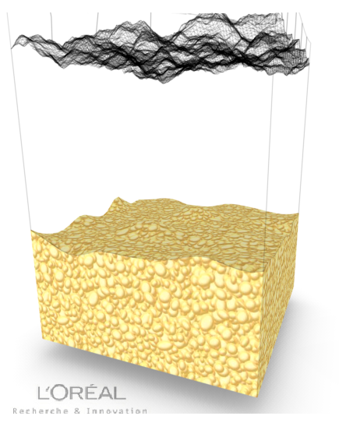
THE HYPODERMIS
http://www.skin-science.fr/_int/_fr/SKIN3D/EN/index_droit.htm

Slide 24
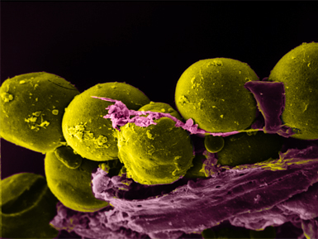
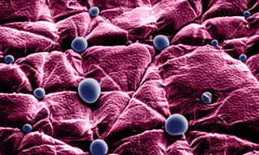
THE HYPODERMIS
DEFINITION & ROLE
Hypodermis: the deepest compartment of the skin
Plays a role in energy storage, protection against impacts and thermal insulation
Made up of:
adipocytes: fat cells
sudoriferous glands
Adipocytes organized
into separate lobes
Sudoriferous glands
Notes:
The hypodermis (or subcutaneous tissue) is the deepest and thickest compartment of the skin.
It is not separate from the dermis.
It is a supple and supportive tissue that will hold its shape and whose role is to serve as an interface between the skin and the organs that it covers (muscles, bones).
The hypodermis is present all over the body except for the ears, the eyelids and the male genital organs.
It is especially thick on the parts of the body that are exposed to high pressure, such as the heels or buttocks.
The hypodermis plays a role in energy storage and protection against impacts.
The hypodermis participates in thermoregulation, the fat plays a passive role in insulation, reducing temperature exchanges with the external environment.
It is made up of:
adipocytes: cells that are specialized in accumulating and storing fat and are located in adipose tissue (triglycerides). They are grouped into lobes that are separated by conjunctive tissue.
sudoriferous glands that secrete sweat.
It is responsible for the body’s silhouette.
The location of cellulite in women.
Although the hypodermis covers the entire body, it tends to accumulate above the belt on the stomach and shoulders in men and below the belt on the thighs, hips and buttocks in women.
Possible malfunctions:
Too much fat storage causes the appearance of orange peel skin and cellulite. Excess fat that is ingested is stored by the skin as subcutaneous fat.
Transition: "Before we take a break, I suggest that we look at a simplified diagram of the skin and review the essential terms."

Slide 25
DIAGRAM OF THE SKIN
I EPIDERMIS
II DERMIS
III HYPODERMIS
Basal layer
6. Stratum corneum
8. Keratinocytes
9. Melanocytes
18. Ground Substance
19. Elastin fibers
20. Collagen fibers
21. Fibroblast
27. Adipocytes
I
6
3
9
II
8
19
22
21
18
20
III
27
PHOTO – INTERNAL USE ONLY

Slide 26
SKIN
AGEING
Notes:
The skin goes through 2 main changes during a person’s lifetime.
The skin matures from birth until the person reaches 20 years old.
After 20, the skin begins to feel the effects of natural ageing.
Slowly, imperceptibly, the passing of time changes the appearance of the skin.
Transition
Ask the participants to react:
"In your opinion, what are the first signs of skin ageing?"

Slide 27
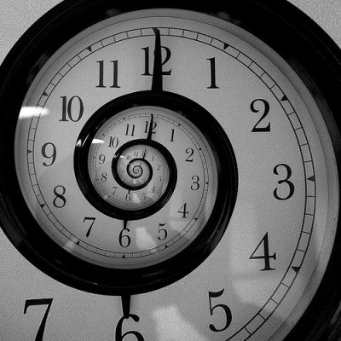

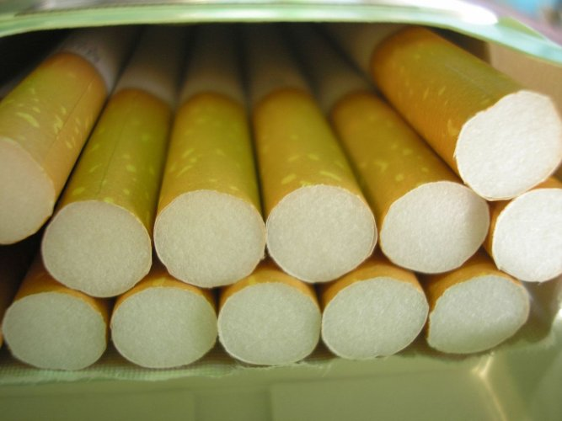


SKIN AGEING
DEFINITION & ROLE
Chronological ageing
due to passing time
Oxydative ageing
due to external factors
Notes:
Skin ageing is the weakening of the matrix in the epidermis and the dermis.
On the surface, the skin is dry and wrinkles appear.
In the dermis, support fibers deteriorate and do not regenerate well.
The dermis loses substance, the skin slackens and wrinkles form.
There are two types of ageing:
Ageing due to passing time, also called intrinsic genetic or chronological ageing
Ageing due to external factors related to environment and lifestyle, also called extrinsic ageing such as:
oxidative stress, pollution, tobacco,
poor lifestyle habits, poor eating habits,
Exposure to the sun (Ultraviolet rays): some people who work outdoors, such as farmers or gardeners, are more exposed to the sun, and are subject to photo-ageing.
75% of ageing concerns the face
80% of ageing is due to action from external factors, also called free radicals
2 wrinkles out of 3 are caused by free-radicals
Day after day, they destroy cells
They quietly and painlessly damage the skin
They are the cause of wrinkles, dark spots, loss of firmness, and therefore ageing.
In more scientific terms, what are free radicals?
Free radicals are produced in excess by cells under the influence of different types of stress. They are molecules that are unstable in oxygen and therefore they take electrons from other molecules to re-establish stability. This causes a chain reaction that leads to skin ageing.
20% of the remaining types of ageing are of genetic origin

Slide 28
SKIN AGEING
WHAT HAPPENS DURING SKIN AGEING?
EPIDERMIS | Slowing of cell division: reduction in keratinocytes, Reduction in melanocytes (10 to 20% per decade from 30 years old), Appearance of pigmentation spots, Reduction in Langerhans cells, Slowing in the production of vitamin D, Reduction in epidermal hydration, which goes from 13% to 7% in mature skin.
THE DERMAL-EPIDERMAL JUNCTION | Reduction in the adhesion of keratinocytes to the matrix, Reduction in anchoring fibers: as dermal fibroblasts are fewer in number, anchoring fibers no longer play their role as the junction between the dermis and the epidermis, Flattening of the DEJ.
DERMIS | Reduction in the size and number of fibroblasts, The dermis becomes less supple, Alteration of the elastic fibers in the dermis: loss of suppleness and firmness, Significant in-depth dehydration: hyaluronic acid content reduces by a third each day, Slowing of blood microcirculation: vascular damage, disturbance in thermo-regulation.
HYPODERMIS | Adipocytes lose volume, the hypodermis thins in certain areas.

Slide 29
SKIN AGEING
DEFINITION
Chronological and environmental ageing
Appearance of wrinkles
Dull complexion
Pigmentation
Sagging skin
Notes:
What is the skin ageing process?
As we have just seen, it is a combination of chronological ageing and environmental ageing.
The 1st signs of ageing show on the skin.
Expression lines
These come from grimaces, twitches, squinting eyes, pursing lips.
Expression lines are related to repetitive movement and facial muscle tension (forehead, corners of the mouth) that pull on the deep part of the dermis, which hollows and forms deep wrinkles over time.
They can be compared to a pair of shoes that have permanent folds in places from walking. They are inevitable but they can be reduced by aesthetic procedures performed by dermatologists.
Wrinkles/fine lines
They are caused by sun exposure. This is an accelerated form of ageing that dermatologists call photo-ageing, you will also hear dermatologists speak about solar radiation.
In addition to being a simple phenomenon of skin ageing, wrinkles have significant consequences on a person’s psychological state because they are often considered as unsightly changes.
Dull complexion: the skin lacks radiance
Pigmentation: appearance of pigment spots (dark spots)
Sagging: loss of density
Transition
"For a better understanding of the slow process of skin ageing, let’s watch this film made by the L’OREAL Research Laboratories."

Slide 30

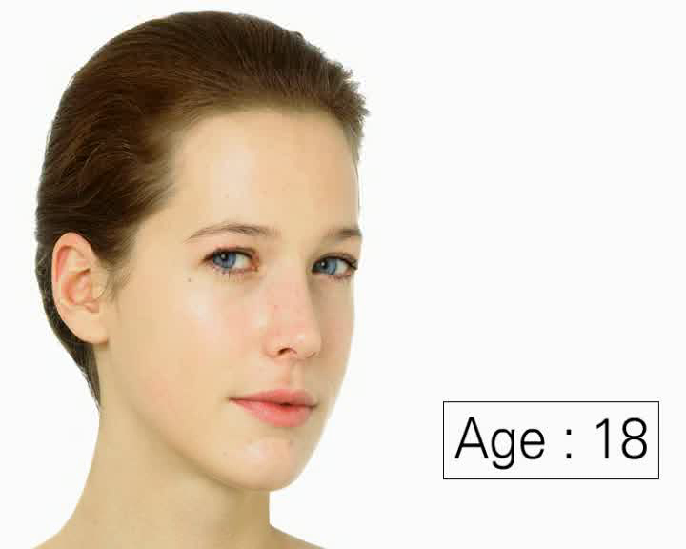

SKIN AGEING
FILM
Notes:
Click on the button to start the film
FILM AND PHOTOS FOR INTERNAL USE ONLY.
WE NO LONGER HAVE THE RIGHTS FOR THE MODEL
The ageing process was simulated by a plastic surgeon and a computer graphics artist to produce the most realistic results.

Slide 32
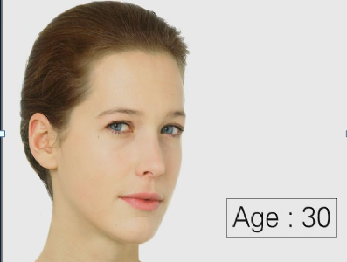
SKIN AGEING
THE AGEING PROCESS – 30 YEARS
FROM
Notes:
We say that skin ageing begins at age 20 - 25.
What happens at 30?
Fine lines appear
50% of women have wrinkles between their eyebrows at this age,
38% in the eye area, 33% in the nasal-labial furrows (the crease from the nose to the corner of the mouth),
The skin becomes dry, fine lines appear around the eyes and mouth,
The skin loses tone, is less firm and sags,
The dermis begins to lose its collagen and elasticity beginning at 30,
Dark circles become slightly more visible.
Explanation of malfunction
Internal forces of tension (grimaces, expressions …) and external forces (folds of the ear area that form on the cheeks, pressure, etc.) have an impact on the skin and in the end, they visibly mark the face.
Chronological ageing causes flattening of the Dermo-Epidermal Junction: wrinkles appear.

Slide 33
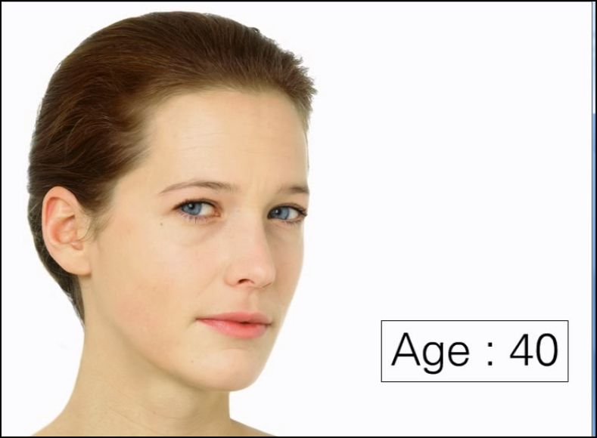
SKIN AGEING
THE AGEING PROCESS – 40 YEARS
FROM
Notes:
What happens at 40?
Expression lines appear
Wrinkles become more pronounced on the forehead (appearance of folds) eyes (appearance of crow’s feet) and the nasal-labial furrows,
The skin becomes rougher, less soft,
The lower part of the face gradually hollows, as do the cheekbones, the eyes, the eyebrows,
The volumes in the face change,
Creases form on the neck, arms and décolleté.
Explanation of malfunction
Expression lines begin to appear at forty because cellular regeneration slows, causing the epidermis to slacken.

Slide 34
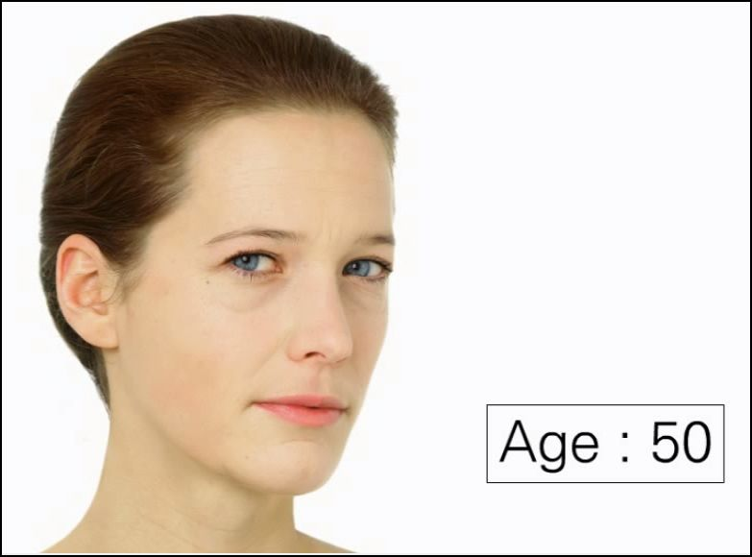
SKIN AGEING
THE AGEING PROCESS – 50 YEARS
FROM
Notes:
What happens at 50?
Loss of volume
The skin thins and dries,
The eye contour is very marked,
Wrinkles increase in the lip area,
Increased sagging of tissues especially toward the bottom of the face contour and the eyelids,
The skin loses its elasticity and firmness,
Appearance of small vessels, even rosacea,
Change in skin pigmentation,
Hands are marked: they lack moisture, the skin is thinner and pale beige spots appear,
Increased number of spots,
Increased folds around the mouth, double chin,
Increased sagging at the corner of the mouth and the tip of the nose,
The nasal-labial furrows become deeper.
Explanation of malfunction
Loss of firmness,
The number of fibroblasts decreases, the elastin fibers are altered and collagen fibers become rigid (glycation),
Finally, the amount of hyaluronic acid (responsible for skin volumes and density) decreases.

Slide 35
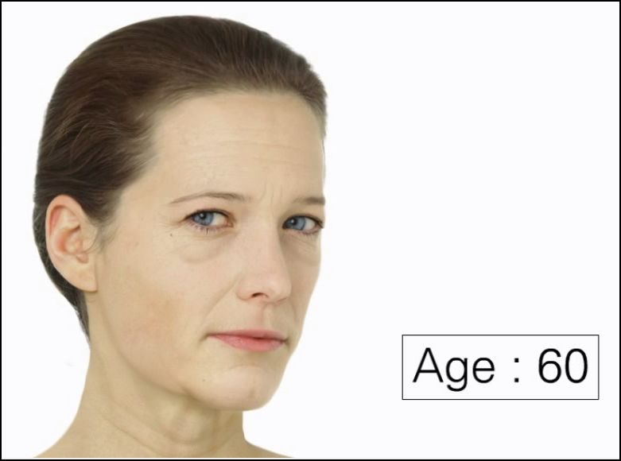
SKIN AGEING
THE AGEING PROCESS – 60 YEARS
FROM
Notes:
What happens at 60?
Skin problems related to hormonal deficiencies.
DHEA is an essential hormone for youthful skin. However, the maximum amount between 20 and 30 years of age gradually decreases and contributes to chronological skin ageing.
The spots on the hands become darker and more numerous. Some appear on the face,
Appearance of hair in areas that usually have no hair,
Changes in healing,
Dryness that causes itching,
Wrinkles that form crow’s feet, frown lines, wrinkles on the forehead and neck become very deep,
Skin lacks vitality, is flaccid,
The complexion becomes dull and loses its radiance. Skin is pale,
Puffiness appears under the eye contour,
The skin becomes increasingly thinner and flaccid,
The eyelids become increasingly flaccid and droop.
Transition
"In the 4 stages of the ageing process that we have just seen, we focused mainly on changes of genetic origin or on chronological ageing. Now let’s look at the effects that the sun has on the skin, also called photo-ageing."

Slide 36
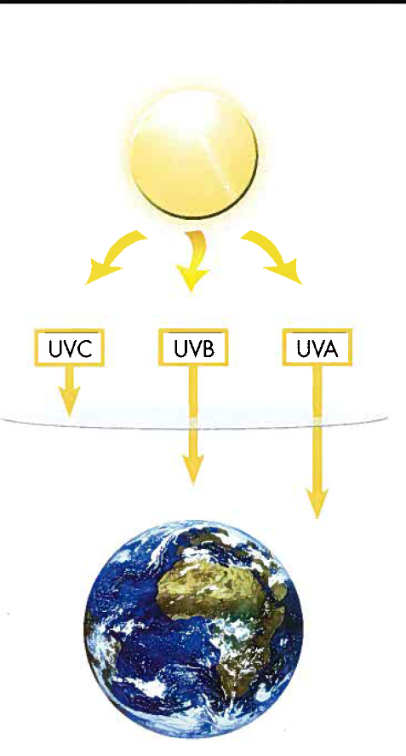
SKIN AGEING
PHOTO-AGEING
UV (Ultraviolet) rays are the main source of free-radicals.
There are three types of UV rays
    UV-A
    UV-B
    UV-C
Notes:
Solar radiation is defined by units: the wavelength is expressed in nanometers.
It depends on ground reflection (grass, sand, water, snow), altitude, the season, the time of exposure and the state of the sky (cloudy, hazy).
UV-A
They account for 95% of UV rays that reach the surface of the Earth and they can penetrate windows. 70% reach the epidermis and the dermis.
They are responsible for direct pigmentation, 1st day tanning disappears.
They cause accelerated ageing (photo-induced) of the skin, free-radicals and skin cancer because they penetrate deeper.
They weaken the immune system.
Mnemonic tip UVA: A like Age.
UV-B
They account for the remaining 5% and cannot penetrate windows. 80% are stopped by the stratum corneum but 20% penetrate the epidermis and 10% the dermis.
They are responsible for indirect pigmentation following erythema.
They cause redness, burns (sunburn, solar erythema).
They alter the cellular membranes and DNA.
They weaken the immune system and cause skin cancer.
Mnemonic tip UVB: B like Burn and Bronze.
UV-C
They are the most aggressive and they are stopped by the atmosphere (the ozone layer). The do not reach the epidermis or the dermis.
Infrareds
They are very penetrating, they reach the epidermis, dermis, and hypodermis, they warm the skin and cause sunstroke (heatstroke).
Prolonged exposure to the sun over several years has repercussions on premature skin ageing: more numerous and deeper wrinkles appear, there are more brown spots, the skin becomes less supple and loses elasticity.

Slide 37

SKIN AGEING
PHOTO-AGEING
What are the effects on the skin?
Positive effects
Sensation of well-being
Vitamin D synthesis
Tanning, sunny complexion
Negative effects
      Sunburn
      Photo-ageing
      Skin cancer
What is a sun protection index?
Notes:
Prolonged exposure to the sun triggers immediate reactions from the skin according to the type of rays.
Tanning
Immediate, temporary pigmentation that fades after a few hours.
Delayed pigmentation that starts approximately 1 or 2 days after exposure reaching its peak on about the 20th day of exposure. Tanning gradually fades without renewed sun exposure.
Delayed tanning causes a copper/bronze tone. For some redheads, sun exposure brings out freckles.
Sunburn or solar erythema
Aspect varies depending on intensity, the length of exposure, the photoype (skin types), the location of exposed skin and pigmentation.
Deeper skin shades are less sensitive than fair skin.
Heatstroke
Headache, overall malaise, hyperthermia, confusion with saturation of thermoregulation due to infrared rays.
The sun accelerates the skin’s ageing process.
Photo-ageing – early skin ageing
Concerns people who work outdoors or intensive tanning enthusiasts.
The skin is dry, prematurely wrinkled, dehydrated, has scattered pigmented spots and loss of elasticity.
The elastin fibers in the dermis are affected by solar elastosis, (small white lumps appear under the skin, the skin is loose and deep creases form in the flesh.
Skin cancer
Concerns people who work outdoors or intensive tanning enthusiasts.
When exposure to the sun is intense and repeated, the cellular repair mechanisms are not sufficient to heal wounds. DNA mutations occur: the damaged cell can multiply uncontrollably and become cancerous because the UVA and UVB rays reach the keratinocytes in the basal layer, where division and differentiation takes place. The cellular division process is affected, cancer develops.
Protection index
A sunscreen product acts like a parasol: the index indicates the parasol’s capacity to absorb more or fewer rays, preventing the skin from being exposed to all of the sun’s rays.
The index represents the multiplication factor of time that the skin can naturally protect itself, or about 15 minutes. This is an average that varies according to individuals.
For example, a sunscreen with the index of 10 indicates that solar erythema will be delayed by 10: 10 x 15 = 150 minutes, or 1:30.
Warning: perspiration, rubbing from a beach towel, the amount of product applied, the season, the place and other factors, reduce this theoretical time. Therefore, it is strongly recommended to apply the sun product more frequently. Of course, it is an index of protection and should not be considered as a value indicating total safety, such as wearing a hat, sunglasses, a t-shirt …

Slide 38
QUESTIONS
&
ANSWERS
?

Slide 39
QUESTIONS & ANSWERS 1/3
Does the skin regenerate itself?
Yes. The epidermis is completely regenerated every 28 days. The dermis is much slower to regenerate, taking 6 to 12 months.
That is why some deep wounds are slow to heal or sometimes never heal completely.
How long can skin live?
Its life expectancy is estimated to be at least 130 years. Compared to other organs that age faster, it is certainly the most resistant. Jeanne Calment, the oldest living French woman, was able to testify to that fact.
?

Slide 40
QUESTIONS & ANSWERS 2/3
Why do some people have oily skin, others dry skin and others both?
Oily skin is located mainly on the face and upper torso. It is caused by the presence of many active sebaceous glands and is also dependent on hormones and genetic heritage.
Dry skin is less localized and covers all areas of the body, in particular areas where there are few, slightly active sebaceous glands. That is the case for the lower legs. Dry skin is sensitive to weather conditions (air conditioning, sun …), and dryness increases in winter.
?

Slide 41
QUESTIONS & ANSWERS 3/3
What are the skin’s main enemies?
- The sun
Certain micro-organisms (bacteria, yeasts, viruses)
Natural ageing
Pollution
- Certain hormonal disorders
Certain nutritious deficiencies
Poor lifestyle
Tobacco…
Are we all equal under the sun?
Not at all. Although the sun shines on everyone, it does so in a very unequal way. That is why dermatologists have"classified" different phototypes according to their tendency to burn (or not) and to tan (or not).
The least protected (for example redheads) always burn and tan very little, while others who are better "armed" (people with deeper skin tones) burn little and always tan.
?

Slide 42








PART 2:
AESTHETIC MEDICINE PROCEDURES AND HR SOLUTIONS

Slide 43


INTRODUCTION What is aesthetic medicine?
Gentle treatment for the first signs of ageing, from 30 years, to leave the skin visibly younger.
Examples:
- Laser: treatment for dark spots, rosacea
- Injections: filling wrinkles, volume
- Peeling: improving skin quality, reducing scars
- Mesotherapy: micro injections of vitamins for radiance and lift
Notes:
The practice of aesthetic medicine means that procedures can be undertaken gently and in plenty of time, right from 30 years, when the first signs of ageing appear.
Aesthetic medicine helps to remove dark spots, rosacea and minor varicose veins.
It removes wrinkles by filling them with special products or acting directly on the muscles responsible.
The technique and the products selected depend on the shape, depth and location of the wrinkles. Various techniques can also be combined in order to achieve the best result.
Wrinkles can be treated by injecting filling products, botulinum toxin or vitamin cocktails, peeling, microdermabrasion, elimination of rosacea and dark spots, rejuvenation of the lips, décolleté and hands, long-lasting depilation. Today some medical procedures are replacing or being combined with surgery to restore new youth to your skin.
An initial consultation with an aesthetic doctor is essential for you to voice your expectations, study the various options and define a treatment strategy according to your personal situation.

Slide 44

INTRODUCTION What is aesthetic surgery?
A surgical procedure to correct deformities or physical features that the patient does not accept.
Examples:
- liposuction
- breast implants
- rhinoplasty
- face lift
Notes:
Also known as plastic surgery, aesthetic surgery is a surgical procedure performed in order to correct the deformities or physical aspects of his/her appearance that the patient does not accept.
With aesthetic surgery, it is now possible to rework all parts of the body. The best known surgical procedures are: liposuction, breast implants, rhinoplasty and face lifts.
Aesthetic surgery operations are performed in an operating theatre, under general or local anaesthetic, depending on the type of operation.

Slide 45


INTRODUCTION Aesthetic medicine v aesthetic surgery
Aesthetic medicine ➔
Non-surgical procedure, non-invasive, gentle
Treatment on the skin surface, no deeper than the dermis
Does not involve passing through skin tissue or mucous membranes.
Requires post-procedure care
AESTHETIC MEDICINE
Aesthetic surgery ➔
Invasive treatment, surgical
Requires the administration of a substance in the patient's blood circulation
AESTHETIC SURGERY
Notes:
What is the difference between aesthetic medicine and aesthetic surgery?
By treating the first signs of ageing early, aesthetic medicine helps to constantly delay the time when the patient will undergo surgery.
In some cases, going under the knife remains the only choice if an optimum result is desired.
Aesthetic medicine is less invasive, it involves gentler procedures which do not require extended stays in a clinic.

Slide 46
INTRODUCTION The international aesthetic medicine market
81.6% of aesthetic procedures are non-surgical
Aesthetic surgery is declining (-20%) to the benefit of aesthetic medicine (+99%)*
The growth of aesthetic medicine will increase by +10% → 2013
TOP 5 AESTHETIC PROCEDURES**
1. Botulinum toxin injections
2. Hyaluronic acid injections
3. Laser depilation
4. Microdermabrasion
5. Intense Pulsed Light - IPL
AESTHETIC MEDICINE
AESTHETIC SURGERY
*Source: ASPS for the period 2000 - 2009 **Source: ASAPS 2009
** Excluding prices at LACLINIC-MONTREUX
Notes:
Data source: ASPS (American Society of Plastic Surgeons). These data should be adapted according to the market.
In just a few figures, here is the evolution of the procedures, frequency and scope of demand for aesthetic medicine.
For the last decade, between 2000 and 2009, there was a significant increase in the aesthetic medicine and aesthetic surgery market: +69%
However, aesthetic surgery itself declined sharply during this period: -20%
While moderately invasive aesthetic medicine climbed: +99%
The most often-requested procedures:
- Botulinum toxin injections, which reported incredible growth between 2000 and 2009, but seem to have slowed over the last two years. However, there are still new research avenues to be explored in terms of lower, but more frequent doses of botulinum toxin, and in terms of applying it to other parts of the face than the forehead
- "Dermal fillers", which are dominated by hyaluronic acid injections, are seen as more accessible and provoke less anxiety in patients. Hyaluronic acid is naturally present in the body and has significantly fewer side effects than botulinum toxin. These techniques therefore have a bright future, in particular because it is easier for a practitioner to obtain a licence to perform these sorts of injections than for botulinum toxins. We will present a summary of the techniques a little later
- Microdermabrasion and chemical peels are two very popular techniques for skin "resurfacing". These techniques tend to attract a wider age range: they can be selected after an acne treatment, or indeed they can be requested for their anti-wrinkle results.
IPL (Intense Pulsed Light) has effects which are similar to the laser. This technique is used for depilation, for the treatment of redness and rosacea but also as "rejuvenating" treatments which boost the skin's collagen production: "Photorejuvenation".
For information:
1. Injections: €200 to €400 / twice a year.
2. Laser: €150 to €400 per session / 4 times a year.
3. Peels: €150 to €600 per session / twice a year.
4. Mesolift: €130 to €410 per session / 3 times a year.

Slide 47



AN UNPARALLELED PARTNERSHIP WITH LACLINIC-MONTREUX
Notes:
As the previous slide shows, aesthetic medicine procedures are increasingly popular among women. Women now prefer to choose gentler, non-invasive methods such as aesthetic medicine, rather than immediately selecting to undergo aesthetic surgery.
As a pioneer and visionary, just like its creator, the Helena Rubinstein brand was been able to detect this trend for aesthetic medicine before anyone else.
As an initiator of avant-garde anti-ageing cosmetics and a pioneer in the creation of clinically-inspired skincare, the Helena Rubinstein brand achieved new heights in its quest for cosmetic excellence by partnering with LACLINIC-MONTREUX: an unprecedented alliance between two anti-ageing experts.
And a first for a cosmetics brand!
The partnership between LACLINIC-MONTREUX and Helena Rubinstein is testament to the unique quality of HR.
LACLINIC-MONTREUX (a Swiss clinic) is one of the world's most prestigious clinics, known all over the globe for the spectacular results achieved by its specialists, who are able to combine art with science.
This partnership has enabled the Helena Rubinstein brand to develop highly concentrated products, which replicate the 4 most popular aesthetic medicine procedures in the world, to achieve results which are right on the cusp of aesthetic medicine.
HR works in close partnership with Dr. Pfulg, an aesthetic surgeon and founder of LACLINIC-MONTREUX, to develop its products, going so far as to replicate aesthetic medicine procedures.

Slide 48


AN UNPARALLELED PARTNERSHIP WITH LACLINIC-MONTREUX
INTERVIEW WITH DR. PFULG
Notes:
Click on the active zone to start the film.
Film already available on HR-eLINK in the PODCAST section.

Slide 49
AN UNPARALLELED PARTNERSHIP WITH LACLINIC-MONTREUX
Notes:
After the movie, the trainer invites participants to give the key words of the film.
The trainer writes the key words on the flipchart.
Here is the feedback from the film:
Dr. Pfulg:
“Dr. Pfulg is an aesthetic surgeon and the founder of LACLINIC-MONTREUX.”
LACLINIC-MONTREUX treatments:
“At LACLNIC-MONTREUX, they perform minimally-invasive or non-invasive treatments such as peels, botox, fillers, mesotherapy etc. The Re-PLASTY range is thought to maintain those results.
- Re-PLASTY products:
“Re-PLASTY products are inspired by the treatments performed at LACLINIC-MONTREUX. They have the most active ingredients in the highest concentrations, which means that they can achieve spectacular anti-ageing results.”
Helena Rubinstein and LACLINIC-MONTREUX share the same search for extreme effectiveness, and this is what really matters to Dr. Pfulg, and why for him, this partnership came naturally.

Slide 50

AN UNPARALLELED PARTNERSHIP WITH LACLINIC-MONTREUX
INTERVIEW WITH DR. PFULG
Notes:
Click on the active zone to start the film.
Film pending, arrival September.
The following questions were put to Dr. Pfulg:
Why did you decide to create your own Aesthetic Surgery and Aesthetic Medicine clinic?
• What is the approach you take to beauty at the clinic?
• What are the expectations of the women who come to LaClinic-Montreux?
• How did you meet Helena Rubinstein? / Tell us more about your meeting with Helena Rubinstein?
• How would you recommend using the Re-PLASTY range?
• How was AGE RECOVERY cream created?
• Please tell us more about this product.
• What is next for you?

Slide 51
AN UNPARALLELED PARTNERSHIP WITH LACLINIC-MONTREUX

Slide 52







PRESENTATION OF LACLINIC-MONTREUX
-
an aesthetic medicine centre
a beauty institute
a dental clinic
a plastic, reconstructive and aestheic surgery department
on the cutting edge of
technology
Notes:
In this exceptional place, where medical perfection is given as much importance as artistic technique, but where the act of surgery is only performed as a last resort, all the possible medical and paramedical specialities are combined:
a beauty institute: face and body treatments, endermologie (cellu M6), post- and pre-operative care, permanent depilation, etc.
an aesthetic medicine centre: treatment of wrinkles with injections, non-surgical lifts, mesotherapy, laser or flash lamp photorejuvenation, peels, dermabrasion, laser skin firming, etc.
a dental clinic
a plastic, reconstructive and aesthetic surgery department on the cutting edge of technology: treatment of wrinkles, surgery for eyelids, nose, ears, face-lifts, chin reshaping with or without implants, thighplasty, abdominoplasty, lipofilling or lipostructure, hair implants.

Slide 53








THE MEDICAL TEAM AT LACLINIC-MONTREUX
Aesthetic surgeons:
Anaesthesiologist:
Dr. Serge Lê Huu
Dr. Michel Pfulg
Dr. Bertrand Mercadier
Dr. Jean Blanchard
Dermatologist:
Aesthetic
doctor:
Dental
surgeon:
Physiotherapist:
Dr. Eleonora Gambillara
Dr. Violette Gribinski
Dr. Milos Tomic
Dr. Jean-Marc Tétier
Notes:
Here is the LACLINIC-MONTREUX medical team:
Dr. Serge Lê Huu
Plastic, reconstructive and aesthetic surgeon FMH*
Dr. Michel Pfulg
Plastic, reconstructive and aesthetic surgeon FMH*
Dr. Bertrand Mercadier
Plastic, reconstructive and aesthetic surgeon
Dr. Jean Blanchard
Specialist in anaesthesiology-surgical recovery
Dr. Eleonora Gambillara
FMH Dermatologist
Dr. Violette Gribinski
Specialist in aesthetic medicine
Dr. Milos Tomic
Dental surgeon
Dr. Jean-Marc Tétier
Physiotherapist, LPG Endermologist
FMH*: Formation Milieu Hospitalier (hospital-based training)

Slide 54

BEAUTY INSTITUTE TEAM AT LACLINIC-MONTREUX
Guilia Longobardi & Irène Bruesch
Notes:
Irène Bruesch and Guilia Longobardi are the two expert aestheticians at LACLINIC-MONTREUX. These two professionals share their expertise with us for the development of our Helena Rubinstein skincare protocols.

Slide 55
Dr. MICHEL PFULG, AESTHETIC SURGEON AND FOUNDER OF LACLINIC-MONTREUX
Pioneer of the soft-lift, fascinated by facial surgery
Art enthusiast and collector
Author of the book: "La Beauté, tout un Art", published by Editions Arziates (1998)
Member of the IPRAS (International Confederation
for Plastic, Reconstructive and Aesthetic Surgery)
Member of the Société Suisse de Chirurgie Plastique, Reconstructive et Esthétique
Member and past-president of the Société Suisse de Médecine Esthétique
Member of the American Society for Aesthetic Plastic Surgery
Author of many scientific articles
Responsible for training on face lifts at the European Board (EBOPRAS)
Notes:
Plastic, reconstructive and aesthetic surgery FMH
Dr. Michel Pfulg is the founder of Laclinic. He began his career as an aesthetic surgeon, leading a hospital-based plastic and reconstructive surgery department before being named director of the aesthetic surgery department at Clinique Valmont, in the Hauts de Montreux, Switzerland. He then practiced his speciality at the La Prairie clinic in Clarens-Montreux.
"The harmony of the face or body depends as much on technical and medical competence as it does on artistic style". Whether in terms of aesthetic surgery or reconstructive surgery, he never revolutionizes. He perfects.
Dr. Michel Pfulg's belief has become the key to his reputation. His natural sense of aesthetics and the passion he has for his art has led him to take a leading position among those who now give this science noble ranking and allow him to make a name for himself.
Dr. Michel Pfulg is a member of the Société Suisse de Médecine, the Société Suisse de Chirurgie Plastique, Reconstructive et Esthétique, the Société Suisse de Médecine Esthétique, which he chaired in 2004, the International Society for Aesthetic Plastic Surgery and the International Confederation of Plastic and Reconstructive Surgeons.
This author of many scientific articles is also an international correspondent and member of the American Society for Aesthetic Surgery.
He work "La Beauté, tout un Art" was published in 1998 by Editions Arziates.

Slide 56



AESTHETIC MEDICINE The most popular aesthetic medicine procedures
CORRECT: The 4 most popular aesthetic medicine procedures
1- Mesolift
2- Peeling
3- Laser
4- Injections
+
REPAIR: Post-procedure care
Notes:
Here are the 4 most popular aesthetic medicine procedures at LACLINIC-MONTREUX, the prestigious aesthetic medicine and surgery clinic in Switzerland.
Let's learn more about these 4 aesthetic medicine procedures in just a few words:
1- Mesolift: micro injections of vitamins, revitalizing anti-ageing molecules (hyaluronic acid) and amino acids into the dermis to deliver radiance to the skin, leaving it smooth and with an instant lift effect.
2- Peeling: the application of an acid solution onto the skin using a brush, to renew the epidermis through desquamation and improve the skin quality: wrinkles and imperfections are erased.
3- Laser: a technique which diffuses pulsed light on 3 wavelengths to target the 3 signs of chromatic ageing, for more radiant, more even-toned skin: dark spots, redness and imperfections are reduced.
4- Hyaluronic acid injections: intradermal injections of hyaluronic acid, which help to fill wrinkles and restore volume to the patient's face by reviving the energy and vitality of the skin.
These 4 procedures are designed to correct the skin.
After each aesthetic medicine procedure, post-operative care is administered to the patient's face. This skincare is designed to repair the skin intensely, as it has just endured the "aggression" of the procedure.
Helena Rubinstein and LACLINIC-MONTREUX have taken inspiration from these 4 procedures and post-operative care techniques to develop its Re-PLASTY range.
We are now going to go into detail for each aesthetic medicine procedure, then we will examine each of the products in the Re-PLASTY range.

Slide 57
INTERVIEW WITH DR. GAMBILLARA, DERMATOLOGIST AT LACLINIC-MONTREUX
INTERVIEW WITH DR. GAMBILLARA
Dr. Eleonora Gambillara
FMH Dermatologist*
AT LACLINIC-MONTREUX
* Formation Milieu Hospitalier (hospital-based training)
Notes:
Film pending, arrival September..

Slide 58

MESOTHERAPY
EXPLAINED BY DOCTORS AT
LACLINIC-MONTREUX

Slide 59
MESOTHERAPY EXPLAINED BY DOCTORS AT LACLINIC-MONTREUX PRESENTATION
“MESOTHERAPY: Sub-cutaneous injection of active ingredients (droplets of medication are deposited under the skin using fine needles).
Main advantage: Achieve a local effect with no toxicity for the other organs and without any drug-related interaction.”
In aesthetic medicine, mesotherapy helps to treat:
Skin ageing
Cellulite
Hair loss
Dr. Eleonora Gambillara*
FMH Dermatologist**
Dr. Violette Gribinski*
Specialist in aesthetic medicine
* Laclinic-Montreux
** Formation Milieu Hospitalier (hospital-based training)
Notes:
"MESOTHERAPY: Technique which involves a sub-cutaneous injection of active ingredients (droplets of medication are deposited under the skin using fine needles).
Main advantage: Achieve a local effect with no toxicity for the other organs and without any drug-related interaction."
"In aesthetic medicine, mesotherapy helps to treat skin ageing, cellulite and hair loss.”

Slide 60
MESOTHERAPY EXPLAINED BY DOCTORS AT LACLINIC-MONTREUX PRESENTATION
SKIN AGEING | CELLULITE | HAIR LOSS
Injection of a cocktail of vitamins and hyaluronic acid. Results: glossy sheen, gradual reduction in fine wrinkles and firming of the skin. Price: €290 | Injection of medicines which release the fats and tone up the muscles and veins. Results: loss of fat which can be measured in centimetres and a reduction in the "orange peel skin" effect. Price: €210 | Injection of the vitamins and trace elements required for regrowth. Results: initial cessation of hair loss followed by gradual regrowth. Price: €210
Dr. Eleonora Gambillara*
FMH Dermatologist**
Dr. Violette Gribinski*
Specialist in aesthetic medicine
* Laclinic-Montreux
** Formation Milieu Hospitalier (hospital-based training)
Notes:
"In aesthetic medicine, mesotherapy helps to treat:
Skin ageing: "injection of a cocktail of vitamins and hyaluronic acid. The result is a glossy sheen, with a gradual reduction in the number of fine wrinkles and firming of the skin."
Price: from €290
Cellulite: "injection of medicines which release the fats and tone up the muscles and veins. This leads to a loss of fat which can be measured in centimetres and a reduction in the 'orange peel skin' effect."
Price: from €210
Hair loss, ”by injecting the vitamins and trace elements needed for regrowth. The result is that hair stops dropping out to start with, and then later on there is gradual regrowth."
Price: from €210
At Helena Rubinstein, we have taken inspiration from mesotherapy which targets skin ageing.

Slide 61
MESOTHERAPY EXPLAINED BY DOCTORS AT LACLINIC-MONTREUX
PRECAUTIONS
Treatment is administered using very fine needles.
Practically painless and does not require any preparation or particular post-session care.
Injections cause moderate pain which can be described as similar to an insect sting.
May be performed by hand or using an electric gun device.
Exceptionally, bruising may occur on the face, spreading within a few days to the body.
Dr. Eleonora Gambillara*
FMH Dermatologist**
Dr. Violette Gribinski*
Specialist in aesthetic medicine
* Laclinic-Montreux
** Formation Milieu Hospitalier (hospital-based training)
Notes:
"Treatment is administered using very fine needles. It is practically painless and does not require any preparation or particular post-session care. Injections cause moderate pain which can be described as similar to an insect sting. May be performed by hand or using an electric gun device. Exceptionally, bruising may occur on the face, spreading within a few days to the body.
There are no contra-indications, other than pregnancy. The treatment is performed in sessions every 10 days for 4 to 6 weeks, then a booster treatment every 6 to 8 weeks."

Slide 62

PEELING
EXPLAINED BY DOCTORS AT
LACLINIC-MONTREUX

Slide 63
PEELING EXPLAINED BY DOCTORS AT LACLINIC-MONTREUX PRESENTATION
PEELING: Eliminates the upper layer of the skin surface, which means the most damaged cells in the epidermis.
It leaves the skin smoother and stimulates collagen and elastin fiber synthesis.
Actions: treats wrinkles, fine lines, pigmentation spots, acne scars and sagging.
Dr. Eleonora Gambillara*
FMH Dermatologist**
Dr. Violette Gribinski*
Specialist in aesthetic medicine
* Laclinic-Montreux
** Formation Milieu Hospitalier (hospital-based training)
Notes:
"In aesthetic medicine, peeling helps to smooth away wrinkles and fine lines by eliminating the upper layer of skin, which contains the most damaged cells in the epidermis. It leaves the skin smoother and stimulates collagen and elastin fiber synthesis.
Peeling helps to treat pigmentation spots, fine lines, minor acne scars and skin sagging. Different peels deliver varying degrees of action depth depending on the concentration of the products, the type of substance used, the time left on the skin and the number of layers applied."
We are now going to see that there are 3 types of peels.

Slide 64
PEELING EXPLAINED BY DOCTORS AT LACLINIC-MONTREUX PRESENTATION
SURFACE PEEL | MEDIUM PEEL | DEEP PEEL
Action in the epidermis and the outer layer of the dermis. Contents: glycolic acid. They can sometimes cause moderate burning and tingling. Red blotches on the skin are always minimal. Complete healing takes a week and the treatments can be repeated for in-depth action. Price: €250 | Action in the deepest layers of the skin, up to the middle dermis. Contents: trichloroacetic acid (TCA) or Amelan to treat pigmentation spots on the skin. The most painful and cause red blotches which last for a number of days, then desquamation. Healing takes place after a fortnight. Price: €290 to €1,250 | Action down to the deep layer of the dermis. These treatments are carried out under anaesthesiological monitoring by an aesthetic surgeon. Price: from €2,900
Dr. Eleonora Gambillara*
FMH Dermatologist**
Dr. Violette Gribinski*
Specialist in aesthetic medicine
* Laclinic-Montreux
** Formation Milieu Hospitalier (hospital-based training)
Notes:
- Surface peel (Glycopeel, Alpha-Beta)
“Surface peels act on the epidermis and the outer layer of the dermis. They can be used to treat acne, oily skin, certain forms of lentigo and fine wrinkles. Surface peels are carried out using glycolic acid. They can sometimes cause moderate burning and tingling sensations and any red blotches on the skin are always minimal. Complete healing takes a week and the treatments can be repeated for in-depth action.”
Price: €250
- Medium peel (Easy Peel, Amelan)
"Medium peels work on the deepest layers, up to the middle dermis. Medium peels are the most painful and cause red blotches which last for a number of days, then desquamation. Healing takes place after a fortnight. We generally use trichloroacetic acid (TCA) or Amelan to treat pigmentation marks on the skin.”
Price: Easy Peel: €290, Amelan, €1250
- Deep peel (Phenol)
“Deep peels go all the way down to the deep layer of the dermis. They are carried out under anaesthesiological monitoring by an aesthetic surgeon.”
Price: subject to estimate, from €2,900

Slide 65
PEELING EXPLAINED BY DOCTORS AT LACLINIC-MONTREUX PRECAUTIONS
Surface peel:
Apply a cream containing fruit acids prescribed by the dermatologist for 15 days before the procedure.
They are carried out every 10 to 15 days and again at intervals.
Medium peel:
Apply creams containing hydroquinone and vitamin A in the morning and evening several weeks before the procedure.
Carried out less frequently.
Deep peel:
Perform an anti-herpes treatment if the whole face will be treated with a peel.
Peels must not be followed by sun exposure (not recommended during the days following the peel due to the risk of skin hyperpigmentation),
There are no contra-indications.
Dr. Eleonora Gambillara*
FMH Dermatologist**
Dr. Violette Gribinski*
Specialist in aesthetic medicine
* Laclinic-Montreux
** Formation Milieu Hospitalier (hospital-based training)
Notes:
”Surface peels are carried out every 10 to 15 days and are then spaced out subsequently"
What to do prior to the treatment:
Apply a cream with fruit acids that the dermatologist will prescribe for you, at least 15 days before the peel.
What to avoid before the peel:
Do not apply any other cream without informing your dermatologist and above all, do not apply a cream containing acidic vitamin A.
”Medium peels are carried out less frequently. Avoid sun exposure (not advisable for a few days after a peel due to the risk of cutaneous hyperpigmentation), there are no contra-indications."
What to do prior to the treatment:
The darker the skin, the more preparation it needs
These creams contain hydroquinone and acidic vitamin A, that are applied morning and evening for several weeks prior to the peel.
These preparations are stopped 5 days before the peel, in order to avoid treating irritated skin.
Deep peels:
What to do prior to the treatment:
An anti-herpes treatment is required if the whole face is being treated with a peel.
Post-operative
You will have to wear a dressing that will prevent you from having a social and professional life for 8 days. Redness will continue for several weeks, but it will be easily concealed with high-coverage make-up.
Do not expose your face to the sun for 6 months.
Peels must not be followed by sun exposure (not recommended during the days following the peel due to the risk of cutaneous hyperpigmentation),

Slide 66

LASERS
EXPLAINED BY DOCTORS AT
LACLINIC-MONTREUX

Slide 67
LASERS EXPLAINED BY DOCTORS AT LACLINIC-MONTREUX PRESENTATION
LASERS: The light emitted by lasers or flash lamps is captured by the target cells and it causes them to be destroyed, which helps to act on upon the vascular or pigment cells to stimulate collagen synthesis without adversely affecting the other surrounding tissue.
There are various types of lasers, which have different effects on the tissue and therefore they have different medical indications.
Dr. Eleonora Gambillara*
FMH Dermatologist**
Dr. Violette Gribinski*
Specialist in aesthetic medicine
* Laclinic-Montreux
** Formation Milieu Hospitalier (hospital-based training)
Notes:
“The light emitted by lasers or flash lamps is captured by the target cells and it causes them to be destroyed, which helps to act upon the vascular or pigment cells or to stimulate collagen synthesis without adversely affecting the other surrounding tissue”
There are various types of lasers, delivering different tissue effects and therefore they have different medical indications:
Flash lamp
"PEARL" ablative laser
"TITAN" infra red lamp
Now let us look at these various types of laser in detail.

Slide 68
LASERS EXPLAINED BY DOCTORS AT LACLINIC-MONTREUX PRESENTATION
FLASH LAMPS | "PEARL" ABLATIVE LASER | "TITAN" INFRA RED LAMP
Emit varying wavelengths adusted by a filter. Results: younger skin overall, wrinkle treatment, skin firmness, sun-related dark spots and redness. | Helps to eliminate the supper layer of the skin. Results: instant radiance, smoother skin. | Stimulates the production of new collagen by warming the skin. Results: treats skin sagging for the face, abdomen and arms.
Dr. Eleonora Gambillara*
FMH Dermatologist**
Dr. Violette Gribinski*
Specialist in aesthetic medicine
* Laclinic-Montreux
** Formation Milieu Hospitalier (hospital-based training)
Notes:
"Flash lamps are different from lasers in that they emit a variable wavelength which can be adjusted using a filter. They are used for the treatment of wrinkles and skin firmness.
They deliver overall skin rejuvenation by treating dark spots associated with sun exposure and rosacea.
The "PEARL" ablative laser helps to eliminate the upper layer of skin. The result is a burst of radiance and smoother skin, at the cost of social eviction for 7 days. The application of an anaesthetic cream 1 hour prior to the treatment is required.
The infra red "Titan" lamp stimulates the production of new collagen by warming the skin. It treats skin sagging on the face, abdomen and arms.
Laser treatment causes moderate, but bearable discomfort. The treated surface may stay red for a few days. It is not recommended for patients to expose their skin to the sun, before and after the treatment."
At Helena Rubinstein, we have taken inspiration from flash lamps.

Slide 69
LASERS EXPLAINED BY DOCTORS AT LACLINIC-MONTREUX PRECAUTIONS
Flash lamps:
No sun exposure before or after the laser
"PEARL" ablative laser:
Social exclusion for 7 days
Application of an anaesthetic cream 1 hour before
No sun exposure before or after the laser
"TITAN" infra red lamp
No sun exposure before or after the laser
The laser treatment causes moderate, but bearable discomfort. The treated surface may stay red for a few days.
Dr. Eleonora Gambillara*
FMH Dermatologist**
Dr. Violette Gribinski*
Specialist in aesthetic medicine
* Laclinic-Montreux
** Formation Milieu Hospitalier (hospital-based training)
Notes:
"The laser treatment causes moderate, but bearable discomfort. The treated surface may stay red for a few days. It is not recommended for patients to expose their skin to the sun, before and after the treatment."

Slide 70

HYALURONIC ACID INJECTIONS
EXPLAINED BY DOCTORS AT
LACLINIC-MONTREUX

Slide 71
HYALURONIC ACID INJECTIONS EXPLAINED BY DOCTORS AT LACLINIC-MONTREUX PRESENTATION
HYALURONIC ACID INJECTIONS
Hyaluronic acid (HA) is a substance naturally present in the dermis which helps to hydrate tissue.
As we age, HA quality deteriorates and its quantity declines, leading to an alteration in the dermis (dried out skin, appearance of wrinkles, loss of volume).
With its volumizing and moisturizing effect, hyaluronic acid fills wrinkles and restores facial volumes.
Dr. Eleonora Gambillara*
FMH Dermatologist**
Dr. Violette Gribinski*
Specialist in aesthetic medicine
* Laclinic-Montreux
** Formation Milieu Hospitalier (hospital-based training)

Slide 72
HYALURONIC ACID INJECTIONS EXPLAINED BY DOCTORS AT LACLINIC-MONTREUX PRESENTATION
Non-allergenic, and completely resorbable.
Immediate and very natural aesthetic results.
Requires no interruption in social life.
Duration of the effect: between 6 and 12 months (varies depending on age, skin quality and lifestyle).
Injections cause only slight discomfort. If necessary, the doctor may offer a local anaesthetic to the patient comprising an aesthetic cream.
Price: 1 syringe, €650
2 syringes, €1080
Dr. Eleonora Gambillara*
FMH Dermatologist**
Dr. Violette Gribinski*
Specialist in aesthetic medicine
* Laclinic-Montreux
** Formation Milieu Hospitalier (hospital-based training)

Slide 73
HYALURONIC ACID INJECTIONS EXPLAINED BY DOCTORS AT LACLINIC-MONTREUX PRECAUTIONS
Redness, slight swelling or bruising may sometimes appear around the injected area.
Contra-indications: some illnesses may present contra-indications for the this treatment (autoimmune diseases, allergies, inflammatory or infectious disorders, etc.).
Dr. Eleonora Gambillara*
FMH Dermatologist**
Dr. Violette Gribinski*
Specialist in aesthetic medicine
* Laclinic-Montreux
** Formation Milieu Hospitalier (hospital-based training)
Notes:
Redness, slight swelling or bruising may sometimes appear around the injected area. These unpleasant effects are short-lived and can easily be concealed.
Some illnesses may present contra-indications for the this treatment (autoimmune diseases, allergies, inflammatory or infectious disorders, etc.). A consultation with a doctor who is experienced in aesthetic medicine is essential for a completely safe treatment.

Slide 74









INTRODUCTION Aesthetic medicine procedures and HR solutions
LACK OF RADIANCE, SAGGING
ROUGHNESS FINE LINES
DARK SPOTS DISCHROMIA
WRINKLES
LOSS OF ELASTICITY
CONCERNS
MESOTHERAPY
PEELING
LASER
INJECTIONS
PROCEDURE
CORRECT
POST-OPERATIVE CARE
+
Re-PLASTY MESOLIFT
Re-PLASTY HD PEEL
Re-PLASTY LASERIST
Re-PLASTY PRO FILLER
REPAIR
POST-OPERATIVE CARE
Dr. PFULG'S PRESCRIPTION
Re-PLASTY
AGE RECOVERY

Slide 75
Re-PLASTY OVERALL HOOK FOR THE WHOLE RANGE
HOOK
“Did you know that now you can achieve the efficacy of aesthetic medicine in a skincare?”
Re-PLASTY PRESENTATION
"I would like to invite you to discover Re-PLASTY, the first cosmetic range that replicates the most cutting-edge aesthetic medicine techniques.
Let me show you our 5 advanced cosmetic protocols created in partnership with LACLINIC-MONTREUX, one of the most prestigious aesthetic medicine clinics in the world, to offer you instant radical correction."

Slide 76


1- MESOLIFT PROTOCOL REMINDER
PROTOCOL REMINDER
MICRO INJECTIONS OF VITAMINS, HYALURONIC ACID AND AMINO ACIDS INTO THE DERMIS
TARGET
LACK OF RADIANCE, SKIN SAGGING, LOSS OF FIRMNESS, SIGNS OF AGEING
RESULTS
INTENSE REGENERATION OF SKIN LIFTING-RADIANCE (LUMINOSITY, RADIANCE, LIFT)
Avant
Après
Notes:
What is Mesolift?
It involves injecting the dermis with a fine needle containing very small quantities of specific products according to the requirements of the skin (vitamins, hyaluronic acid and amino acids). The whole face is targeted, with particular attention to wrinkles. Mesolift can be carried out by hand or with a gun device.
The injection is composed of a nutritious and revitalizing blend chosen by the doctor depending on the patient’s skin type. It contains vitamins, trace elements and minerals to stimulate microcirculation, oxygenation and the production of collagen. Hyaluronic acid is used since few years and permits to replump and rehydrate the dermis intensely.
This method mostly includes natural products. It gives fine, dull, dry, tired and damaged (sun, tobacco, etc.) skin a result that cannot be obtained using ordinary fillers.
It treats the condition of the skin (radiance and tensing effect) and moderate sagging. It also provides effective prevention against ageing for all skin types.
One session takes 20 minutes.
To obtain a good result, 4 sessions at intervals of 15 days are recommended, then one session every month or every two months in order to maintain the results.

Slide 77


1- MESOLIFT / Re-PLASTY MESOLIFT
AESTHETIC MEDICINE PROCEDURE: MESOLIFT
HR SOLUTION:
Re-PLASTY MESOLIFT
RADIANCE- LIFTING CONCENTRATE
Instant luminosity
Intense smoothing-lift

Slide 78

1- Re-PLASTY MESOLIFT HOOK
HOOK:
“Did you know that now you can achieve the efficacy of one Mesolift session with Re-PLASTY Mesolift range, in only 15 days of use?”
Re-PLASTY MESOLIFT PRESENTATION:
"I would like to invite you to discover Re-PLASTY MESOLIFT, the first cosmetic care that replicates the efficacy of one Mesolift session, in only 15 days of use.
This product has been created in partnership with LACLINIC-MONTREUX, one of the most prestigious aesthetic medicine clinics in the world to offer you instant radical correction:
Day after day, your skin will be more radiant, luminous with ideal lift.”

Slide 79
1- Re-PLASTY MESOLIFT 4 REASONS TO PURCHASE Re-PLASTY MESOLIFT (LINK TO AESTHETIC MEDICINE)
Re-PLASTY MESOLIFT PRODUCTS DEVELOPED IN ASSOCIATION WITH LACLINIC-MONTREUX FOR RESULTS THAT ECHO THE EFFECTIVENESS OF AESTHETIC MEDICINE
"Madam, Re-PLASTY products are developed in association with LACLINIC-MONTREUX, a prestigious aesthetic medicine and aesthetic surgery clinic in Switzerland, to provide you with, in this case, the home reproduction of the Mesolift treatment as practiced at LACLINIC-MONTREUX, with results that echo its effectiveness.
2) INSTANTLY VISIBLE RESULTS
  "Indeed, with its high concentration of active ingredients, Re-PLASTY products give you instantly visible results.
  We have scientific tests proving that in 15 days of Re-PLASTY Mesolift application, we can achieve results which are equivalent to a Mesolift session at LACLINIC-MONTREUX."
3) ADVANTAGES OF USING THE Re-PLASTY RANGE
AN ALTERNATIVE TO AESTHETIC MEDICINE
  "The Re-PLASTY Mesolift solution is less costly than several Mesolift sessions (€280/session), and furthermore, micro injections of Mesolift may cause slight pain and bruising may appear.
4) SUMPTUOUS TEXTURES
"As well as their extreme effectiveness, our products have extremely sensorial textures"

Slide 80

1- Re-PLASTY MESOLIFT PRESENTATION
Re-PLASTY
MESOLIFT
REPRODUCTION OF MESOLIFT AT HOME
MESO-SOLUTION, AN ULTRA CONCENTRATED COMPLEX:
Vitamin C (10%) – Hyaluronic acid – Amino acids
Notes:
Re-Plasty Mesolift
In order to instantly replicate the spectacular clinical results of Mesolift, Helena Rubinstein Laboratories have made a new breakthrough in cosmetic technology: Meso-solution, an exclusive complex which carefully incorporates the major components of a Mesolift solution in an expert dosage, fine-tuned with the medical team at LACLINIC-MONTREUX:
a nutritious, revitalizing blend containing hyaluronic acid to refill and rehydrate the dermis,
vitamins, trace elements and minerals to stimulate skin micro-circulation, oxygenation and the neo formulation of collagens.
Meso-solution contains a high level of pure vitamin C: up to 10%. The formula also includes an extract of re-oxydizing algae to stimulate cell metabolism.

Slide 81



1- Re-PLASTY MESOLIFT STAR ACTIVE INGREDIENTS
Re-PLASTY
MESOLIFT
VITAMIN C
PURE, HIGHLY CONCENTRATED VITAMIN C (10%)
Anti-free radical power, smoothing of the skin,
even-toned complexion
HYALURONIC ACID
Excellent moisturizer, absorbs up to 1000 x its weight in water
MESO-SOLUTION
AMINO ACIDS
Help to build and hydrate the dermis
HYALURONIC ACID
FERULIC ACID
Powerful anti-free radical, overall antioxidant protection
AMINO ACIDS
Notes:
Specifically selected ingredients to perfectly target identified concerns
Meso-solution
This exclusive complex, carefully incorporating the major components of a mesolift solution for expert action on skin plasto-lumière: radiance and perfection of skin plasticity.
- Pure, highly concentrated vitamin C has beneficial properties for the epidermis and the dermis. Powerful anti-free radical, action on skin smoothing and on complexion uniformity. Result: more radiant, smoother skin.
- Hyaluronic acid, an excellent moisturizer due to its ability to absorb up to a thousand times its weight in water.
- Amino acids aim to rebuild tissue whose protein structure has been damaged by the skin ageing process. They also help to improve skin hydration.
A pro-oxygenizing active ingredient for firmer, more toned skin that appears lifted
High concentration of ferulic acid
This powerful protective complex is enriched in ferulic acid - one of the most powerful cell protectors used in dermatology. It was designed to help the cell's "bodyguards" in their fight against attacks from chronological and environmental skin ageing.
Radiance filter
This is like a radiance shield to create ideal skin light in an instant, while protecting it from the harmful effects of UV rays.

Slide 82


1- Re-PLASTY MESOLIFT THE RANGE
Re-PLASTY
MESOLIFT
LIFTING RADIANCE EXTREME CONCENTRATE
LIFTING RADIANCE INTENSE CREAM
SPF 15
REVIVING INTENSE GEL FOR EYES
Instant anti-ageing procedure inspired by Mesolift
Expert action on skin lifting-radiance
Instant anti-ageing procedure inspired by Mesolift
Expert action on radiance and perfect skin plasticity
Instant anti-ageing procedure inspired by Mesolift
Expert action on the revitalising and smoothing of the eye contour
ACTION
Visible smoothing-lift - Reinforced tonicity
Ideal plasticity - Intense radiance
Active lifting - Radiance injection - Ideal plasticity
Perfect eye contour plasticity
Immediate clarity - Smooth, even-toned skin
RESULTS
Meso-solution C¹⁰
Ferulic acid
Meso-solution
Ferulin
Radiance filter
Meso-solution
Ferulic acid
Expert dosage of draining active ingredients
Notes:
Re-Plasty Cosmetic Mesolift
Instantly visible clinical results.
ACTIVE LIFTING - RADIANCE INJECTION - IDEAL SKIN PLASTICITY
The skin is instantly protected, its plasticity is magnified. Visible smoothing lift, a brightened and more even complexion, visibly toned features. In 1 month, the skin's plasticity is transformed. Intense smoothing lift, even skin tone, recreated radiance.
Re-Plasty Mesolift Cosmetic Ritual
Serum: Lifting-Radiance Extreme Concentrate
Day: Lifting-Radiance Intense Cream SPF 15
Eyes: Reviving Intense Gel for eyes
Night: Re-PLASTY AGE RECOVERY Cream

Slide 83

1- Re-PLASTY MESOLIFT THE RANGE
Re-PLASTY
MESOLIFT
LIFTING RADIANCE EXTREME CONCENTRATE
LIFTING RADIANCE INTENSE CREAM SPF 15
REVIVING INTENSE GEL FOR EYES
MESO-SOLUTION C10
10% Pure Vitamin C
Hyaluronic acid
Amino acids
Brown algae extract
FERULIC ACID
MESO-SOLUTION
Vitamin CG (pure)
Hyaluronic acid
Amino acids
Brown algae extract
FERULIN
RADIANCE FILTER (mother-of-pearl + sunscreens)
MESO-SOLUTION
FERULIC ACID
EXPERT DOSAGE OF DRAINING ACTIVE INGREDIENTS
TECHNOLOGY
Notes:
LIFTING RADIANCE EXTREME CONCENTRATE
MESO-SOLUTION C10
10% Pure vitamin C: powerful antioxidant
Hyaluronic acid: "plump effect"
Amino acids: hydrating properties
Sea algae extract: pro-oxygenating
FERULIC ACID: powerful structuring anti-ageing, anti-free radical, anti-dehydrating
LIFTING RADIANCE INTENSE CREAM SPF 15
MESO-SOLUTION
Pure vitamin CG: powerful antioxidant
Hyaluronic acid: "Plump effect"
Amino acids: hydrating properties
Sea algae extract: pro-oxygenating
FERULIN: powerful structuring anti-ageing, anti-free radical, anti-dehydrating
RADIANCE FILTER (mother-of-pearl + sunscreens): instant light effect, active protection
REVIVING INTENSE GEL FOR EYES
MESO-SOLUTION
FERULIC ACID: powerful structuring anti-ageing, anti-free radical, anti-dehydrating
EXPERT DOSAGE OF DRAINING ACTIVE INGREDIENTS: anti-puffiness, anti-dark circles

Slide 84
1- Re-PLASTY MESOLIFT TEST RESULTS
Re-PLASTY
MESOLIFT
IN 2 WEEKS, ACHIEVE EQUIVALENT RESULTS TO A MESOLIFT SESSION AT LACLINIC-MONTREUX
CLINICAL STUDY ON THE ACTION OF Re-PLASTY MESOLIFT
Instantly
- 50.5% S
- 25.7% S
- 19.9% S
- 33.7% S
- 17.0% S
- 14.3% S
2 weeks
- 56.8% S
- 51.4% S
- 28.2% S
- 32.2% S
- 30.4% S
- 27.8% S
Redness
Irregular skin texture
Skin flabbiness
Complexion uniformity
Presence of wrinkles
Skin sagging
The product shows a spectacular lift-radiance effect right from the first application.

Slide 85

1- Re-PLASTY MESOLIFT TEST RESULTS
Two groups of 15 subjects were monitored over 8 weeks: one group had 4 sessions of mesotherapy, the second was enrolled in a cosmetic protocol using a 10% vitamin C serum.
Notes:
Comparative studies have shown results close to those achieved by the Mesolift procedure performed at Laclinic-Montreux:
Improvement in skin radiance: +17% after 4 weeks (*)
Improvement in skin micro-relief: +30% after 8 weeks (*)
Improvement in skin hydration: +10% from 2 weeks
Improvement in skin transparency: +25% from 2 weeks
(*) Instrumental measures (videomicroscope, chromasphere, corneometry)
A first in cosmetics: Helena Rubinstein Laboratories have dared to rise to the challenge of comparing Re-Plasty Mesolift with the mesotherapy applied at Laclinic-Montreux.
Dr.Michel Pflug's conclusions are unequivocal:
"Women who usually choose to undergo mesotherapy will be able to select the Helena Rubinstein/LACLINIC-MONTREUX skincare protocol and be sure to achieve almost identical improvements in their skin."
Results on radiance and skin microrelief are obtained more rapidly by the skincare protocol than by mesotherapy after just 4 weeks of treatment.

Slide 86


1- Re-PLASTY MESOLIFT ROUTINE / LINK SELLING
+
CORRECT
REPAIR
MORNING AND
EVENING
MORNING
MORNING AND EVENING
EVENING


✴

+
+
+
Re-PLASTY MESOLIFT
SERUM
Re-PLASTY MESOLIFT CREAM
Re-PLASTY MESOLIFT EYE GEL
Re-PLASTY
AGE RECOVERY
Notes:
We recommend using Re-PLASTY MESOLIFT with Re-PLASTY MESOLIFT day cream and eye contour and Re-PLASTY AGE RECOVERY for the night.
Apply the Re-PLASTY MESOLIFT serum concentrate over the entire face and neck (following the specific application techniques).
As a day cream, you can suggest Re-PLASTY MESOLIFT, since it offers a lot of radiance. Apply the day cream over the face and neck using upward smoothing movements. Use the entire surface of the hand, working from the neck towards the forehead, avoiding the eye contour.
For the delicate eye zone, you should recommend the eye contour product from the same range. Apply the texture, working from the inner to the outer corner of the eye, for an instant anti-ageing and smoothing effect.
As a night cream, you can suggest Re-PLASTY AGE RECOVERY, an accelerating night treatment to fight against all the signs of ageing: wrinkles, skin damage and imperfections.
The Re-PLASTY AGE RECOVERY night cream is "positioned" as a must have.
We will be reviewing more details about the product together in a moment.

Slide 87

1- Re-PLASTY MESOLIFT HOW TO TALK ABOUT THE TEXTURES?
Re-PLASTY MESOLIFT lifting-radiance extreme concentrate
A technical, penetrating formula with prodigious fluidity. Its texture infuses and energizes the skin for an instant lifting-radiance effect.
Re-PLASTY MESOLIFT lifting-radiance intense cream SPF 15
Intense, dense and sculpting cream for an instant lifting-revitalizing effect and active protection.
Ideal "mother-of-pearl" skin glow with protection from ultra-violet rays.
Re-PLASTY MESOLIFT reviving intense gel for eyes
An expert, fresh, gliding gel for instantly visible smoothing revitalization of the eyes.
Notes:
Re-PLASTY MESOLIFT lifting-radiance extreme concentrate
A technical, penetrating formula with instantly visible anti-ageing power.
This fluid, a pure gem of advanced technology (10% pure vitamin C), is the absolute must-have treatment. Its prodigious texture with amazing fluidity infuses and energizes the skin for an instant lifting-radiance effect;
NB:
Scent: The very strong odor of the Mesolift serum is due to the presence of ferulic acid in its formula.
If customers express displeasure at the odour of the serum, you may give the following response:
"Madam, the very strong odor of the Mesolift serum is due to the presence of ferulic acid in its formula. We have decided to keep this active ingredient, to the detriment of the sensorial aspect, in order to maintain this product's effectiveness".
Formula color: Before applying the serum to the hand or face of the customer, always pump out the remaining serum in the tip as it tends to oxidize and become brown (instead of beige), due to the presence and high concentration of vitamin C.
Re-PLASTY MESOLIFT lifting-radiance intense cream SPF 15
Intense, dense and sculpting cream for an instant lifting-revitalizing effect and active protection. Its Glow Filter SPF complex instantly creates "pearly" skin light which is ideal for protecting the face from the harmful effects of ultra-violet rays.
Re-PLASTY MESOLIFT reviving intense gel for eyes
An expert, fresh, gliding gel for instantly visible smoothing revitalization of the eyes. Fragrance-free, to respect the fragile eye contour. Tested under ophthalmological supervision.

Slide 88



1- Re-PLASTY MESOLIFT SALES SCENARIO
  In the mirror
  "My skin is dull and tired it lacks firmness. I'm looking for the very best in anti-ageing"
  "So you would like visible and instant firmness while reviving the radiance of your skin"
  "In aesthetic medicine, one of the most effective techniques to lift the features and deliver instant radiance is Mesolift. At LACLINIC-MONTREUX, a world-renowned Swiss clinic, the Mesolift protocol involves micro-injecting a solution containing powerful dermatological active ingredients into the skin. HR has now signed an exclusive partnership with LACLINIC-MONTREUX and can offer you Re-PLASTY MESOLIFT"
  "Inspired by the Mesolift protocol at LACLINIC-MONTREUX, Re-PLASTY MESOLIFT delivers instant and spectacular clinical results. The skin firm with revived radiance and ideal plasticity. The face is truly younger"
  Exclusive composition inspired by the Mesolift solution at LACLINIC-MONTREUX: Pure vitamin C up to 10%, hyaluronic acid, ferulic acid.
  Reformulation
  Link with aesthetic
  medicine
  Benefits
  Key active ingredients
  Sensorial discovery
+
+
+

Slide 89



1- Re-PLASTY MESOLIFT PRICE OBJECTION
"The price may indeed seem high, but you should know that a Mesolift session costs around €278.
In addition, a 40ml serum will deliver 2 months of use with application morning and evening, which breaks down to €3.60 per day.
This serum is designed for customers looking for instant results who are prepared to pay the price of effectiveness.”
HR PRODUCT | HR PRODUCT PRICE | HR PRODUCT PRICE PER DAY* | AESTHETIC MEDICINE PROCEDURE PRICE
Re-PLASTY Mesolift serum (40ml) | €218 | €3.60* | MESOLIFT (face): €278 / session
* Used morning and evening for 2 months (60 days): €218 / 60 days = €3.60

Slide 90


2- PEELING PROTOCOL REMINDER
PROTOCOL DEFINITION
APPLICATION OF A BLEND OF GLYCOLIC, LACTIC, AND PHYTIC ACIDS, RETINOL AND LHA TO EXFOLIATE THE SURFACE OF THE EPIDERMIS
TARGET
WRINKLES, IRREGULARITIES, REDNESS
RESULTS
INTENSE RENOVATION OF THE SKIN SURFACE, NEW-SKIN EFFECT, IMPROVEMENT IN SKIN QUALITY
Before
After
Notes:
What is a Peel?
A facial peel is a cosmetic, chemical treatment that can be performed by a dermatologist to help lessen the appearance of blemishes, light scarring, and any number of other skin irregularities on the face. Also called chemical peels, facial peels can improve the appearance of fine lines and wrinkles, and give new life to sun-damaged skin.
For a deeper peel, a dermatologist can recommend a professional facial peel that will remove more layers of skin, thereby eliminating or at least reducing the appearance of deeper and darker blemishes. The procedure is successful with all kinds of superficial skin marks.
These facial peel procedures are effective in reducing wrinkles without having to undergo a complete facelift.
The 3 acids generally used in these types of peel are:
- Glycolic acid (flaking action)
- Lactic acid (flaking action)
- Phytic acid (antioxidant action to act on complexion radiance)
One session takes up to 1 hour.
Mild facial peels can be repeated every three to six months, but deeper peels require more time between procedures to allow the skin to recover and renew itself.

Slide 91

2- PEELING / Re-PLASTY HD PEEL
AESTHETIC MEDICINE PROCEDURE: PEELING
HR SOLUTION:
Re-PLASTY HD PEEL
PERFECT SKIN RENEWER NIGHT
CONCENTRATE
Polished Irregularities
Smoothed wrinkles

Slide 92

2- Re-PLASTY HD PEEL HOOK
HOOK:
“Did you know that now you can achieve the efficacy of one Peel session with Re-PLASTY HD Peel range, in only 15 days of use?”
Re-PLASTY HD PEEL PRESENTATION:
"I would like to invite you to discover Re-PLASTY HD PEEL, the first cosmetic care that replicates the efficacy of one Peel session, in only 15 days of use.
This product has been created in partnership with LACLINIC-MONTREUX, one of the most prestigious aesthetic medicine clinics in the world to offer you instant radical correction:
Day after day, your lines and wrinkles are reduced, roughness and unevenness are smoothed. Your skin will be renewed.”

Slide 93
2- Re-PLASTY HD PEEL 4 REASONS TO PURCHASE Re-PLASTY HD PEEL (LINK TO AESTHETIC MEDICINE)
Re-PLASTY HD PEEL PRODUCTS DEVELOPED IN ASSOCIATION WITH LACLINIC-MONTREUX FOR RESULTS THAT ECHO THE EFFECTIVENESS OF AESTHETIC MEDICINE
"Madam, Re-PLASTY products are developed in association with LACLINIC-MONTREUX, a prestigious aesthetic medicine and aesthetic surgery clinic in Switzerland, to provide you with, in this case, the home reproduction of a peeling treatment as practiced at LACLINIC-MONTREUX, with results that echo its effectiveness.
2) INSTANTLY VISIBLE RESULTS
  "Indeed, with its high concentration of active ingredients, Re-PLASTY products give you instantly visible results.
  We have scientific tests proving that in 15 days of Re-PLASTY HD Peel application, we can achieve results which are equivalent to a peeling session at LACLINIC-MONTREUX."
3) ADVANTAGES OF USING THE Re-PLASTY RANGE
AN ALTERNATIVE TO AESTHETIC MEDICINE
  “The Re-PLASTY HD Peel solution is less restrictive than a peeling session in aesthetic medicine, because during a peel performed by a doctor, you have to prepare your skin by applying a cream containing fruit acids for 15 days before the procedure.
  In additino, after the peel, the skin is often slightly burned and begins a heal process over 1 to 2 weeks, depending on the type of peel. Any sun exposure is also prohibited, due to the risk of hyperpigmentation.
4) SUMPTUOUS TEXTURES
"As well as their extreme effectiveness, our products have extremely sensorial textures"

Slide 94

2- Re-PLASTY HD PEEL PRESENTATION
Re-PLASTY
HD PEEL
REPLICATE A PROFESSIONAL PEEL AT HOME
PEEL-SOLUTION, AN ULTRA CONCENTRATED COMPLEX:
Glycolic acid – Lactic acid – Phytic acid
+ RETINOL
+ LHA
+ UVA/UVB Sunscreens
Notes:
INSTANT ANTI-AGEING PROCEDURES
Re-Plasty HD Peel
A concentration of clinical expertise
PEEL SOLUTION
Original complex which replicates the exfoliation solution applied at LACLINIC-MONTREUX and is composed of glycolic, lactic and phytic acid. This peel-solution has incredible exfoliating powers and helps to encourage even desquamation of the upper layers of the stratum corneum. Glycolic acid (obtained from sugar cane, beets or grape extracts) and lactic acid belong to the AHA family. They help to promote even desquamation of the upper layers of the epidermis: they weaken the bonds between corneocytes and facilitate the elimination of dead cells on the skin surface. Phytic acid is a plant acid (from mushrooms), and is used in dermatological peels for its desquamation action. It contains anti-inflammatory and antioxidant properties.
We will observe the role of the LHA and retinol contained in the formula on the next slide.

Slide 95


2- Re-PLASTY HD PEEL STAR ACTIVE INGREDIENTS
Re-PLASTY
HD PEEL
PEEL SOLUTION
Exfoliation for the epidermis to refine the skin texture and imperfections, and reduce the depth of wrinkles.
Peel-solution is composed of three acids:
- Glycolic acid
- Lactic acid
- Phytic acid
HIGH DOSE OF PURE
RETINOL 0.1%
PEEL-SOLUTION
HIGH DOSE OF PURE RETINOL
Dermatologists' leading anti-wrinkle molecule
HIGH DOSE OF LHA
Ultra-precise, targeted exfoliating action
LHA
UVA/UVB SUNSCREENS
Protection against photo-ageing, prevention of dark spots and wrinkles
Notes:
INSTANT COSMETIC PROCEDURES
Re-Plasty HD Peel
A concentration of clinical expertise
PEEL SOLUTION
Original complex which replicates the exfoliation solution applied at LACLINIC-MONTREUX and is composed of glycolic, lactic and phytic acid. This peel-solution has incredible exfoliating powers and helps to encourage even desquamation of the upper layers of the stratum corneum. Glycolic acid (obtained from sugar cane, beets or grape extracts) and lactic acid belong to the AHA family. They help to promote even desquamation of the upper layers of the epidermis: they weaken the bonds between corneocytes and facilitate the elimination of dead cells on the skin surface. Phytic acid is a plant acid (from mushrooms), and is used in dermatological peels for its desquamation action. It contains anti-inflammatory and antioxidant properties.
HIGH DOSE OF PURE RETINOL
Dermatologists' leading anti-wrinkle molecule. The molecule of excellence to stimulate cell renewal and diminish fine lines and wrinkles. The serum contains one of the highest concentrations of pure retinol and is right on the cusp of medically-prescribed products. Its action on wrinkles is bolstered by an encapsulated vitamin A derivative, whose effectiveness is gradually released overnight.
HIGH DOSE OF LHA
Ultra-precise, targeted exfoliating action. Lipo Hydroxy Acid is a L’Oréal exclusive patented active ingredient. This product of 10 years of research is the latest generation of salicylic acid derivatives. Its exfoliating action is much more powerful than that of traditional salicylic acid. It has excellent affinity with the epidermis and delivers high definition exfoliation.
SPF anti-UVA+++ / anti-UVB SUNSCREENS
Protection against photo-ageing, prevention of dark spots and wrinkles.

Slide 96



2- Re-PLASTY HD PEEL THE RANGE
Re-PLASTY
HD PEEL
HIGH POTENCY RETINOL ANTI-WRINKLE SPOT REDUCING NIGHT CONCENTRATE
REFINING DARK SPOTS CORRECTING CREAM SPF 10
SKIN RENEWER INSTANT PEEL MASK
ACTION
Retinol procedure with a concentration on the cusp of prescription products
Correction – Smoothing – Intense anti-wrinkle
Instant anti-ageing procedure that replicates peeling technology
Peeling – Correction – Protection
A high performance formula
for instant texture improvement
and skin radiance
High-definition skin result:
Intense smoothing - Reduction in roughness and wrinkles
Anti-free radical protection
High-definition skin result:
Smoothed wrinkles - Reduced dark spots
Perfect skin texture
Instant radice – New skin effect
Skin looks dazzling and smooth
Appears polished
RESULTS
After 15 days of using the Prodigy Re-PLASTY range: skin quality equivalent to a peeling session at LACLINIC-MONTREUX
Peel-solution
High dose of pure retinol
Vitamin E derivative
Peel-solution
LHA
UVA/UVB Sunscreens
Peel-solution
High dose of HEPES
High dose of Urea
TECHNOLOGY
Notes:
INSTANT COSMETIC PROCEDURES
Re-Plasty HD Peel
Instantly visible clinical results.
SMOOTHED WRINKLES – PERFECT SKIN TEXTURE
After 15 days of using the full routine, skin quality is equivalent to an anti-ageing peeling session at LACLINIC-MONTREUX.
Re-Plasty HD Peel ritual
Serum: High potency retinol anti-wrinkle spot reducing night concentrate
Day: Refining cream dark spot correction SPF 10
Mask: Skin renewer instant peel mask
Night: Re-PLASTY AGE RECOVERY Cream

Slide 97
2- Re-PLASTY HD PEEL THE RANGE
Re-PLASTY
HD PEEL
HIGH POTENCY RETINOL ANTI-WRINKLE SPOT REDUCING NIGHT CONCENTRATE
REFINING DARK SPOTS CORRECTING CREAM SPF 10
SKIN RENEWER INSTANT PEEL MASK
PEEL-SOLUTION
HIGH DOSE OF PURE RETINOL
VITAMIN E DERIVATIVE
PEEL-SOLUTION
Glycolic, lactic and phytic acids
LHA (Lipo Hydroxy Acid: salicylic acid derivative)
UVA/UVB SUNSCREENS
PEEL-SOLUTION
HIGH DOSE OF HEPES
HIGH DOSE OF UREA
TECHNOLOGY
Notes:
HIGH POTENCY RETINOL ANTI-WRINKLE SPOT REDUCING NIGHT CONCENTRATE
PEEL-SOLUTION: exfoliation
HIGH DOSE OF PURE RETINOL: anti-wrinkle
VITAMIN E DERIVATIVE: antioxidant
REFINING DARK SPOT CORRECTING CREAM SPF 10
PEEL-SOLUTION
Glycolic, lactic and phytic acids: exfoliation
LHA (Lipo Hydroxy Acid: salicylic acid derivative): high definition exfoliation
UVA/UVB SUNSCREENS: protection against photo-ageing and prevention of dark spots and wrinkles
SKIN RENEWER INSTANT PEEL MASK
PEEL-SOLUTION: exfoliation
HIGH DOSE OF HEPES: exfoliation, moisturization
HIGH DOSE OF UREA: intense moisturization

Slide 98
2- Re-PLASTY HD PEEL TEST RESULTS
Re-PLASTY
HD PEEL
IN 2 WEEKS, EQUIVALENT RESULTS
TO 1 PEELING SESSION AT LACLINIC-MONTREUX
EFFECT OF Re-PLASTY HD PEEL RETINOL
ON EPIDERMAL RENEWAL
WITNESS
RETINOL
After 20 days of treatment, the appearance of new cells can be observed throughout the living epidermis, down to the deepest layers.
Notes:
The objective achieved by Re-Plasty HD PEEL was to obtain the same results in 14 days of use as a medical peel performed at LACLINIC-MONTREUX.

Slide 99

2- Re-PLASTY HD PEEL TEST RESULTS
RE-PLASTY OFFERS SIGNIFICANT REDUCTIONS AND EQUIVALENT RESULTS ON 4 MAIN PARAMETERS OBSERVED AFTER 1 PEELING SESSION
2 groups of 10 subjects were monitored over 2 weeks: one group had one chemical peel, the second group was enrolled in a protocol involving 0.1% retinol serum.
.
Notes:
The objective achieved by Re-Plasty HD PEEL was to obtain the same results in 14 days of use as a medical peel performed at LACLINIC-MONTREUX.
J = Day

Slide 100


2- Re-PLASTY HD PEEL ROUTINE / LINK SELLING
+
CORRECT
REPAIR
MORNING AND
EVENING
MORNING
MORNING AND EVENING
TWICE
A WEEK
EVENING


✴

+
+
+
Re-PLASTY HD PEEL
SERUM
Re-PLASTY HD PEEL
CREAM
Re-PLASTY MESOLIFT
EYE GEL
Re-PLASTY HD PEEL
MASK
Re-PLASTY
AGE RECOVERY
Notes:
We recommend using Re-PLASTY HD PEEL with Re-PLASTY HD PEEL day cream, Re-PLASTY MESOLIFT eye contour, Re-PLASTY HD PEEL mask and Re-PLASTY AGE RECOVERY night cream.
Apply Re-PLASTY HD PEEL serum over the entire face and neck (following the specific application procedure).
As a day cream, you can recommend Re-PLASTY HD PEEL. Apply the day cream over the face and neck using upward smoothing movements. Use the entire surface of the hand, working from the neck towards the forehead, avoiding the eye contour.
For the delicate eye zone, you can recommend the eye contour product from the same range. Apply the texture, working from the inner to the outer corner of the eye, for an instant anti-ageing and smoothing effect.
Twice a week, apply Re-PLASTY HD PEEL mask over the entire face and neck, avoiding the eye contour, for 5 minutes. You can also recommend applying it to the hands.
As a night cream, you can recommend Re-PLASTY AGE RECOVERY, an accelerating night care that fights against all the signs of ageing: wrinkles, skin damage and imperfections.
The Re-PLASTY AGE RECOVERY night cream is "positioned" as a must have.
We will be reviewing more details about the product together in a moment.

Slide 101
2- Re-PLASTY HD PEEL HOW TO TALK ABOUT THE TEXTURES?
Re-PLASTY HD PEEL High potency retinol anti-wrinkle spot
reducing night concentrate
High performance, silky texture fluid, as delicate as a silk veil.
Re-PLASTY HD PEEL Refining cream SPF 10
Smoothing, rich emulsion which creates a protective, soothing film on the skin surface. Delivers extreme comfort for the skin to counterbalance the exfoliating ingredients (acids: glycolic, lactic, phytic + 0.35% LHA). SPF 10 / PA+++ Protection.
Re-PLASTY MESOLIFT Skin renewer instant peel mask
High performance formula for luminous, soft and smooth skin. Aqueous transparent gel texture that does not dry out, extremely soft.
Notes:
Re-PLASTY HD PEEL high potency retinol anti-wrinkle spot reducing night concentrate
A high performance, silky texture fluid, as delicate as a silk veil. Its high concentration texture, enriched with 0.1% retinol (anti-ageing) as well as a vitamin E derivative (anti-free radical) instantly permeates the skin for smooth, skin-renewal and unprecedented anti-ageing results
WARNING: avoid the eye contour. Combine daily with a day care treatment containing photoprotection. Do not use with another product containing retinol. In case of recurring discomfort, space out the applications to help the skin adapt.
Re-PLASTY HD PEEL Refining cream SPF 10
Smoothing, rich emulsion which creates a protective, soothing film on the skin surface. This cream with its rich appearance delivers extreme comfort for the skin to counterbalance the exfoliating ingredients (acids: glycolic, lactic, phytic + 0.35% LHA). Its SPF 10 / PA+++ protection shields the skin from photo-ageing and prevents the appearance of dark spots.
Re-PLASTY HD PEEL Skin renewer instant peel mask
A high performance formula for luminous, soft and smooth skin. This mask with an aqueous and transparent gel texture does not dry out and is extremely soft (the triple solution of exfoliating acids + 10% hepes – keratolytic – are counter balanced by 10% urea – moisturizing). It should be applied once or twice a week in a thick layer, avoiding the eye contour, and left to work for 5 minutes.

Slide 102



2- Re-PLASTY HD PEEL SALES SCENARIO
  In the mirror
  "My skin has lost its softness, it feels rough, I have wrinkles which are becoming more visible. I'm looking for the very best in anti-ageing"
  "So you are looking to visibly and instantly restore perfect skin texture and erase your wrinkles"
  "In aesthetic medicine, one of the most effective techniques to reduce the depth of wrinkles and refine imperfections is dermatological peeling. At LACLINIC-MONTREUX, the globally renowned Swiss clinic, the peel protocol involves resurfacing the skin. HR has now signed an exclusive partnership with LACLINIC-MONTREUX and can offer you Re-PLASTY HD PEEL"
  "Inspired by the peeling protocol at LACLINIC-MONTREUX, Re-PLASTY HD PEEL delivers instant and spectacular clinical results. The skin is soft, smooth and its texture is stunning"
  This exclusive composition is inspired by the peeling procedure at LACLINIC-MONTREUX with 3 acids + LHA, and a night serum with a high concentration of retinol for high definition exfoliation and unprecedented anti-ageing results."
  Reformulation
  Link with aesthetic
  medicine
  Benefits
  Key active ingredients
  Sensorial discovery
+
+
+
+

Slide 103



2- Re-PLASTY HD PEEL PRICE OBJECTION
"The price may indeed seem high, but you should know that a Peeling session costs around €250.
In addition, a 30ml serum will deliver 1.5 months of use with application morning and evening, which breaks down to €3 per day.
This serum is designed for customers looking for instant results who are prepared to pay the price of effectiveness.”
HR PRODUCT | HR PRODUCT PRICE | HR PRODUCT PRICE PER DAY* | AESTHETIC MEDICINE PROCEDURE PRICE
Re-PLASTY HD Peel serum (40ml) | €131 | €2.90* | PEELING (face): €250 / session
* Used morning and evening for 1.5 months (45 days): €131 / 45 days = €2.90

Slide 104


3- LASER - INTENSE PULSED LIGHT PROTOCOL REMINDER
PROTOCOL DEFINITION
PULSED LIGHT DIFFUSION ACCORDING TO 3 WAVELENGTH SPECTRUMS TO ACT ON THE 3 ELEMENTS RESPONSIBLE FOR CHROMATIC AGEING:
MELANIN – HAEMOGLOBIN – MICRO-RELIEF
TARGET
DISCHROMIA, DARK SPOTS, HYPERPIGMENTATION, AGEING
RESULTS
DARK SPOTS ARE ELIMINATED, THE COMPLEXION IS SHEER,
LUMINOUS AND SMOOTH
Before
After
Notes:
What is a Laser session?
Intense Pulsed Light (IPL) photo rejuvenation is a nonsurgical cosmetic skin treatment performed on patients aiming to reverse signs of ageing and to correct skin dischromia.
Corrective IPL treatment is commonly used to reduce skin discoloration - technically referred to as hyperpigmentation - usually caused by sun damage. IPL is used to diminish the appearance of age and liver spots (flat, dark spots of varying size and hue). Age spots are a typical skin result in fair-skinned people who've experienced an overexposure to UV rays.
IPL treatment is also used on unwanted birthmarks and redness caused by rosacea. IPL photo rejuvenation is also used for the reduction of fine lines and wrinkles, which is achievable with multiple sessions.
One session takes 20 minutes.
One or two sessions can correct broken capillaries and redness, typically around the nose. Age spots, liver spots and similar forms of skin hyperpigmentation usually require multiple sessions. Session quantity depends on the depth of the skin ailment. Texture issues, like fine lines and wrinkles, require the most time. All results are long-term to permanent.
Find out more about the use of laser in aesthetic medicine:
Laser or IPL: The difference between LASER and "INTENSE PULSED LIGHT" is that LASER only has one beam of light, in other words, the light only delivers one color, whereas Intense Pulsed Light releases more white colored beams of light.
In the case of Intense Pulsed Light, the emission may be modified by filters which transmit light beyond a specific ray, which gives Intense Pulsed Light many different uses, such as depilation, photo-rejuvenation and vessels.
As the lasers only have one beam of light, multiple lasers are required for multiple uses.
A laser / Intense Pulsed Light are very specific sources of light which emit a wavelength in just one direction, which allows for the production of a small, but very intense beam of light. The action of each laser and of IPL depend on their wavelength. The light emitted is harnessed by the target cells, which means that vascular, pigmentation or xxx cells can stimulate collagen synthesis without altering the other tissue. These techniques have been used more and more frequently in aesthetic medicine over the last few years.

Slide 105
3-LASER-INTENSE PULSED LIGHT
/ Re-PLASTY LASERIST
AESTHETIC MEDICINE PROCEDURE: LASER – INTENSE PULSED LIGHT
HR SOLUTION:
Re-PLASTY LASERIST
INTENSE BRIGHTENING CONCENTRATE
Reduced spots
Radiant skin

Slide 106

3- Re-PLASTY LASERIST HOOK
HOOK:
“Did you know that now you can achieve the efficacy of one laser session with Re-PLASTY Laserist ?”
Re-PLASTY LASERIST PRESENTATION:
"I would like to invite you to discover Re-PLASTY LASERIST, the first cosmetic skincare that replicates the efficacy of one laser session.
This product has been created in partnership with LACLINIC-MONTREUX, one of the most prestigious aesthetic medicine clinics in the world to offer you instant radical correction.
Day after day, dark spots, redness and imperfections are reduced, your skin is more radiant.

Slide 107
3- Re-PLASTY LASERIST 4 REASONS TO PURCHASE Re-PLASTY LASERIST (LINK TO AESTHETIC MEDICINE)
Re-PLASTY LASERIST PRODUCTS DEVELOPED IN ASSOCIATION WITH LACLINIC-MONTREUX FOR RESULTS THAT ECHO THE EFFECTIVENESS OF AESTHETIC MEDICINE
"Madam, Re-PLASTY products are developed in association with LACLINIC-MONTREUX, a prestigious aesthetic medicine and aesthetic surgery clinic in Switzerland, to provide you with, in this case, the home reproduction of a laser treatment as practiced at LACLINIC-MONTREUX, with results that echo its effectiveness.
2) INSTANTLY VISIBLE RESULTS
  "Indeed, with its high concentration of active ingredients, Re-PLASTY products give you instantly visible results.
  We have scientific tests proving that in 1 month of applying Re-PLASTY LASERIST, we can achieve results which are equivalent to a Laser session at LACLINIC-MONTREUX."
3) ADVANTAGES OF USING THE Re-PLASTY RANGE
AN ALTERNATIVE TO AESTHETIC MEDICINE
  "The Re-PLASTY Laserist solution is less restrictive than a laser session in aesthetic medicine, because in the case of a laser session you must not expose your skin to the sun before or after the procedure, and if you undergo an ablative laser procedure, you have to endure social exclusion for 7 days due to redness and slight burning.
4) SUMPTUOUS TEXTURES
"As well as their extreme effectiveness, our products have extremely sensorial textures"

Slide 108

3- Re-PLASTY LASERIST PRESENTATION
Re-PLASTY
LASERIST
MIMICS A SESSION OF INTENSE PULSED LIGHT
AN ULTRA CONCENTRATED AND BRIGHTENING FORMULA TO FIGHT AGAINST PIGMENTATION FLAWS:
LASERIST SOLUTION HIGHLY CONCENTRATED IN LHA
Notes:
INSTANT ANTI-AGEING PROCEDURES
Re-Plasty Laserist
In the search for excellent results on skin plasticity, HELENA RUBINSTEIN and
LACLINIC-MONTREUX have joined forces in an unprecedented partnership on anti-ageing expertise to replicate a laser procedure in a skincare product.
Inspired by the laser procedure at LACLINIC-MONTREUX, HELENA RUBINSTEIN laboratories have fine-tuned Laserist-Solution: a unique combination of cutting-edge depigmentation molecules.
Laserist-Solution combined with escine and hyaluronic acid which helps to fight against:
Dark spots
Redness
Irregularities

Slide 109

3- Re-PLASTY LASERIST STAR ACTIVE INGREDIENTS
Re-PLASTY
LASERIST
LASERIST SOLUTION
Overall action on pigmentation spots and irregularities.
It is composed of a unique and patented combination of cutting-edge depigmentation molecules.
Laserist-solution is composed of:
LHA
White ceramides
Vitamin CG
Red algae extract
LHA
LASERIST-SOLUTION
RED ALGAE EXTRACT
UVA/UVB SUNSCREENS
Protection against photo-ageing, prevention of dark spots and wrinkles
Notes:
INSTANT COSMETIC PROCEDURES
Re-Plasty Laserist
LHA: Lipo Hydroxy Acid is a L’Oréal exclusive patented active ingredient. This product of 10 years of research is the latest generation of salicylic acid derivatives. Its exfoliating action is much more powerful than that of traditional salicylic acid. It has excellent affinity with the epidermis. High definition exfoliation for the epidermis.
White Ceramide: this new generation anti-dark spot molecule regulates the pigmentation process at the source.
Vitamin CG (stable vitamin C derivative) reduces pigmentation spots and protects against free radicals. Vitamin CG has various actions: it inhibits tyrosinase activity, the key enzyme in melanin synthesis, which helps to brighten the complexion. It is also anti-free radical and keratolytic. It is also known for its anti-ageing properties, through the synthesis of collagen, an essential component in the dermis that is responsible for its resistence and contributes to its elasticity. As opposed to Vitamin C, which changes very easily in an aqueous solution, with heat or light. Vitamin CG is stabilized vitamin C (glucosylated form of vitamin C), which makes it less sensitive to oxidation. It gradually transforms itself into active vitamin C inside the skin, which means that it has a prolonged action for optimum effectiveness.
Red algae extract: Palmaria palmata is a red algae measuring 50cm long that grows in the North Atlantic. It is rich in alginate and other trace elements as well as marine minerals, antioxidants and proteins. It is used in the cosmetics industry for its brightening properties (anti-tyrosinase and anti-melanin transfer activities).

Slide 110

3- Re-PLASTY LASERIST THE RANGE
Re-PLASTY
LASERIST
ANTI-DARK SPOT CONCENTRATE INTENSIVELY BRIGHTENING
INSTANT DARK SPOT
CORRECTOR
The reproduction of a laser procedure targeting the three signs of chromatic ageing: Dark spots – Redness – Imperfections
ACTION
Micro-exfoliates – Corrects and conceals dark spots
RESULTS
Reduced dark spots – Restored radiance –
Sheer skin
Reduced dark spots – Restored radiance
Laserist solution
Hyaluronic acid
Laserist solution highly concentrated in LHA
Diakalite, micro-beads, pigments
TECHNOLOGY
Notes:
INSTANT COSMETICS PROCEDURES:
Re-Plasty Laserist
ANTI-DARK SPOT CONCENTRATE INTENSIVELY BRIGHTENING
Results:
- Instantly, the complexion is radiant, unified and smooth.
- Day after day, dark spots, redness and imperfections are reduced. Skin texture is smoother, more even and more translucent.
Texture:
Silky serum with a velvety finish for instantly illuminated skin
INSTANT DARK SPOT CORRECTOR
Results:
Instantly, dark spots are hidden.
Day after day, dark spots are reduced in size, number and intensity.
Texture:
Refined and subtly tinted emulsion.
DIRECTIONS FOR USE
To load the pen, turn the dosing button anti-clockwise (X6 COMPLETE TURNS).
Then carry out ½ to 1 TURN between each use. Apply to dark spots before delicately blending with a brush and/or your fingertips.
Tip:
Can be used for “touch ups" throughout the day.
To maintain the quality and efficacy of your brush: wipe the brush with a clean and dry paper handkerchief after each use.
In the point of sale, clean the pen using a paper handkerchief soaked in hydro-alcoholic solution to avoid the proliferation of bacteria and above all to reassure your customer. Ideally, this should be done in front of her.

Slide 111
3- Re-PLASTY LASERIST THE RANGE
Re-PLASTY
LASERIST
ANTI-DARK SPOT CONCENTRATE INTENSIVELY BRIGHTENING
INSTANT DARK SPOT
CORRECTOR
LASERIST SOLUTION
LHA (Lipo Hydroxy Acid: salicylic acid derivative)
White ceramides
Vitamin CG
Red algae extract
LASERIST SOLUTION highly concentrated in LHA
Diakalite, micro-beads, pigments
Moisturizing plum extract
TECHNOLOGY
Notes:
LHA: Lipo Hydroxy Acid is an exclusive patented L'Oreal active ingredient. Stemming from 10 years' research, it represents the latest generation in salicylic acid derivatives. Its exfoliating action is significantly more powerful than traditional salicylic acid. It has excellent affinity with the epidermis. High-definition epidermal exfoliation.
White Ceramide: a next-generation anti-dark spot molecule that regulates the pigmentation process at its source.
Vitamin CG: (stable vitamin C derivative) clarifies pigmentation spots and protects against free radicals. Vitamin CG offers various actions: it inhibits the activity of tyrosinase, a key enzyme in melanin synthesis thus brightening the complexion; it is anti-free radical and keratolytic. It is also known for its anti-ageing properties by stimulating the synthesis of collagen, an essential dermal constituent, responsible for its resistance and involved in its elasticity. Unlike vitamin C, which easily degrades in aqueous solution or when exposed to heat or light, vitamin CG is a stabilized (glucosylated) form of vitamin C which is less sensitive to oxidation. It is gradually converted into active vitamin C within the skin, which means that it has a prolonged action for optimum efficacy.
Red algae extract: Palmaria palmata is a red algae measuring 50cm long that grows in the North Atlantic. It is rich in alginate and other trace elements as well as marine minerals, antioxidants and proteins. It is used in the cosmetics industry for its brightening properties (anti-tyrosinase and anti-melanin transfer activities).
Escine: Active extract derived from Indian horse chestnut. It is very rich in saponin and has anti-inflammatory and vasoconstrictor properties. It stimulates blood micro-circulation, protects capillaries, reduces their permeability and increases their resistance. Lastly, it soothes skin.
Hyaluronic acid: One of the key components of the extra-cellular matrix. Hyaluronic acid is now widely used as an ingredient in beauty products thanks to its hydrating properties. It is also increasingly used in esthetic surgery to augment soft tissues, particularly for wrinkle filling.
Diakalytes: concave silicone micro-particles which reflect and diffuse light, thus visibly correcting irregularities at skin's surface.
Micropearl: reflects light at skin's surface for a rosy color effect.
Pigments: cover the skin surface and blend with the skin’s own color to instantly hide pigmentation spots.

Slide 112


3- Re-PLASTY LASERIST TEST RESULTS
Re-PLASTY
LASERIST
THE EFFICACY OF ONE LASER SESSION
ON THE VISIBILITY OF DARK SPOTS
EFFECT OF Re-PLASTY LASERIST
ON MELANIN SPOTS
- 56%
T0
T28 days
After one month of use, the quantity of melanin in the upper layers of the skin is, on average, significantly reduced by 56%*

Slide 113


3- Re-PLASTY LASERIST TEST RESULTS
Re-PLASTY
LASERIST
7
6
5
5
4
3
2
1
DARK SPOTS &
IMPERFECTIONS
CLARITY
SKIN
TEXTURE
RADIANCE
SMOOTHING
In vivo tests, evaluation after the use of the serum morning and evening over 8 weeks.
Notes:
In vivo tests, evaluation after the use of the serum morning and evening over 8 weeks.

Slide 114

3- Re-PLASTY LASERIST TEST RESULTS
In vivo comparative test, 2 groups: 1 group of 10 treated with IPL Laser and 1 group of 20 treated with the Laserist routine.

Slide 115

3- Re-PLASTY MESOLIFT ROUTINE / LINK SELLING
+
CORRECT
REPAIR
MORNING AND
EVENING
MORNING
MORNING AND EVENING
MORNING
EVENING
✴

✴


✴
OR
+
+
+
+
Re-PLASTY LASERIST
SERUM
Re-PLASTY MESOLIFT
OR
HD PEEL CREAM
Re-PLASTY MESOLIFT
EYE GEL
Re-PLASTY LASERIST
CORRECTOR
Re-PLASTY
AGE RECOVERY
Notes:
We recommend using Re-PLASTY LASERIST serum with Re-PLASTY MESOLIFT or HD PEEL day cream, Re-PLASTY MESOLIFT eye contour, Re-PLASTY LASERIST CORRECTOR and Re-PLASTY AGE RECOVERY for the night.
Apply the Re-PLASTY LASERIST serum concentrate over the entire face and neck (following the specific application techniques).
As a day cream, you can suggest Re-PLASTY MESOLIFT or HD PEEL, according to the customer’s needs. Apply the day cream over the face and neck using upward smoothing movements. Use the entire surface of the hand, working from the neck towards the forehead, avoiding the eye contour.
For the delicate eye zone, you should recommend the Mesolift eye contour. Apply the texture, working from the inner to the outer corner of the eye, for an instant anti-ageing and smoothing effect.
In the morning, apply Re-PLASTY LASERIST corrector to any dark spots.
As a night cream, you can suggest Re-PLASTY AGE RECOVERY, an accelerating night treatment to fight against all the signs of ageing: wrinkles, skin damage and imperfections.
Re-PLASTY AGE RECOVERY night cream is "positioned" as a must have.
We will be reviewing more details about the product together in a moment.

Slide 116
3- Re-PLASTY LASERIST HOW TO TALK ABOUT THE TEXTURES?
Re-PLASTY LASERIST Anti-dark spot concentrate intensively brightening
A silky serum texture with a delicate fragrance that melts onto the skin for an intensely velvet finish and instantly illuminated skin.
Re-PLASTY LASERIST Instant dark spot corrector
Slightly tinted emulsion which helps to target pigmentation spots on the face and hands.
Notes:
Re-PLASTY LASERIST Anti-dark spot concentrate
A silky serum texture with a delicate fragrance that melts onto the skin for an intensely velvet finish and instantly illuminated skin.
Re-PLASTY LASERIST Instant dark spot corrector
Slightly tinted emulsion which helps to target pigmentation spots on the face and hands.
Its shade helps to conceal dark spots by melting into the skin's natural tone in an instant.
PRECAUTIONS FOR USE: instant dark spot corrector to be applied locally to dark spots on the face and/or hands.
Avoid the eye contour. Apply a broad spectrum sunscreen of SPF 15 or higher during the use of this dark spot corrector.

Slide 117


3- Re-PLASTY LASERIST PRICE OBJECTION
"The price may indeed seem high, but you should know that a laser session costs around €300.
In addition, a 40ml serum will deliver 2 months of use with application morning and evening, which breaks down to €3 per day.
This serum is designed for customers looking for instant results who are prepared to pay the price of effectiveness.”
HR PRODUCT | HR PRODUCT PRICE | HR PRODUCT PRICE PER DAY* | AESTHETIC MEDICINE PROCEDURE PRICE
Re-PLASTY Laserist serum (40ml) | €181 | €3* | LASER (face): €300 / session
* Used morning and evening for 2 months (60 days): €181 / 60 days = €3

Slide 118

3- Re-PLASTY MESOLIFT SALES SCENARIO
  In the mirror
  "My complexion is uneven, I have dark spots on my face. I'm looking for the very best in effectiveness"
  "So you are looking to visibly reduce your dark spots and restore a sheer complexion"
  "In aesthetic medicine, one of the most effective techniques to fight against dark spots is Intense Pulsed Light. At LACLINIC-MONTREUX, the globally renowned Swiss clinic, Intense Pulsed Light sessions involve targeting and eliminating dark spots. HR has now signed an exclusive partnership with LACLINIC-MONTREUX and can offer you Re-PLASTY LASERIST"
  "Re-PLASTY LASERIST replicates sessions of Intense Pulsed Light at LACLINIC-MONTREUX and delivers instant and spectacular clinical results. Dark spots disappear, your skin is luminous and sheer."
  This exclusive composition is inspired by results from sessions of Intense Pulsed Light at LACLINIC-MONTREUX, the formula is a concentrated anti-dark spot solution with intense brightening, laser effects.
  Reformulation
  Link with aesthetic
  medicine
  Benefits
  Key active ingredients
  Sensorial discovery
or
+
+
+
+

Slide 119

4- HYALURONIC ACID INJECTIONS PROTOCOL REMINDER
PROTOCOL DEFINITION
INJECTION OF HYALURONIC ACID INTO THE DERMIS TO FILL WRINKLES AND RESTORE VOLUME AND ELASTICITY TO THE FACE
TARGET
WRINKLES, IRREGULARITIES, LOSS OF VOLUME AND ELASTICITY
RESULTS
FILLED WRINKLES, RESTORED VOLUME AND ELASTICITY
Before
After
Notes:
What are hyaluronic acid injections?
Hyaluronic acid injections are one of the most effective techniques used in aesthetic medicine to COMBAT:
wrinkles
loss of elasticity and volume
irregularities
Hyaluronic injections are intradermal injections able to correct imperfections and wrinkles. Hyaluronic acid is an excellent volumizer and is used for remodeling cheeks, lips and facial contours, thus restoring all the skin’s energy and vitality.
Hyaluronic acid is a substance naturally found in the dermis. It is an essential component of the structure of the skin because it helps to moisturize the tissues.
As we get older, the quality of this hyaluronic acid deteriorates, the amount decreases leading to an adverse effect on the dermis. The skin dries out and fine wrinkles appear, followed by actual wrinkles. The cheeks, cheekbones and lips lose their density. With its volumizing and moisturizing effect, hyaluronic acid fills wrinkles and thus restores the face's elasticity.
Hyaluronic acid is non-allergenic and is fully resorbable. The aesthetic results are immediate and very natural.
This technique has come increasingly to the forefront of aesthetic medicine in recent years.

Slide 120

4- HYALURONIC ACID INJECTIONS /Re-PLASTY PRO FILLER
AESTHETIC MEDICINE PROCEDURE: HYALURONIC ACID INJECTIONS
HR SOLUTION:
Re-PLASTY PRO FILLER
INTENSE WRINKLE CORRECTOR
& ELASTICITY RESTORER
Reduced deep wrinkles
Enhanced tonicity

Slide 121

4- Re-PLASTY PRO FILLER HOOK
HOOK:
“Did you know that now you can achieve the efficacy of one hyaluronic acid
injection in a serum?”
Re-PLASTY PRO FILLER PRESENTATION:
"I would like to invite you to discover Re-PLASTY PRO FILLER, the first cosmetic skincare that replicates the efficacy of one hyaluronic acid injection.
This product has been created in partnership with LACLINIC-MONTREUX, one of the most prestigious aesthetic medicine clinics in the world to offer you instant radical correction:
Instantly, wrinkles are smoothed, skin is moisturized, elasticity is restored.
Day after day, deep wrinkles are reduced, and skin is re-plumped with ideal plasticity..”
+ sensorial discovery on the hand “expert technique with the dropper-syringe”

Slide 122
1- Re-PLASTY PRO FILLER 4 REASONS TO PURCHASE Re-PLASTY PRO FILLER (LINK TO AESTHETIC MEDICINE)
Re-PLASTY PRO FILLER PRODUCTS DEVELOPED IN ASSOCIATION WITH LACLINIC-MONTREUX FOR RESULTS THAT ECHO THE EFFECTIVENESS OF AESTHETIC MEDICINE
"Madam, Re-PLASTY products are developed in association with LACLINIC-MONTREUX, a prestigious aesthetic medicine and aesthetic surgery clinic in Switzerland, to provide you with, in this case, the home reproduction of a hyaluronic acid injection session as practiced at LACLINIC-MONTREUX, with results that echo its effectiveness.
2) INSTANTLY VISIBLE RESULTS
  "Indeed, with its high concentration of active ingredients, Re-PLASTY products give you instantly visible results.
  We have scientific tests proving that Re-PLASTY PRO FILLER is the cosmetic alternative to the hyaluronic acid injections practiced at LACLINIC-MONTREUX."
3) ADVANTAGES OF USING THE Re-PLASTY RANGE
AN ALTERNATIVE TO AESTHETIC MEDICINE
  "The Re-PLASTY Pro Filler solution is less restrictive than a session of hyaluronic acid injections which may induce redness and bruising, and in addition, you may not present with any contra-indications to undergo this procedure (allergies, autoimmune disease, etc.).
4) SUMPTUOUS TEXTURES
"As well as their extreme effectiveness, our products have extremely sensorial textures"

Slide 123

4- Re-PLASTY PRO FILLER PRESENTATION
Re-PLASTY
PRO FILLER
THE COSMETIC ALTERNATIVE TO A HYALURONIC ACID INJECTION
A UNIQUE COMBINATION OF:
FILLER SOLUTION: a unique combination of high concentration hyaluronic acid and cutting-edge replumping molecules.
- LR2412 (4%): acts on the major targets involved in skin ageing and optimizes the natural cycle of hyaluronic acid.
Notes:
INSTANT ANTI-AGEING PROCEDURES
Re-Plasty Pro Filler
Inspired by the hyaluronic acid injection procedure at LACLINIC-MONTREUX, HELENA RUBINSTEIN Laboratories have developed the Filler-Solution: an innovative association of hyaluronic acid in high concentration and cutting-edge re-plumping molecules.
When combined with hyaluronic acid, Filler-Solution allows users to fight against:
- wrinkles,
- loss of elasticity,
- irregularities.
LR 2412(4%) ACTIONS:
LR2412 (4%) acts on the skin on 3 levels*, targeting the major factors involved in skin ageing.
+
LR 2412 (4%) acts on hyaluranosome on 2 levels** of the skin to optimize the natural synthesis of hyaluronic acid.
Hyaluranosome is a group of enzymes, proteins and molecules, that controls the activity and metabolism of hyaluronic acid .
* Epidermis, DEJ and superficial dermis
** Epidermis and superficial dermis

Slide 124

4- Re-PLASTY PRO FILLER PRESENTATION
Re-PLASTY
PRO FILLER
THE COSMETIC ALTERNATIVE TO HYALURONIC ACID INJECTIONS
- FILLER SOLUTION: an innovative combination of high concentration hyaluronic acid and cutting-edge re-plumping molecules.
- LR2412 (4%): acts on major targets involved in skin ageing, and on the optimization of the natural synthesis of hyaluronic acid.
Notes:
INSTANT ANTI-AGEING PROCEDURES
Re-Plasty Pro Filler
Inspired by the hyaluronic acid injection procedure at LACLINIC-MONTREUX, HELENA RUBINSTEIN Laboratories have developed the Filler-Solution: an innovative association of hyaluronic acid in high concentration and cutting-edge re-plumping molecules.
When combined with hyaluronic acid, Filler-Solution allows users to fight against:
- wrinkles,
- loss of elasticity,
- irregularities.
LR 2412(4%) ACTIONS:
LR2412 (4%) acts on the skin on 3 levels*, targeting the major factors involved in skin ageing.
+
LR 2412 (4%) acts on hyaluranosome on 2 levels** of the skin to optimize the natural synthesis of hyaluronic acid.
Hyaluranosome is a group of enzymes, proteins and molecules, that controls the activity and metabolism of hyaluronic acid .
* Epidermis, DEJ and superficial dermis
** Epidermis and superficial dermis

Slide 125


4- Re-PLASTY PRO FILLER STAR ACTIVE INGREDIENTS
Re-PLASTY
PRO FILLER
FILLER SOLUTION
“INJECTION” OF HYALURONIC ACID AND VOLUMIZING MOLECULES INTO THE SKIN:
- Hyaluronic acid (high molecular weight)
- Hyaluronic acid (low molecular weight)
- Galanga extract
- Glycyrhizinic acid
FILLER-SOLUTION
FILLER SOLUTION
LR 2412 (4%)
Optimize the natural synthesis of hyaluronic
acid injection into the skin.
UVA / UVB SUNSCREENS
Protection against photo-ageing, prevention of dark spots and wrinkles
LR 2412 (‘%)

Slide 126

4- Re-PLASTY PRO FILLER TECHNOLOGY
1) FILLER SOLUTION
- HYALURONIC ACID - HIGH MOLECULAR WEIGHT (HMW):
→ HA (HMW) in superficial epidermis
Skin benefits: instant hydration and replenishment of the skin
EPIDERMIS
- HYALURONIC ACID - LOW MOLECULAR WEIGHT (LMW):
→ HA (LMW) in deep epidermis
Skin benefits: anti-wrinkle effect, improve of skin elasticity
- GALANGA EXTRACT:
→ Stimulates the synthesis of Hyaluronic Acid which is in the dermis
Skin benefits: skin is re-plumped, wrinkles are filled.
DERMIS
- GLYCYRHIZINIC ACID:
→ Protects Hyaluronic Acid from degradation
2) LR 2412 (4%)
→ Boosts the metabolism of hyaluronic Acid in dermis and epidermis
Notes:
First of all, the trainer has to explain the difference between Hyaluronic acid with high molecular weight and hyaluronic acid with low molecular weight:
A molecule with high molecular weight means that the molecule is large. Consequently, it will be not able to cross the skin’s layers and will remain on the skin surface.
A molecule with low molecular weight means that the molecule is small. Consequently, it will be able to pass through the layers of the skin and reach deep into its depths.
Click on the slide to start the animation, step by step
1) FILLER SOLUTION
- HYALURONIC ACID - HIGH MOLECULAR WEIGHT (HMW):
→ Brings HA (HMW) to the upper epidermis to create a hydrophilic film on the surface of the skin and to retain the water in the upper layers of the epidermis.
Skin benefits: instant hydration and replenishment of the skin
- HYALURONIC ACID - LOW MOLECULAR WEIGHT (LMW):
→ HA (LMW) in the deep epidermis (synergic activity with HA of HMW): Improves the metabolism of lipids, stimulates the synthesis of GAGs and proteins of tight junctions; regulates the differentiation of keratinocytes (in vitro test).
Skin benefits: anti-wrinkle effect, improvement of skin elasticity
- GALANGA EXTRACT:
→ Stimulates the synthesis of Hyaluronic Acid in the dermis which has 3D volume properties to redensify the dermis.
Skin benefits: skin is re-plumped, wrinkles are filled.
- GLYCYRHIZINIC ACID: (no animation on the slide show for this active ingredient)
→ Protects Hyaluronic Acid from damage.
2) LR 2412 (4%)
→ Boosts the metabolism of Hyaluronic Acid in the dermis and epidermis

Slide 127

4- Re-PLASTY PRO FILLER THE RANGE
Re-PLASTY
PRO FILLER
INTENSE WRINKLE CORRECTOR & ELASTICITY RESTORER
ACTION
The efficacy of one hyaluronic acid injection to fight against:
Deep wrinkles– Loss of volume and elasticity – Irregularities
Corrected deep wrinkles – enhanced tonicity
RESULTS
Filler solution
LR2412 (4%)
Notes:
INSTANT COSMETICS PROCEDURES
Re-Plasty Pro Filler
INTENSE WRINKLE CORRECTOR & ELASTICITY RESTORER
Results:
- In an instant, wrinkles are smoothed, skin is moisturized, elasticity is restored.
- Day after day, deep wrinkles are reduced, skin is re-plumped with ideal plasticity.
Texture:
A transforming texture for ideal plasticity and a fresh sensation on application.

Slide 128
4- Re-PLASTY PRO FILLER THE RANGE
Re-PLASTY
PRO FILLER
INTENSE WRINKLE CORRECTOR & ELASTICITY RESTORER
- FILLER SOLUTION
Hyaluronic Acid (high molecular weight)
Hyaluronic Acid (low molecular weight)
Galanga extract
Glycyrhizinic Acid
- LR2412 (4%)
TECHNOLOGY
Notes:
INSTANT COSMETIC PROCEDURES
Re-Plasty Pro Filler
Hyaluronic acid: One of the key components of the extra-cellular matrix. Hyaluronic acid is now widely used as an ingredient in beauty products thanks to its hydrating properties. It is also increasingly used in aesthetic medicine to augment soft tissues, particularly for wrinkle filling.
Galanga Extract:
→ Stimulates the synthesis of Hyaluronic Acid in the dermis which has 3D volume properties to redensify the dermis.
Skin benefits: skin is re-plumped, wrinkles are filled.
Glycyrhizinic Acid: (no animation on the slide show for this active ingredient)
Protects Hyaluronic Acid from damage
LR 2412 (4%): Boosts the metabolism of Hyaluronic Acid in the dermis and epidermis.

Slide 129




4- Re-PLASTY PRO FILLER TEST RESULTS
Re-PLASTY
PRO FILLER
THE COSMETIC ALTERNATIVE
TO A HYALURONIC ACID INJECTION
EFFECT OF Re-PLASTY PRO-FILLER
ON THE APPEARANCE OF WRINKLES AFTER 4 WEEKS
NASOLABIAL FOLDS
UPPER LIP WRINKLES
-15.4%
Wrinkles before application (T0)
Wrinkles after 4 weeks
of application
Upper lip wrinkle before applicationT0
Upper lip wrinkle after 4 weeks of application
4 weeks after application of PRO-FILLER, the skin surface is visibly smoother

Slide 130

4- Re-PLASTY PRO FILLER ROUTINE / LINK SELLING
+
CORRECT
REPAIR
MORNING AND
EVENING
MORNING
MORNING AND EVENING
EVENING
✴



✴
+
OR
+
+
Re-PLASTY PRO FILLER
SERUM
Re-PLASTY MESOLIFT
OR
HD PEEL CREAM
Re-PLASTY MESOLIFT
EYE GEL
Re-PLASTY
AGE RECOVERY
Notes:
We recommend using Re-PLASTY PRO FILLER serum with Re-PLASTY MESOLIFT or HD PEEL day cream, Re-PLASTY MESOLIFT eye contour, and Re-PLASTY AGE RECOVERY for the night.
Apply Re-PLASTY PRO FILLER serum concentrate over the entire face and neck (following the specific application techniques).
For the day cream, you can recommend Re-PLASTY MESOLIFT or HD PEEL, depending on the customer’s needs. Apply the day cream over the face and neck using upward smoothing movements. Use the entire surface of the hand, working from the neck towards the forehead, avoiding the eye contour.
For the delicate eye zone, you should recommend the Mesolift eye contour. Apply the texture, working from the inner to the outer corner of the eye, for an instant anti-ageing and smoothing effect.
As a night cream, you can suggest Re-PLASTY AGE RECOVERY, an accelerating night treatment to fight against all the signs of ageing: wrinkles, skin damage and imperfections.
Re-PLASTY AGE RECOVERY night cream is "positioned" as a must have.
We will be reviewing more details about the product together in a moment.

Slide 131
3- Re-PLASTY LASERIST HOW TO TALK ABOUT THE TEXTURES?
Re-PLASTY PRO FILLER concentrate
A transforming texture for ideal plasticity and a fresh sensation on application.
Notes:
Re-PLASTY LASERIST concentrate
a silky serum texture with a delicate fragrance that melts onto the skin for an intensely velvet finish and instantly illuminated skin.
Re-PLASTY LASERIST instant dark spot corrector
This slightly tinted emulsion helps to target pigmentation spots on the face and hands.
Its shade helps to conceal dark spots by blending into the skin's natural tone in an instant.
PRECAUTIONS FOR USE: instant dark spot corrector to be applied locally to dark spots on the face and/or hands.
Avoid the eye contour. Apply a broad spectrum sunscreen of SPF 15 or higher during the use of this dark spot corrector.

Slide 132


4- Re-PLASTY PRO FILLER SALES SCENARIO
  In the mirror
  "I have wrinkles, my face has started looking hollow and is less plump. I'm looking for the very best in effectiveness"
  "So you would like to visibly reduce your wrinkles and restore volume and elasticity to your face"
  "In aesthetic medicine, one of the most effective techniques to fight against wrinkles, loss of volume and elasticity is an injection with hyaluronic acid. At LACLINIC-MONTREUX, the globally renowned Swiss clinic, hyaluronic acid injections involve injecting hyaluronic acid deep inside the dermis, a molecule which helps to provide volume and fill wrinkles. HR has now signed an exclusive partnership with LACLINIC-MONTREUX and can offer you Re-PLASTY PRO FILLER"
  "Re-PLASTY PRO FILLER is the cosmetic alternative to hyaluronic acid injections and delivers instant and spectacular clinical results. Wrinkles are filled, and the volume and elasticity of the skin are restored."
  Exclusive composition inspired by results from HA injections at LACLINIC-MONTREUX. The formula is a solution with a high concentration of hyaluronic acid with high and low molecular weight (to fill on the surface, and deeper down) and LR2412 (4%) to boost the natural HA cycle in the skin.
  Reformulation
  Link with aesthetic
  medicine
  Benefits
  Key active ingredients
  Sensorial discovery
+
or
+
+

Slide 133

4- Re-PLASTY PRO FILLER PRICE OBJECTION
"The price may indeed seem high, but you should know that an injection of hyaluronic acid costs around €600.
In addition, a 30ml serum will deliver 1.5 months of use with application morning and evening, which breaks down to €5 per day.
This serum is designed for customers looking for instant results who are prepared to pay the price of effectiveness. “
HR PRODUCT | HR PRODUCT PRICE | HR PRODUCT PRICE PER DAY* | AESTHETIC MEDICINE PROCEDURE PRICE
Re-PLASTY Pro Filler Serum (30ml) | €234 | €5* | LASER (face): €600 / session
* Used morning and evening for 1.5 months (45 days): €234 / 45 days = €5.20

Slide 134
Re-PLASTY GEOGRAPHY
CONCERNS
LACK OF RADIANCE, SAGGING
ROUGHNESS FINE LINES
DARK SPOTS DISCHROMIA
WRINKLES
LOSS OF ELASTICITY
MESOTHERAPY
PEELING
LASER
INJECTIONS
PROCEDURE
CORRECT
OPERATIVE CARE
+
Re-PLASTY MESOLIFT
Re-PLASTY HD PEEL
Re-PLASTY LASERIST
Re-PLASTY PRO FILLER
REPAIR
Dr. PFULG'S PRESCRIPTION
Re-PLASTY
AGE RECOVERY
POST-OPERATIVE CARE

Slide 135

5 –POST-OPERATIVE CARE: Re-PLASTY AGE RECOVERY
Re-PLASTY
AGE RECOVERY
THE 1st POST-PROCEDURE BAND-AID CREAM

Slide 136



5 – POST-OPERATIVE CARE: Re-PLASTY AGE RECOVERY
At the beginning of our partnership with Helena Rubinstein,
I shared this necessity to give to my patients a cosmetic ”Band-Aid”
Dr Pfulg, founder of LACLINC MONTREUX and pioneering aesthetic surgeon
Notes:
Dr Pfulg, founder of LACLINC MONTREUX and pioneering aesthetic surgeon, discloses the secret of his exceptional post-procedure care:
30% PROXLANE associated with CICA-SOLUTION to repair all the signs of ageing.
Interview with Dr. Pfulg:
How was this AGE RECOVERY product conceived?
When we began our partnership with Helena Rubinstein, I shared this requirement to offer my patients a "cosmetic Band-Aid". A balm that would help to prevent the skin staying damaged by a procedure, as it was left exposed and weakened.
In response to this need, we took the opposite approach to how skincare is usually designed: We sought out maximum effectiveness with no compromises, testing very high concentrations of the most powerful active ingredients by Helena Rubinstein research, such as ProXylane. After all kinds of procedures, we tested hundreds of different formulations here on my patients, and we obtained truly incredible results on the skin's healing rate! But beyond that, we discovered even more amazing results when it was used on a daily basis.
Tell us
One of my patients came back a few weeks after her procedure to request some more jars of our formulation. We both then noticed an extraordinary improvement in wrinkles, imperfections and skin damage. We compared this formula to Crème de Jouvence or Crème de la Mer, and the results were even better, with a deep regenerating effect for skin lacking in nutrition.
Along with Helena Rubinstein, we then decided to offer this cream with an incredible "Band-Aid effect" to the greatest number of people, to repair all the signs of ageing.
As the result of four years of shared knowledge and complex fine-tuning, in 2011 we succeeded in producing AGE RECOVERY, a night care treatment containing 30% concentration of ProXylane, which has the power to accelerate epidermal repair and helps to regenerate the skin from deep inside, with unparalleled effectiveness.

Slide 137
4- Re-PLASTY AGE RECOVERY 4 REASONS TO PURCHASE Re-PLASTY AGE RECOVERY (LINK TO AESTHETIC MEDICINE)
Re-PLASTY AGE RECOVERY PRODUCTS DEVELOPED IN ASSOCIATION WITH LACLINIC-MONTREUX FOR RESULTS THAT ECHO THE EFFECTIVENESS OF AESTHETIC MEDICINE
"Madam, Re-PLASTY products are developed in association with LACLINIC-MONTREUX, a prestigious aesthetic medicine and aesthetic surgery clinic in Switzerland, to provide you with, in this case, the home reproduction of a hyaluronic acid injection session as practiced at LACLINIC-MONTREUX, with results that echo its effectiveness.
2) INSTANTLY VISIBLE RESULTS
  "Indeed, with its high concentration of active ingredients, Re-PLASTY products give you instantly visible results.
  We have scientific tests proving that Re-PLASTY AGE RECOVERY acts like a real Band-Aid treatment in post-operative care with incredible results on the accelerated skin healing and on the reduction in signs of ageing, such as wrinkles, skin damage and imperfections."
3) ADVANTAGES OF USING THE Re-PLASTY RANGE
AN ALTERNATIVE TO AESTHETIC MEDICINE
  "The Re-PLASTY Age Recovery solution has been developed in association with Dr. Pfulg. This miracle cream is composed of cica solution, which is used in post-operative care to intensely repair the skin of patients after procedures, and a 30% concentration of ProXylane to intensely reduce all the signs of ageing."
4) SUMPTUOUS TEXTURES
"As well as their extreme effectiveness, our products have extremely sensorial textures"

Slide 138




5 – POST-OPERATIVE CARE: Re-PLASTY AGE RECOVERY
PROTOCOL DEFINITION
A “POST-OPERATIVE" NIGHT CARE TREATMENT USED AT LACLINIC-MONTREUX AFTER EACH AESTHETIC MEDICINE PROCEDURE, A REGENERATION ACCELERATOR FOR INTENSE SKIN REPAIR AND TO FIGHT AGAINST ALL THE SIGNS OF AGEING
TARGET
SKIN WEAKENED BY AN AESTHETIC MEDICINE PROCEDURE, WRINKLES, CUTANEOUS DAMAGES AND IMPERFECTIONS
RESULTS
NOURISHED, SOOTHED AND COMFORTABLE SKIN - ALL THE SIGNS OF AGEING ARE VISIBLY CORRECTED
THE 1st POST-PROCEDURE BAND-AID CARE
7 days of treatment
Placebo
ProXylane 30%

Slide 139


5 – POST-OPERATIVE CARE: Re-PLASTY AGE RECOVERY
POST-OPERATIVE CARE
AESTHETIC MEDICINE:
SKIN REPAIR ACCELERATING NIGHT CARE
Repaired age damaged

Slide 140

5- Re-PLASTY AGE RECOVERY PRESENTATION
Inspired by the secret of Dr Pfulg, Helena Rubinstein laboratories have created the 1st repairing “Band-Aid” care.
Re-PLASTY
AGE RECOVERY
NIGHT AFTER NIGHT,
CORRECT ALL THE SIGNS OF AGEING
wrinkles - imperfections – cutaneous damages

Slide 141
5- Re-PLASTY AGE RECOVERY PRESENTATION
Re-PLASTY
AGE RECOVERY
A NIGHT CARE TREATMENT AND REGENERATION ACCELERATOR TO FIGHT AGAINST ALL THE SIGNS OF AGEING:
WRINKLES
CUTANEOUS DAMAGES
IMPERFECTIONS
A FORMULA THAT IS ULTRA CONCENTRATED IN:
PROXYLANE (30%)
CICA SOLUTION
Notes:
Dr.Pfulg, the founder or LACLINC MONTREUX and a pioneering aesthetic surgeon, reveals his secret for exceptional post-operative care management:
The application of hyaluronic and glycyrrhizic acid to damaged skin.
Dr. Pfulg also noticed that this solution accelerated the repair of signs of ageing, and its action was particularly effective during the night, when the skin is able to repair and renew itself, and to assimilate active ingredients.

Slide 142


5- Re-PLASTY AGE RECOVERY STAR ACTIVE INGREDIENTS
Re-PLASTY
AGE RECOVERY
CICA SOLUTION
A complex which has been inspired by Dr. Pfulg's medical expertise
- HYALURONIC ACID: helps to repair the skin with its Band-Aid action, preserves the quality of skin tissue.
- GLYCYRRHIZIC ACID: acts as a brake on irritation to soothe the skin.
CICA-SOLUTION
CICA SOLUTION
PROXYLANE (30%)
For the 1st time, the highest concentration (30%) of this cutting-edge anti-ageing active ingredient ever to be formulated into a night care treatment, to achieve exceptional results on the rate of skin regeneration.
PROXYLANE
Notes:
Pro-xylane™: this patented molecule originating from a plant compound acts on all the components of the dermis to improve communication between cells and fight effectively against the loss of skin density associated with ageing.
Glycyrrhizic Acid: (glycyrrhetinic acid, glycyrrhizine, liquorice or licorice) is an active ingredient (saponine) in liquorice. The chemical substance has anti-inflammatory properties, which are used in particular for ointments to soothe the skin and the gums, etc.

Slide 143


5- Re-PLASTY AGE RECOVERY THE RANGE
Re-PLASTY
AGE RECOVERY
SKIN REPAIR ACCELERATING
NIGHT CARE
ACTION
Repair all signs of ageing:
Wrinkles – Cutaneous damages – Imperfections
Nourished, soothed and comfortable skin
– All signs of ageing are visibly corrected
RESULTS
ProXylane 30%
Cica-Solution
TECHNOLOGY
Notes:
INSTANT COSMETIC PROCEDURES
Re-Plasty Age Recovery
After 3 nights, repairs all signs of ageing:
WRINKLES – CUTANEOUS DAMAGES– IMPERFECTIONS

Slide 144
5- Re-PLASTY AGE RECOVERY THE RANGE
Re-PLASTY
AGE RECOVERY
SKIN REPAIR ACCELERATING
NIGHT CARE
PROXYLANE 30%
CICA-SOLUTION
Hyaluronic Acid
Glycyrrhizic Acid
TECHNOLOGY
Notes:
INSTANT COSMETIC PROCEDURES
Re-Plasty Age Recovery
PRO-XYLANE 30%: this patented molecule derived from a vegetal composite acts on dermal components to improve communication between cells and effectively combat ageing-relating loss of skin density.
HYALURONIC ACID: known in aesthetic medicine for enhancing skin repair with its Band-Aid action and preserving the quality of cutaneous tissues.
GLYCYRRHIZIC ACID: (lycyrrhizinic acid, glycyrrhizine, liquorice or licorice) is a key active ingredient (saponin) from liquorice. This chemical substance is endowed with anti-inflammatory properties, which are particularly useful in balms designed to soothe the skin or gums...

Slide 145

5- Re-PLASTY AGE RECOVERY TEST RESULTS
NIGHT AFTER NIGHT,
CORRECT ALL THE SIGNS OF AGEING
wrinkles – cutaneous damages– imperfections
EFFECT OF Re-PLASTY AGE RECOVERY
ON WRINKLES
Wrinkles before application
(T0)
Wrinkles after 6 months
Wrinkles before application
(T0)
Wrinkles after 6 months
Results are visible: skin is repaired faster
and is regenerated; wrinkles are corrected
Notes:
In vivo test conducted with Besançon teaching hospital and 4 dermatologists, on 28 women having undergone light aesthetic medicine procedures (e.g. laser, IPL, injections, peels)
All the volunteers presented with erythema (redness) before applying the product. After the 1st application 53% of volunteers presented with no other erythema.
Before applying the product, 58% of volunteers presented with dryness and/or desquamation. After application, none of the volunteers presented with dryness.
Tolerance was good for all subjects.
Comments most often given were "rich, smooth, pleasant texture" or "pleasant absorption on application".
The "fragrance is pleasant" and the product is "soothing and brightening".

Slide 146


5- Re-PLASTY AGE RECOVERY HOOK
HOOK:
“Have you heard about the post-procedure care used after aesthetic medicine procedures which performs miracles on all the signs of ageing?”
Re-PLASTY AGE RECOVERY PRESENTATION:
“I would like to invite you to discover Re-PLASTY AGE RECOVERY, the first cosmetic care that replicates the efficacy of a post-procedure treatment to repair all the signs of ageing.
At LACLINIC-MONTREUX, a renowned Swiss clinic, the post-procedure solution works to regenerate skin and correct all the signs of ageing.
Today, HR has signed an exclusive partnership with LACLINIC-MONTREUX to offer you
Re-PLASTY AGE RECOVERY, highly concentrated in ProXylane (30%), for an instant radical correction of all the signs of ageing: wrinkles, skin damage and imperfections.
Instantly, skin is soothed, nourished and smooth.
Day after day, all the signs of ageing are visibly corrected to reveal skin that is restored, and looks brand new.”
+ sensorial discovery on the hand with texture application.

Slide 147

5- Re-PLASTY AGE RECOVERY ROUTINE / LINK SELLING
+
CORRECT
REPAIR
MORNING AND EVENING
MORNING
MORNING AND EVENING
EVENING
✴


+
+

✴
OR
+
Re-PLASTY MESOLIFT
OR
HD PEEL CREAM
Re-PLASTY MESOLIFT
EYE GEL
Re-PLASTY
AGE RECOVERY
Re-PLASTY CONCENTRATE
Notes:
Re-PLASTY AGE RECOVERY night cream is "positioned" as a must have.
It should recommended as a night cream to repair the skin after the highly concentrated serums.

Slide 148
5- Re-PLASTY AGE RECOVERY HOW TO TALK ABOUT TEXTURES?
Re-PLASTY AGE RECOVERY
A "Band-Aid" texture: formulation breakthrough. This melting balm transforms on application to envelope the skin in soothing comfort. Its "Band-Aid effect" leaves the skin visibly repaired.
Notes:
Re-PLASTY AGE RECOVERY
A "Band-Aid" texture: formulation breakthrough. This melting balm transforms on application to envelope the skin in soothing comfort. Its "Band-Aid effect" leaves the skin visibly repaired. Night care treatment which contains the highest level of Pro-Xylane (30%).

Slide 149






5- Re-PLASTY AGE RECOVERY SALES SCENARIO
  In the mirror
  "When I wake up in the morning, my skin does not recover as quickly as it used to, it feels uncomfortable. I have the feeling that my signs of ageing are increasingly visible or My skin needs intense repair after I have used the Re-PLASTY serums or I have undergone an aesthetic medicine procedure."
  "So you are looking for a pampering night care treatment to correct all your signs of ageing and repair your skin intensely"
  "In aesthetic medicine, one of the most effective techniques to correct the signs of ageing and repair the skin intensely is the post-operative treatment. At LACLINIC-MONTREUX, the globally renowned Swiss clinic, post-operative care involves healing the tissue with an application of Cica Solution, patented by Dr. Pfulg. HR has now signed an exclusive partnership with LACLINIC-MONTREUX and can offer you Re-PLASTY AGE RECOVERY"
  "Re-PLASTY AGE RECOVERY replicates the post-operative care administered at LACLINIC-MONTREUX and delivers instant and spectacular clinical results, due in particular to the combination of Cica Soltion with 30% ProXylane. Signs of ageing, skin damage and imperfections are corrected and the skin is intensely repaired"
  Exclusive composition inspired by post-operative care at LACLINIC-MONTREUX. This formula is a combination of Cica Solution (hyaluronic and glycyrrhizic acid) and a 30% concentration of ProXylane.
  Reformulation
  Link with aesthetic
  medicine
  Benefits
  Key active ingredients
  Sensorial discovery
+
or
+
+
or
or
or

Slide 150


5- Re-PLASTY AGE RECOVERY PRICE OBJECTION
"The price may indeed seem high, but you should know that post-operative care costs around €315.
In addition, the 50ml Age Recovery cream will deliver 2 months of use with application morning and evening, which breaks down to €4.50 per day.
This cream is designed for customers looking for instant results who are prepared to pay the price of effectiveness.”
HR PRODUCT | HR PRODUCT PRICE | HR PRODUCT PRICE PER DAY* | AESTHETIC MEDICINE PROCEDURE PRICE
Re-PLASTY Age Recovery night cream (50ml) | €270 | €4.50* | POST-OPERATIVE CARE: €315 / session
* Used morning and evening for 2 months (60 days): €270 / 60 days = €4.50

Slide 151
Re-PLASTY GEOGRAPHY
LACK OF RADIANCE, SAGGING
ROUGHNESS FINE LINES
DARK SPOTS DISCHROMIA
WRINKLES
LOSS OF ELASTICITY
CONCERNS
MESOTHERAPY
PEELING
LASER
INJECTIONS
PROCEDURE
CORRECT
POST-OPERATIVE CARE
+
Re-PLASTY MESOLIFT
Re-PLASTY HD PEEL
Re-PLASTY LASERIST
Re-PLASTY PRO FILLER
REPAIR
POST-OPERATIVE CARE
Dr. PFULG'S PRESCRIPTION
Re-PLASTY
AGE RECOVERY

Slide 152

Re-PLASTY HOOK
“Did you know that now you can achieve the efficacy of aesthetic medicine in a skincare?”
“Did you know that now you can achieve the efficacy of one Mesolift session with Re-PLASTY Mesolift range, in only 15 days of use?”
“Did you know that now you can achieve the efficacy of one Peel session with Re-PLASTY HD Peel range, in only 15 days of use?”
“Did you know that now you can achieve the efficacy of one laser session with Re-PLASTY Laserist ?”
“Did you know that now you can achieve the efficacy of one hyaluronic acid injection in a serum?”
“Have you heard about the post-operative care used after aesthetic medicine procedures which performs miracles on all signs of ageing?”

Slide 153










Re-PLASTY ROUTINE / LINK SELLING
CONCERNS
CORRECT: Treat the skin
REPAIR: Calm and correct all signs of ageing during the night
MESOLIFT
SERUM
MESOLIFT
CREAM
EYE CONTOUR
NIGHT CREAM
RE-PLASTY
MESOLIFT
COSMETIC
PROTOCOL
DULLNESS
SAGGING
+
+
+

✴


PEELING
SERUM
HD PEEL
CREAM
EYE CONTOUR
MASK
NIGHT CREAM
ROUGHNESS
FINES LINES
Re-PLASTY
HD PEEL
PROTOCOL
+
+
+
+

✴


LASER
SERUM
CREAM SELECTED ACCORDING TO CUSTOMER NEEDS
SPF 15 OR 10
EYE CONTOUR
SPOT CORRECTION
NIGHT CREAM
DARK SPOTS
DISCHROMIA
Re-PLASTY
LASERIST
PROTOCOL
+
+
+
+

✴

✴

HYALURONICACID INJECTIONS
SERUM
CREAM SELECTED ACCORDING TO CUSTOMER NEEDS
SPF 15 OR 10
EYE CONTOUR
NIGHT CREAM
DEEP WRINKLES
LOSS OF VOLUME & ELASTICITY
Re-PLASTY
PRO FILLER
PROTOCOL
+
+
+

✴


Notes:
For HD PEEL and LASERIST protocols you can also recommend MESOLIFT eye contour care.
2011: NAME CHANGE - CLARIFICATION AND SIMPLIFICATION OF GEOGRAPHY:
PRODIGY Re-PLASTY MESOLIFT COSMETIC becomes Re-PLASTY MESOLIFT COSMETIC
PRODIGY HIGH DEFINITION PEEL becomes Re-PLASTY HD PEEL

Slide 154


PART 3:
CUSTOMER CIRCLE
SALES SCENARIO ROLE PLAYS
Notes:
PART 3: CUSTOMER PATH AND SALES SCENARIO ROLE PLAYS
Objectives: Focus on the ideal HR customer path and train the Personal Beauty Experts in the 4 different Re-PLASTY sales scenarios ranging from the greeting to wrapping up the sale.
- HR Customer circle: Before starting the sales scenario role plays, present the slides on the customer path, explaining each step in detail.

Slide 155








HR CUSTOMER CIRCLE
1 GREETING– Premium and Expert welcome, including the brand presentation
2 FACE DIAGNOSIS IN THE MIRROR & SKIN ANALYSIS– Invite the customer to express her concerns. Needs identification + reformulation
3 ADVISING AND EXPERIENCING
PRODUCT ROUTINE RECOMMENDATION & PRODUCT DISCOVERY
SENSORIAL EXPERIENCE ON THE HAND
PERSONALIZED PRESCRIPTION
4 ENGAGING – Samples, Loyalty, Service
INVITATION TO JOIN THE HR CLUB AND RECEIVE THE PERSONALIZED PRESCRIPTION BY EMAIL
GIVE SAMPLES WITH APPLICATION ADVICE
SENSORIAL FACE PROTOCOL

Slide 156
HR SALES METHOD
1. GREETING
2. MIRROR DIAGNOSIS
Premium and expert welcome including the presentation
of the brand
Invitation for the customer to express her concerns. Finding needs + reformulation
4. ENGAGING
3. ADVISING AND EXPERIENCING
Sampling
Loyalty-building
Service
Serum + cream + eye contour + foundation
Discovery on the hand

Slide 157

1- GREETING
Premium and expert welcoming including the presentation of the brand
BRAND MESSAGE:
- Over 100 years of anti-ageing expertise
- Mrs. Rubinstein
- Power Beauty
- High concentration of products
- Partnership with LACLINIC-MONTREUX
BRAND MESSAGE WITH IPAD OR BA’s BOOK
Notes:
STEP 1: GREETING - Premium and expert welcome including brand presentation
Premium & expert welcome
The Personal Beauty Expert attracts customers in the HR Brand Environment with a premium and expert image and welcome. She always gives the customer her full attention.
Brand presentation
The Personal Beauty Expert always introduces the brand by highlighting the following points:
- Over 100 years of anti-ageing expertise
- Mrs. Rubinstein
- Power Beauty
- High concentration of products
- Partnership with LACLINIC-MONTREUX
This presentation could be accompanied by the HR brand book or the iPad.
“Welcome to HR, the brand with more than 100 years of anti-ageing expertise. It was created by an extraordinary woman, Mrs. Rubinstein, who invented the first cosmetics. She was convinced that beauty gives power and that each woman who gives herself the means has the power to be beautiful. Today, we still believe in this “Power Beauty”.
Our products are developed to the very highest standards. We have an exceptional partnership with LACLINIC-MONTREUX, Switzerland, which allows us to create skincare which is right on the cusp of aesthetic medicine.”

Slide 158
HR SALES METHOD
1. GREETING
2. MIRROR DIAGNOSIS
Premium and expert welcome including the presentation
of the brand
Invitation for the customer to express her concerns. Finding needs + reformulation
4. ENGAGING
3. ADVISING AND EXPERIENCING
Sampling
Loyalty-building
Service
Serum + cream + eye contour + foundation
Discovery on the hand

Slide 159
2- MIRROR DIAGNOSIS
Invitation for customer to express her skin concerns. Finding needs and reformulation.
HR uniqueness: diagnosis in front of the mirror
1) Invitation for customer to express her skin concerns. Finding needs
2) Reformulating customer’s needs
Option: Skin measurements with HR Skinscope & iPad
Notes:
STEP 2: MIRROR DIAGNOSIS – Invitation for customer to express her skin concerns. Finding needs and reformulation.
The uniqueness of the HR diagnosis the use of a mirror. HR diagnosis with the mirror is inspired by the diagnosis made ​by the surgeon in aesthetic medicine. It gives more expertise to the Personal Beauty Expert and allows interactivity with the client.
Invitation for the customer to express her skin concerns. Finding needs
This step allows the customer to express her skin concerns and what she would like to change on her face. The PBE stands behind the customer both to see what she sees in the mirror and to allow her to answer. She listens to her and has to remember what she says.
Reformulating customer’s needs
To finish, the PBE summarizes the customer's needs by pointing out the areas out the various zones on the customer’s face, without touching them.

Slide 160
HR SALES METHOD
1. GREETING
2. MIRROR DIAGNOSIS
Premium and expert welcome including the presentation
of the brand
Invitation for the customer to express her concerns. Finding needs + reformulation
4. ENGAGING
3. ADVISING AND EXPERIENCING
Sampling
Loyalty-building
Service
Serum + cream + eye contour + foundation
Discovery on the hand

Slide 161
3- ADVISING & EXPERIENCING
Serum + cream + eye care + foundation
1) Advising / introduce the routine
Presentation of the suitable routine (serum + cream + eye contour + foundation) and each product to the customer.
Sharing of knowledge and expertise on the products using the iPad.
Notes:
STEP 3: ADVISING AND EXPERIENCING
Advising / introduce the routine
The PBE presents the suitable routine (serum + cream + eye contour + foundation) and each product to the customer. During this step, the PBE shares her knowledge and her expertise on the products.

Slide 162
3- ADVISING & EXPERIENCING
2) Sensorial discovery on hand
Routine discovery on the customer’s hand, step by step, according to the specific application techniques of each product.
3) Personal prescription
The PBE fills in the diagnosis and products sections on the prescription card (or iPad).
Notes:
Sensorial discovery on the hand
This step allows the customer to discover and appreciate the sensoriality of the HR products.
The PBE proceeds to the routine discovery on the customer’s hand, step by step, according to the specific application techniques for each product.
Beauty prescription card
The PBE fills in the diagnosis and products sections on the personal prescription card (or iPad).

Slide 163
HR SALES METHOD
1. GREETING
2. MIRROR DIAGNOSIS
Premium and expert welcome including the presentation
of the brand
Invitation for the customer to express her concerns. Finding needs + reformulation
4. ENGAGING
3. ADVISING AND EXPERIENCING
Sampling
Loyalty-building
Service
Serum + cream + eye contour + foundation
Discovery on the hand

Slide 164
4- ENGAGING
1) Sampling
Give advice for the sample product with explanations on how to use it
2) CRM: build the relationship and loyalty
Invitation to join the HR club and have the opportunity to receive the personal prescription by email
Notes:
STEP 4: ENGAGING – sampling, build the relationship, loyalty and service
Sampling
The PBE chooses suitable samples and prepares a sample of products that have been recommended but not purchased, prioritizing the must-haves.
The samples must be explained: what they are, how to use them.
Build the relationship and loyalty
The PBE suggests that the customer becomes a member of the customer file. She asks her to fill in the CRM file or fill it in for her (or fill in the file for her using the iPad).

Slide 165

4- ENGAGING
3) HR service
Offer an HR Power Beauty Intervention (15’ or 30’), or Focus.
If the customer is not available, the PBE suggests that she makes an appointment for another day.
4) Thanks / Finalize
PBE thanks the customer and reassures her in her choice of products.
Goes to the cash register, gives her the products, gives her a business card and explains that she will back at the point of sale another time.
Finally, the PBE goes with the customer to the exit and smiles when she leaves.
Notes:
HR Service
The PBE immediately asks the customer if she would like to have a HR Power Beauty Intervention or a Focus. If the customer is not available, the PBE suggests that she makes an appointment for another day.
Finalize
The PBE thanks the customer and reassures her in her choice of products.
She goes with the customer to the cash register, gives her the products, gives her business card and explains that she will back at the point of sale another time.
Finally, the PBE goes with the customer to the exit and smiles when she leaves.

Slide 166
SALES SCENARIO ROLE PLAYS
SALES SCENARIO ROLE PLAYS
Notes:
- Role plays Re-PLASTY sales scenario:
Having completed this reminder on sales techniques and the customer path, ask participants to get into pairs. One will be the customer, the other will be the Personal Beauty Expert.
Hand out to each pair one of the four sheets "Sales scenario role plays". Once the customer path is complete, hand out a new sheet to each pair and ask the participants to switch roles.

Slide 167


SALES SCENARIO ROLE PLAYS
POSSIBLE CASES: COMBINATION OF 2 Re-PLASTY SERUMS
CASE 1: A customer has dark spots + redness + deep wrinkles and loss of volume:
+
MORNING
EVENING
CASE 2: A customer has dark spots + redness + lack of radiance + skin sagging:
+
MORNING
EVENING
CASE 3: A customer has deep wrinkles + loss of volume + lack of radiance + skin sagging:
+
MORNING
EVENING
CASE 4: A customer has deep wrinkles + loss of volume + irregular skin texture + fine lines:
+
MORNING
EVENING
DO NOT RECOMMEND:
+
Due to excessive desquamation action, risk of irritation!
+
Due to very high irritation risk
Notes:
As well as the classic cases previously discussed, your Personal Beauty Experts may be confronted with cases combining several concerns, corresponding to different product solutions.
On this slide we have listed the possible combinations (morning/evening) of the various serums in the Re-PLASTY range. In this case, recommend applying one serum in the morning and a different serum in the evening.
Two combinations must be AVOIDED:
Laserist + HD Peel due to excessive desquamation (risk of irritation)
Mesolift + HD Peel due to excessive risk of skin irritation.
It is very important to underline this point to your PBEs during the training.

Slide 168
SALES SCENARIO ROLE PLAYS CASE 1: DARK SPOTS, REDNESS, IMPERFECTIONS, DEEP WRINKLES, LOSS OF VOLUME
CASE 1:
CUSTOMER
CONCERNS:
DARK SPOTS,
REDNESS,
IMPERFECTIONS,
DEEP WRINKLES,
LOSS OF VOLUME
Notes:
HR Solution: Re-PLASTY LASERIST + Re-PLASTY PRO FILLER (one in the morning, the other in the evening) + Re-PLASTY Mesolift eye contour + Re-PLASTY HD Peel day cream + Re-PLASTY AGE RECOVERY night cream

Slide 169
HR CUSTOMER CIRCLE CASE 1: DARK SPOTS, REDNESS, IMPERFECTIONS, DEEP WRINKLES, LOSS OF VOLUME
1 GREETING– Premium and Expert welcome, including the brand presentation
2 FACE DIAGNOSIS IN THE MIRROR & SKIN ANALYSIS– Invite the customer to express her concerns. Needs identification + reformulation
3 ADVISING AND EXPERIENCING
PRODUCT ROUTINE RECOMMENDATION & PRODUCT DISCOVERY
SENSORIAL EXPERIENCE ON THE HAND
PERSONALIZED PRESCRIPTION
4 ENGAGING – Samples, Loyalty, Service
INVITATION TO JOIN THE HR CLUB AND RECEIVE THE PERSONALIZED PRESCRIPTION BY EMAIL
GIVE SAMPLES WITH APPLICATION ADVICE
SENSORIAL FACE PROTOCOL
Notes:
HR Solution: Re-PLASTY LASERIST + Re-PLASTY PRO FILLER (one in the morning, the other in the evening) + Re-PLASTY Mesolift eye contour + Re-PLASTY HD Peel day cream + Re-PLASTY AGE RECOVERY night cream

Slide 170
SALES SCENARIO ROLE PLAYS CASE 2: DARK SPOTS, REDNESS, SKIN SAGGING,
LACK OF RADIANCE
CASE 2:
CUSTOMER
CONCERNS:
DARK SPOTS,
REDNESS,
SKIN SAGGING,
LACK OF RADIANCE
Notes:
HR Solution: Re-PLASTY LASERIST + Mesolift (one in the morning, the other in the evening) + Re-PLASTY Mesolift eye contour + Re-PLASTY Mesolift day cream + Re-PLASTY AGE RECOVERY night cream

Slide 171
HR CUSTOMER CIRCLE CASE 2: DARK SPOTS, REDNESS, SKIN SAGGING, LACK OF RADIANCE
1 GREETING– Premium and Expert welcome, including the brand presentation
2 FACE DIAGNOSIS IN THE MIRROR & SKIN ANALYSIS– Invite the customer to express her concerns. Needs identification + reformulation
3 ADVISING AND EXPERIENCING
PRODUCT ROUTINE RECOMMENDATION & PRODUCT DISCOVERY
SENSORIAL EXPERIENCE ON THE HAND
PERSONALIZED PRESCRIPTION
4 ENGAGING – Samples, Loyalty, Service
INVITATION TO JOIN THE HR CLUB AND RECEIVE THE PERSONALIZED PRESCRIPTION BY EMAIL
GIVE SAMPLES WITH APPLICATION ADVICE
SENSORIAL FACE PROTOCOL
Notes:
HR Solution: Re-PLASTY LASERIST + Mesolift (one in the morning, the other in the evening) + Re-PLASTY Mesolift eye contour + Re-PLASTY Mesolift day cream + Re-PLASTY AGE RECOVERY night cream

Slide 172
SALES SCENARIO ROLE PLAYS CASE 3: DEEP WRINKLES, LOSS OF VOLUME, LACK OF RADIANCE, SKIN SAGGING
CASE 3:
CUSTOMER
CONCERNS:
DEEP WRINKLES,
LOSS OF VOLUME,
LACK OF RADIANCE,
SKIN SAGGING
Notes:
HR Solution: Re-PLASTY PRO FILLER + Re-PLASTY Mesolift (one in the morning, the other in the evening) + Re-PLASTY Mesolift eye contour + Re-PLASTY Mesolift day cream + Re-PLASTY AGE RECOVERY night cream

Slide 173
HR CUSTOMER CIRCLE CASE 3: DEEP WRINKLES, LOSS OF VOLUME,
LACK OF RADIANCE, SKIN SAGGING
1 GREETING– Premium and Expert welcome, including the brand presentation
2 FACE DIAGNOSIS IN THE MIRROR & SKIN ANALYSIS– Invite the customer to express her concerns. Needs identification + reformulation
3 ADVISING AND EXPERIENCING
PRODUCT ROUTINE RECOMMENDATION & PRODUCT DISCOVERY
SENSORIAL EXPERIENCE ON THE HAND
PERSONALIZED PRESCRIPTION
4 ENGAGING – Samples, Loyalty, Service
INVITATION TO JOIN THE HR CLUB AND RECEIVE THE PERSONALIZED PRESCRIPTION BY EMAIL
GIVE SAMPLES WITH APPLICATION ADVICE
SENSORIAL FACE PROTOCOL
Notes:
HR Solution: Re-PLASTY PRO FILLER + Re-PLASTY Mesolift (one in the morning, the other in the evening) + Re-PLASTY Mesolift eye contour + Re-PLASTY Mesolift day cream + Re-PLASTY AGE RECOVERY night cream

Slide 174
SALES SCENARIO ROLE PLAYS CASE 4: DEEP WRINKLES, LOSS OF VOLUME,
IRREGULAR SKIN TEXTURE, FINE LINES
CASE 4:
CUSTOMER CONCERNS:
DEEP WRINKLES,
LOSS OF VOLUME,
IRREGULAR SKIN TEXTURE,
FINE LINES
Notes:
HR Solution: Re-PLASTY PRO FILLER + Re-PLASTY HD PEEL (one in the morning, the other in the evening) + Re-PLASTY Mesolift eye contour + Re-PLASTY HD Peel day cream + Re-PLASTY AGE RECOVERY night cream

Slide 175
HR CUSTOMER CIRCLE CASE 4: DEEP WRINKLES, LOSS OF VOLUME,
IRREGULAR SKIN TEXTURE, FINE LINES
1 GREETING– Premium and Expert welcome, including the brand presentation
2 FACE DIAGNOSIS IN THE MIRROR & SKIN ANALYSIS– Invite the customer to express her concerns. Needs identification + reformulation
3 ADVISING AND EXPERIENCING
PRODUCT ROUTINE RECOMMENDATION & PRODUCT DISCOVERY
SENSORIAL EXPERIENCE ON THE HAND
PERSONALIZED PRESCRIPTION
4 ENGAGING – Samples, Loyalty, Service
INVITATION TO JOIN THE HR CLUB AND RECEIVE THE PERSONALIZED PRESCRIPTION BY EMAIL
GIVE SAMPLES WITH APPLICATION ADVICE
SENSORIAL FACE PROTOCOL
Notes:
HR Solution: Re-PLASTY PRO FILLER + Re-PLASTY HD PEEL (one in the morning, the other in the evening) + Re-PLASTY Mesolift eye contour + Re-PLASTY HD Peel day cream + Re-PLASTY AGE RECOVERY night cream

Slide 176

PART 4:
KNOWLEDGE TEST
AND GRADED ROLE PLAYS
Notes:
Calculation of the overall test score: (written test + oral):
WRITTEN:
PART 1: SKIN BIOLOGY: /25 points
PART 2: AESTHETIC MEDICINE PROCEDURES AND HR RESPONSES: /115 points
PART 3: CUSTOMER PATH: /20 points
ORAL: SALES SCENARIO ROLE PLAYS: /20 points
Example of a PBE with the following scores in the 3 parts of the written test:
PART 1: 21/25 points
PART 2: 90/115 points
PART 3: 14/20 points
And 16/20 in the sales scenario role plays
Step 1: transform the score into a mark out of 20:
21/25 points → to calculate the score out of 20: (21x20)/25 = 16.8/20
90/115 points → to calculate the score out of 20: (90x20)/115 = 15.6/20
14/20 points → out of 20
Step 2: overall written test score:
(16.8+15.6+14)/3 = 15.4/20
Step 3: overall written test + role plays:
(15.4+16)/2= 15.7/20
→ The PBE has achieved an overall score of 15.7 for the whole test (written + oral), she has therefore passed the test and will receive her Instant Re-PLASTY Aesthetic Procedures Diploma.

Slide 177
PART 5:
Re-PLASTY 15’/30’ PROTOCOL TRAINING

Slide 178




Re-PLASTY 15’/30’ PROTOCOLS
PEELING: Re-PLASTY HD PEEL
“Resurfacing the epidermis, cellular renewal, polished irregularities, new skin effect, repairing”
  Duration 1hr
RADIANCE: Re-PLASTY MESOLIFT
“Immediate radiance, lift, tonicity, repairing”
  Duration 1hr
ANTI-DARK SPOT, EVENNESS: Re-PLASTY LASERIST
“Anti dark spot action, clarifying, unifying, smoothing, repairing”
  Duration 1hr
FILLING, ANTI-WRINKLE: Re-PLASTY PRO FILLER
“Replumpling, filling wrinkles, stimulation of epidermal elasticity, repairing”
  Duration 1hr

Slide 179
PART 6:
Re-PLASTY 60’/120’
CABIN PROTOCOL TRAINING

Slide 180


Re-PLASTY PROTOCOLS
Re-PLASTY PERSONAL TREATMENT
RE-PLASTY PERSONAL TREATMENT
Made of measure method inspired by aesthetic medicine for immediate results
  Personal diagnosis
  Personal protocol with specific products
      Correct: procedure
      Repair: post-procedure
      “IDEAL PLASTICITY OF THE SKIN SURFACE AND DEEP TREATMENT, FIRMLESS, IN-DEPTH RESTORATION, LIFT EFFECT”
Duration 1hr 30
Notes:
The first treatment is Re-PLASTY Personal Treatment.
It’s a made-to-measure protocol inspired by aesthetic medicine for visible instant results.
This treatment is composed of a personal diagnosis and a personal protocol selected by the BA, according to the customer’s needs.
There is a correcting step as for procedure treatments
And a repairing step as for post-procedure treatments
This protocol lasts 1hr 30 minutes.

Slide 181

Re-PLASTY PROTOCOLS
Re-PLASTY PERSONAL TREATMENT
RE-PLASTY PERSONAL TREATMENT
ATS: The New Powerful Process (electrostimulation) to incredibly enhance the performance of the personal treatment.
Duration 2hrs
Notes:
To complete this protocol, we recommend combining a new powerful electrostimulation process to enhance the performance of the personal treatment.
With this device, the protocol lasts 2 hours.

Slide 182
Re-PLASTY1HR PROTOCOLS
PEELING: Re-PLASTY HD PEEL
“Resurfacing the epidermis, cellular renewal, polished irregularities, new skin effect, repairing”
  Duration 1hr
RADIANCE: Re-PLASTY MESOLIFT
“Immediate radiance, lift, tonicity, repairing”
  Duration 1hr
ANTI-DARK SPOT, EVENNESS: Re-PLASTY LASERIST
“Anti dark spot action, clarifying, unifying, smoothing, repairing”
  Duration 1hr
FILLING, ANTI-WRINKLE: Re-PLASTY PRO FILLER
“Replumpling, filling wrinkles, stimulation of epidermal elasticity, repairing”
  Duration 1hr

