Slide 1

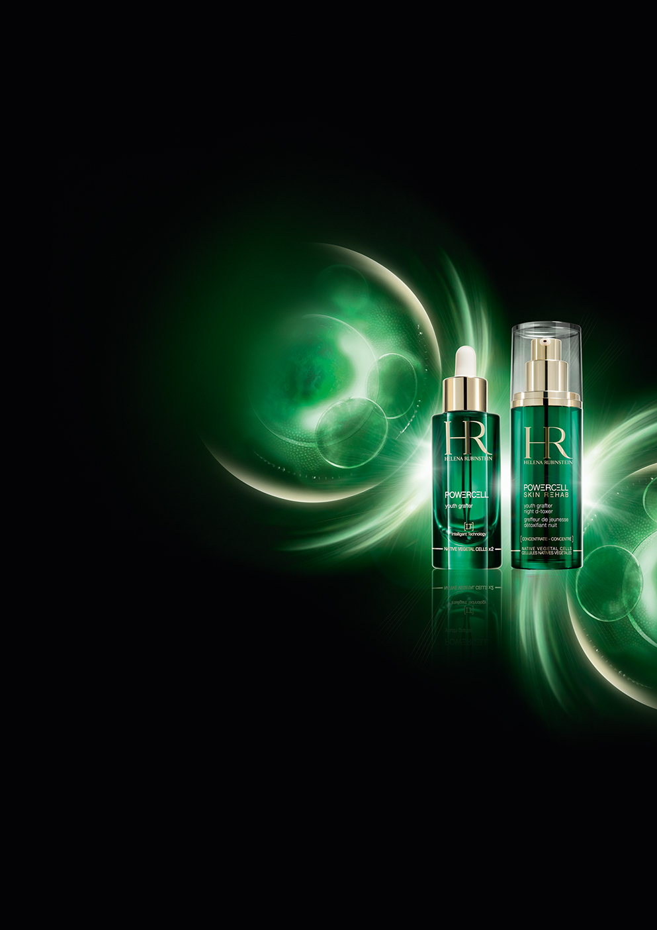







KEY POINTS TO KNOW & REMEMBER
FOR WHOM? Demanding women seeking a boosting night care with the power to detox and repair the skin from lack of sleep (quality and quantity), from age 30
SKIN CONCERNS: Skin exposed to urban aggressions leading to fine lines, wrinkles and lack of radiance (stress, indoor pollution and electromagnetic pollution).
RESULTS: smoothed rested features, pure radiant complexion, reinvigorated and younger skin
USE: at night, apply generously (2 pressures) on face and neck, massage and leave in overnight on a perfectly cleansed skin. Apply a cream if necessary.
TEXTURE: silky, auto diffusing and highly nutritive serum
PRICE (PPI): 140€ - 30ml
NEW
NIGHT D-TOXER
THE 1ST NIGHT
MASK-IN-ESSENCE
NEW
CUSTOMER’S WORDS:
“I lack sleep. My skin is less radiant; wrinkles are appearing.
I would like a product to fight against ageing signs”
IT’S SLEEP QUALITY NOT JUST QUANTITY THAT BOOST SKIN’S YOUTH
- STRESS: prevents body and mind from reaching deep sleep
- INDOOR POLLUTION: affects the quality of your sleep
- ELECTROMAGNETIC POLLUTION: home devices disturb deep sleep
→ Development of free radicals that affect cells, leading to cellular burn-out and disturbing the cell regeneration during the night
TWO COMPLEMENTARY TECHNOLOGIES:
✴
The Powercell youth grafter Serum:
PROTECT & REPAIR
The Powercell Skin Rehab night Serum:
DETOX & REVITALIZE
NEW
NATIVE VEGETAL CELLS of OCEANIC CRISTA and SEA HOLLY
The native vegetal cells of "Power Plants“ repair “burn-out” cells : disconnection of cells with the environment leading to the acceleration of the skin ageing due to URBAN AGGRESSIONS .
The cellular adaptation mechanisms are reactivated to provide a younger skin : tissular repair², cellular regeneration³ & anti free-radical protection².
+
+
X9 STRONGER ANTI-FREE RADICAL POWERS⁵
150 MILLION NATIVE VEGETAL CELLS
(+ X2,5 concentrated vs day serum)
to match with specifics night skin needs:
to restore the skin signs of good sleep quality.
+ Vitamin E to reinforce the anti-oxidant power of
the sea holly.
EFFICACY PROVEN:
In 5 days the visible signs of a younger skin, in 1 month targeted ageing signs improved for 100% of women:
The Powercell youth grafter¹
The Powercell Skin Rehab⁴
98%
SMOOTHER
96%
100%
SMOOTHER
98%
100%
MORE REFINED
90%
100%
MORE REFINED
98%
100%
FIRMER
100%
FIRMER
100%
100%
MORE RADIANT
94%
100%
MORE PLUMPED
94%
100%
5 DAYS
1 MONTH
5 DAYS
1 MONTH
4
¹Auto-evaluation on 52 women ²In-vitro test on reconstructed skin ³In-vivo test ⁴Auto-Evaluation on 53 women ⁵Vs Powercell serum 1ST generation
Notes:
1

Slide 2

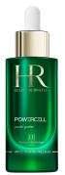


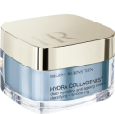
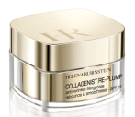
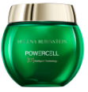
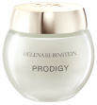


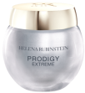
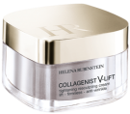




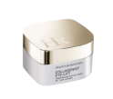

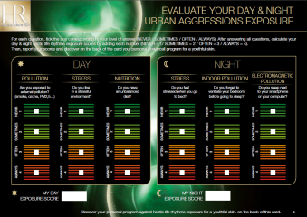
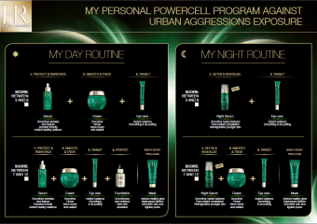
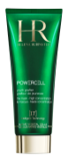

SALES SCENARIO
Good morning Madam, welcome to Helena Rubinstein,
this brand has more than 110 years of anti-ageing expertise.
Our products are developed with the highest requirement.
We have an exceptional partnership with LACLINIC-MONTREUX, in Switzerland, that allows us to develop skincare at the frontier of aesthetic medicine.
“If you look at your skin in the mirror, what would you like to improve? Show me…”
“When I look at myself, I see lack of vitality and radiance and wrinkles are appearing.
I would like a product to repair and protect it against daily aggressions.
I’m afraid urban aggressions are going to make me age faster”.
1
Welcome
2
Focus in the mirror
“What if, it was the quality of your sleep and not just the quantity that acts
on the youth of your skin?”
HOOK
3
As you may know, during the day, your skin is constantly attacked by urban aggressions,
such as pollution, stress, unbalanced diet, etc.
Recently, scientists have discovered that skin is also attacked during the night:
stress, indoor pollution and electromagnetic pollution ruin the quality of your sleep!
That means that, even if you sleep 8hrs, your skin can still looks tired & older.
It is sleep quality that leads to a visibly younger looking skin!
Yet, urban aggressions deteriorate sleep quality.
Indeed, urban aggressions increase the production of free radicals responsible for
cellular burn-out (disconnection of cells with the environment), your skin’s cells are no longer able to regenerate themselves during the night, leading to the acceleration of skin ageing.
Helena Rubinstein, as expert, has developed
a complete day & night program against urban aggressions: [BA presenting the duo]
the Powercell dose of youth, now day & night, with complementary concentrations,
actives ingredients and textures to match perfectly with your day & night skin needs.
During the night, the skin needs 2,5 x energy to regenerate itself. The night serum is, therefore
x 2,5 concentrated (vs day serum) with the power of 150 million Native Vegetal Cells
from Power Plants. Detox and revitalize the skin as after a good sleep quality.
Apply 2 pressures to eliminate the harmful free radicals and to rectify the night cell damages.
Every morning, your skin will be smoother and reinvigorated with a pure radiant complexion.
Please, discover the texture on your hand.
You can appreciate its auto-diffusing and nutritive power leaving a silky veil feel.
Would you like to evaluate your day & night urban aggressions exposure score thanks to
a quick - 2 minutes test?
[BA presents the day & night adapted routines to the customer, according to test results,
focusing on the synergic action of the day & night serum→ cf. test results card].
Treat
✴
NEW
+
DAY SERUM
NIGHT SERUM
+


OR
+
OR
POWERCELL & PRODIGY CREAMS
COLLAGENIST CREAMS
+


POWERCELL & PRODIGY
EYE CONTOURS
OR
COLLAGENIST EYE CONTOURS
+
Twice a week
POWERCELL MASK
4
Enhance
Every morning, enhance your skin with Powercell Foundation:
You will appreciate its ultra natural “nude effect” and lasting comfort during the day.
30’ protocol application
“If you have a few moments,
I would be delighted to offer you a 30’ protocol application.”
5
YES: Follow the step by step
book.
NO: Offer an appointment according to the customer’s availability
6
Finalize
Give the customer the opportunity to join the HR address book + propose trial samples.
Notes:
2

