Slide 1

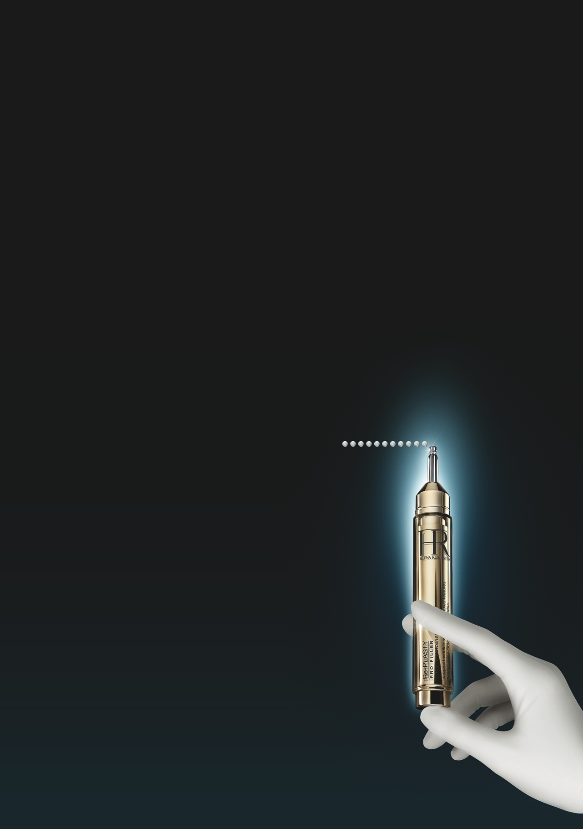
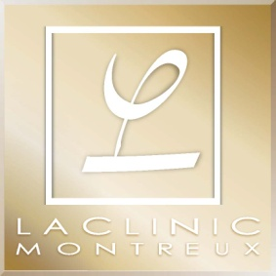
Re-PLASTY
PRO FILLER
SERUM-IN-BLUR
KEY POINTS TO KNOW & REMEMBER
FOR WHO ? Demanding women seeking instant optical blurring effect and long term efficacy on wrinkles. From 30.
SKIN CONCERNS: Wrinkles of eye and lip contours.
RESULTS: Instantly replicates the visible optical blurring effect of a targeted hyaluronic acid injection.
Smoothed & plumped wrinkles
USE: Every morning, before Re-Plasty routine or at anytime of the day as a touch up. Apply on eye and lips contours.
PRICE: 140€- ¥20 000 - ¥1450 - HK$1450 / 15ml (PPI)
INSTANTLY, OPTICAL FILLING EFFICACY, WITHOUT INJECTION
DAY BY DAY, SMOOTHED WRINKLES, REVEALED POSITIVE EXPRESSIONS
Notes:
1

Slide 2





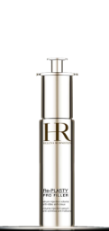
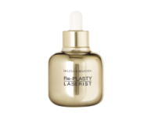
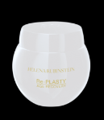
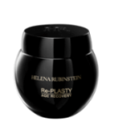
SALES SCENARIO
1
HOOK
“WHAT IF IN 12 SECONDS YOU CAN HAVE THE EFFECT OF A HYALURONIC ACID INJECTION AND MAKE 2/3 OF YOUR AGE PERCEPTION DISAPPEAR ?”
2
TREAT
“With age, facial expressions become more marked, wrinkles are deeper, your lines are drawn, it can make you look tired. In fact, wrinkles of eye and lip contours (glabellar lines, crow’s feet, nasolabial folds) are responsible for 2/3 of perception of skin ageing.
HELENA RUBINSTEIN has developed PRO FILLER EYE AND LIP, the 1st SERUM-IN-BLUR able to instantly replicate the visible optical blurring effect of hyaluronic acid injection.
(In less than 1 month, wrinkles are reduced)
This breakthrough technology, combines the power of a serum ( 3 HA FILLER-SOLUTION + SOY EXTRACT) to a BLUR-TEXTURE.
3 HA FILLER-SOLUTION unique combination of 3 different hyaluronic acids to visibly correct wrinkles. They gradually penetrate into the skin to reach the different epidermis layers and provide a progressive anti-ageing correction. Skin is re-plumped, more hydrated, wrinkles are reduced.
SOY EXTRACT mimic the needle effect to stimulate collagen reorganization and synthesis.
The BLUR texture is composed is of 2 optical agents, LUMINOSITY and SOFT FOCUS AGENTS lighter than classical agents. Wrinkles are smoothed and re-plumped, as erased.
Every morning, before Re-Plasty routine or at anytime of the day as a touch up. Apply on eye and lip contours.”
✴





✴

+
OR
OR
OR
OR
+
OR
PRO-FILLER EYE & LIP
SERUM – IN – BLUR
RE-PLASTY CONCENTRATES
AGE RECOVERY DAY
AGE RECOVERY NIGHT
Notes:
2

