Slide 1
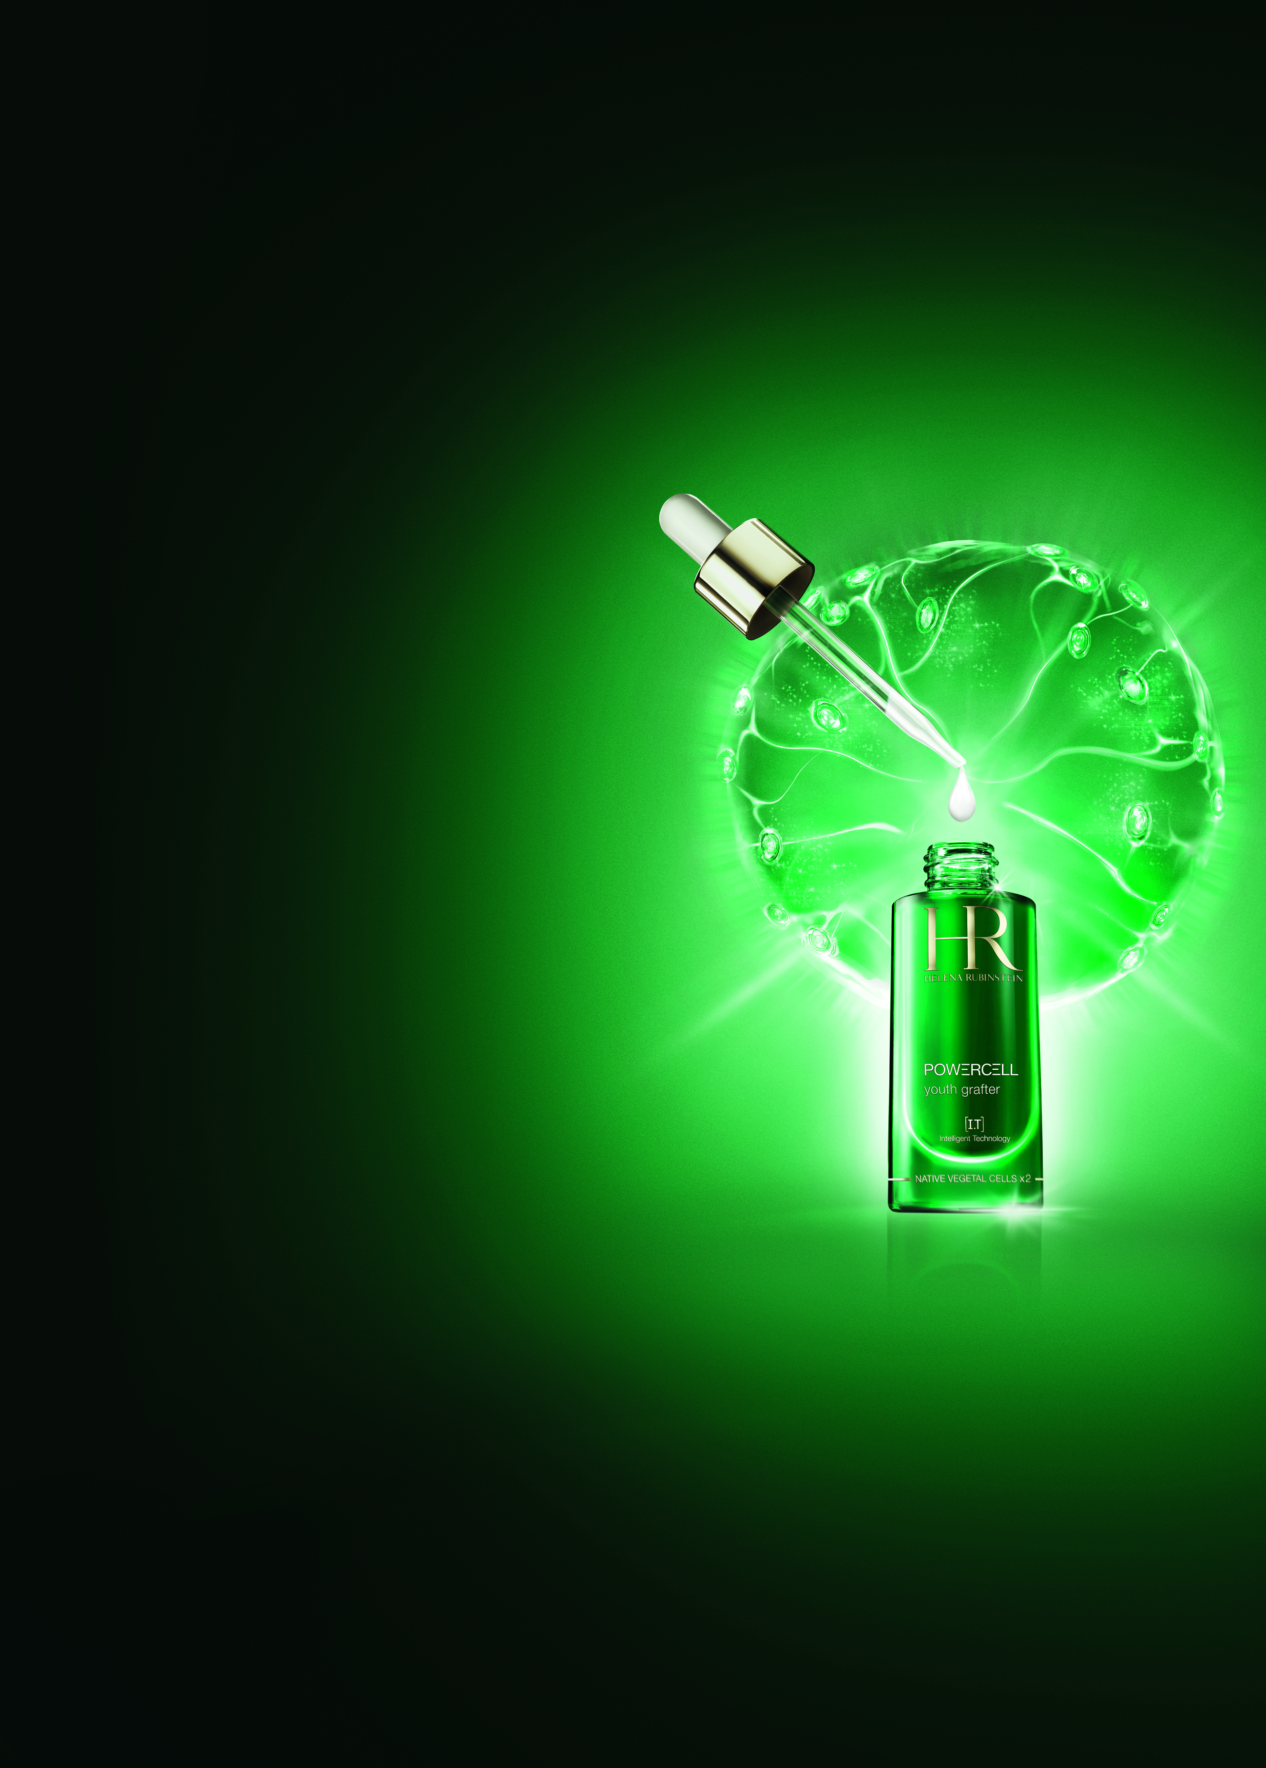
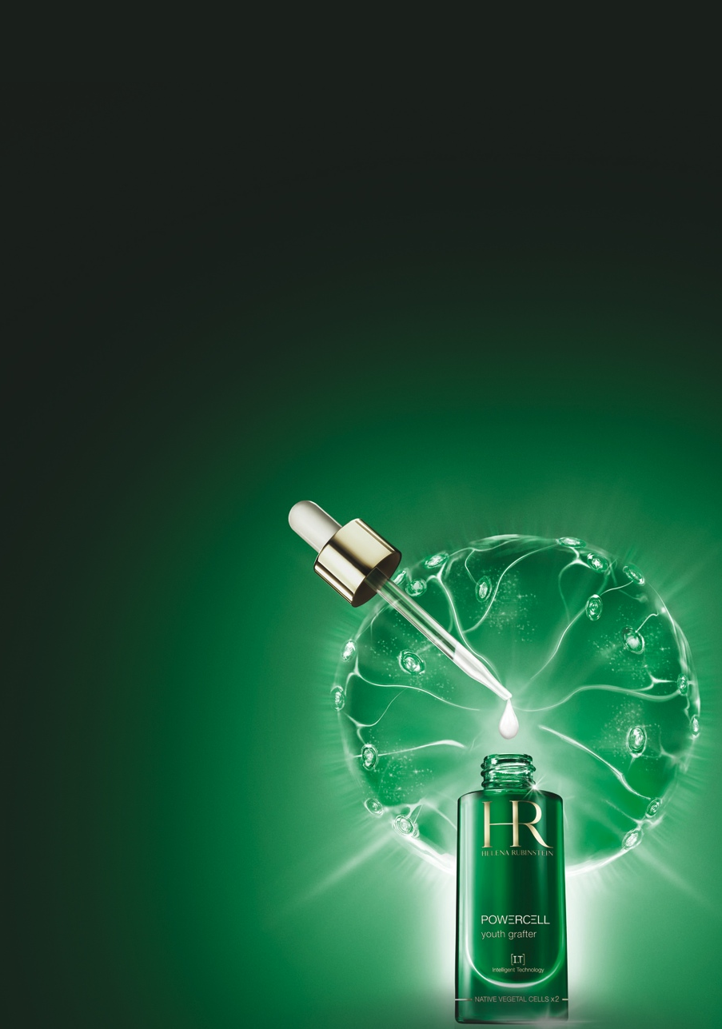



KEY POINTS TO KNOW & REMEMBER
FOR WHO ? Demanding women seeking youth boosting skincare able to defend & repair skin against hectic life rhythms, from age 30
SKIN CONCERNS: wrinkles, loss of elasticity, lack of radiance, daily micro aggressions
RESULTS: smoothed wrinkles & texture – boosted tonicity – instant healthy radiance
USE: Every day and night, apply Powercell routine: serum, cream, eye contour. Twice a week, apply Powercell mask for an instant youth shot.
PRICE: 104€ - 16538JPY – 1298RMB / 30ml (PPI) (serum)
THE DAILY DOSE OF YOUTH
2X CONCENTRATION
FOR A 9X POWER AGAINST HECTIC LIFE RHYTHMS*
*vs Powercell serum 1ST generation

Slide 2


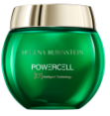
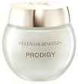
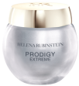


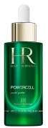
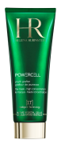
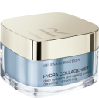


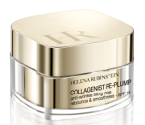
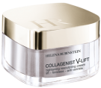
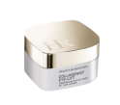
SALES SCENARIO
1
Hook
“Did you know that hectic life rhythms could lead to a cellular “burnout”
& accelerate ageing?”
2
Treat
"HECTIC LIFE RHYTHMS (stress, pollution, lack of sleep, fatigue, jet lag, etc.) exhaust skin’s youth and lead to a CELLULAR BURN-OUT (disconnection of cells with the environment). Instead of producing good molecules, “burn-out” cells are going to produce toxic molecules, which accelerate the skin ageing.
Thanks to the complementary actions of native vegetal cells drawn from the heart of two "POWER PLANTS“ - OCEANIC CRISTA AND SEA HOLLY – POWERCELL [IT] is now able to repair “burn-out” cells at 4 levels and cellular communication to reactivate the cellular adaptation mechanisms for skin to function younger: tissular repair², cellular regeneration³ & anti free-radical protection².
POWERCELL [IT] is 2x MORE CONCENTRATED IN NATIVE VEGETAL CELLS than the 1st generation for a 9X POWER AGAINST HECTIC LIFE RHYTHMS
While other serums deliver a fixed message to all cells without reaching the “burn-out” ones,
POWERCELL [IT] is the 1st intelligent skincare able to identify and repair “burnt-out” cells, to repair and reconnect them to the environment.
This breakthrough [IT] technology is exclusive to Helena Rubinstein and contains the active fusion of native vegetal cells found at the heart of 2 power plants: OCEANIC CRISTA & SEA HOLLY. These plants are called halophytes. There are only 2% of this kind of plants on earth capable of thriving under the most changing & hostile environments. They are so powerful that NASA consider them as “the energy of the future”, and has created a special laboratory dedicated to their research.
WITHIN 5 DAYS , THE SKIN IS VISIBLY YOUNGER LOOKING
WITHIN 1 MONTH, A 100% IMPROVEMENT IN THE SKIN'S PROPERTIES
smoothed wrinkles & texture - boosted tonicity - instant healthy radiance.”



Twice a week
+
POWERCELL & PRODIGY CREAMS
+
POWERCELL &
PRODIGY EYE CONTOURS
+
OR

OR

POWERCELL SERUM
POWERCELL MASK
COLLAGENIST CREAMS
COLLAGENIST EYE CONTOURS

