Slide 1
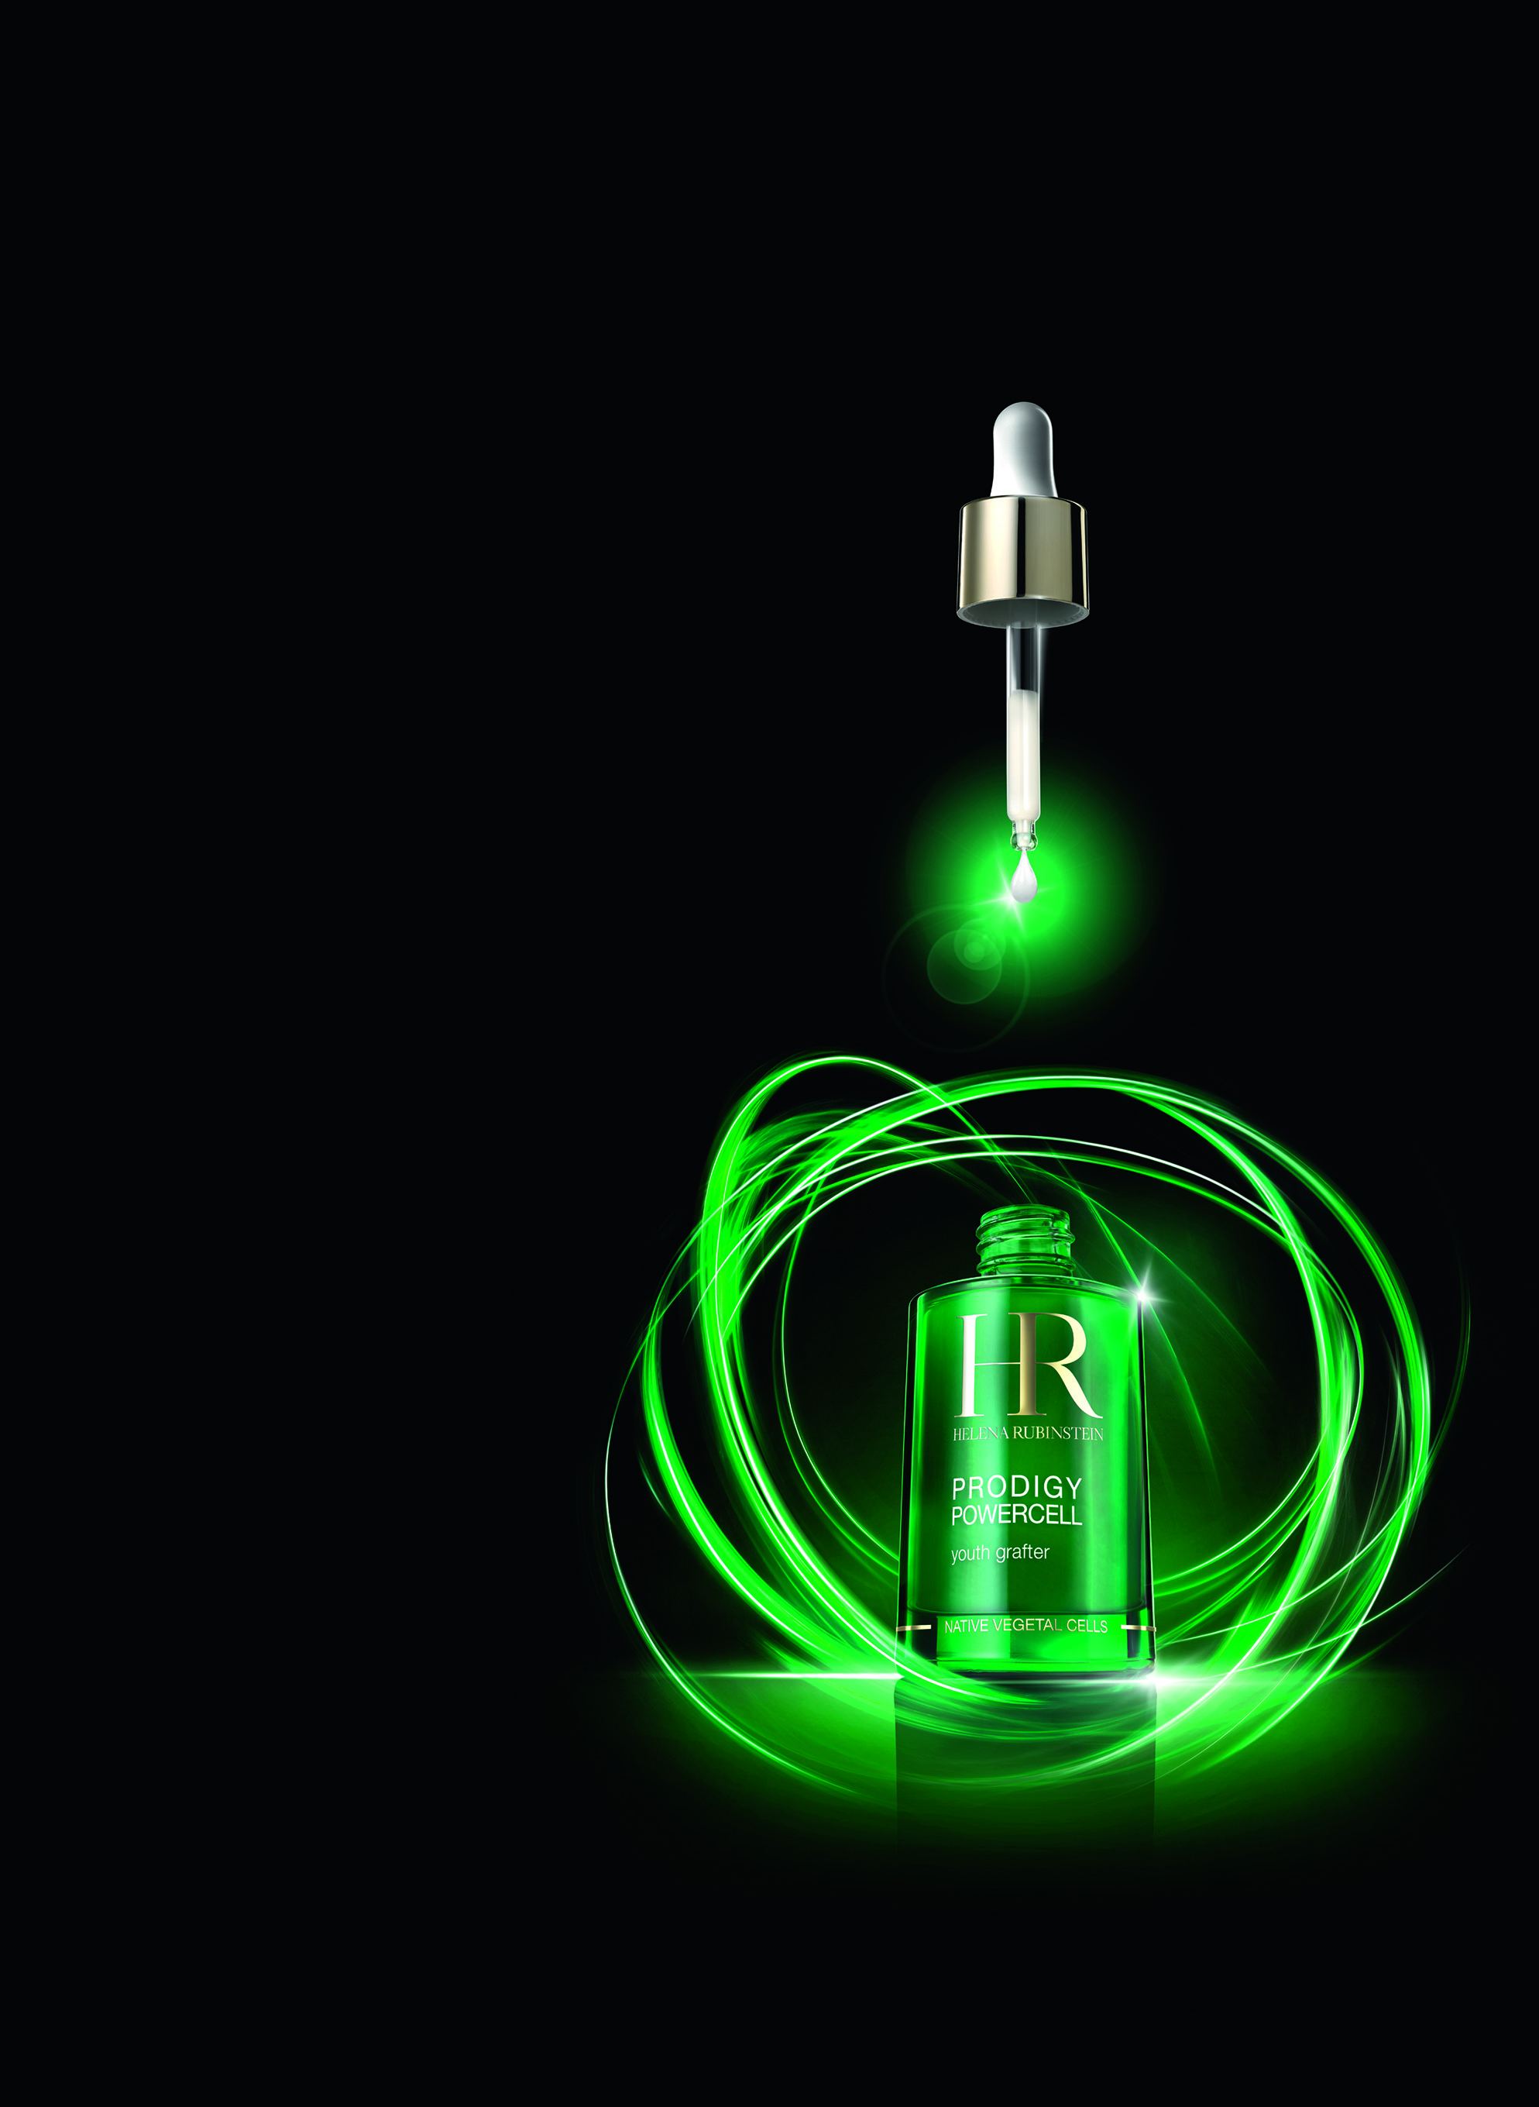


PRODIGY POWERCELL
Youth grafter
KEY POINTS TO KNOW & REMEMBER
FOR WHO ? Demanding women seeking global anti-ageing and a serum able to protect skin against daily aggressions, from age 30
SKIN CONCERNS: wrinkles, loss of tone, lack of radiance, daily micro aggressions
RESULTS: in 5 days: smoothed skin – recreated radiance – reinforced tonicity + Skin protected against 25 youth aggressors
USE: Every day and night, apply Prodigy Powercell serum, on face, neck and décolleté, according to specific gesture.
PRICE:
Serum: 111€ - 50ml (PPI)
NOW TESTED AGAINST
25 DAILY AGGRESSIONS*

Slide 2
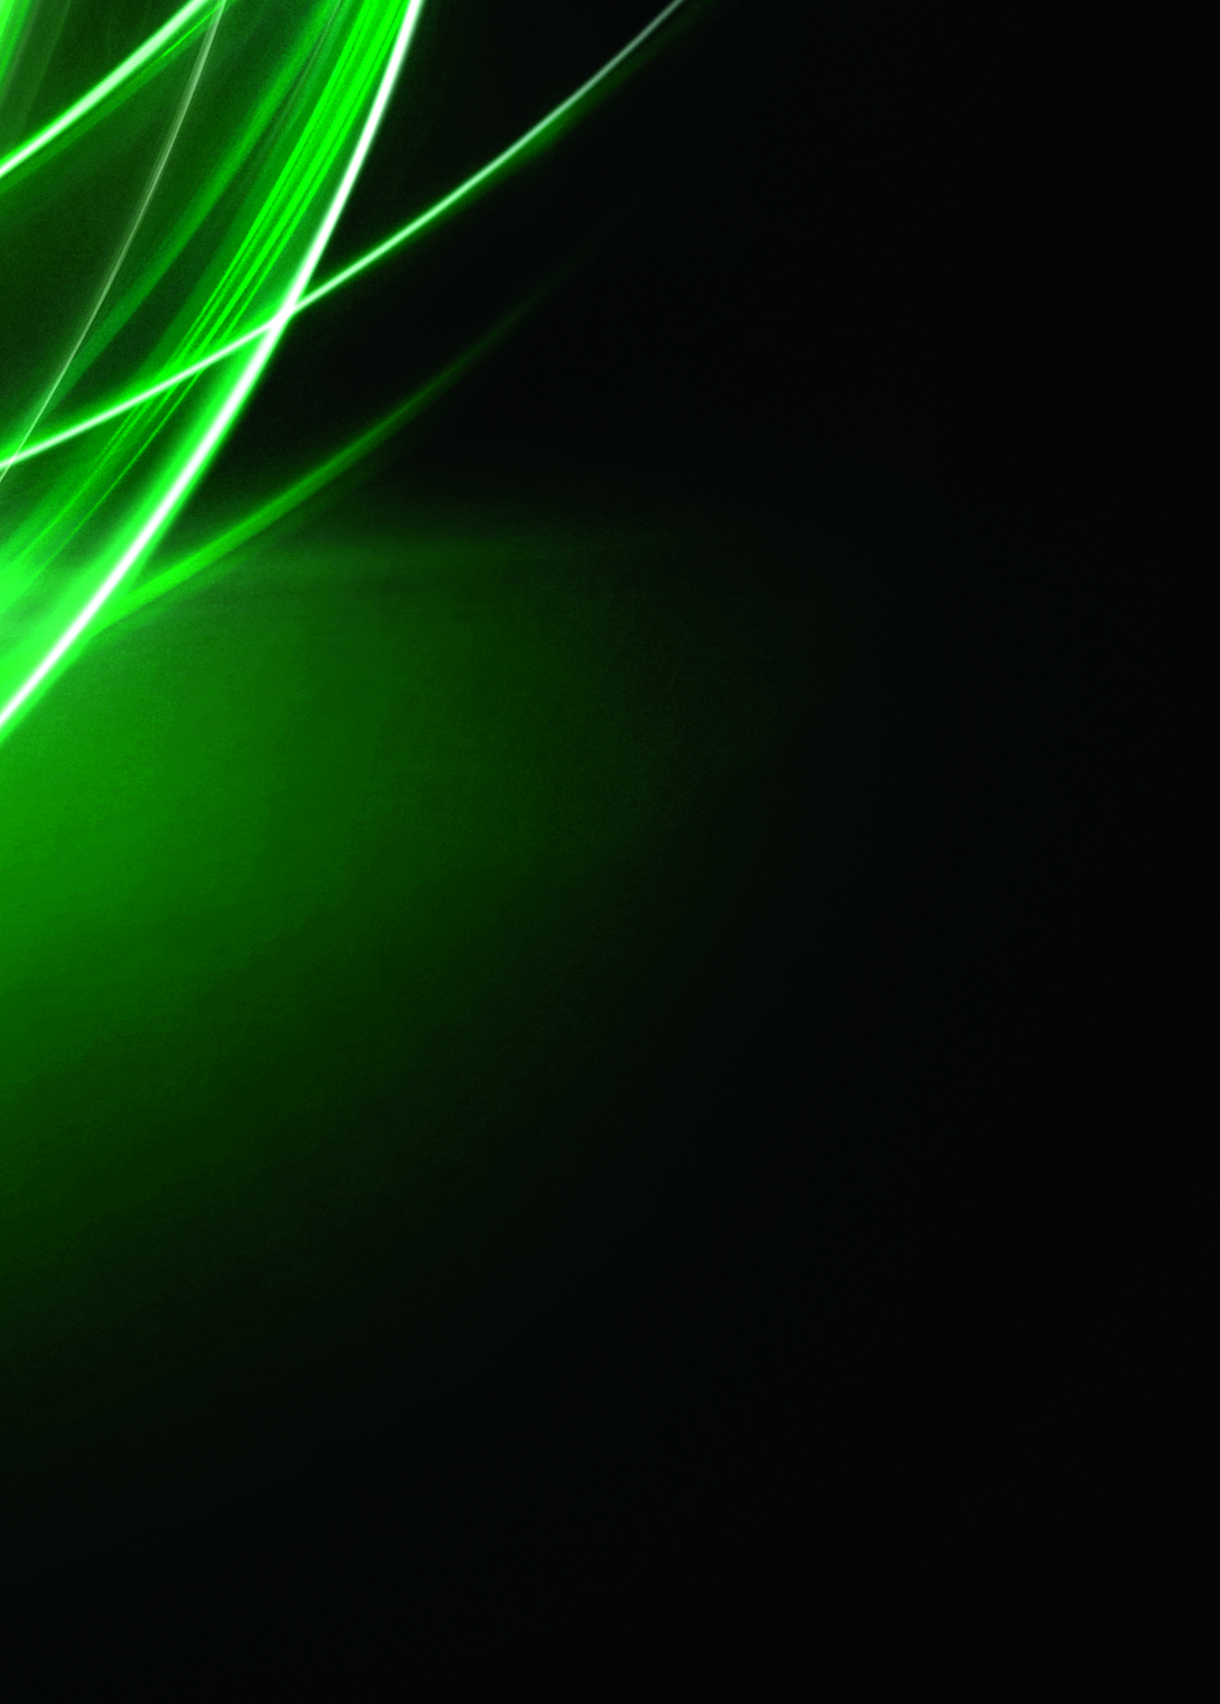
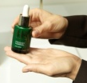
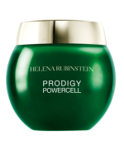
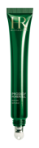
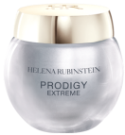
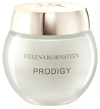

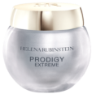
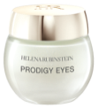

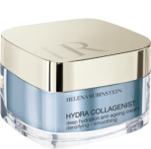
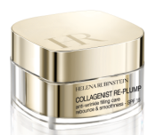
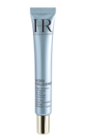

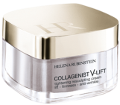
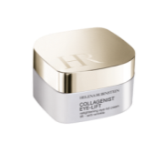
SALES SCENARIO
1
Hook
”Did you know that only one drop of this mighty green bottle can empower your skin against up to 25 daily aggressions?”
OR
“Do you know the only serum sold every minute around the world?”
[BA’s showing Prodigy Powercell on her hands]
2
Treat
“Let me introduce you PRODIGY POWERCELL serum, the first youth booster step of your anti-ageing routine.
Besides the spectacular results on your skin in only 5 days, today, we have also proven that a single drop of this serum allows to protect your skin against 25 daily different youth aggressions such as waves, pollution, UV, etc.
Prodigy Powercell serum is the 1st vegetal stem cells of the market.
Our Helena Rubinstein Laboratories have identified and isolated vegetal stem cells of Oceanic Crista, a powerful plant with exceptional survival faculties.
The vegetal stem cells contained in this little green bottle, simultaneously act on the 3 great anti-ageing mechanisms: cell regeneration, tissular repair and anti free radical defense.
With Prodigy Powercell, we clinically prove the results:
Your skin is recreated : stronger, radically younger. Wrinkles are reduced,
tonicity is reinforced, radiance is recreated.
In only 3 years, this little green bottle has made its proofs:
1 serum sold every minutes around the world, 7 awards, 4 patents, 2 scientific publications…
[Propose to your customer to apply on her hand Prodigy Powercell serum,
according to the specific hand modeling]



✴
+
PRODIGY CREAMS
+
PRODIGY EYE CONTOURS
+
OR

OR

PRODIGY POWERCELL
SERUM
PRODIGY POWERCELL
FOUNDATION
COLLAGENIST CREAMS
COLLAGENIST EYE CONTOURS

