Slide 1
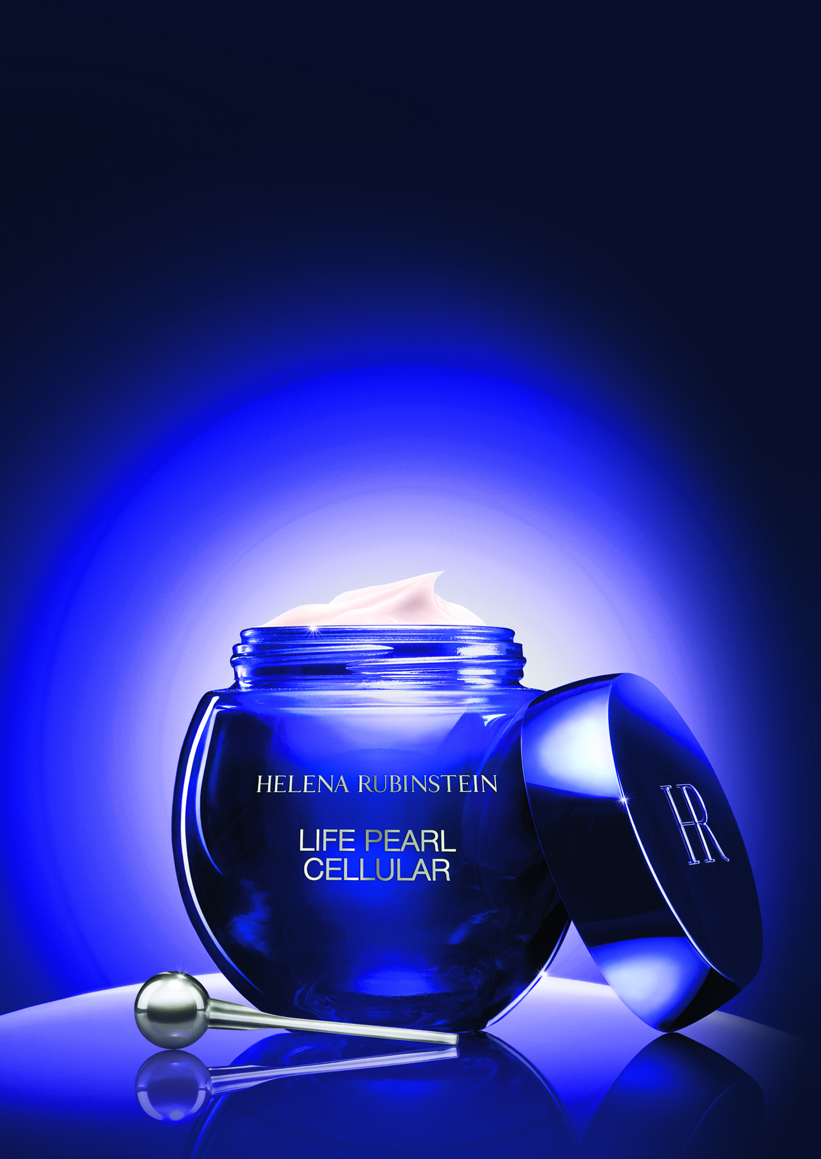


LIFE PEARL CELLULAR
the sumptuous cream cellular rebirth
complete anti-ageing care – pearlescent radiance
KEY POINTS TO KNOW & REMEMBER
FOR WHO ? Demanding women with purchasing power, from 45
SKIN CONCERNS: Sagging - deep wrinkles - dry skin - uneven complexion - lack of radiance
YOUTHFUL “ORIENT”: vibrant radiance - ideal translucency - polished surface - reshaped contours
VELVETY SATIN-FINISH TEXTURE
USE: Every day and night, after the Essence, face, neck and décolleté.
PRICE: 390€ - 50mL (PPI) / “This cream is not for everybody, it is the price of efficacy and of a sensorial experience to every application.”
THE PEARLESCENT “ORIENT”
OF A YOUTHFUL SKIN REBORN

Slide 2

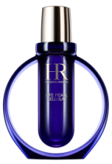
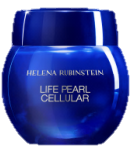
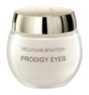
SALES SCENARIO
1
Hook
“What if your skin could reach the perfection of a black pearl ?”
2
Treat
Let me introduce you LIFE PEARL CELLULAR THE SUMPTUOUS CREAM that allows your skin to reach a youthful “orient”.
The “Orient” is the ultimate perfection criterion of the Royal Black Pearl: the purity of its radiance, the depth and the vibration of its color and the reflection of the light at its surface.
Thanks to Life Pearl Cellular Cream, your skin is now able to reach the pearlescent “Orient” of a youthful skin: vibrant radiance- ideal translucency - polished surface - reshaped contours.
True gem of formulation, it combines the regenerating CYTO-PEARL ELIXIRTM enriched with micronized pearl extracts that reinforces internal cell structure,
to the LIGHT ESSENCE COMPLEXTM, a unique combination of cellular detoxifying and skin renewing active ingredients (inside), that brings immediate radiance (surface).
Instantly, skin is smoother and reflects a new radiance vibrant with life.
Day by day, it reveals an ideal translucency, a polished surface and reshaped contours full of youth.
YOUTHFUL “ORIENT”
Let me unveil its sumptuous texture that wraps the skin in a precious satin veil for a rich, refreshing and nourishing finish.
[While applying Life Pearl Cellular Cream to the customer’s hand,
according to the specific hand modeling]
Invite the customer to touch the velvety satin-finish and see the immediate radiance of the skin.
Apply Life Pearl Cellular Cream with the massage pearl, every day and night after the Essence, according to the specific ritual to energize and regenerate your skin.
+
+



LIFE PEARL CELLULAR ESSENCE
LIFE PEARL CELLULAR CREAM
PRODIGY EYES

