Slide 1
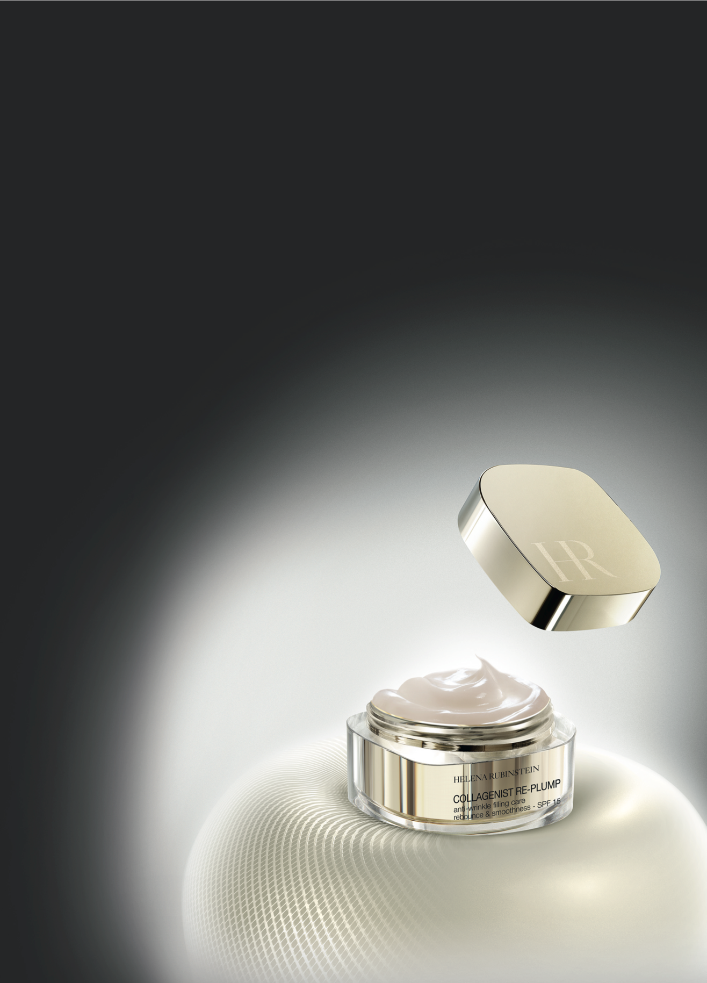


COLLAGENIST RE-PLUMP
anti-wrinkle filling care
KEY POINTS TO KNOW & REMEMBER
FOR WHO ? Demanding women seeking anti-wrinkle care and regain a youthful plump, from age 30
SKIN CONCERNS: Visible wrinkles - loss of rebounce – loss of volume & firmness
RESULTS: De-wrinkled skin – rebounced surface
USE: Every day and night, apply, Collagenist Re-Plump Creams (day & night), after Prodigy Powercell Serum, on face, neck and décolleté, according to specific gesture
PRICES:
Cream (day & night): 115€ - 50ml (PPI)
Eye Zoom: 73€ - 15ml (PPI)
Lip Zoom: 55€ - 15ml (PPI)
AGE MARKS NO LONGER HOLD ONTO THE SKIN

Slide 2

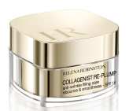



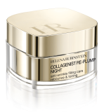
SALES SCENARIO
1
Hook
“Have you already noticed that upon awakening,
pillow marks stay visibly longer on your face?”
[BA’s showing Collagenist BA tool] → BA speech on “COLLAGENIST RE-PLUMP BA’s tool sheet”
2
Treat
New customer
Customer seeking Collagenist with pro-Xfill
“A product of 12 years of Collagen expertise, HELENA RUBINSTEIN Laboratories spot the “shape-memory” collagens key-factor in the deformation and bounce back of the skin. Deteriorating with age; skin loses its original plump, age marks set deeply.
Let me introduce the new COLLAGENIST RE-PLUMP, our 1st cream which has a such technology able to stimulate the synthesis of these “shape memory” collagens for a double action:
- in-depth: Its unique COLLAGEN RESET COMPLEX boosts the production of the “shape-memory” collagens (XII, XVI)* and the 5 key structuring collagens (I, III, IV, V, VII)* to rebounce the skin and regain resilience.
on-surface: REPLUMPING HYALURONATE rebounces skin surface in association with a cell renewal active to instantly replump skin and smooth wrinkles.”
[Whilst applying Collagenist Re-Plump routine to the customer’s hand, according to the hand modeling below]
Invite the customer to touch the smooth finish and the bounce back effect.
Do you know our cult product Collagenist Lip Zoom able to redesign lips’original bouncy plump, essential to complete your beauty bag?
“It is totally normal that you will not find this product anymore because we have changed its name and packaging but also improved its technology for better results.
Let me introduce the new Collagenist Re-Plump which benefits from an HR innovation, to stimulate, in addition to the five other collagen structure, the synthesis of “shape memory” collagens.
Now, COLLAGENIST RE-PLUMP goes one step further for a double action:
- in-depth: Its unique COLLAGEN RESET COMPLEX boosts now the production of the “shape-memory” collagens (XII, XVI)* and the 5 key structuring collagens (I, III, IV, V, VII)*, already targeted by Collagenist with pro-xfill, to rebounce the skin and regain resilience.
- on-surface: REPLUMPING HYALURONATE rebounces skin surface in association with a cell renewal active to instantly replump skin and smooth wrinkles.”
[Whilst applying Collagenist Re-Plump routine to the customer’s hand, according to the hand modeling below]
Invite the customer to touch the smooth finish and the bounce back effect.
Do you know our cult product Collagenist Lip Zoom able to redesign lips’original bouncy plump, essential to complete your beauty bag?
EASY TO MAKE SALES
✴
+
+
+
+
DAY CREAM SPF 15



PRODIGY POWERCELL
SERUM

EYE ZOOM
LIP ZOOM
NIGHT CREAM

