Slide 1
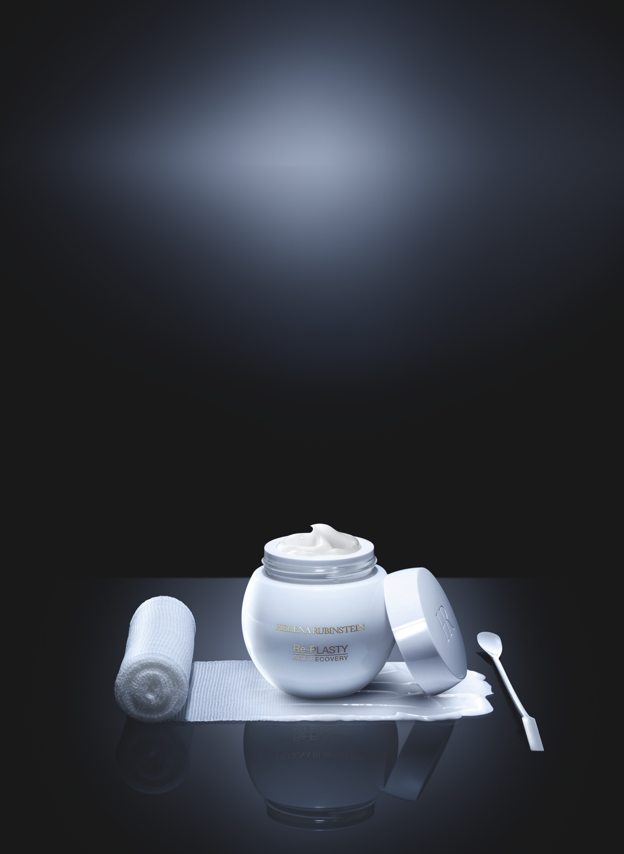



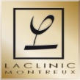
Re-PLASTY
AGE RECOVERY DAY
skin soothing repairing cream
intense antioxidant protection
KEY POINTS TO KNOW & REMEMBER
FOR WHO ? Demanding women seeking exceptional protecting anti-ageing day care / those who have already used the Re-PLASTY products / undergone aesthetic medicine procedures
SKIN CONCERNS: uncomfortable and fragilized dry skin, tugging sensation, wrinkles, age damages
RESULTS: IN 3 DAYS, VISIBLE SKIN RECOVERY AFTER AN AESTHETIC PROCEDURE: intense repair – instant soothing – active antioxidant protection
USE: every morning, after Re-PLASTY concentrate, apply on face, neck and décolleté, avoiding the eye contour, according to specific gesture.
PRICE: 260€ - 50ml (PPI)
THE 1st “BANDAGE”
TEXTURED CREAM
SO POWERFUL: IN 3 DAYS,
VISIBLE SKIN RECOVERY AFTER AN AESTHETIC PROCEDURE

Slide 2

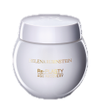


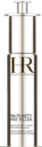
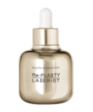


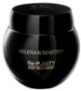
SALES SCENARIO
1
Hook
“What if you could have in a cream similar repairing results as after a post-interventional care at LACLINIC-MONTREUX?“
2
Treat
“For Dr. Pfulg, surgeon and founder of LACLINIC MONTREUX, it is unthinkable to leave the skin exposed after a medical intervention, damaged… Feeling fragilized…
To repair, soothe and protect the skin , the HR laboratories worked closely with Dr. PFULG during 5 years; after dozens of formulations and tests after all types of interventions, they created a “cosmetic bandage” cream that showed great improvement on skin recovery, but beyond that they witnessed amazing results on age damages corrections: skin dryness, wrinkles and imperfections. They decided to share this great discovery with all the demanding women searching for the most powerful weapon against ageing.”
“Re-PLASTY AGE RECOVERY DAY CREAM is the 1st “bandage” textured cream. Helena Rubinstein laboratories and Dr. Pfulg worked hand in hand to provide with exceptional formula while maintaining an amazing sensorial “bandage” texture:
They associated ACTI-PLAST SOLUTION to sooth, repair and moisturize skin and a COMPLETE ANTIOXYDANT COMPLEX (vit. C+ E) to protect skin against a broad spectrum of free radicals.
Instantly, the skin is soothed, nourished and more luminous. the cutaneous barrier is restored.
Day after day, skin is reinforced, tugging sensations disappear, wrinkles and dryness are significantly reduced. age damages are corrected. The skin is protected from external aggressions and looks visibly younger.”
Each morning, alone or after your usual Re-PLASTY concentrate, apply
Re-PLASTY AGE RECOVERY DAY CREAM over the face, neck and décolleté (avoiding the eye contour).
[Propose to your customer to apply on her hand Age Recovery day cream,
according to the specific hand modeling].
✴



✴

Re-PLASTY
AGE RECOVERY DAY CREAM

✴
OR
OR
OR
+
+
+
+
+

Re-PLASTY CONCENTRATES
PREMIUM UV
SPF 50 /
PA +++
Re-PLASTY
MESOLIFT EYE GEL
PRODIGY POWERCELL FOUNDATION
Re-PLASTY
AGE RECOVERY NIGHT CREAM

