Slide 1
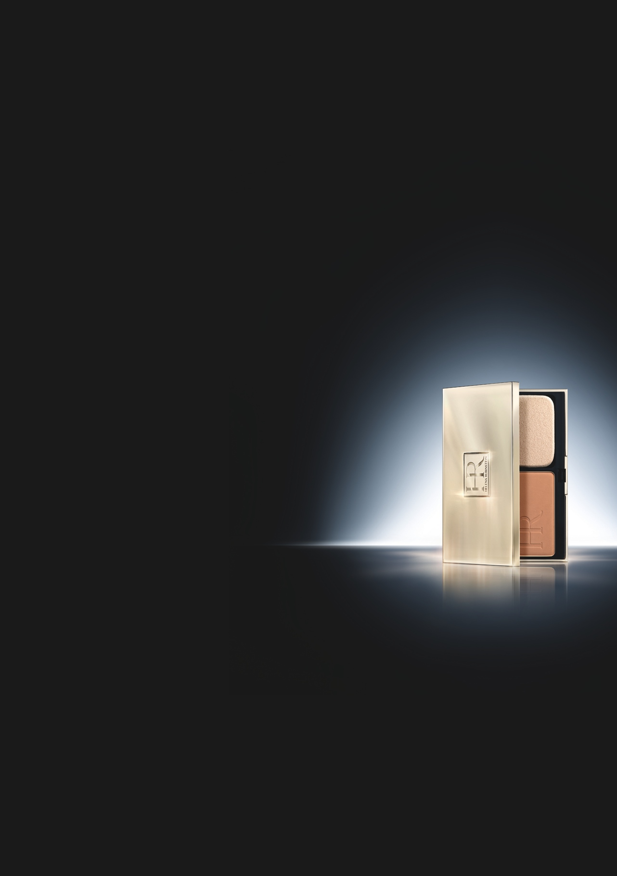

PRODIGY COMPACT
GLOBAL ANTI-AGEING* FOUNDATION
SMOOTHNESS, RADIANCE
12-hr COMFORT / SPF 35 – PA+++
KEY POINTS TO KNOW & REMEMBER
FOR WHO ?
Compact users who want matte luminous result
and who have combination to oily skin.
Women who do not like fluid foundation.
MAKE-UP RESULTS
Matte luminous & even complexion
Visibly refined skin texture
Smoothed wrinkles as if “polished”
ADDED BENEFITS
12hr comfort
HIGH PROTECTION FPS 35 – PA +++
Enriched in skincare ingredients
USE : TWO WAY COMPACT FOUNDATION
Apply to the face with the sponge, from the
“T” zone blending outward with smoothing movements to create an even finish.
For a natural-look finish use a dry sponge.
For a greater coverage use a wet sponge.
DESIGN
LUXURIOUS DESIGN : GOLD PALE METALLIZATION
WITH BLACK SUEDE SLEEVE
PRICE:
80 € /11,7 grs / 0,41 oz
5 SHADES:
13
20
23
24
30
STAR SHADE
* reduces the appearance of fine lines and wrinkles

Slide 2

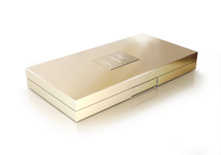
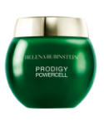
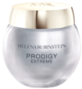
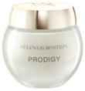

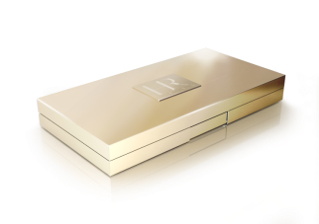

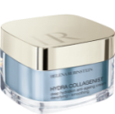
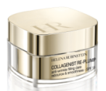
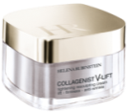
SALES SCENARIO
1
Hook
“Do you want to look younger with
a matte luminous complexion?
[BA’s showing Prodigy Compact on her hands]
2
Product
Presentation
“ I’d like to introduce to you PRODIGY COMPACT FOUNDATION, the new HR compact foundation that instantly mattifies, illuminates and smoothes the skin as if polished for a visibly rejuvenated complexion.
Its caring formula, perfectly acts in synergy with the PRODIGY skin care range .
Its lightweight and comfortable texture blends into the skin, without mask effect and absorbs excess of sebum for a 12 hours comfort.
Moreover , it contains a SPF 35 / PA+++ filter that protects from photo-ageing.”
3
Skincare
Advice
✴
✴
+
PRODIGY CREAMS
✴
+
+
OR
PRODIGY POWERCELL
SERUM
COLLAGENIST CREAMS

