Slide 1
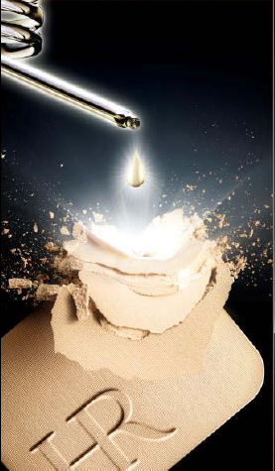
NEW
PRODIGY
COMPACT FOUNDATION

Slide 2
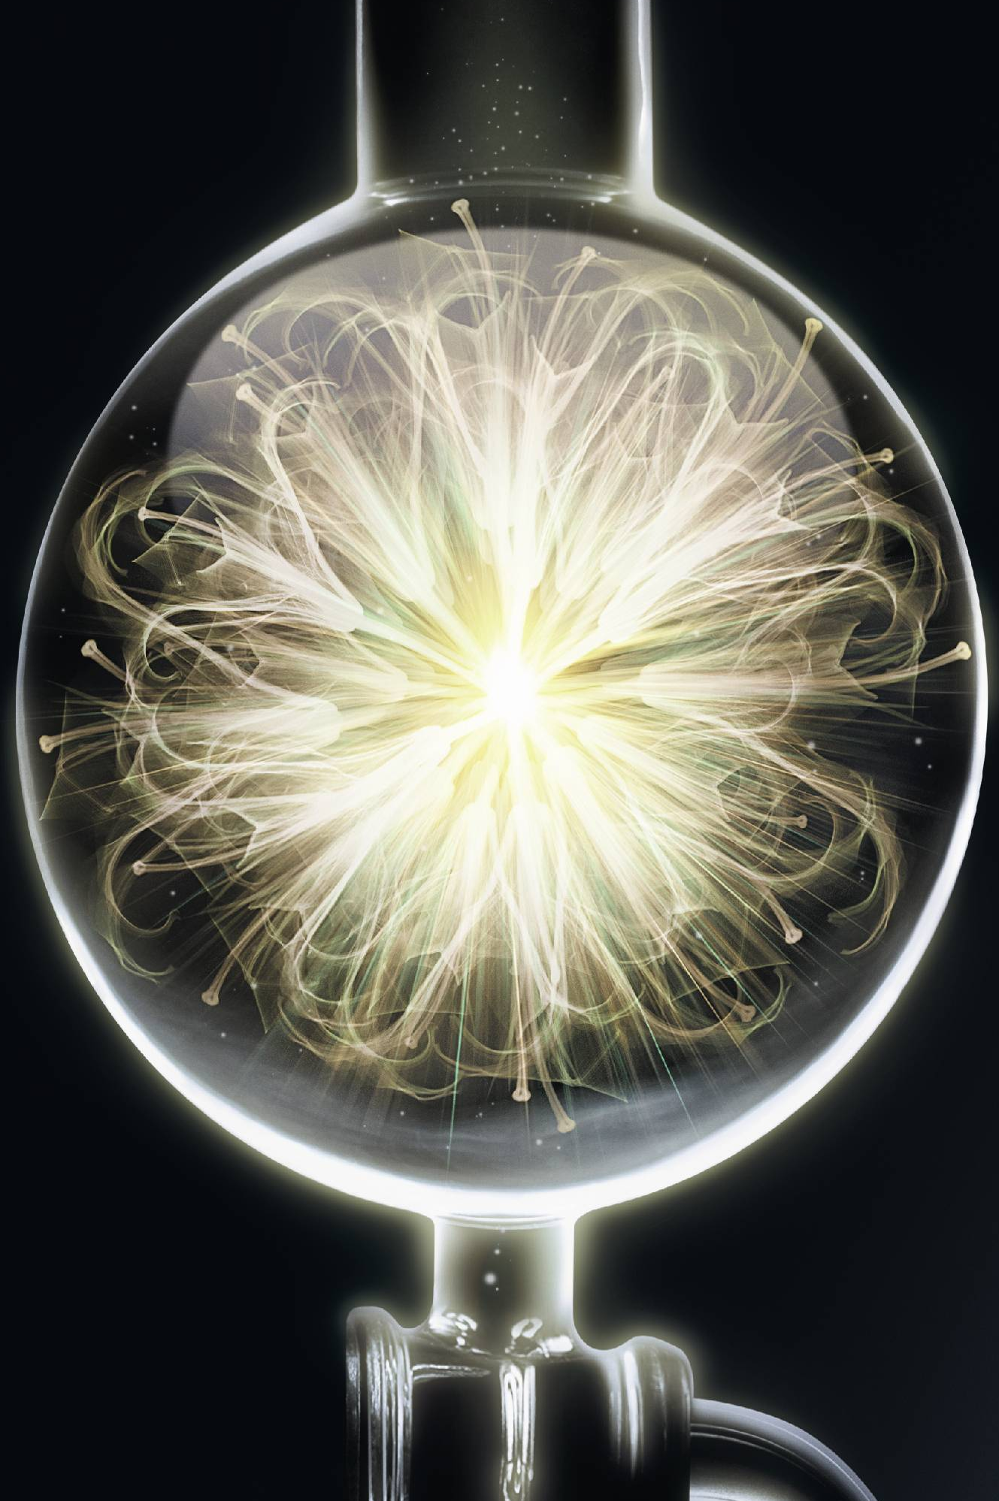
PRODIGY SKIN CARE RANGE
STORY TELLING
A PRODIGY OF NATURE
FROM THE BOTANICAL KINGDOM
Notes:
Of course, you already know PRODIGY skin care range.
Inspired by this miracle of nature, Helena Rubinstein has created a breakthrough vegetal synergy, the Molecular Bio-Sap™, concentrated in its new Masterpiece of Science, PRODIGY:
LIKE SAP TRANSFUSING LIFE AT THE HEART OF THE PLANT, THE NEW PRODIGY IS A
YOUTH TRANSFUSION ALL THROUGH SKIN UNTIL THE DEEPEST DERMIS :
FROM DEEP INSIDE TO A RENEWED SKIN.
THE MOLECULAR BIO-SAP™: A VEGETAL LIFE CONCENTRATE TO REACH THE DEEPEST DERMIS:
With unprecedented expertise in vegetal biology, the Helena Rubinstein laboratories have created a new generation of Bio-Sap™: the Molecular Bio-Sap™.
The new Molecular Bio-SapTM is a unique synergy of 5 supernatural vegetal ingredients which transfuses its vital power all through the 5 fundamental skin layers with an unprecedented action even at the deepest dermis:
-Prevents dermal cellular senescence, i.e." presses pause” on fibroblasts ageing and degeneration for a prorogated cellular youth.
- Stops collagen glycation, chemical reaction which stiffens the collagen fibers and prevent them from being renewed.

Slide 3
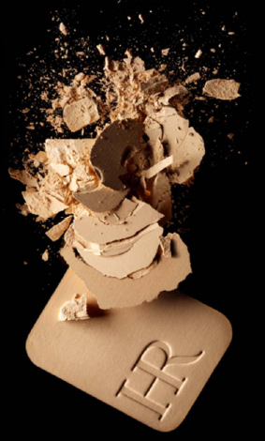
PRODIGY COMPACT
NEW PRODUCT
NEW
A COMPACT FOUNDATION
AT THE FRONTIER OF SKINCARE
PRODIGY
COMPACT
Notes:
From PRODIGY SKIN CARE TO PRODIGY MAKE-UP the link was evident:
The brand of the foundation at the frontier of skincare, Helena Rubinstein puts its skincare expertise at the service of complexion rejuvenation and creates PRODIGY COMPACT

Slide 4
PRODIGY COMPACT
NEW PRODUCT
PRODIGY
COMPACT
FOUNDATION
GLOBAL ANTI-AGEING*FOUNDATION
SMOOTHNESS, RADIANCE, 12-hr COMFORT
SPF 35 - PA +++
Notes:
PRODIGY, Global Anti-Ageing compact foundation, a new foundation at the frontier of skincare.
* Reduces the appearance of fine lines & wrinkles

Slide 5
MATTE ANTI-AGEING MAKE-UP
WOMEN’S EXPECTATIONS
“I have an oily skin and I need a compact foundation
to even my complexion and rejuvenate my face……”
“ I have wrinkles, and I want to even
my complexion with a matte result, but I am afraid to use a compact foundation because it usually marks fine lines and I am afraid it makes me older…….”
“I have never been a fan of compact powder foundation!
It dries the skin and I would like to find a comfortable compact foundation. ”
“I would like to find a compact foundation that does not
mark the fine lines with mask effect because it makes me look older ! .”
Notes:
First of all, let’s see the women’s expectations
Let’s guess what are sentences that customers should say.
Can you try to find that sentences, with key words about customer’s concerns?

Slide 6
PRODIGY COMPACT
NEW PRODUCT/CONCEPT
PRODIGY
COMPACT FOUNDATION
LIKE A YOUTH TRANSFUSION
FOR A PRODIGIOUS REJUVENATED COMPLEXION
EVEN MATTE & LUMINOUS COMPLEXION
VISIBLY REFINED SKIN TEXTURE
SMOOTHED WRINKLES AS IF “POLISHED”
HIGH UV PROTECTION - SPF 35-PA+++
Notes:
PRODIGY COMPACT, Global Anti-Ageing compact foundation, a new foundation at the frontier of skincare.
It provides an even matte luminous complexion, with visibly refined skin texture and global smoothed action, but also a high protection against UV agression, with SPF 35 –PA +++
This global anti-ageing* compact is the perfect complement to the Prodigy skincare routine like a youth transfusion for a prodigious rejuvenated complexion.
PRODIGY COMPACT is a foundation enriched with hyaluronic acid microspheres and the Molecular Bio-Sap™ – the powerful anti-ageing concentrate from the Prodigy skincare range.
Like a “youth transfusion”, it instantly and visibly reveals a prodigious rejuvenated complexion.

Slide 7
LIGHT MATTE ANTI-AGEING MAKE-UP
PRODIGY ANSWERS
CONCERNS
PRODIGY COMPACT SOLUTION
1 OILY SKIN
1 LIGHT MATTE FINISH
2 UNEVEN AND DULL COMPLEXION
2 EVEN AND LUMINOUS COMPLEXION
3 FINE LINES & WRINKLES +
PORES & UNEVEN SKIN SURFACE
3 GLOBAL SMOOTHING ACTION =
VISIBLY REFINED SKIN TEXTURE + SMOOTHED WRINKLES
4 UV AGEING DAMAGES
4 HIGH PROTECTION WITH SPF 35-PA +++
Notes:
Now we have found the key concerns for the « prodigy compact foundation » customers, let’s summarize them.
What is the response that PRODIGY COMPACT FOUNDATION provides for these concerns.

Slide 8
LIGHT MATTE ANTI-AGEING MAKE-UP
PRODIGY ANSWERS
CONCERNS
PRODIGY COMPACT SOLUTION
5 NOT LAST / RESULT DETERIORATION
5 LONG LASTING 12 Hours
6 MASK EFFECT
6 NO MASK EFFECT/ULTRA-FINE FORMULA
7 DRY TEXTURE/HEAVY SENSATION
7 WEIGHTLESS/CARING & COMFORT FORMULA
Notes:
Let’s discover the other benefits of PRODIGY COMPACT.
5 Long lasting 12 hours
6 No mask effect
7 Weightless, caring and comfort formula

Slide 9
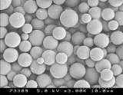
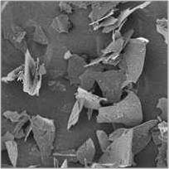

PRODIGY COMPACT
TECHNOLOGY
A COMPACT FORMULA FOR A GLOBAL ANTI-AGEING EFFECT WITH VISIBLY GLOBAL SMOOTHING ACTION:
FORMULA:
N°1 Hyaluronic Acid microspheres = 12-hour comfort (long lasting hydration)
N°2 Very fine powders =Visibly more refined skin texture & no mask effect
N°2 Hydrophobic powders = Control shine
N°4 Pigments = Radiant complexion
+ enriched with molecular bio-sap.
Notes:
To perfectly and visibly perform on the make-up result and skin surface aspect, formula contains:
1- Hyaluronic Acid microspheres: Long-lasting Hydration (12H lasting comfort)
2- Very fine powders: Visibly refined skin texture & No mask effect
3- Hydrophobic powders: Absorbs sebum for shine control
4- Pigments: Radiant complexion
+ enriched with molecular Bio –sap
This compact foundation has been developed in complement of the cream to provide a visibly even, luminous and then rejuvenated matte complexion with a global smoothing action without mask effect.
If necessary, do a reminder for skincare:
PRODIGY skincare range, you know that like sap transfusing life at the heart of the plant, the new Prodigy is a real « youth transfusion » through to the deepest dermis, from deep inside to renewed skin.
New Molecular Bio-Sap is a unique synergy of 5 supernatural active ingredients to target the 5 fundamental layers of the skin until the deepest dermis for a deep skin renewal.
It contains:
1 – Litchi polyphenols: Limit dermal collagen fibres glycation and prevent dermal cellular senescence, for a deep skin redensification (reticular dermis)
2 - Active fractions of Maïtake (also known in Traditional Chinese Medicine as the “eternity mushroom”): Stimulate support* fibres, for deep firmness (papillary dermis)
3 – Rice peptides: Stimulate the synthesis of anchorage* collagens, for a deep anti-wrinkle (DEJ)
4 –Baikal Skullcap rhizomes extracts: Fight against the creation of melanin*, pigment responsible for the generation of spots for a deep luminosity (deep epidermis)
5 – Active fractions of Japanese Lily Bud : Strength the barrier function, for a deep hydration (epidermis)

Slide 10
PRODIGY COMPACT
MAKE-UP RESULTS
MAKE-UP RESULTS
MATTE LUMINOUS & EVEN COMPLEXION
VISIBLY REFINED SKIN TEXTURE (PORE-LESS LOOK)
SMOOTHED FINE LINES & WRINKLES“AS IF POLISHED”
EFFICIENT & LIGHTWEIGHT COVERAGE
MARK-FREE ( NO MASK EFFECT)
OTHER BENEFITS
12-hr COMFORT
HIGH UV PROTECTION SPF 35 PA +++
Notes:
So, now you know the make-up result that you can propose to your customer when you sell PRODIGY COMPACT foundation.
Let’s summarize it:
Ask to the audience to react, and list on the paper board:
Moreover, comfort sensation stays for 12 hours and skin is protected against UV thanks to its filters SPF 35 /PA +++
Conclusion
For these women, the expected make-up result is:
A visibly rejuvenated matte complexion that doesn’t mark lines and visibly smooth surface with no mask effect.
She wants Lightweight texture with 12-hr comfort.

Slide 11
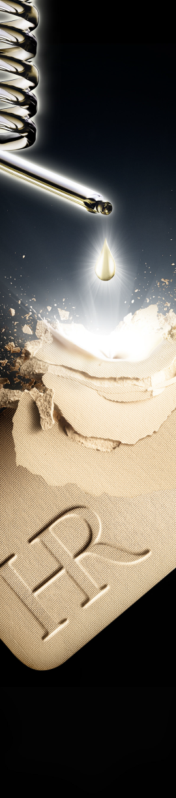
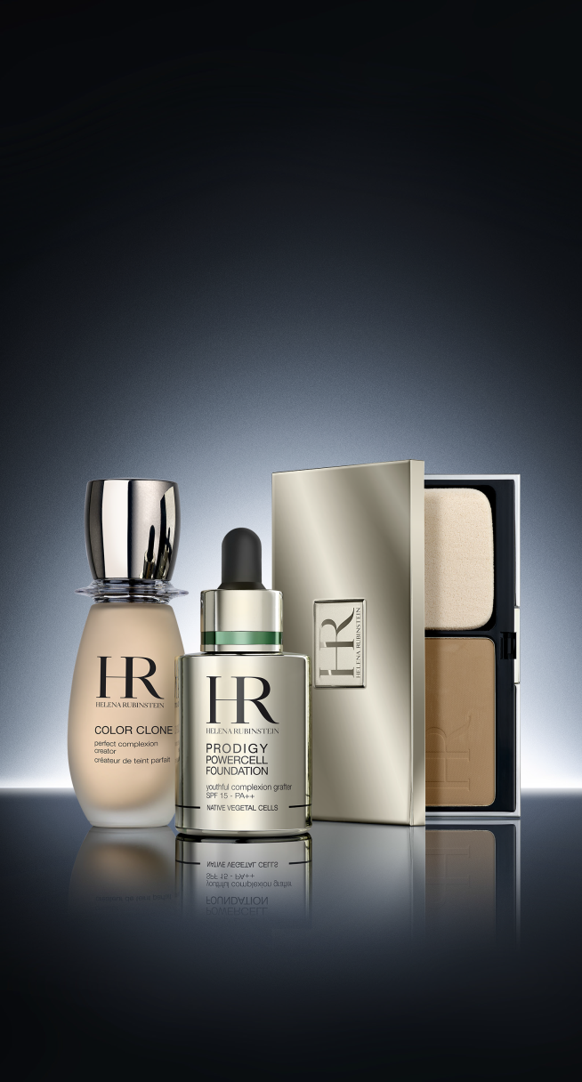
PRODIGY COMPACT
ADVERTISING
WORK IN PROGRESS
Notes:
This is the advertising for the PRODIGY COMPACT FOUNDATION, combined with skincare range.

Slide 12
PRODIGY COMPACT
APPLICATION
CLASSIC COMPACT FOUNDATION APPLICATION
A TWO-WAY COMPACT FOUNDATION FOR A TAILOR-MADE MAKE-UP RESULT
TRANSPARENT AND NATURAL RESULT (dry sponge)
OR
MORE SOPHISTICATED LOOK AND HIGHER COVERAGE (wet sponge)
APPLICATION USING THE PRODIGY SPONGE
Apply to the face with the sponge, from the “T” zone blending outward with smoothing movements to create an even finish.
For a natural-look finish, use a dry sponge.
For a greater coverage, use a wet sponge.
Notes:
Application advice:
To even out your complexion, apply PRODIGY COMPACT foundation over the entire face with the sponge, repeating smoothing movements
and blending from the center outwards.
You can use it dry: for a transparent, natural result.
OR use a moist sponge: for a more sophisticated look and higher coverage.

Slide 13
PRODIGY COMPACT
RANGE
SHORT RANGE: FOCUSED ON THE BEST SELLER SHADES COVERING ALL TONE NEEDS
GOLD
24
30
13
20
23
Star shade
BEIGE
fair
dark
Notes:
The star shade is also represented on the visual.

Slide 14
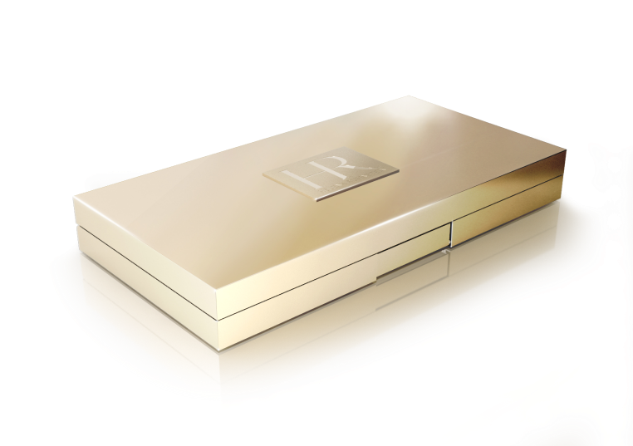
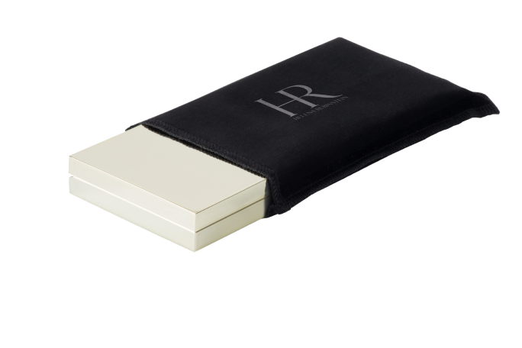
PRODIGY COMPACT
DESIGN
LUXURIOUS DESIGN
WITH GOLD PALE METALLIZATION
IN LINE WITH PRODIGY FRANCHISE
&
BLACK SUEDE SLEEVE
PRICE
80 Euros / 11,7 grs / 0,4 oz

Slide 15

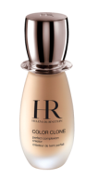
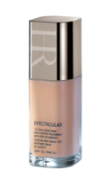
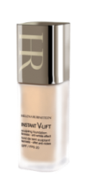


PRODIGY COMPACT
HR FOUNDATION GEOGRAPHY
FOUNDATION GEOGRAPHY
NATURAL
LASTING
ANTI-AGEING
COLOR CLONE
SPECTACULAR
INSTANT
V-LIFT
PRODIGY LIQUID LIGHT
PRODIGY
POWERCELL
NEW : PRODIGY
COMPACT
Perfect complexion creator
SPF 10
12-hour Extra wear
Anti-dull Complexion
SPF 10
Sculpting Firmness
Anti-wrinkle effect
SPF 20
Radiance
Line smoothing
SPF 15 / PA +++
Youthful complexion grafter
SPF 15/PA ++
Prodigious rejuvenated complexion
SPF 35 / PA +++
Notes:
This is the HR FOUNDATION offer.

Slide 16



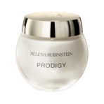

LINK SELLING
FULL PRODIGY ROUTINE
SKIN CARE
GLOBAL ANTI-AGEING CONCERN
MAKE-UP
INSTANT ANTI-AGEING

✴

✴
+
+
+
PRODIGY POWERCELL SERUM
PRODIGY CREAM
PRODIGY EYE BALM
COMPACT
FOUNDATION
SERUM-IN-LOTION
ESSENCE CONCENTRATE
CREAM
FOUNDATION

Slide 17
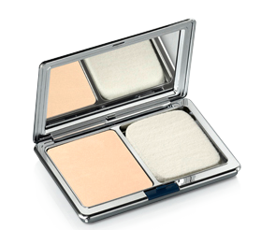
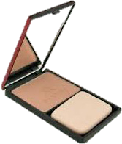
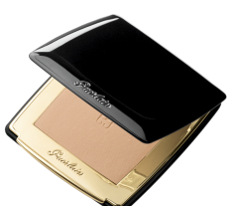
COMPETITION
LA PRAIRIE
CELLULAR TREATMENT FOUNDATION
Price : 67,00 €
SISLEY
PHYTO-TEINT ÉCLAT
COMPACT
Price : 82,20 €
GUERLAIN
PARURE GOLD
COMPACT
Price : 68,60 €
* THE HR +
COMFORT
BETTER SMOOTHING EFFECT
SOFT FOCUS EFFECT
* THE HR +
COMFORT
SMOOTHED SKIN SURFACE
SOFT FOCUS EFFECT
LIGHTEST TEXTURE
* THE HR +
COMFORT
LIGHTEST TEXTURE
* Internal tests made by Stéphanie PEIRELLO-HERVE, HR International Make-Up Artist

