Slide 1

Re-PLASTY PRESCRIPTION
TRAINING MODULE
INTERNATIONAL AND ASIAN VERSION

Slide 2
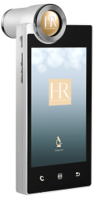
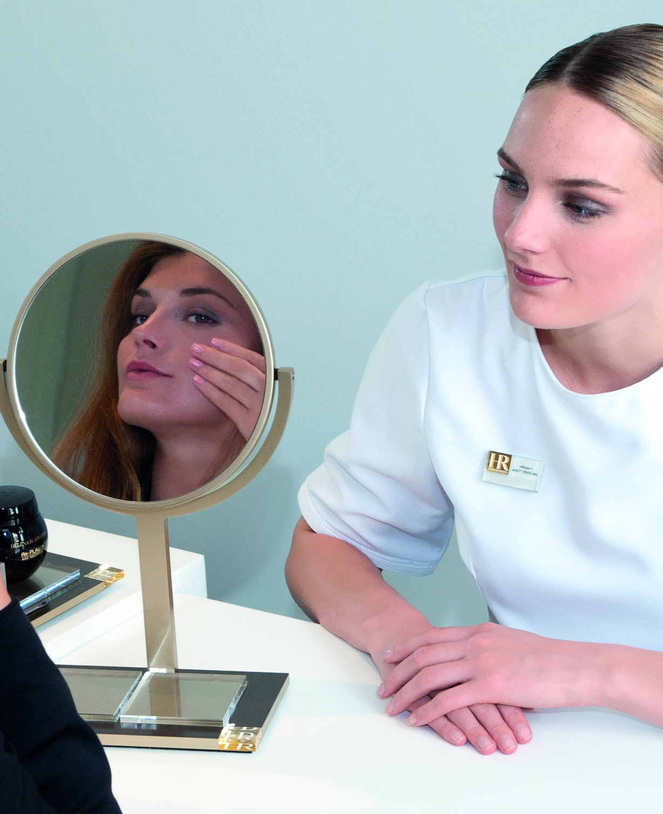
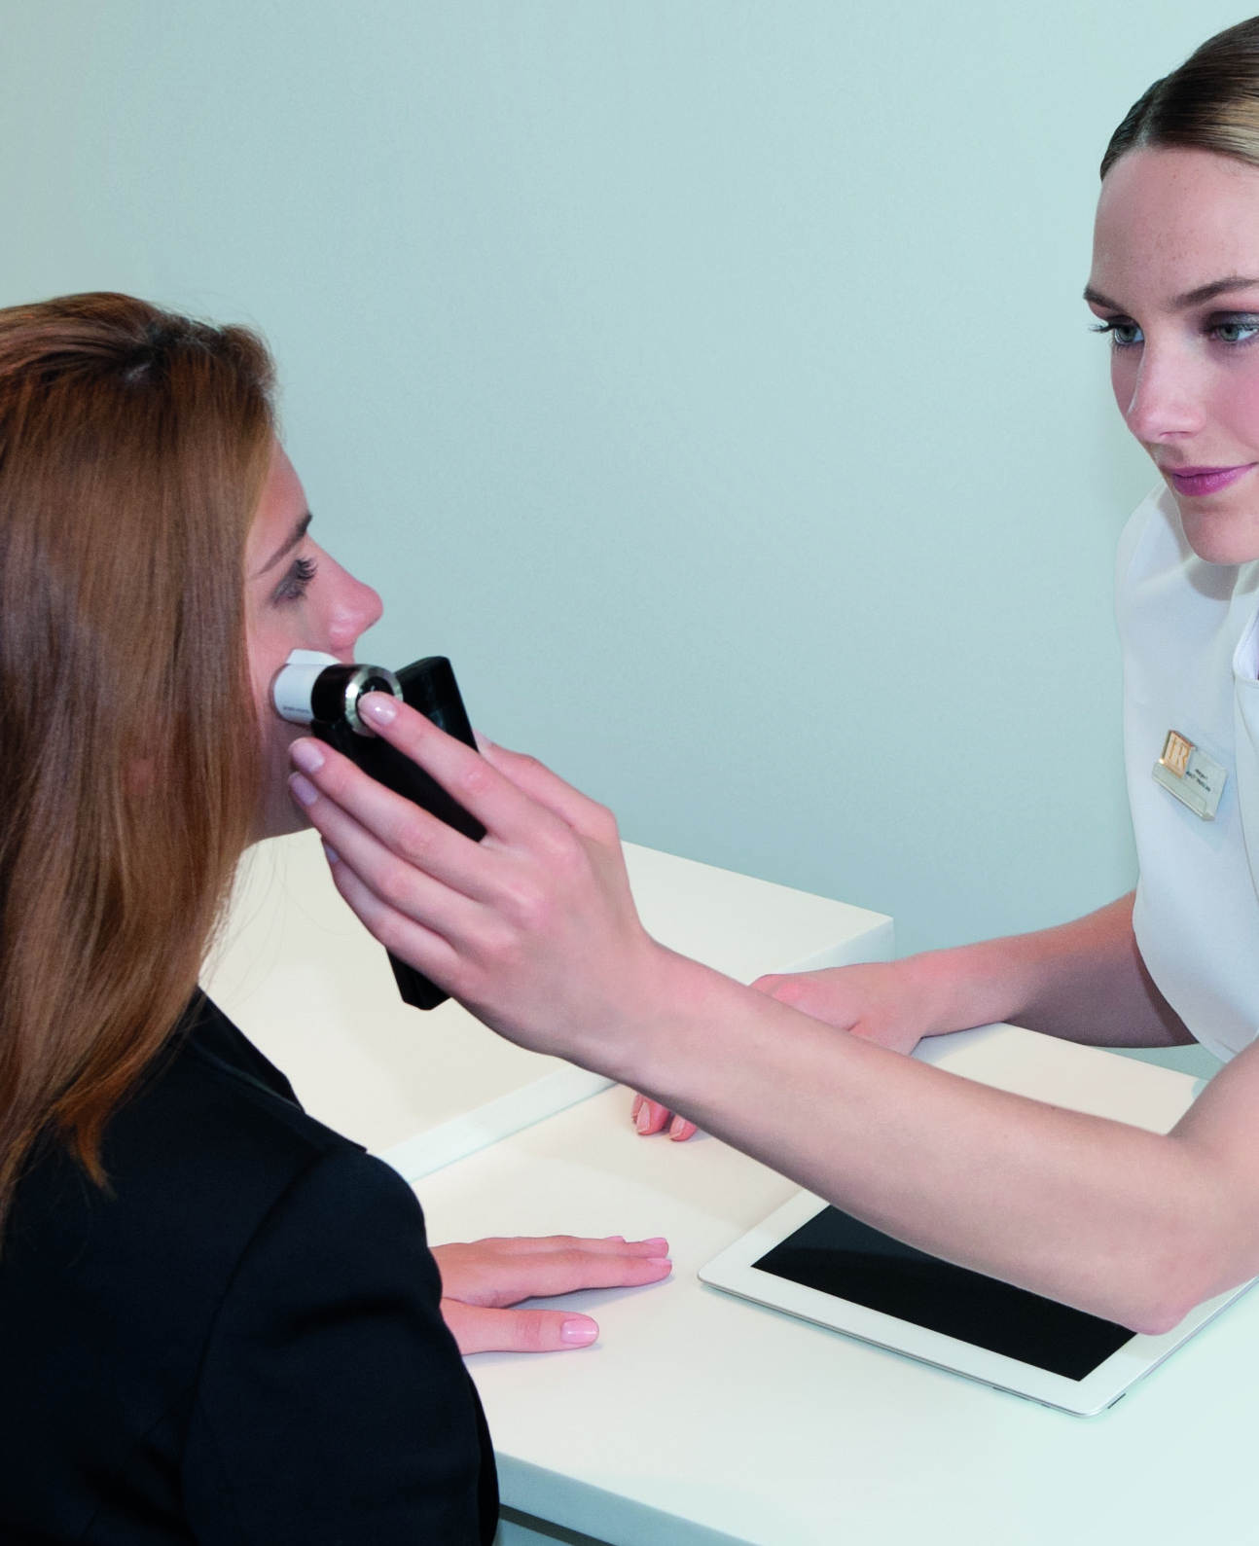
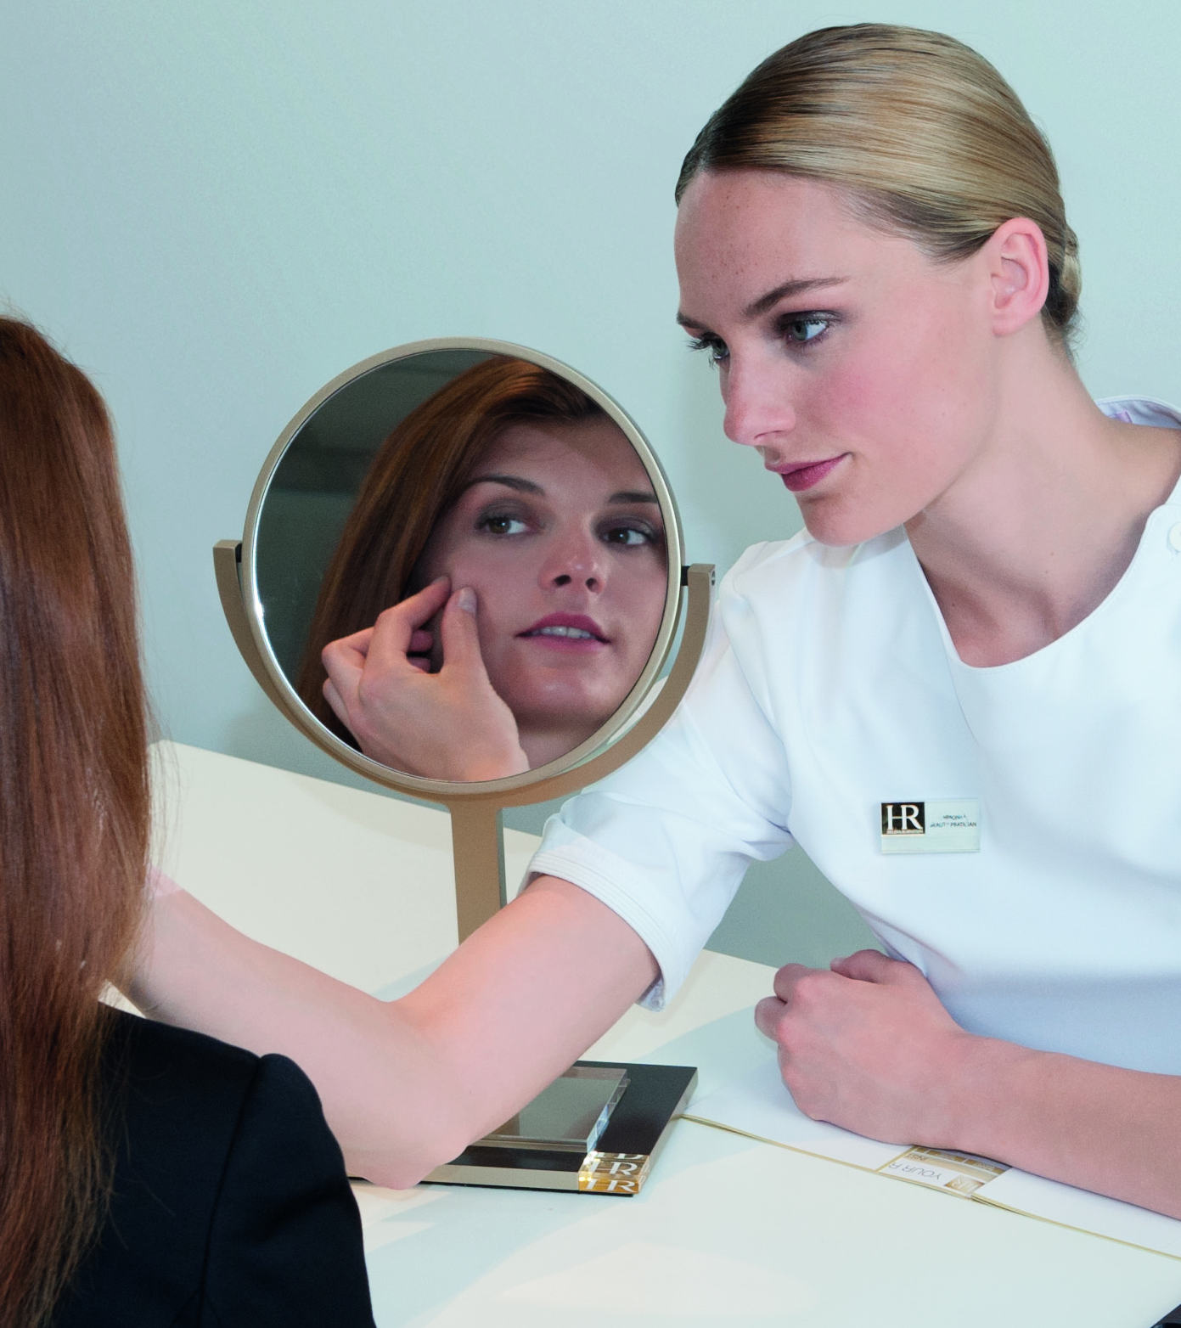
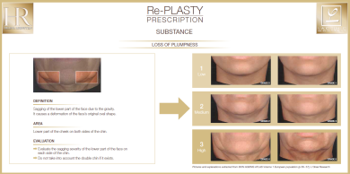
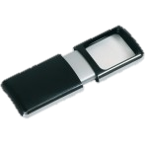
Re-PLASTY PRESCRIPTION CLINICAL DIAGNOSIS
THE « LACLINIC » CONSULTATION FOR HELENA RUBINSTEIN
IN 3 EASY STEPS
THE COSMETIC REPLICATION OF THE CLINICAL DIAGNOSIS MADE BY Dr. PFULG
STEP 1
STEP 2
STEP 3
MIRROR
SKIN PROFILER
BA MANUAL EVALUATION
MAIN CONCERN(S) EXPRESSED BY THE CUSTOMER IN FRONT OF THE MIRROR
SKIN PROFILING ANALYSIS: SUBSTANCE – TEXTURE – TONE
SPECIFIC GESTURES, LIGHTING MAGNIFYING DEVICE, SKIN AGEING ATLAS
PROFILE DETERMINED BY THE BA
Notes:
We will now focus on the step 2 of the diagnosis. Step 1 and 3 are detailed in the Re-Pasty Prescription training module.

Slide 3
Re-PLASTY PRESCRIPTION CLINICAL DIAGNOSIS
THE « LACLINIC » CONSULTATION FOR HELENA RUBINSTEIN
STEP 2
PERFORMED WITH THE SKIN PROFILER
DEVICE PRESENTATION
SETTINGS
TAKING MEASURES
IMPORTANT THINGS TO KNOW

Slide 4
Re-PLASTY PRESCRIPTION CLINICAL DIAGNOSIS
THE « LACLINIC » CONSULTATION FOR HELENA RUBINSTEIN
1. DEVICE PRESENTATION
The SKIN PROFILER:
EXPERT AND FRAGILE DEVICE
MOBILE SKIN ANALYZER
SPECIFIC SOFTWARE AND ALGORYTHM DEVELOPPED FOR HR
TOUCH SCREEN
HIGH RESOLUTION & AUTO ADJUSTMENT FOR SKIN ANALYSIS [X30]
MORE THAN 15,000 SKINS IN DATABASE
Notes:
Specific software and algorythm developped ONLY for Helena Rubisntein and Re-Plasty Prescriptiuon in particular.
The provider, a Korean company, has its own technology and based its knowledge on optical cameras and skin regerences (more than 5,000 for Caucasian and more than 10,000 for Asian)

Slide 5
Re-PLASTY PRESCRIPTION CLINICAL DIAGNOSIS
THE « LACLINIC » CONSULTATION FOR HELENA RUBINSTEIN
1. DEVICE PRESENTATION
How to introduce the SKIN PROFILER:
« Is an expert skin device with an exclusive software developped by Helena Rubinstein.
It will allow me to measure your 3 clinical criteria of a perfect beautiful skin:
Substance, with elasticity and wrinkles
Texture, with hydration and pores
Tone, with pigmentation and redness
It is absolutely painless and will only take a few minutes.
To have an accurate result, I need to remove your make-up…
The device has different sensors and especially cameras that will magnify your skin 30 times…
I also need to know your age group… »

Slide 6
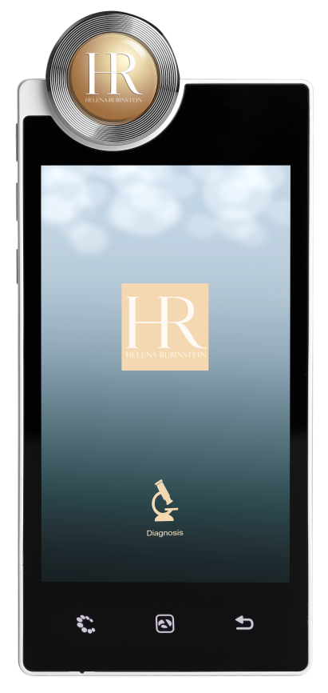
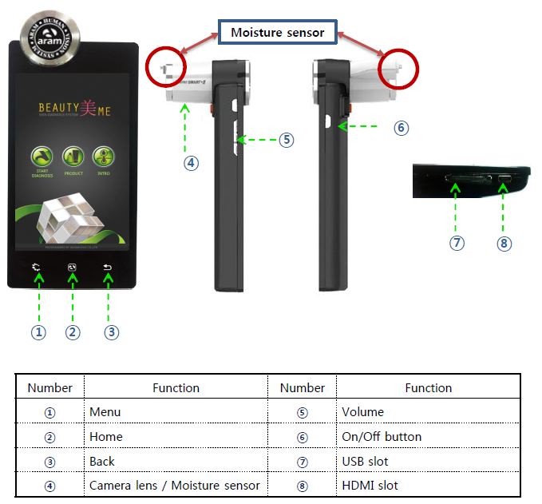

Re-PLASTY PRESCRIPTION CLINICAL DIAGNOSIS
THE « LACLINIC » CONSULTATION FOR HELENA RUBINSTEIN
1. DEVICE PRESENTATION

Slide 7
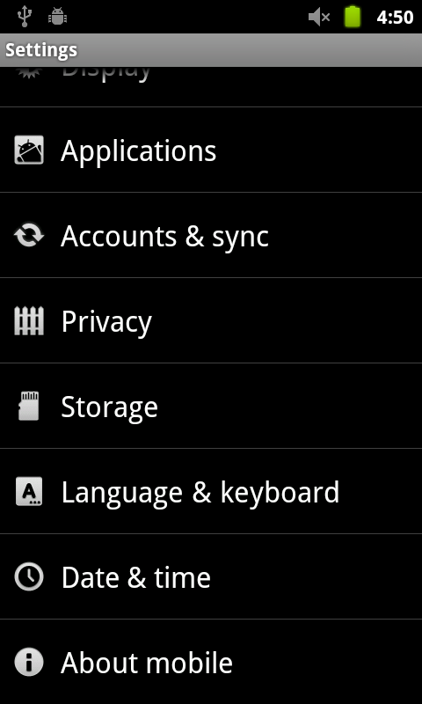
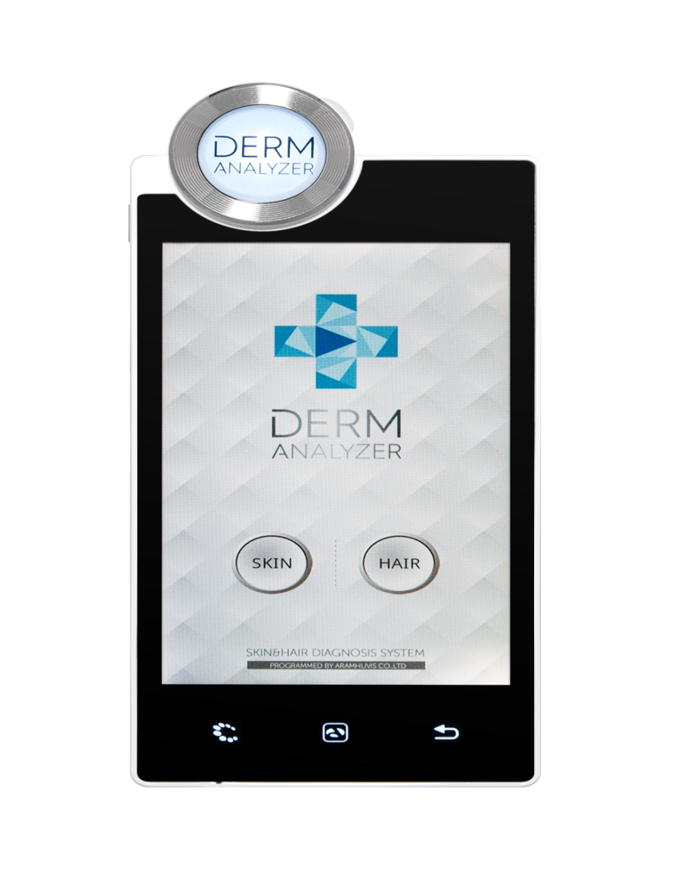

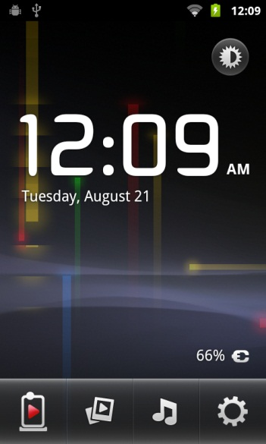

Re-PLASTY PRESCRIPTION CLINICAL DIAGNOSIS
THE « LACLINIC » CONSULTATION FOR HELENA RUBINSTEIN
2; 2. SYSTEM SETTING: DATE & TIME ZONE
Tap Button
Tap Button
Select “Date & Time

Slide 8
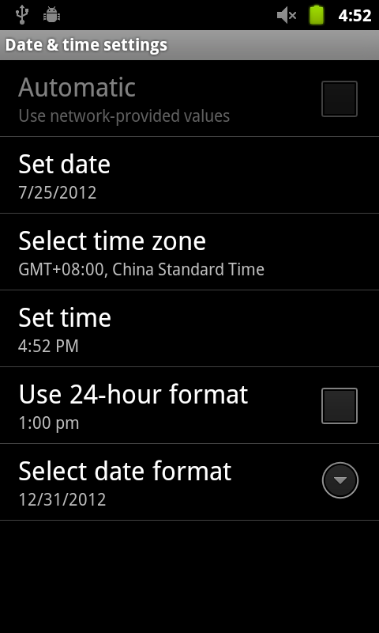
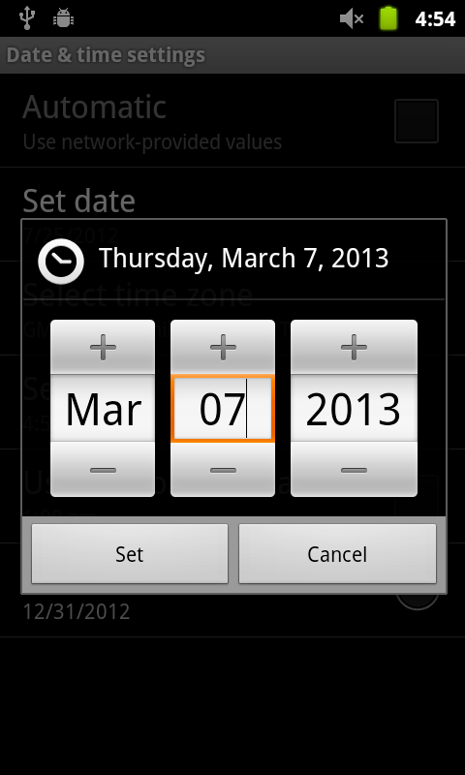

Re-PLASTY PRESCRIPTION CLINICAL DIAGNOSIS
THE « LACLINIC » CONSULTATION FOR HELENA RUBINSTEIN
2. SYSTEM SETTING: DATE & TIME ZONE
Select “Set date”
Change the date and
select “Set” button
Please check the setting is correctly applied

Slide 9
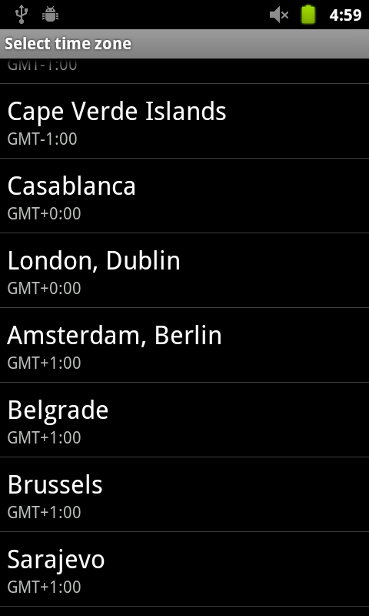
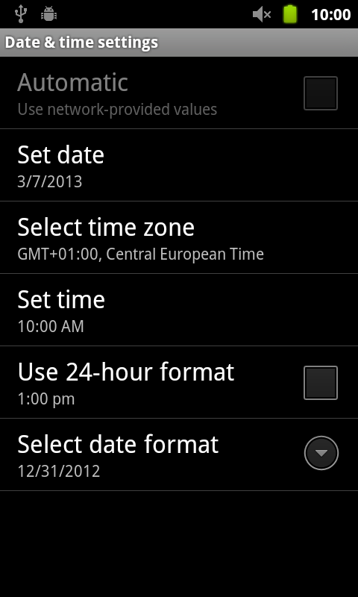
Re-PLASTY PRESCRIPTION CLINICAL DIAGNOSIS
THE « LACLINIC » CONSULTATION FOR HELENA RUBINSTEIN
2. SYSTEM SETTING: DATE & TIME ZONE
Select “Select time zone” button
Change into the current time zone .
Please check the setting is correctly applied.

Slide 10
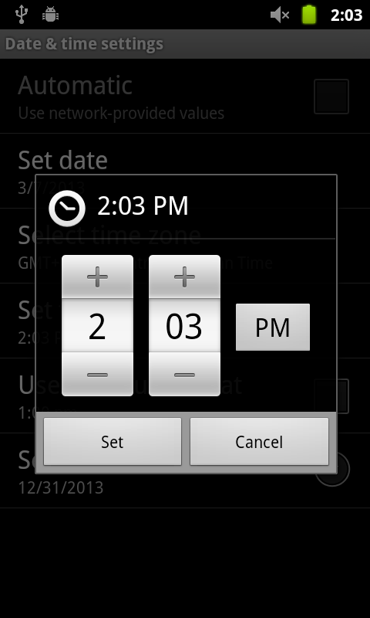

Re-PLASTY PRESCRIPTION CLINICAL DIAGNOSIS
THE « LACLINIC » CONSULTATION FOR HELENA RUBINSTEIN
2. SYSTEM SETTING: DATE & TIME ZONE
Select “Set time”
Change into the current time and select
“Set” button.
Please check the setting is correctly applied.

Slide 11
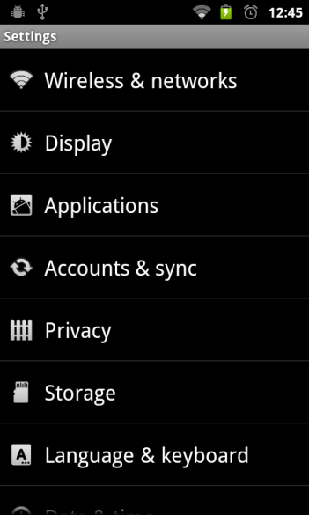
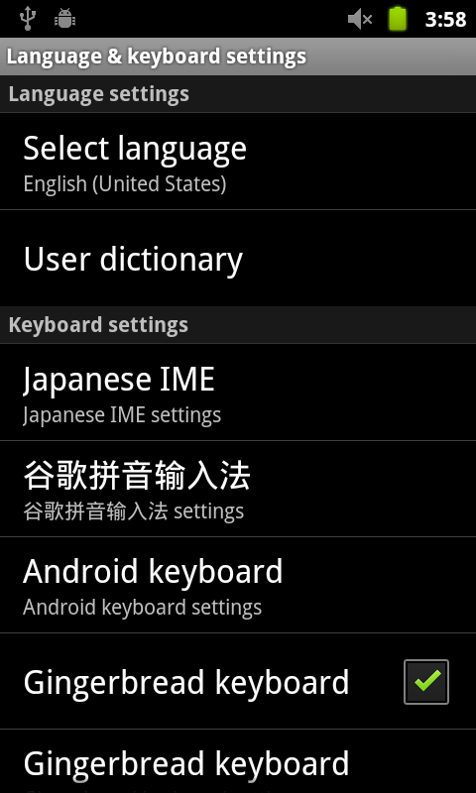
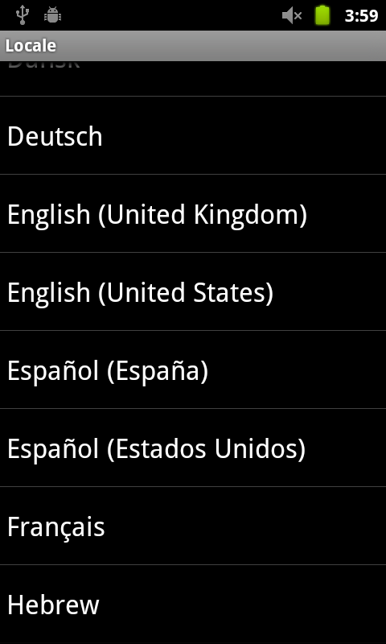
Re-PLASTY PRESCRIPTION CLINICAL DIAGNOSIS
THE « LACLINIC » CONSULTATION FOR HELENA RUBINSTEIN
2. SYSTEM SETTING: LANGUAGE
Select
“Language & keyboard”
Select “Select language”
Choose the language you
want to use on the list.

Slide 12
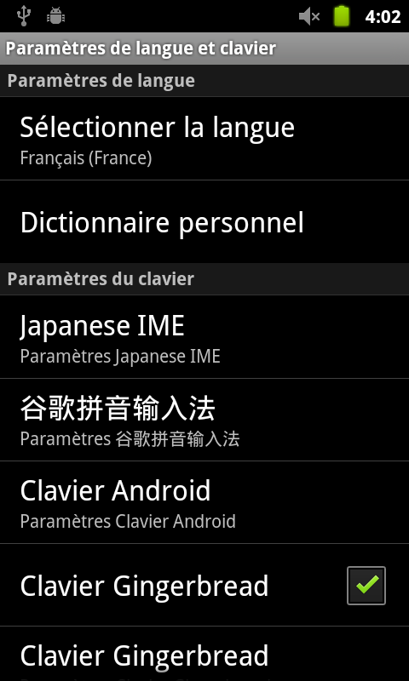
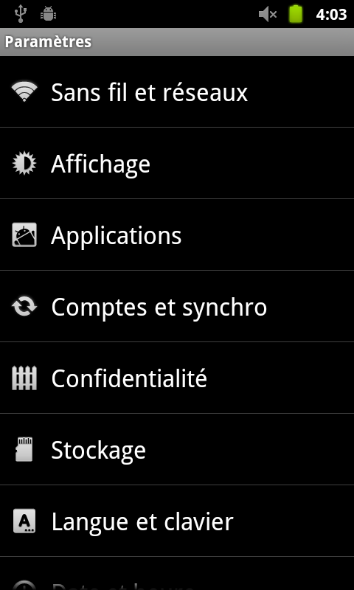
Re-PLASTY PRESCRIPTION CLINICAL DIAGNOSIS
THE « LACLINIC » CONSULTATION FOR HELENA RUBINSTEIN
2. SYSTEM SETTING: LANGUAGE
Check the language
Check the language

Slide 13
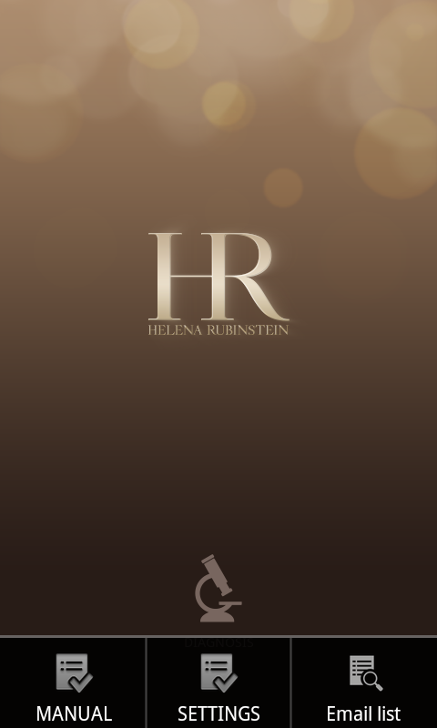
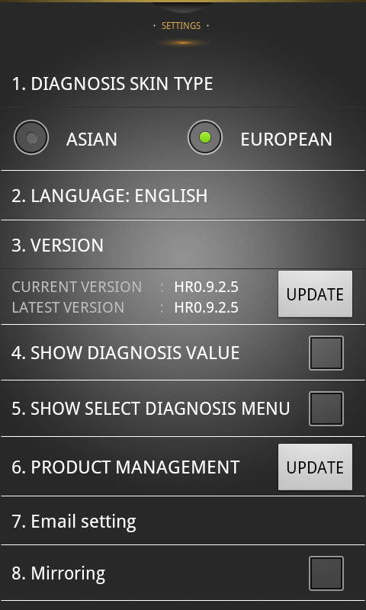




Re-PLASTY PRESCRIPTION CLINICAL DIAGNOSIS
THE « LACLINIC » CONSULTATION FOR HELENA RUBINSTEIN
2. APP SETTING: LANGUAGE
Tap
On the Settings,
choose “Current Region”.
Setting Page

Slide 14
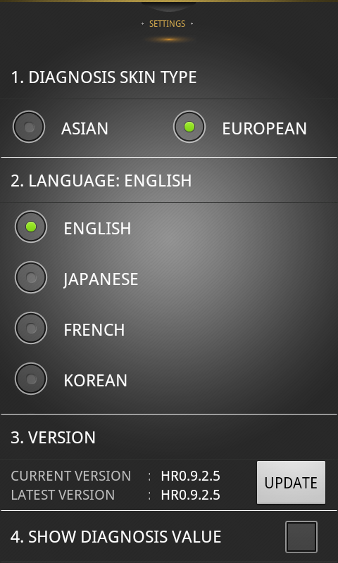

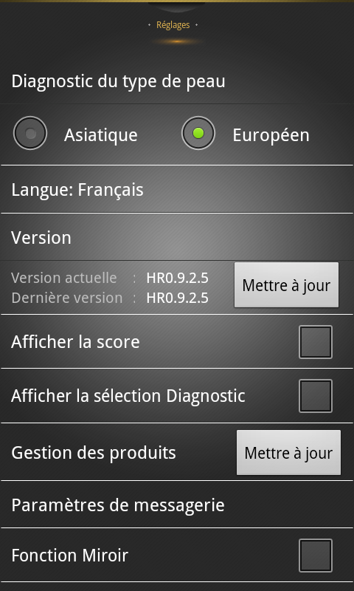
Re-PLASTY PRESCRIPTION CLINICAL DIAGNOSIS
THE « LACLINIC » CONSULTATION FOR HELENA RUBINSTEIN
2. APP SETTING: LANGUAGE
Check the language option and among the lists, select a language you want to use
Make sure the language you select
All language is appeared as you selected

Slide 15
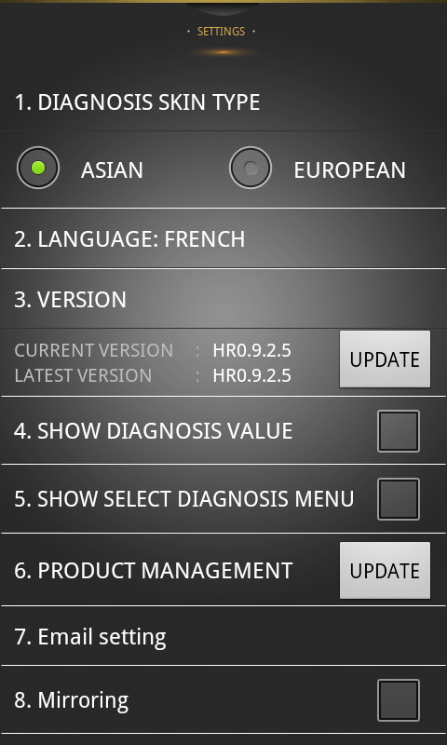
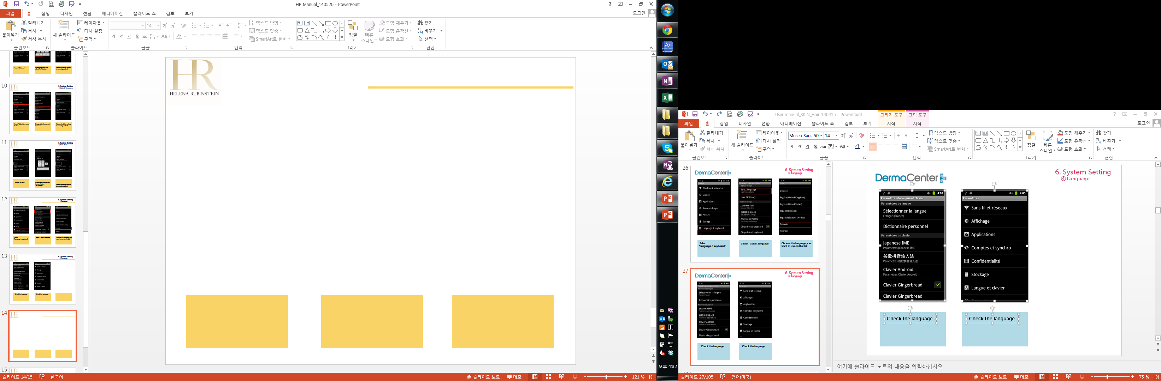
Re-PLASTY PRESCRIPTION CLINICAL DIAGNOSIS
THE « LACLINIC » CONSULTATION FOR HELENA RUBINSTEIN
2. APP SETTING: ETHNICITY
Check the Skin Type
Select
“Asian” or European”

Slide 16



Re-PLASTY PRESCRIPTION CLINICAL DIAGNOSIS
THE « LACLINIC » CONSULTATION FOR HELENA RUBINSTEIN
2. APP SETTING: APP UPDATE
Tap
Select “Settings”
Setting Page
Notes:
The App update has o be done only when needed or required.
You need to have a wifi access.

Slide 17
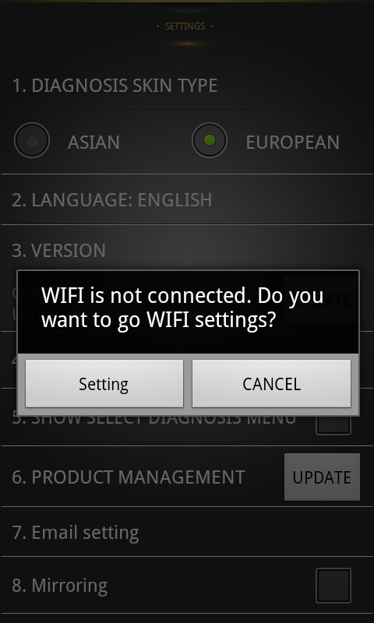
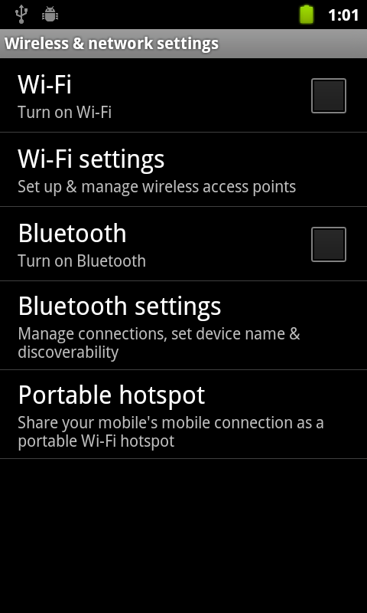
Re-PLASTY PRESCRIPTION CLINICAL DIAGNOSIS
THE « LACLINIC » CONSULTATION FOR HELENA RUBINSTEIN
2. APP SETTING: APP UPDATE
Select “Update” button
To update the version,
go to the wifi setting page
by choosing “setting”
button
Wi-fi Setting page

Slide 18
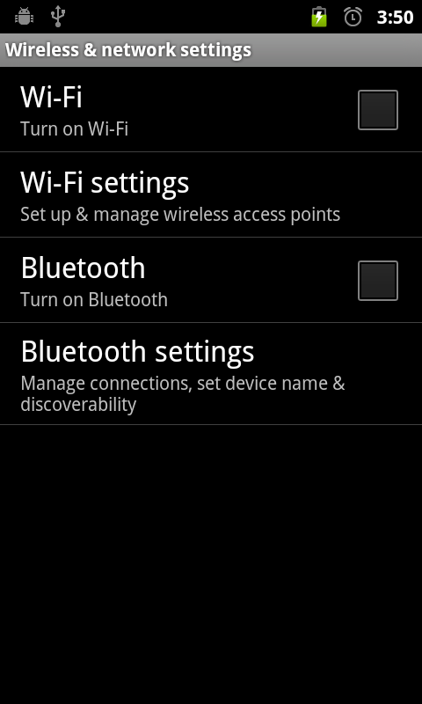
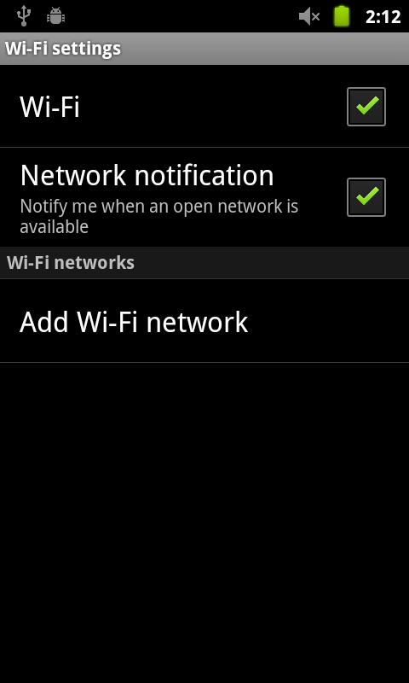
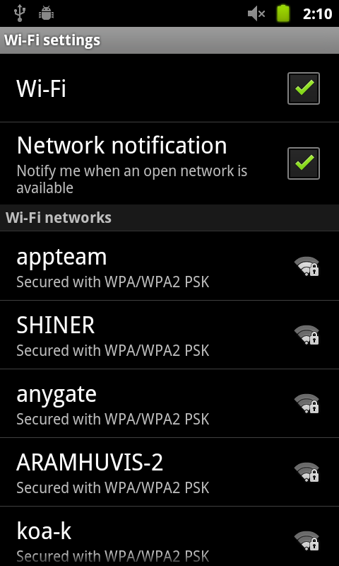
Re-PLASTY PRESCRIPTION CLINICAL DIAGNOSIS
THE « LACLINIC » CONSULTATION FOR HELENA RUBINSTEIN
2. APP SETTING: APP UPDATE
Select
“Wi-Fi settings”
Check the square box
Wi-Fi list will appear

Slide 19
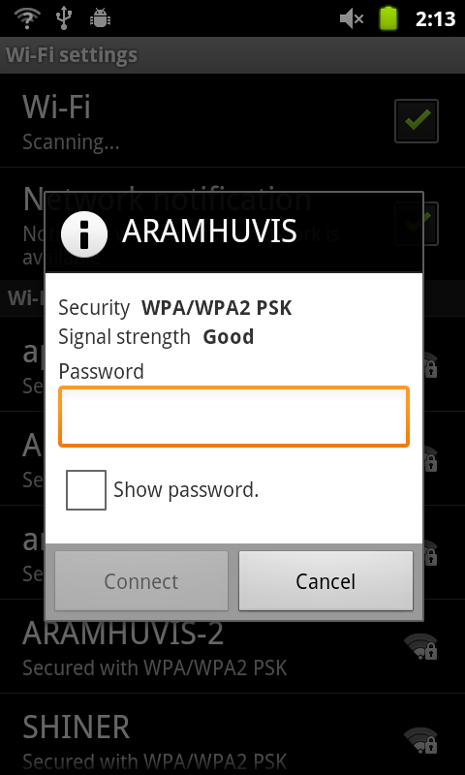
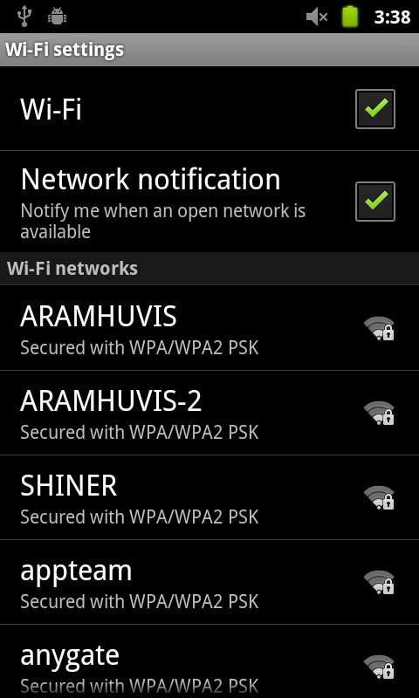
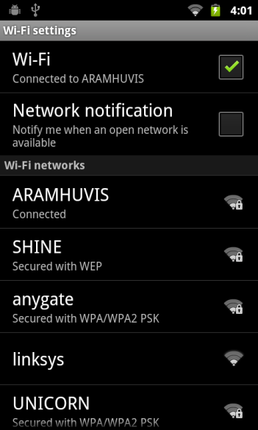
Re-PLASTY PRESCRIPTION CLINICAL DIAGNOSIS
THE « LACLINIC » CONSULTATION FOR HELENA RUBINSTEIN
2. APP SETTING: APP UPDATE
Among the list, select the Wi-Fi connection you can use
Wait until the device is connecting with Wi-Fi
Once the device is connected with Wi-Fi , you can see the Wi-Fi signal as above image

Slide 20

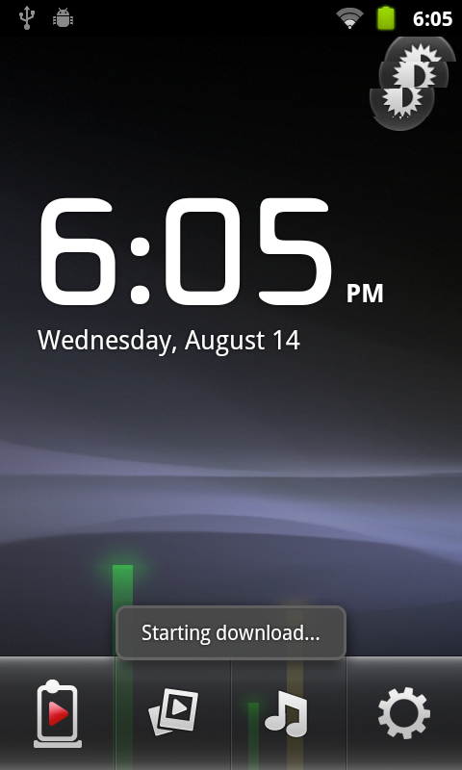
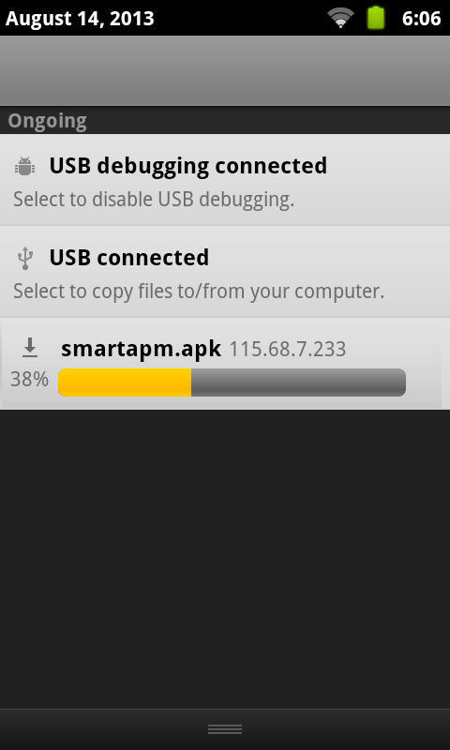
Re-PLASTY PRESCRIPTION CLINICAL DIAGNOSIS
THE « LACLINIC » CONSULTATION FOR HELENA RUBINSTEIN
2. APP SETTING: APP UPDATE
To be connected to
the update link
Starting download…
Please scroll up to down the top part of pages to check the current process

Slide 21
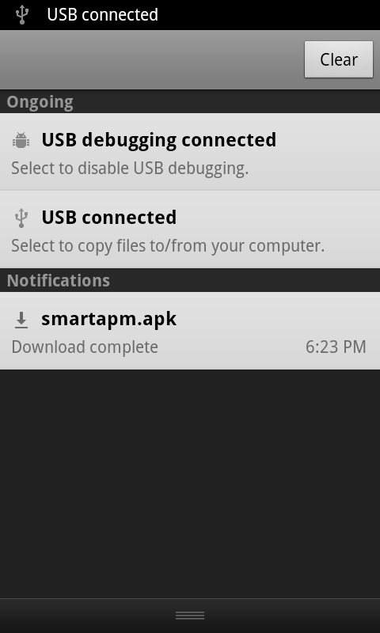
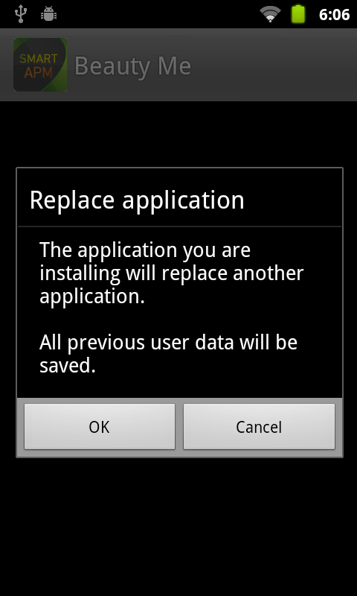
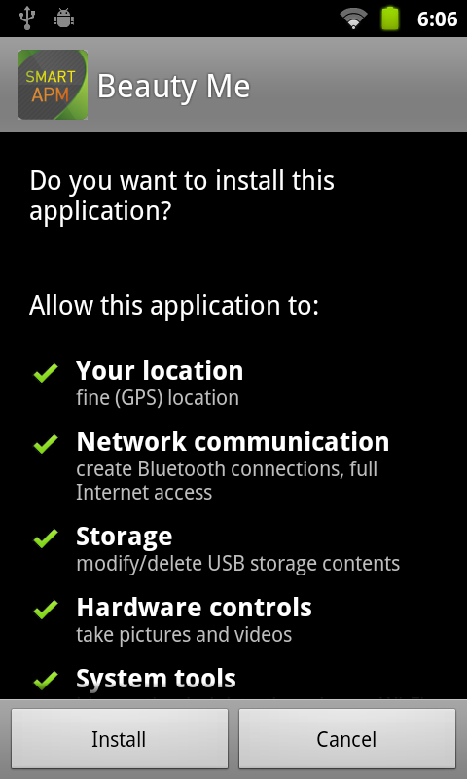
Re-PLASTY PRESCRIPTION CLINICAL DIAGNOSIS
THE « LACLINIC » CONSULTATION FOR HELENA RUBINSTEIN
2. APP SETTING: APP UPDATE
Among the list, select the Wi-Fi connection you could use
Wait until the device is connecting with Wi-Fi
Once the device is connected with Wi-Fi , you can see the Wi-Fi signal as above image

Slide 22
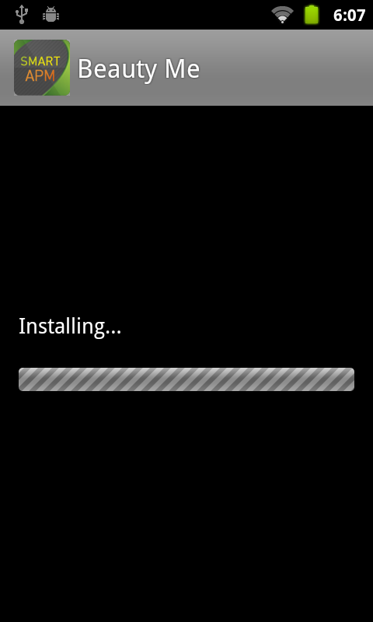
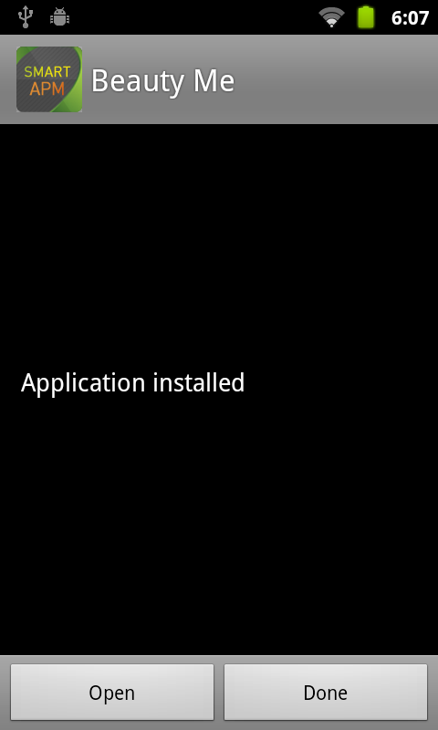

Re-PLASTY PRESCRIPTION CLINICAL DIAGNOSIS
THE « LACLINIC » CONSULTATION FOR HELENA RUBINSTEIN
2. APP SETTING: APP UPDATE
Installing
Select “Open”
Main Page

Slide 23
Re-PLASTY PRESCRIPTION CLINICAL DIAGNOSIS
THE « LACLINIC » CONSULTATION FOR HELENA RUBINSTEIN
3. TAKING MEASURES
Measures have to be taken on a skin with no make up.
In case your customer wears make-up, you will have to remove it smoothly.
Measures are taken on 4 areas of the face:
Centre of the cheek: for hydration and elasticity
Cheekbone: for redness and pigmentation
Cheek close to the nose: for pores
Close to the outer corner of the eye: for wrinkles
Notes:
To remove make-up, use a tissue or milk & lotion in case of heavy make-up. Do not use any moisturizer before using the Skin Profiler.
Indeed, make-up may interfere with sensors and give an inaccurate diagnosis result.
Before removing customer’s make-up entirely or on the zones where measures have to be taken, do NOT forget to disinfect your hands. Clean the sensor with the special cloth provided.
The zones where to take measures are always indicated by a circle on the face on the screen on the device

Slide 24
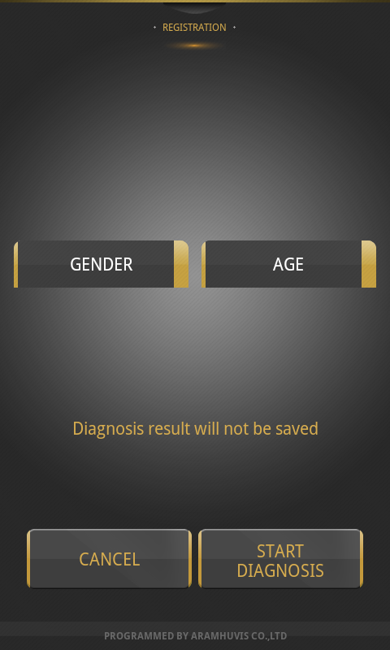
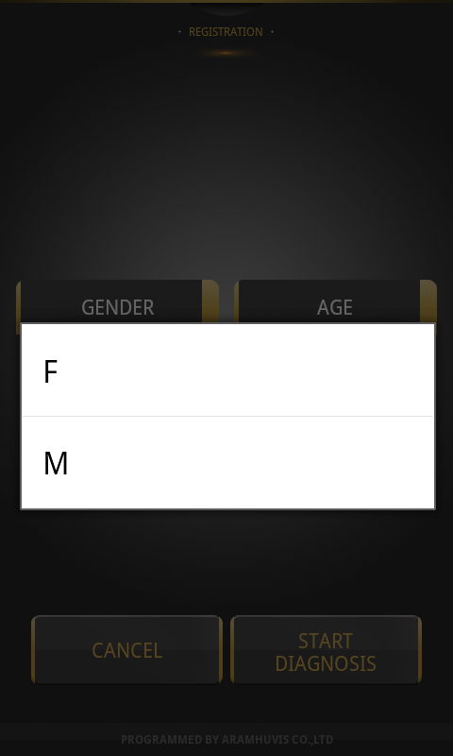
Re-PLASTY PRESCRIPTION CLINICAL DIAGNOSIS
THE « LACLINIC » CONSULTATION FOR HELENA RUBINSTEIN
3. TAKING MEASURES: DIAGNOSIS
On main page,
Select Diagnosis
Select “Gender”
Choose F (Female)
or M (Male)

Slide 25
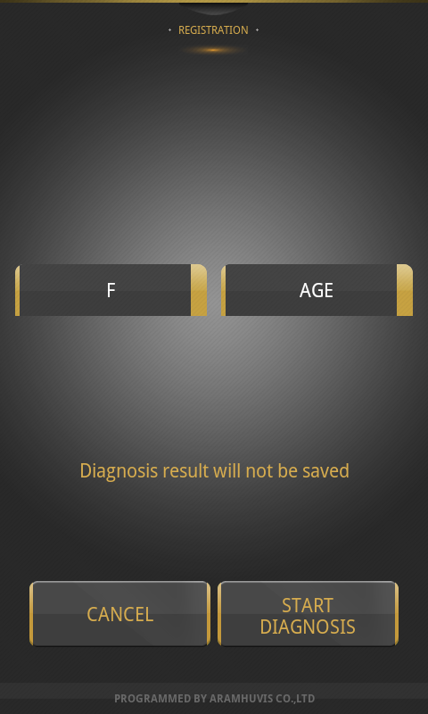
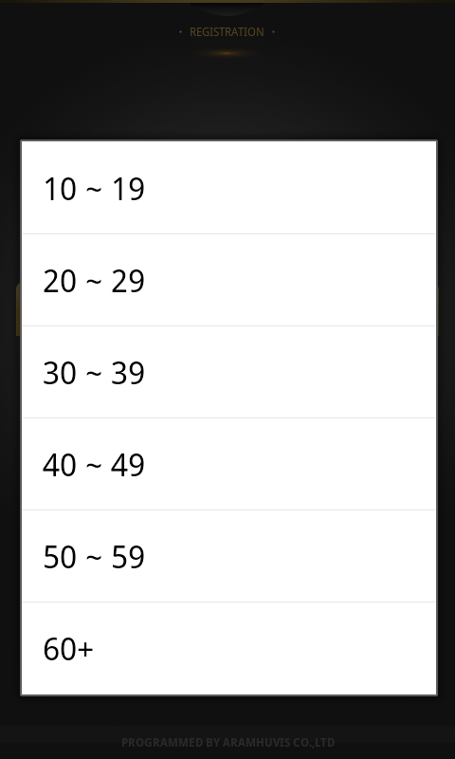

Re-PLASTY PRESCRIPTION CLINICAL DIAGNOSIS
THE « LACLINIC » CONSULTATION FOR HELENA RUBINSTEIN
3. TAKING MEASURES: DIAGNOSIS
“F” is selected.
Then select “Age”
Among the lists,
Check the age group
Gender & Age group is selected
Then, select “Start diagnosis” button

Slide 26
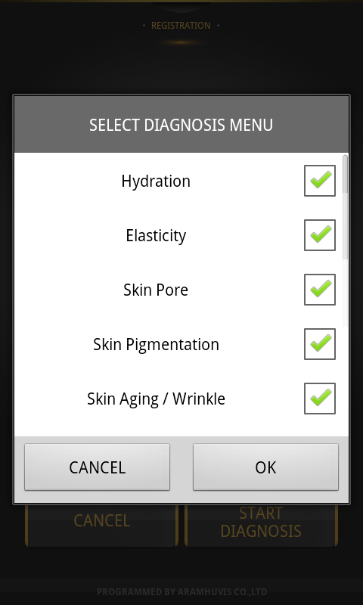
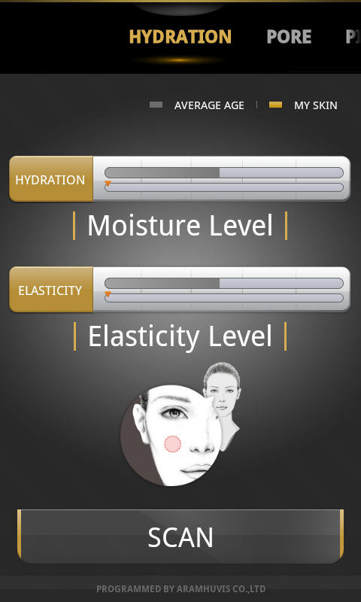


Re-PLASTY PRESCRIPTION CLINICAL DIAGNOSIS
THE « LACLINIC » CONSULTATION FOR HELENA RUBINSTEIN
3. TAKING MEASURES: HYDRATION & ELASTICITY
Before the diagnosis,
Check the diagnosis parameters and select “OK” button.
Place sensor on skin and tap [Scan] button
After 2~3 seconds,
Hydration value will be
Appeared the bar graph
Notes:
For each measurement, once all the criterai of gender, age group are selected, you will find a grey horizontal line indicating the AVERAGE result for the same gender, athnicity and age group. This is based on calculation of the average corresponsing skins that are in the datbalse of the device (Cf. green rectangle).
Then, after the measure are taken, an orange/brown line will appear below the first one, indicating the customer’s own results.
The more the skin is hydrated, the better.
The more the skin is elastic, the better.

Slide 27
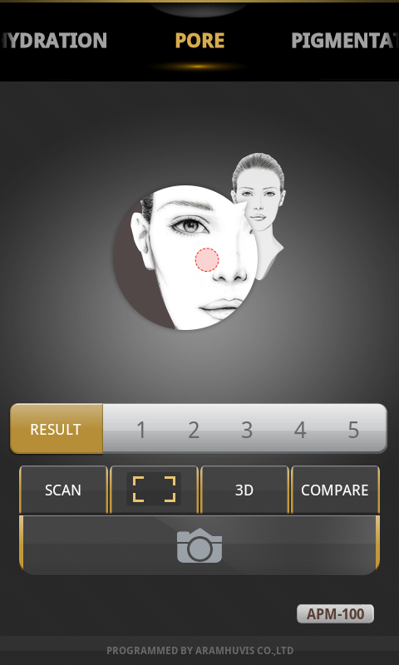


Re-PLASTY PRESCRIPTION CLINICAL DIAGNOSIS
THE « LACLINIC » CONSULTATION FOR HELENA RUBINSTEIN
3. TAKING MEASURES: PORES
Select “Camera” Icon,
to activate the lens.
Select “Capture” button
To take image.
Notes:
Before taking any measurement with the camera, warn the customer that she will see her skin in big, magified 30 times.
It can be scarry for customers and therefore you have to show how the camera will magnify, for instance taking a picture of the fabric of a piece of the customer’s clothes (scarf, sleesbves, etc.). You can then ad another stp after the fabric, taking a picture similarly on her hand.
To witch from a type of measure to the other, scroll horizontally the screen with your finger.

Slide 28
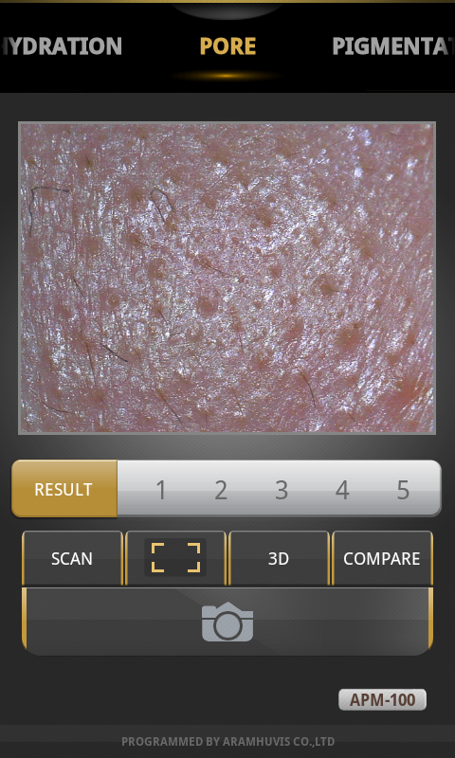

Re-PLASTY PRESCRIPTION CLINICAL DIAGNOSIS
THE « LACLINIC » CONSULTATION FOR HELENA RUBINSTEIN
3. TAKING MEASURES: PORES
Select “Camera” Icon,
to activate the lens.
Select “Capture” button
To take image.
Select “Scan”
Notes:
The more narrow and small the pores are, the better.

Slide 29




Re-PLASTY PRESCRIPTION CLINICAL DIAGNOSIS
THE « LACLINIC » CONSULTATION FOR HELENA RUBINSTEIN
3. TAKING MEASURES: PORES
Analyzing the status
The analysis result will be appeared with number evaluation and comment, Select
to magnify the image
Check the image and
Select “Close”

Slide 30



Re-PLASTY PRESCRIPTION CLINICAL DIAGNOSIS
THE « LACLINIC » CONSULTATION FOR HELENA RUBINSTEIN
3. TAKING MEASURES: PORES
Select to check the sample image with the clients image.
With sample image,
The client can figure out the differences.”
Once touch the screen.”
Good , Normal,, Bad samples are available to check

Slide 31


Re-PLASTY PRESCRIPTION CLINICAL DIAGNOSIS
THE « LACLINIC » CONSULTATION FOR HELENA RUBINSTEIN
3. TAKING MEASURES: PORES
Select to check the image with 3D image.
It is available to check the pore depth by touching the screen.
Available to check the skin depth with a variety of angles by touching it and zoom in.

Slide 32



Re-PLASTY PRESCRIPTION CLINICAL DIAGNOSIS
THE « LACLINIC » CONSULTATION FOR HELENA RUBINSTEIN
3. TAKING MEASURES: PIGMENTATION
Select “Camera” Icon,
to activate the lens.
Select “Capture” button
To take image.
Select “Scan”
Notes:
The less pigmentation you have , the better.

Slide 33



Re-PLASTY PRESCRIPTION CLINICAL DIAGNOSIS
THE « LACLINIC » CONSULTATION FOR HELENA RUBINSTEIN
3. TAKING MEASURES: PIGMENTATION
The analysis result will be appeared with number evaluation and comment
Select to magnify the image
Check the image and
Select “Close”

Slide 34



Re-PLASTY PRESCRIPTION CLINICAL DIAGNOSIS
THE « LACLINIC » CONSULTATION FOR HELENA RUBINSTEIN
3. TAKING MEASURES: PIGMENTATION
Select to check the sample image with the clients image.
With sample image,
The client can figure out the differences.”
Once touch the screen.”
Good , Normal,, Bad samples are available to check

Slide 35

Re-PLASTY PRESCRIPTION CLINICAL DIAGNOSIS
THE « LACLINIC » CONSULTATION FOR HELENA RUBINSTEIN
3. TAKING MEASURES: WRINKLES
-Wrinkle mode
1. The user should hold the device
Horizontally as left image.
2. Unlike other parameter, after the user capture the wrinkle area, there is an additional step to select the measurement part.
3. When you take pictures, please inform the customer to close the eyes and do not place the sensor into the eye part closely.

Slide 36



Re-PLASTY PRESCRIPTION CLINICAL DIAGNOSIS
THE « LACLINIC » CONSULTATION FOR HELENA RUBINSTEIN
3. TAKING MEASURES: WRINKLES
Select “Camera” Icon,
to activate the lens.
Select “Capture” button
to take image.
Unlike other parameters,
the square guide line will be shown to select the exact measurement.
Notes:
The less the wrinkles, the better.

Slide 37


Re-PLASTY PRESCRIPTION CLINICAL DIAGNOSIS
THE « LACLINIC » CONSULTATION FOR HELENA RUBINSTEIN
3. TAKING MEASURES: WRINKLES
Move the square as far as from the eyes to get the exact result and select “Save” button
Select “Analyze” button
The analysis result will be appeared with star evaluation and comment.

Slide 38

Re-PLASTY PRESCRIPTION CLINICAL DIAGNOSIS
THE « LACLINIC » CONSULTATION FOR HELENA RUBINSTEIN
3. TAKING MEASURES: WRINKLES
Select to magnify the image
Check the image and
Select “Close”

Slide 39



Re-PLASTY PRESCRIPTION CLINICAL DIAGNOSIS
THE « LACLINIC » CONSULTATION FOR HELENA RUBINSTEIN
3. TAKING MEASURES: WRINKLES
Select to check the sample image with the clients image.
With sample image,
The client can figure out the differences.”
Once touch the screen.”
Good , Normal,, Bad samples are available to check

Slide 40


Re-PLASTY PRESCRIPTION CLINICAL DIAGNOSIS
THE « LACLINIC » CONSULTATION FOR HELENA RUBINSTEIN
3. TAKING MEASURES: WRINKLES
Select to check the image with 3D image.
It is available to check the pore depth by touching the screen.
Available to check the skin depth with a variety of angles by touching it and zoom in.

Slide 41


Re-PLASTY PRESCRIPTION CLINICAL DIAGNOSIS
THE « LACLINIC » CONSULTATION FOR HELENA RUBINSTEIN
3. TAKING MEASURES: REDNESS
Select “Camera” Icon,
to activate the lens.
Select “Capture” button
To take image.
Select “Scan”
Notes:
The less the redness, the better.

Slide 42


Re-PLASTY PRESCRIPTION CLINICAL DIAGNOSIS
THE « LACLINIC » CONSULTATION FOR HELENA RUBINSTEIN
3. TAKING MEASURES: REDNESS

Slide 43



Re-PLASTY PRESCRIPTION CLINICAL DIAGNOSIS
THE « LACLINIC » CONSULTATION FOR HELENA RUBINSTEIN
3. TAKING MEASURES: REDNESS
Select to check the sample image with the clients image.
With sample image,
The client can figure out the differences.”
Once touch the screen.”
Good , Normal,, Bad samples are available to check

Slide 44



Re-PLASTY PRESCRIPTION CLINICAL DIAGNOSIS
THE « LACLINIC » CONSULTATION FOR HELENA RUBINSTEIN
3. TAKING MEASURES: RESULTS
All results are appeared with the bar graph to compare with average value compare
Scroll up and down to check whole results
Once touch each parameter, it is available to check the skin image you took

Slide 45
Re-PLASTY PRESCRIPTION CLINICAL DIAGNOSIS
THE « LACLINIC » CONSULTATION FOR HELENA RUBINSTEIN
3. TAKING MEASURES: RESULTS
Image checking
Image checking

Slide 46



Re-PLASTY PRESCRIPTION CLINICAL DIAGNOSIS
THE « LACLINIC » CONSULTATION FOR HELENA RUBINSTEIN
3. TAKING MEASURES: PROFILE
Select above button to recommend the product
Check the product then
Go back to menus to click
button
Go next page

Slide 47


Re-PLASTY PRESCRIPTION CLINICAL DIAGNOSIS
THE « LACLINIC » CONSULTATION FOR HELENA RUBINSTEIN
3. TAKING MEASURES: PROFILE
In last page, select “home” icon to exit
Select “OK” button
Main page

Slide 48
Re-PLASTY PRESCRIPTION CLINICAL DIAGNOSIS
THE « LACLINIC » CONSULTATION FOR HELENA RUBINSTEIN
4. IMPORTANT THINGS TO KNOW
1. The product undergoes strict quality management and inspection process before production and introduction to market.
2. In case of functional or operational defect with occurs under normal condition of use within 10 days after purchase, the provider will repair it for free or replace in new product.
3. When this product goes out under the normal use, the provider will repair it free of charge under warranty.
4. Please keep the warranty card included in the box when you ask for repair service.
5. You will need to pay repair charge after warranty runs out.
6. For this product, warranty is 14 months from invoice date.

Slide 49
Re-PLASTY PRESCRIPTION CLINICAL DIAGNOSIS
THE « LACLINIC » CONSULTATION FOR HELENA RUBINSTEIN
4. IMPORTANT THINGS TO KNOW: WARRANTY
Notice device’s status for Aram HUVIS
-Take pic of device
-Describe problems
-Serial number needed
Fill out repair request form and mail to assistant manager.
Report problem to technician of Aram HUVIS
Manager will inform you next procedure.
Ship devices to
Global sales division
The repair will take 2 weeks from arrival date. If it takes longer than expectation, manager will notice for you.
Ship to customer by FEDEX

Slide 50
Re-PLASTY PRESCRIPTION CLINICAL DIAGNOSIS
THE « LACLINIC » CONSULTATION FOR HELENA RUBINSTEIN
4. IMPORTANT THINGS TO KNOW: WARRANTY
How to send the device to Aram HUVIS
1. Warranty : 14 months.
2. Time for repair : within 30 days.
3. Cost :
- Within warranty : Sending delivery(Buyer), repair cost and returning
delivery(Aram)
* If the product is broken by user's fault, repair cost could be charged.
- After warranty : Sending delivery and repair cost(Buyer), returning
delivery(Aram)
4. How to send :
- As sending a present from person to person by EMS or FEDEX.
(Do not write the company name)
- Total value should be under 99$.(Write non-commercial value)

Slide 51

Re-PLASTY PRESCRIPTION CLINICAL DIAGNOSIS
THE « LACLINIC » CONSULTATION FOR HELENA RUBINSTEIN
4. IMPORTANT THINGS TO KNOW: WARRANTY
Service request form
Date of purchase | / / | Company
Contact Person
Address : TEL :
Product name, serial No : Problems :
801-ho , 560 Dunchon-daero, Jungwon-gu
Seongnam-si Gyeonggi-do 462-716 KOREA
E-mail : info@aramhuvis.com

Slide 52


Re-PLASTY PRESCRIPTION CLINICAL DIAGNOSIS
THE « LACLINIC » CONSULTATION FOR HELENA RUBINSTEIN
4. IMPORTANT THINGS TO KNOW: HOW TO FIND USER GUIDE
On the main page
select button
Then Select
“OK” button
You can see the page
as above

Slide 53



Re-PLASTY PRESCRIPTION CLINICAL DIAGNOSIS
THE « LACLINIC » CONSULTATION FOR HELENA RUBINSTEIN
4. IMPORTANT THINGS TO KNOW: HOW TO FIND USER GUIDE
Connect the device with PC or laptop via USB cable

Slide 54


Re-PLASTY PRESCRIPTION CLINICAL DIAGNOSIS
THE « LACLINIC » CONSULTATION FOR HELENA RUBINSTEIN
4. IMPORTANT THINGS TO KNOW: HOW TO FIND USER GUIDE
Drag down
You can see the message “USB connected on the
top of the screen.
Then touch the top part
and drag it down
Select “USB connected”

Slide 55



Re-PLASTY PRESCRIPTION CLINICAL DIAGNOSIS
THE « LACLINIC » CONSULTATION FOR HELENA RUBINSTEIN
4. IMPORTANT THINGS TO KNOW: HOW TO FIND USER GUIDE
Select “Turn on USB
storage” button.
Select “OK” button
The icon color will be changed into orange.
It means USB storage is ready to use

Slide 56



Re-PLASTY PRESCRIPTION CLINICAL DIAGNOSIS
THE « LACLINIC » CONSULTATION FOR HELENA RUBINSTEIN
4. IMPORTANT THINGS TO KNOW: HOW TO FIND USER GUIDE
Then PC or laptop will recognize the device as a USB disk.
Disk driver could be (D:) or (E:) and so on.
Please open the folder.

Slide 57




Re-PLASTY PRESCRIPTION CLINICAL DIAGNOSIS
THE « LACLINIC » CONSULTATION FOR HELENA RUBINSTEIN
4. IMPORTANT THINGS TO KNOW: HOW TO FIND USER GUIDE
The folder is arranged as above

Slide 58
Re-PLASTY PRESCRIPTION CLINICAL DIAGNOSIS
THE « LACLINIC » CONSULTATION FOR HELENA RUBINSTEIN
4. IMPORTANT THINGS TO KNOW: HOW TO FIND USER GUIDE
In order to check the user manual, select “User Manual”.

Slide 59
Re-PLASTY PRESCRIPTION CLINICAL DIAGNOSIS
THE « LACLINIC » CONSULTATION FOR HELENA RUBINSTEIN
TROUBLESHOOTING & FAQ
I cannot turn on the device:
Connect and charge the device (or the battery) using the adaptator provided by the supplier. The battery charging indicator will be displayed on the main page, like any telephone.
I cannot power on the device even if the battery is full:
The battery might be dislocated on the device. Please take it out, place it back and switch on the device again.
The battery is not charging very well:
Take out the battery, then place it back inside the device.
Check the connections between device, battery and charger
Battery cannot be charged if there is an alien substance on the charging port. In this case, please clean the charging port.
The device turns on but the app / diagnosis does not work:
Check the smart card is correctly inserted (SD card slot on the button of the device)
There is dust on the device:
Clean the dust using a smooth fabric. Do not use benzene, alcohol, or any detergent.

Slide 60
Re-PLASTY PRESCRIPTION CLINICAL DIAGNOSIS
THE « LACLINIC » CONSULTATION FOR HELENA RUBINSTEIN
TROUBLESHOOTING & FAQ
The screen is “frozen” / blocked and the keys are not working when using the device:
Take out the battery from the device then place it back again. If the device still does not work, then contact the Aram Huvis.
A “force close” message appears the screen:
The repetition of commands can sometimes trigger a bug. Sometimes there may also be a brief delay before the command is completed. Do not repeat / multiply the tasks as the device will no longer be able to follow them.
I cannot connect to Wi-Fi:
Check the connection status on setting page
Try to connect to another Wi-Fi
The touchscreen does not react to my finger commands:
Before using for the 1st time, remove the protective plastic film
You can use the stylus-pen provided by the supplier.
The screen was turned off:
The device has a power save function that turns the screen off after one minute. Press the on/off button to switch the screen on again.

Slide 61
Re-PLASTY PRESCRIPTION CLINICAL DIAGNOSIS
THE « LACLINIC » CONSULTATION FOR HELENA RUBINSTEIN
TROUBLESHOOTING & FAQ
I can see the black screen during measurement only:
Check the LED light inside lens on the head part when you try the measurement. If you cannot see the light, please contact the Aram Huvis.
The image is not clear:
Tap the screen while capturing the image to focus.
I cannot update the application:
Check the connection network, the update will be done after you connect to Wi-Fi.
If I repeat the measurements several times I do not find the same results:
This is normal. You can never take measurements exactly on the same zone, with the same angle, and same pressure. And also skin changes! But in any case even if you will not get exactly the same results, you will be in the same “area”. For example if you get 52 as result, you will not get a 7 after, but probably a 54, a 47, etc.

Slide 62
Re-PLASTY PRESCRIPTION CLINICAL DIAGNOSIS
THE « LACLINIC » CONSULTATION FOR HELENA RUBINSTEIN
TROUBLESHOOTING & FAQ
The profile given by the machine is different from the concerns expressed by my customer:
This can be easily explained. Indeed, customers do not always have a realistic opinion of themselves and sometimes just think they have big concerns on some items that somebody else would not notice. For example, you can have a customer who is obsessed by elasticity, firmness. But compared to women of her age, she may have better or much better results. This is the reason why in this case that the Skin Profiler would not identify Substance as a key criterion to tackle.
Discussing with your customers will allow you to better understand and explain the difference. Similarly you can have a difference between the concerns expressed by your customer and your visual and manual diagnosis.
The profile given by the device is different from the one I found after my visual and manual diagnosis:
This can be easily explained too. Indeed, the Skin Profiler will give the profile based on customer’s skin AND comparison with the average of all skins of the same age group for the same gender and the same ethnicity. This is why you may have some differences.

Slide 63
Re-PLASTY PRESCRIPTION CLINICAL DIAGNOSIS
THE « LACLINIC » CONSULTATION FOR HELENA RUBINSTEIN
CAUTION !
HUMIDITY / WATER
Do not put the product in a place that is too humid and do not spray or spill with liquid.
TEMPERATURE
Do not use in a too hot or too cold environment (normal conditions of use: 15°C – 35°C.
SUNLIGHT
Do not expose to the sun or direct ray of light.
ELECTRICITY
Always use the right source and voltage of electricity to charge the battery.
SHOCK / VIBRATION
Do not drop the device or give it a strong shock or vibration.
DIRT ON LENS
Make sure the camera lenses and sensors are clean are kept away from pollution. Use the protection cap when not in use. If it is polluted by finger prints or external dirt, cleanse it with a cotton stick soaked with 70% ethyl alcohol solution or use the provided air blower to remove the dust.

Slide 64
Re-PLASTY PRESCRIPTION CLINICAL DIAGNOSIS
THE « LACLINIC » CONSULTATION FOR HELENA RUBINSTEIN
!
THE TWO FOLLOWING PAGES ARE FOR JAPAN ONLY

Slide 65
Re-PLASTY PRESCRIPTION CLINICAL DIAGNOSIS
THE « LACLINIC » CONSULTATION FOR HELENA RUBINSTEIN
HOW TO SET THE LENS
Tap
Select “Settings”
Setting Page
Notes:
In Japan, you will receive a total of two lenses together with the device.
The two lenses are identical.
Lens 1 should be used first.
Lens 2 is a spare lens.
In case you need to use lens 2 instead of lens 1, you will have to do what is described in these two pages.

Slide 66


Re-PLASTY PRESCRIPTION CLINICAL DIAGNOSIS
THE « LACLINIC » CONSULTATION FOR HELENA RUBINSTEIN
HOW TO SET THE LENS
Scroll the page up
Set the Lens number

Slide 67
Re-PLASTY PRESCRIPTION

