Slide 1

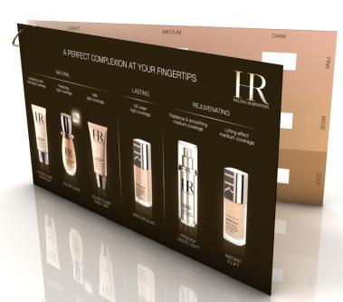
HR COMPLEXION ADVICE CARD
TRAFFIC STOPPING SCENARIO
+
INSTRUCTIONAL USER GUIDE

Slide 2
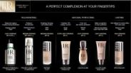

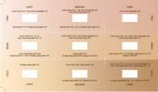


HR PERFECT COMPLEXION ADVICE CARD
USER GUIDE
STEP 1 ATTRACT and WELCOME the customer:
STEP 2 Choose the right foundation according
to the customer’s needs:
Use the HR complexion advice card (page 1)
and select the adapted foundation
according to the customer’s needs.
STEP 3 Advice the right foundation to the customer
and explain it to her:
“ Hello, welcome to Helena Rubinstein.
Today, HR invites you to reveal your perfect complexion in a few minutes .”
(in case of stand up configuration)
AND
“Please have a sit ”
(in case of “one to one” siting configuration)
Offer her a coffee or a tea.
“If you agree, we will proceed to a complexion diagnosis, in order to find your adapted foundation and color according to your needs”
Page 1
Page 1
“Based on the foundation result you are looking
for and according to your needs, your HR
foundation is PRODIGY POWERCELL FOUNDATION
the youthful complexion grafter foundation with
vegetal stem cells ”. (page 1)
“ First, can you share with me the complexion result you would like to have? ”
“Soft or strong coverage, powdery or satin finish, natural or sophisticated result, anti-ageing properties…”
Select a foundation with the customer.
“Now lets check the shade that suits you.”
STEP 4 Choose the right shade (intensity & color)
according to the customer’s skin tone.
STEP 5 Advice the right color of foundation
adapted to the customer between two
possibilities :
STEP 6 Confirm the choice of color, by testing the color on the customer’s skin:
Hand OR Hand & Jaw
Page 3
Page 4
Apply the two selected shades to the
customer’s hand or jaw to find the right one.
“Apparently, the best color that suits you is
shade n° 23 Biscuit”
“Do you like it?”
“What do you think?”
Disinfect your hands and prepare a cotton pad
soaked with make-up remover on a tray.
“Now, let’s discover your complexion profile …”
“ The right shade for you seems to be 22 Apricot or 23 Biscuit.”
Place the complexion shades scale close to the customer’s jaws or hands(page3, for customer & BA )
If it is done on the jaws, remove make-up before on the small part of the jaws where you want to check the color.
Take the two testers of the two shades pre-selected.
Clean the hand of customer and/or a small part of the jaw with a cotton pad soaked
with lotion.
+
“Now, I would like to show you, in few minutes and
on your hand the efficiency of our products,
with skincare combined to foundation” .
“ …and let’s find your complexion intensity and color tone.”

Slide 3

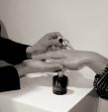
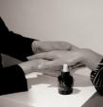
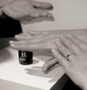
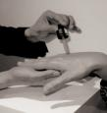

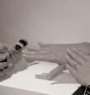
STEP 7 Achieve the “before/after “experience to show the difference on the customer’s hand and to present and explain products (recommended link selling) :
Take the selected foundation in the selected shade.
Disinfect your hands in front of customer. Proceed to the “before and after” demonstration including skincare on the hand.
Explain and apply on one hand:
Hold the customer’s hand in your own hand, protected by a tissue paper.
First clean the customer’s hand with a cotton pad soaked with lotion .
Apply Prodigy Powercell serum + Prodigy cream and then use one of the 2 selected shades of selected foundation.
Show the difference before /after to the customer.
“Because skincare is 50% of the make up result I would like to show you the efficiency of your foundation, combined to the best of skincare on the hand first:
Before, I have to prepare your skin with PRODIGY POWERCELL youth grafter, and PRODIGY CREAM for a global anti-ageing benefit.
Then, I will apply PRODIGY POWERCELL FOUNDATION ”
PRODIGY POWERCELL SERUM DISCOVERY
FOUNDATION DISCOVERY (example with PRODIGY POWERCELL FOUNDATION)
> DO
Place a drop of serum on the client’s hand
> SAY
1st youth grafter:
100% of the active power of vegetal
stem cells
> DO
Smoothing serum application
> SAY
Reduces wrinkles, reinforces tone, recreates radiance
> DO
The client feels, observes and appreciates the result
> SAY
After 5 days, the visible signs of younger skin
> DO
Shake before use.
Place a drop of foundation
on the client’s hand with the dropper
> SAY
PRODIGY POWERCELL FOUNDATION,
the first foundation as concentrated
in vegetal stem cells as the PRODIGY POWERCELL serum
> DO
Apply foundation with a brush
OR fingers
> SAY
Fluid texture, hydrating effect,
easy to apply
Perfect yet
imperceptible make-up result
> DO
The client touches, feels and appreciates the result
> SAY
Combined action
of skincare and make-up: double youth grafting power
> RESULT
Complexion is smoothed, uniform, fresh and radiant with youth skin smoothed
uniformity recreated nude skin sensation

Slide 4

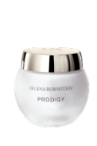

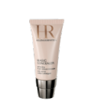

STEP 9 Offer the Focus Beauty Revelation service:
“If you have a few moments, I’d be delighted to show you how to create this beautiful look at home.”
YES
Proceed according to the service routine
shown in the FOCUS brochure
NO
Offer an appointment
to fit with the customer’s availability
+
+
+
+
STEP 10 Finalize
Ask if she would like to be included in the HR address book

